Slide 1


SMART INDIA HACKATHON 2025
TITLE PAGE
Problem Statement ID – 25093
Problem Statement Title- Centralized Digital Platform for Comprehensive student activity record in HEIs.
Theme- Smart Education
PS Category- Software
Team Name – Team Dexter

Slide 2
IDEA TITLE
Team Dexter
Proposed Solution
✅ Idea/Solution/Prototype: Smart Student Hub (Web + Mobile App)
The Smart Student Hub is a centralized digital platform designed for Higher Education Institutions (HEIs) to comprehensively record, track, verify, and showcase student activities across academic and non-academic dimensions. It bridges the information gap between departments and digitizes student engagement, achievements, and institutional reporting.
Detailed Explanation
The platform consists of two core components:
Student Interface (Web & Mobile App):
  A personal dashboard showing academic performance, extra-curricular involvement, volunteering, internships, etc.
  Upload portal for certificates, event participation, leadership roles, etc.
  Track submission status and receive approval feedback.
  Auto-generate verified digital portfolio (PDF & sharable web link).
Faculty/Admin Interface:
  Validate and approve student submissions with evidence (certificates, proof).
  Real-time analytics dashboard for institution-level insights.
  Exportable reports for NAAC, AICTE, NIRF, and accreditation requirements.

Slide 3
IDEA TITLE
Team Dexter
How It Addresses the Problem:
Consolidation: Right now, student records are spread across departments and papers. We bring them all together in one place.
Visibility – Students get a live dashboard to track their academic and extra activities easily.
Verification: Faculty check and approve every record, so the data is trusted and authentic.
Reporting: Institutions can generate NAAC/NIRF reports instantly instead of spending weeks.
Preparation: By graduation, every student has a verified digital portfolio, ready for jobs or higher studies.”
Innovation and Uniqueness
Auto-Generated Portfolio: A verified, professional-looking profile for each student.
Gamified Experience: Students earn points/badges for each verified activity, promoting participation.
Institutional Insights: Heatmaps, trends, and department-wise participation analytics.
Open APIs: Allows integration with LMS, ERP, or national education platforms.
AI-Driven Recommendations: Suggest workshops, MOOCs, or contests based on student activity trends (future phase).

Slide 4










TECHNICAL APPROACH
Team Dexter
Tech Stack
Frontend: React.js (Web), Flutter/React Native (Mobile)
Backend: Node.js + Express (REST API) / SpringBoot
Database: MongoDB (NoSQL for flexibility)
Auth & Storage: Firebase Auth + Firebase Storage (Certificates)
Deployment: Vercel (Web), Expo (Mobile), MongoDB Atlas (DB), AWS
System Architecture
Web/Mobile App → REST API → Backend Server → Database/Storage
Role-based access (Student, Faculty/Admin)
Auto-Portfolio Engine compiles verified data into PDF/Web format
Admin Dashboard for real-time analytics & accreditation reports.
Development Workflow (Agile Sprints)
Sprint 1: Login, Dashboard UI (Web & Mobile)
Sprint 2: Activity Upload & Approval Workflow
Sprint 3: Portfolio Generation + Report Export
Sprint 4: Analytics Dashboard + Institutional Insights

Slide 5
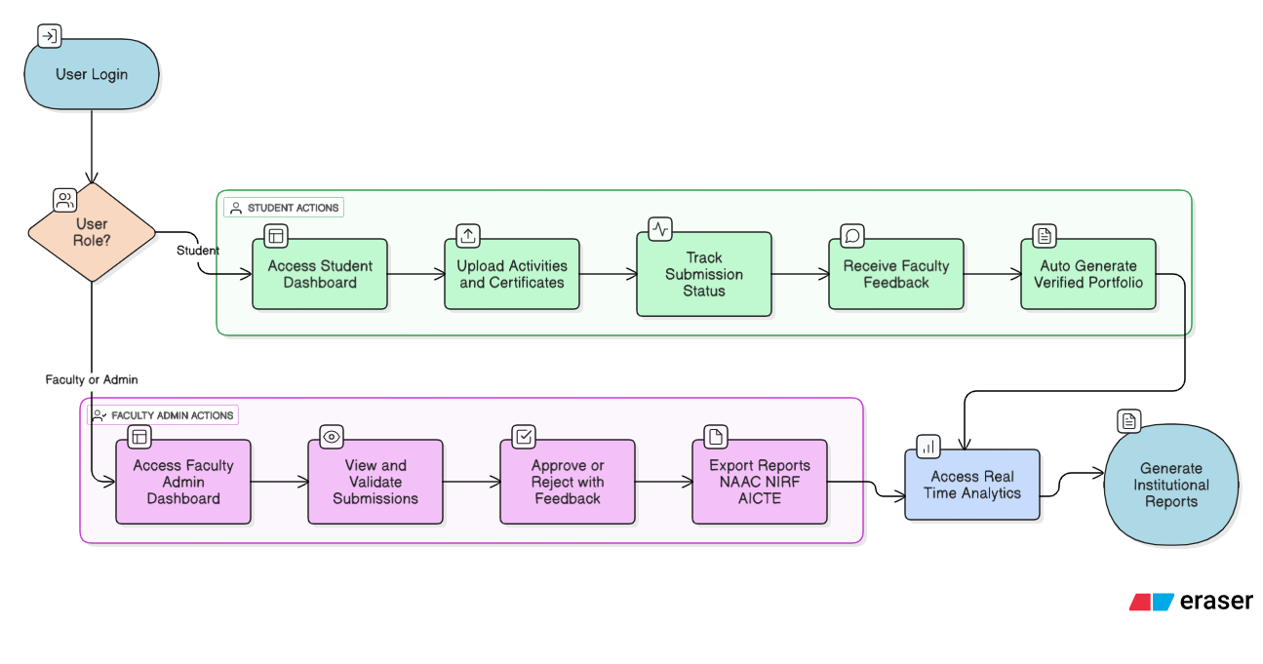
TECHNICAL APPROACH
Team Dexter

Slide 6
FEASIBILITY AND VIABILITY
Team Dexter
Feasibility
Technical Feasibility: Tech stack is proven, scalable, and developer-friendly.
Operational Feasibility: Can be integrated with existing LMS/ERP platforms.
User Feasibility: Students and faculty already engage in similar workflows offline — easy transition.
Potential Challenges and Risks
Challenge | Mitigation Strategy
Adoption resistance from faculty | Orientation, training, and ease-of-use design
Data overload and misuse | Role-based access, moderation workflows
Verification delays | Batch approval, delegated validators
Privacy concerns | Secure logins, encrypted data storage

Slide 7
IMPACT AND BENEFITS
Team Dexter
Potential Impact on the Target Audience
🎓 Benefits to Students:
Centralized, verified digital record from Day 1
Simplifies placements, fellowships, and admissions
Encourages participation and self-improvement through gamification
Saves time collecting proofs and certificates
🏫 Benefits to Institutions:
Faster, accurate reporting for accreditation (NAAC, NIRF)
Real-time student activity tracking
Helps identify under-engaged students or departments
Promotes a culture of achievement and participation
🌍 Socio-Economic & Environmental Benefits:
Social: Encourages holistic student development beyond academics.
Economic: Reduces costs related to paperwork, audits, and manual data management.
Environmental: Paperless, reducing the carbon footprint of HEIs.

Slide 8
RESEARCH AND REFERENCES
Team Dexter
Category | References (Title – Source)
Digital Portfolios | “The Contribution of Digital Portfolios…” (MDPI) “Digital Portfolio as an assessment strategy…” (Distance Educ.) “Role of E‑portfolios…” (J Digital Learning in Teacher Educ.)
Learning Analytics & EDM | “Educational data mining and learning analytics: An updated survey” (arXiv) “Learning Analytics on Student Engagement…” (MDPI) “Uncovering Student Engagement Patterns in Moodle…” (arXiv) “Student‑centric Model of LMS Activity…” (arXiv)
Dashboards & Monitoring | “Designing a Dashboard for Student Teamwork Analysis” (arXiv)
Frameworks & Context | INCEPR – Inter/National Coalition for Electronic Portfolio Research Wikipedia: Analytics in Higher Education Wikipedia: Learning Analytics

