Slide 1
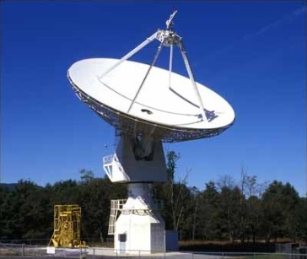
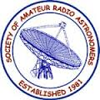
SARA Conference 2018 20 Meter Dish Demo & Cas A Observation Program

Slide 2
20 Meter Dish Demo
Green Bank Conference Account - Explore!
Skynet Account (free UNC Course) - Your Personal Account!
Demo Example – Watch the dish move outside!
SARA Cas A Observing Program
Fading at an average rate of 0.67 percent per year in the L-band
SARA Section Open Forum

Slide 3
20 Meter Dish Demo
Observing Advice
Track
Set to 60 seconds for galactic hydrogen and strong pulsars
On-Off
Offset to a few beamwidths or 3-4 degrees
Durations generally larger than optical: Use 30 to 60 seconds
For hydrogen in nearby galaxies 200-300 seconds
For 1.4 GHz receiver
Daisy maps should have radius of 2 degrees or more
Set radius to 120-180 arcmin. (3-4 beamwidths); 4 petals quick look.
0.1 – 0.2 sec integration time
Raster maps no smaller than 3.5x3.5 degrees; or 6x6 beamwidths
For gap sweep, use ¼ or 1/3 beamwidth for quick maps; 1/5 or 1/10 for detailed
Map depth: time in integration is the time corresponding to the gap along the sweeps, and it will calculate the slew speed.

Slide 4
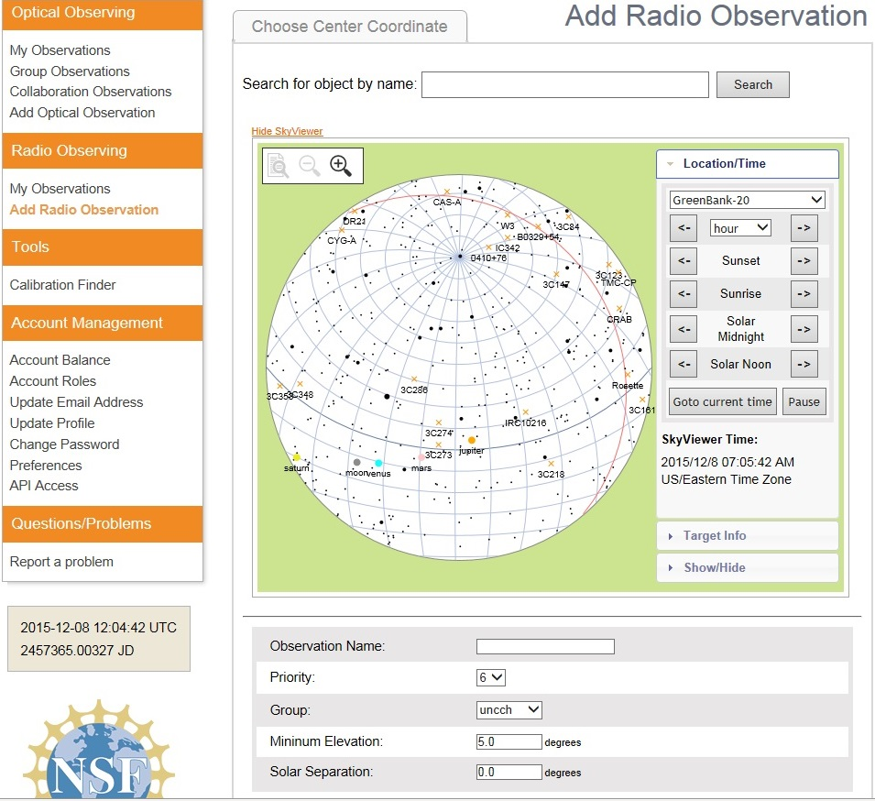
20 Meter Dish Demo
Add a Radio Observation
-Select an Object
(Database or RA/Dec)
-Minimum Elevation
(Used for mapping)
-Solar Separation
(to prevent solar side lobe
interference)

Slide 5
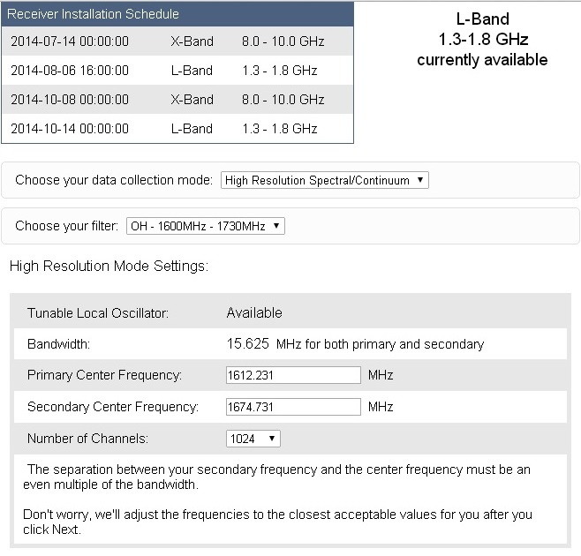
20 Meter Dish Demo
Configure Receiver
Low Resolution: continuum mapping/pulsars
High Resolution: Spectral Lines
No Filter Full Band (with interference)
H1 Filter (continuum maps, 1355-1455 MHz)
OH Filter (Iridium sat. interference, 1.6-1.73 GHz)

Slide 6
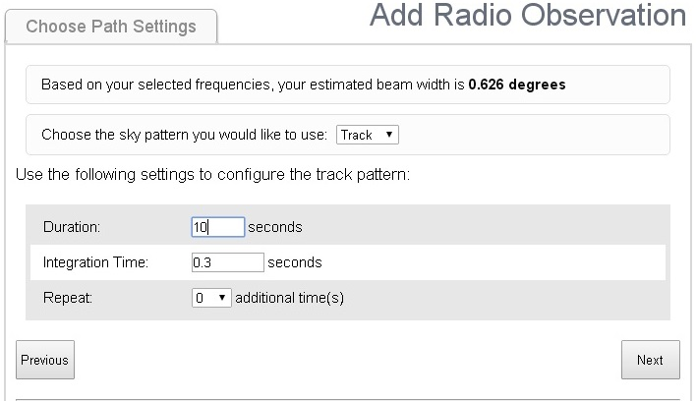
20 Meter Dish Demo
Choose Path Setting
Track: Good for spectra in high resolution & pulsars
On/ Off: Compares to a reference & good for fainter spectral lines
Daisy: Petal pattern maps for preliminary observations
Map (Raster): Back & forth detailed scans (wide band continuum observations)

Slide 7
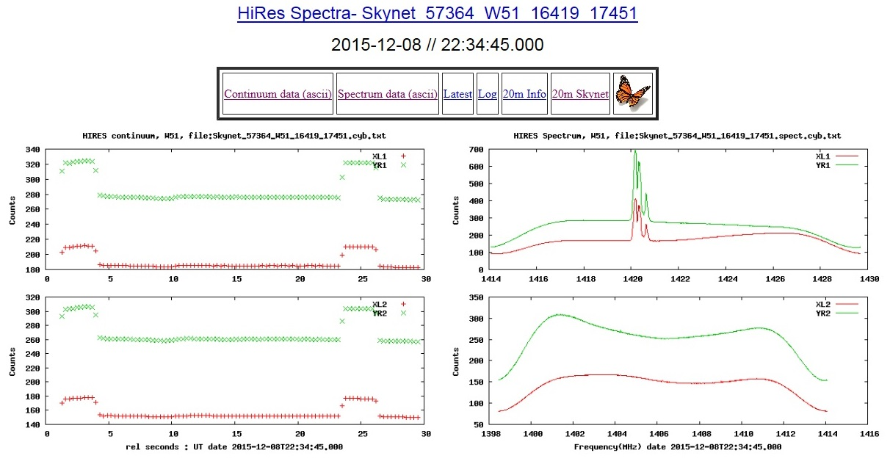
20 Meter Dish Demo
Electron polarization: A property of electrons defined by the Pauli Exclusion Principle but simply described as up or down, or left and right. Radio telescopes are equipped with polarizing filters that distinguish between the two electron polarizations.
Output (Track) : Molecular Cloud W51
Shows the continuum. This is the average of the central 80% of each spectrum pattern vs time. The four traces are two polarizations and two frequency bands. Note Baseline, Calibration, and Target traces.
Shows the average spectra
averaged over all integrations. The upper and lower plots are for the two frequency bands and the two traces in each plot are for the two polarizations.

Slide 8
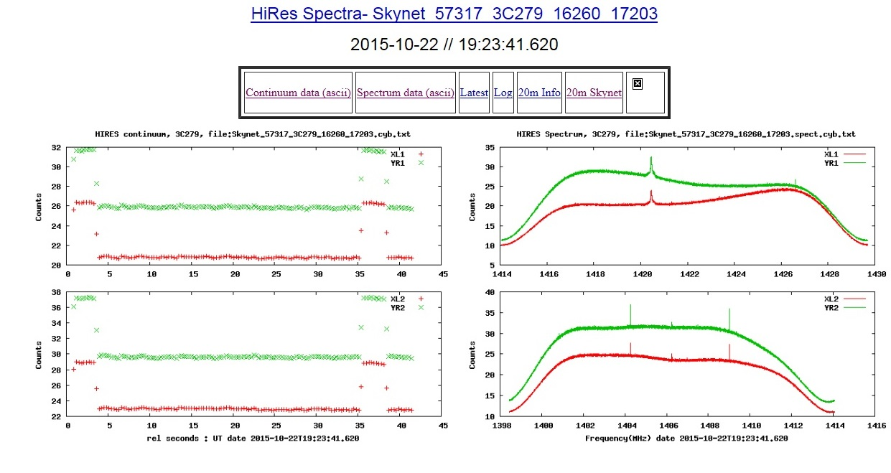
20 Meter Dish Demo
Output (On/Off): 3C279

Slide 9
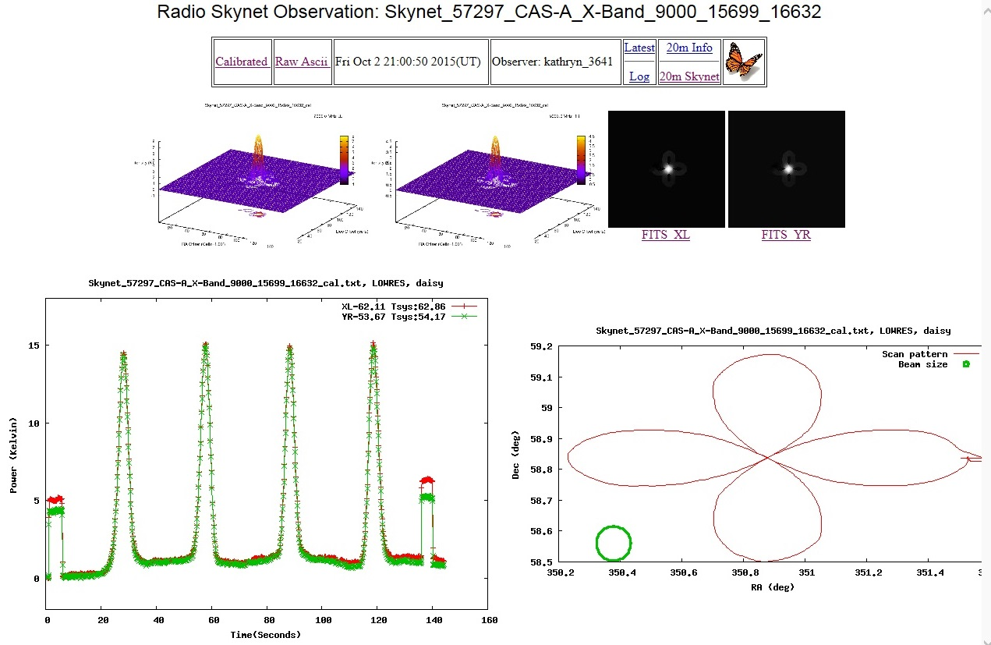
20 Meter Dish Demo
Output (Daisy): Cassiopeia A
The color wedge on the right represents the intensity of the source in Kelvins, not the physical temperature of the object but rather the increase in temperature the telescope feels when pointed at the source.
Sharp peaks of intensity correspond to the telescope pointing directly
at the source which is at the center of the daisy pattern.

Slide 10
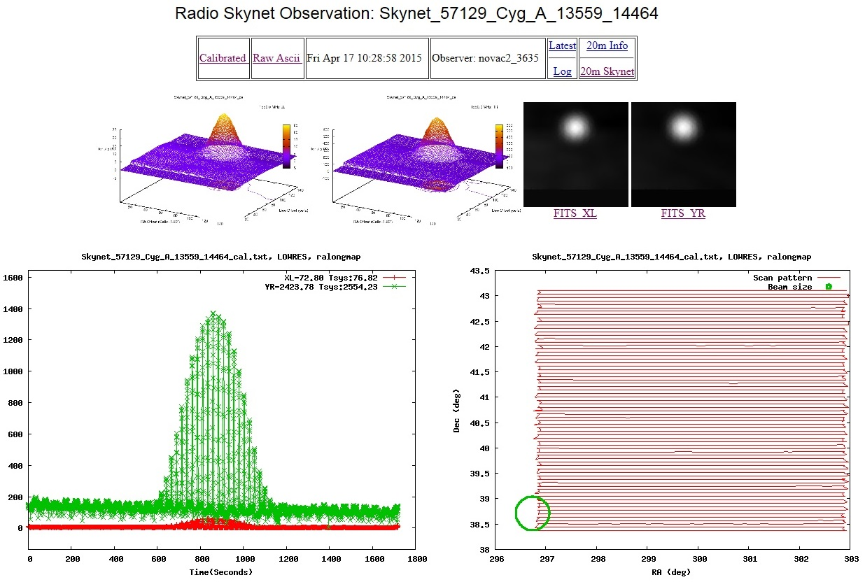
20 Meter Dish Demo
Output (Map): Cygnus A

Slide 11
SARA Cas A Observation Program
Development of a Citizen Science Database
Primary Target: Cas A (SNR) with 40 ft and 20m
Flux: ; Distance:
Other Targets: Tau A (fading at 0.102%/yr in L-band), Cyg A, Vir A
Goal: Track Fading Rates
Guide: Reichart Paper on Cas A:
http://www.gb.nrao.edu/20m/projdocs20m/FadingofCassA_MN469p1299_2017.pdf
Observation Inputs for Raster Map
Central Frequency 1395 MHz; Duration:
Bandwidth: 80 MHZ; Beamwidth 0.75; Integration Time: 0.3 sec
See SARA Journal article on the proposed CasA Observation Program
Strive towards similar models and fits per Reichart Paper

Slide 12
SARA Cas A Observation Program
Tables 1 & 3 Reichart Paper

Slide 13
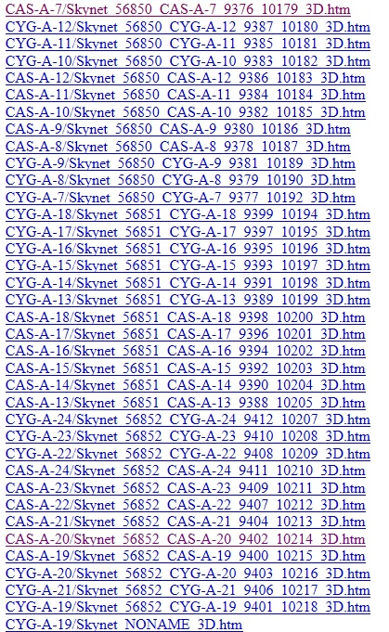
SARA Sections Observation Program
Reichart Data Files: www.gb.nrao.edu/20m/peak/log2014

Slide 14
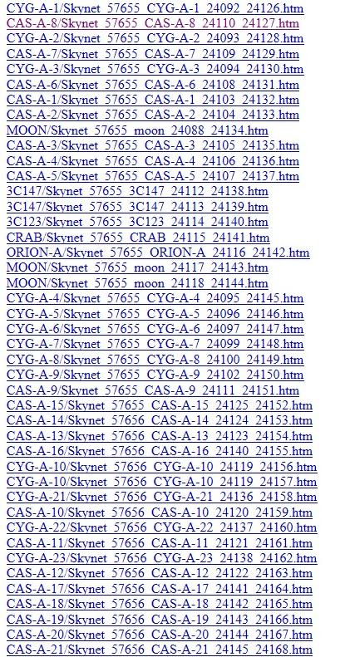
SARA Sections Observation Program
Reichart Data Files: www.gb.nrao.edu/20m/peak/log20146.htm#2016_09_01

Slide 15
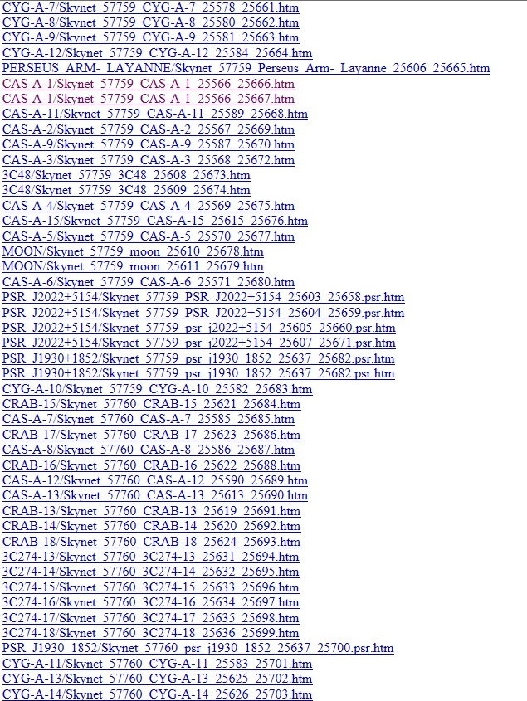
SARA Sections Observation Program
Reichart Data Files: www.gb.nrao.edu/20m/peak/log20147.htm#jan2017

Slide 16
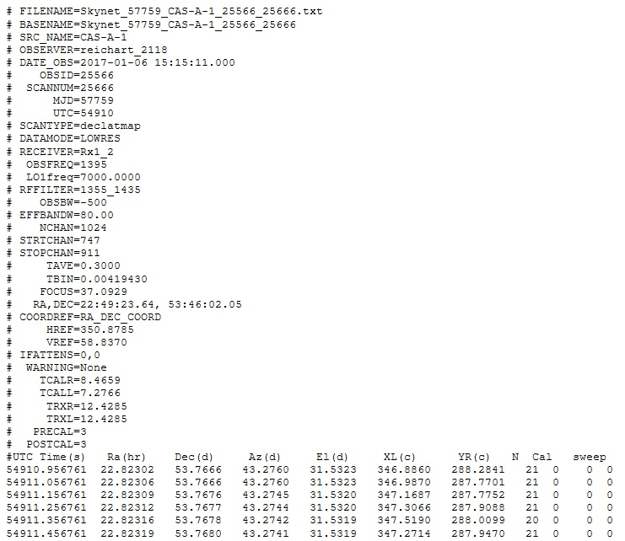
SARA Sections Observation Program
Reichart Data Files: www.gb.nrao.edu/20m/peak/CAS-A-1/Skynet_57759_CAS-A-1_25566_25666.txt

Slide 17
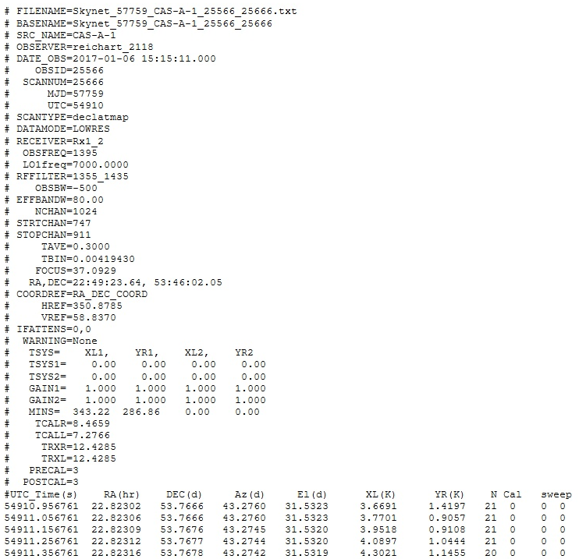
SARA Sections Observation Program
Reichart Data Files: www.gb.nrao.edu/20m/peak/CAS-A-1/Skynet_57759_CAS-A-1_25566_25666_cal.txt

Slide 18
SARA Cas A Observation Program
Calculation for Counts, Kelvins, and Jankys
Counts: A measure of the intensity of a signal created by photons bouncing off of the dish and into the receiver. This unit can be converted to a temperature (K) and subsequently to Janskys (intensity per unit area).
Jansky: A unit of measurement of flux density equal to 10-26 Watts / meter2 / Hz, named after the radio astronomy pioneer Karl Jansky.
To convert to Kelvin: The intensities in the ASCII file are total intensities, meaning the object intensity and the system intensity. You need to subtract the system values for the left and right polarizations (which can be found in the corner of the 2D plot) and then use the following conversion factors that can be found in an Excel table on the website.
To convert to Janskys: Use the following equation (re-arrange as necessary):
S = 2 σ T_{A} / A η _{A}
Where:
S = Flux Density (Janskys)
σ = Stefan-Boltzman constant (1.38 x 10⁻²³)
T_{A} = Average temperature (Left, Right polarization, in K)
η_{A} = Telescope Efficiency (elevation dependent, available on website)
A = Area of dish (available on website)

Slide 19
SARA Cas A Observation Program
Output and Data Processing Screens
Output screen provided (Skynet 20 m dish)
Widely available output screens (Radio SkyPipes, GNU Radio)
User programmed output screens (Python – Princeton 18 m)
Other: Audio; Paper Strip Chart
Interpretation of Data
Manuals and papers
Cross comparisons
Resolution Expectations (Can the target be resolved?)
Repeating Observations by adjusting input parameters
Observation Database Links
FILENAME=Skynet_57979_cas_a_30005_30225.A.spect.cal.txt# BASENAME=Skynet_57979_cas_a_30005_30225# SRC_NAME=cas_a# OBSERVER=sara_4988#
# FILENAME=Skynet_57986_cas_a_30076_30282.txt# BASENAME=Skynet_57986_cas_a_30076_30282# SRC_NAME=cas_a# OBSERVER=sara_4988# DATE_OBS=2017-08-21

Slide 20
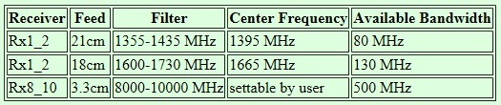
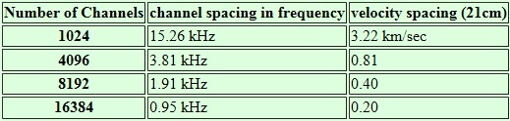
SARA Cas A Observation Program
Data Processing
Low resolution mode provides 1024 spectral channels in a 500 MHz band. The channel spacing is 0.488 MHz
High resolution mode allows the number of channels to be selected.

Slide 21
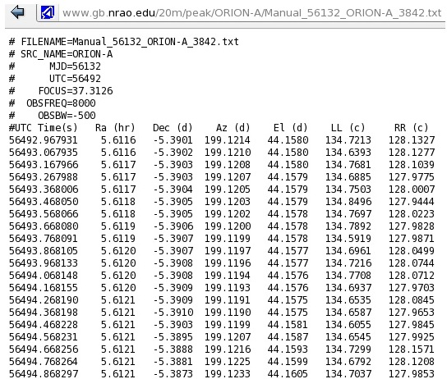
SARA Cas A Observation Program
Data Processing
When the 20m telescope observes an object it is recording data 10x a second.
Time, position, and the amount of counts received by both polarizations of the telescope are recorded.
Raw data
Calibrated
Raw Ascii
Continuum Data (Ascii)
Spectrum Data (Ascii)

Slide 22
SARA Cas A Observation Program
Quality Control
Interference
Doppler
Galactic hydrogen and arms
Internal instrumentation noise
On-Off Techniques
Solar temperature effects
Ground/building reflections, sky blockage, side lobes
Secondary frequency: comparisons, problem identification
Band width & other parameters chosen
Ubiquitous neutral hydrogen
SARA Analytical Section Observation Tips

Slide 23
SARA Cas A Observation Program
Educational Links
http://www.gb.nrao.edu/20m/spectra20m_advice.html
http://www.gb.nrao.edu/20m/obsadvice.html
http://www.gb.nrao.edu/20m/map20m_advice.html
http://www.gb.nrao.edu/20m/beginnersadvice.html
http://www.gb.nrao.edu/20m/
https://safe.nrao.edu/wiki/bin/view/GB/Skynet/DocumentSeries
http://www.gb.nrao.edu/20m/projdocs20m/FadingofCassA_MN469p1299_2017.pdf
http://www.gb.nrao.edu/20m/projdocs20m/g20_2012_08_BigManual.pdf
https://safe.nrao.edu/wiki/bin/view/GB/Skynet/WebHome
https://safe.nrao.edu/wiki/bin/view/GB/Skynet/Calibrationnotes

Slide 24
SARA Cas A Observation Program
Questions, Comments, Volunteering?
Email SARA Section Analytical Section Coordinator
Tzikas@alum.rpi.edu

