Slide 1
Dish Based Ranking https://github.com/bvaidyan/Drank2
Balaji Vaidyanathan

Slide 2
Problem Statement
Yelp only does Restaurant based ranking
What is the use of visiting the best ranked restaurants if you can’t get YOUR DISH served the BEST there on that DAY.
Dynamic Dish Based Ranking of restaurants doesn’t exist currently.
Built a ML model to learn ranking of restaurants for any given dish name on a particular day/week/month.

Slide 3
Effort
Scraping internet (60%)
Yelp review, author info (184 restaurants, 75K reviews) scraped near Santa Clara, CA
Modeling (30%)
feature set identification (dish count, rating, date of review, review count, friends count)
GBRegressor (R2_score = 0.95)
Results/Analysis (10%)
Plots showing dish based restaurant ranking

Slide 4
Machine Learning Based Ranking
Training Set Preparation
feature generation (dish count, users rating, date of review, users review count, users friends count)
Target – Dish based restaurant Ranking from past reviews
Used deterministic decay fn based ranking on old reviews
Weighting function = rating/5*sqrt(dcount)*decay_fn(rev_date)
Translated a ranking problem into a regression model where for given pair of {dish X restaurant}, a affinity score is learnt.
Trained using 10-20 popular menu items, over 8 years

Slide 5
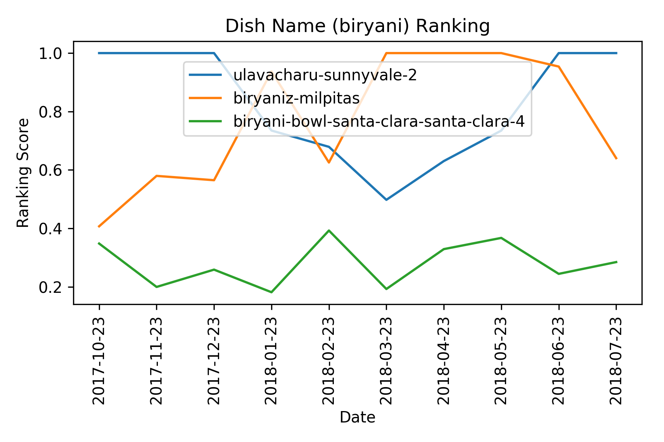
Lots of Dynamic Change Observed
Yelp Rank number 1 is given to restaurant biryani-bowl–santa-clara (my ranking is 10), that has very less Biryani mentioned for July-2018, and in addition has lots of low ranked reviews for this particular dish. Yelp uses the dish name occurrence instead of the context of its occurrence to rank.

Slide 6
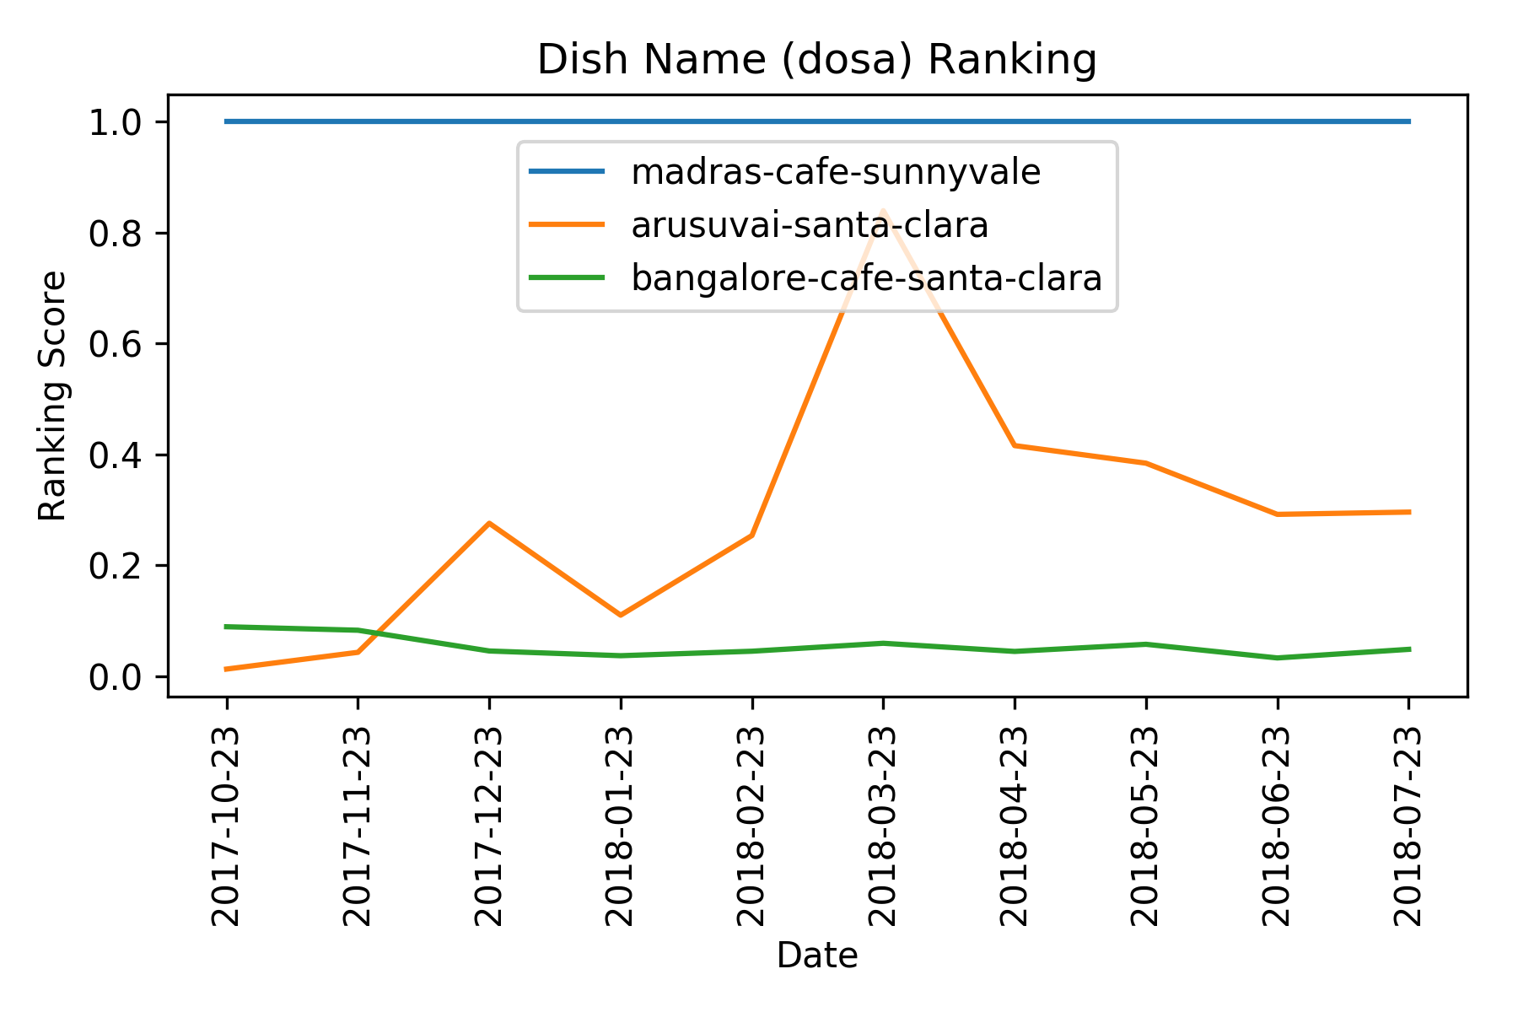
Consistent Performer is Ranked High
Bangalore Café is ranked 3rd in Yelp for Dosa (my ranking is 23). Personally I know the chef who does Dosa here is travelling in India for past several months. Yelp is still showing old ranking based on the dish count in old reviews.

Slide 7
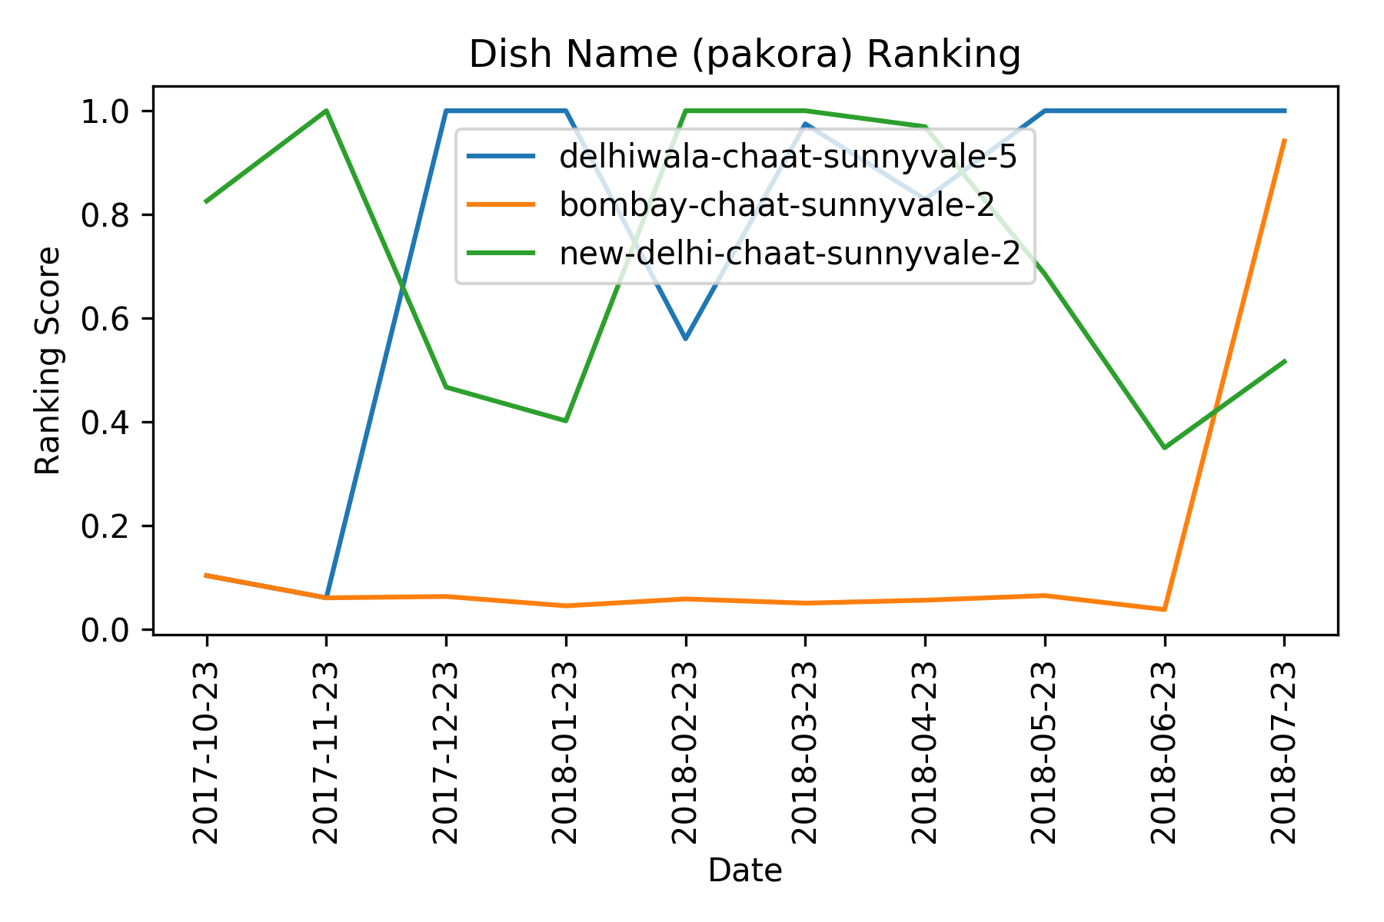
New Performing Restaurant Ranked High
Bombay-chat-sunnyvale just opened last month, and has only 8 reviews. But all their reviews mention “pakora” with high review ratings. This brought up its ranking to 2 in my model for the month of July-2018.

Slide 8
Future Improvements
Extend the system to handle multiple dish names.
Extend the system to update its database of reviews on the go (only the new ones)
Speed up the scraping (Distributed and parallel data collection using IP rotation)

