Slide 1
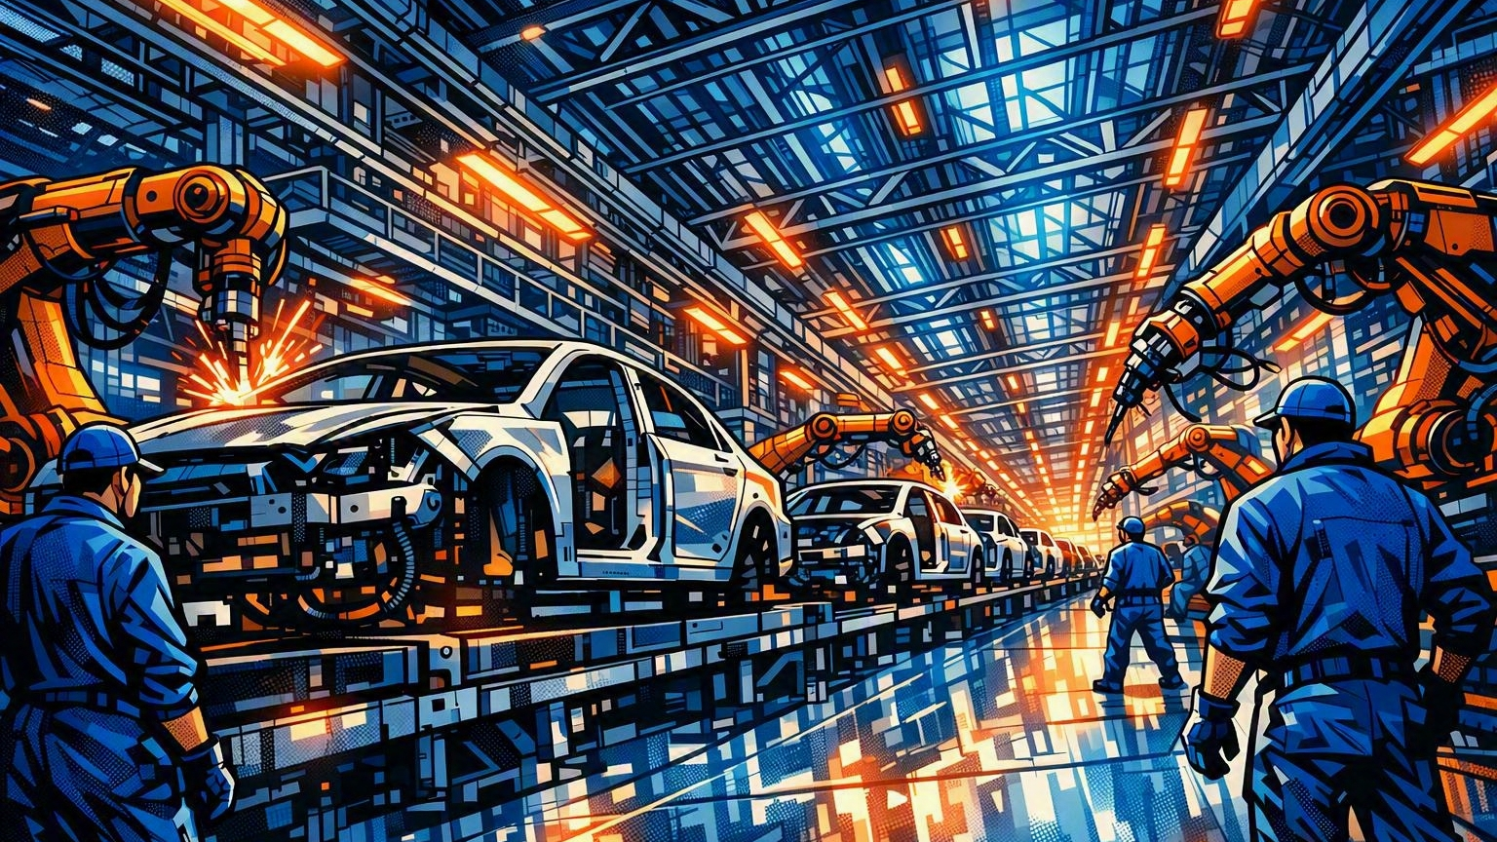
THE ENGINE
AND THE CAR
Why modernization stalls when the engine ships incomplete

Slide 2
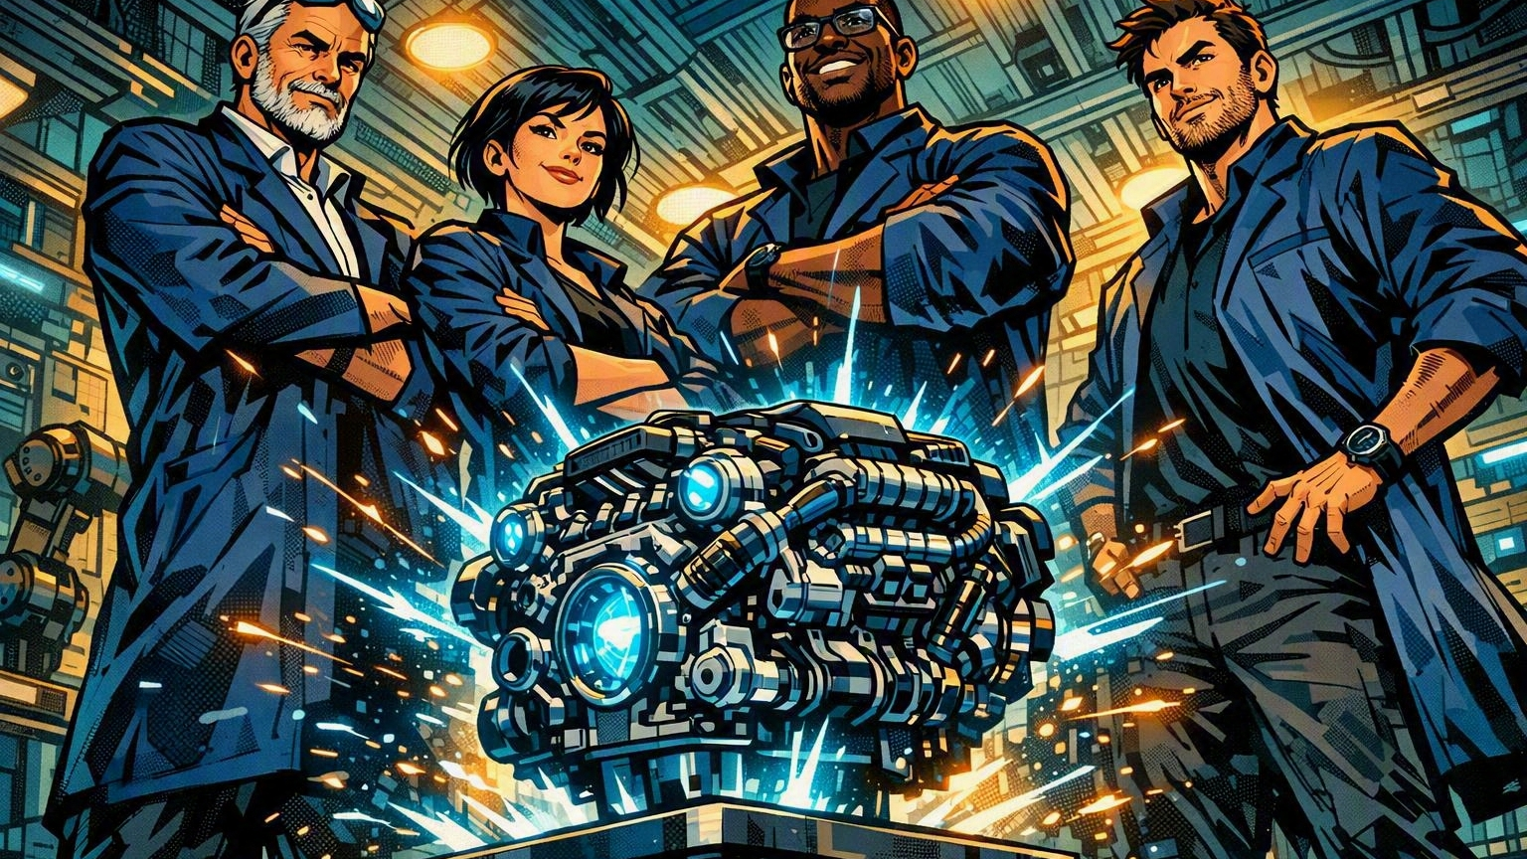
THE ENGINE TEAM
They built the safest engine the company has ever made. Okta. Every car must run it by fall.
2

Slide 3
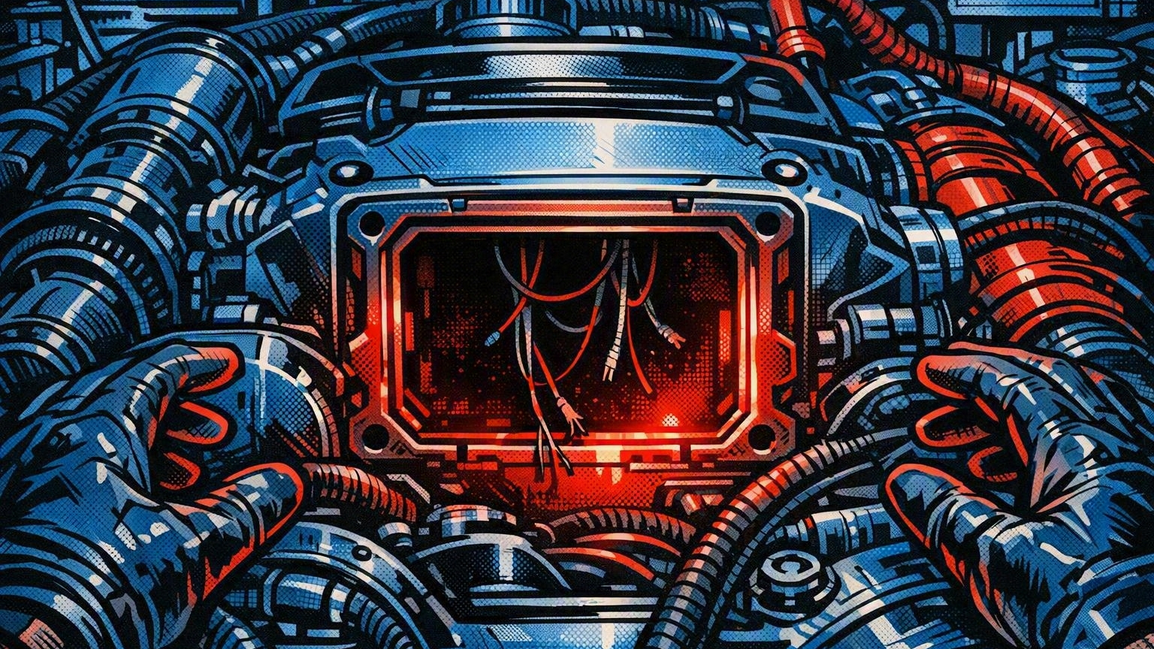
BUT...
The engine arrived missing a critical component: authorization.
3

Slide 4
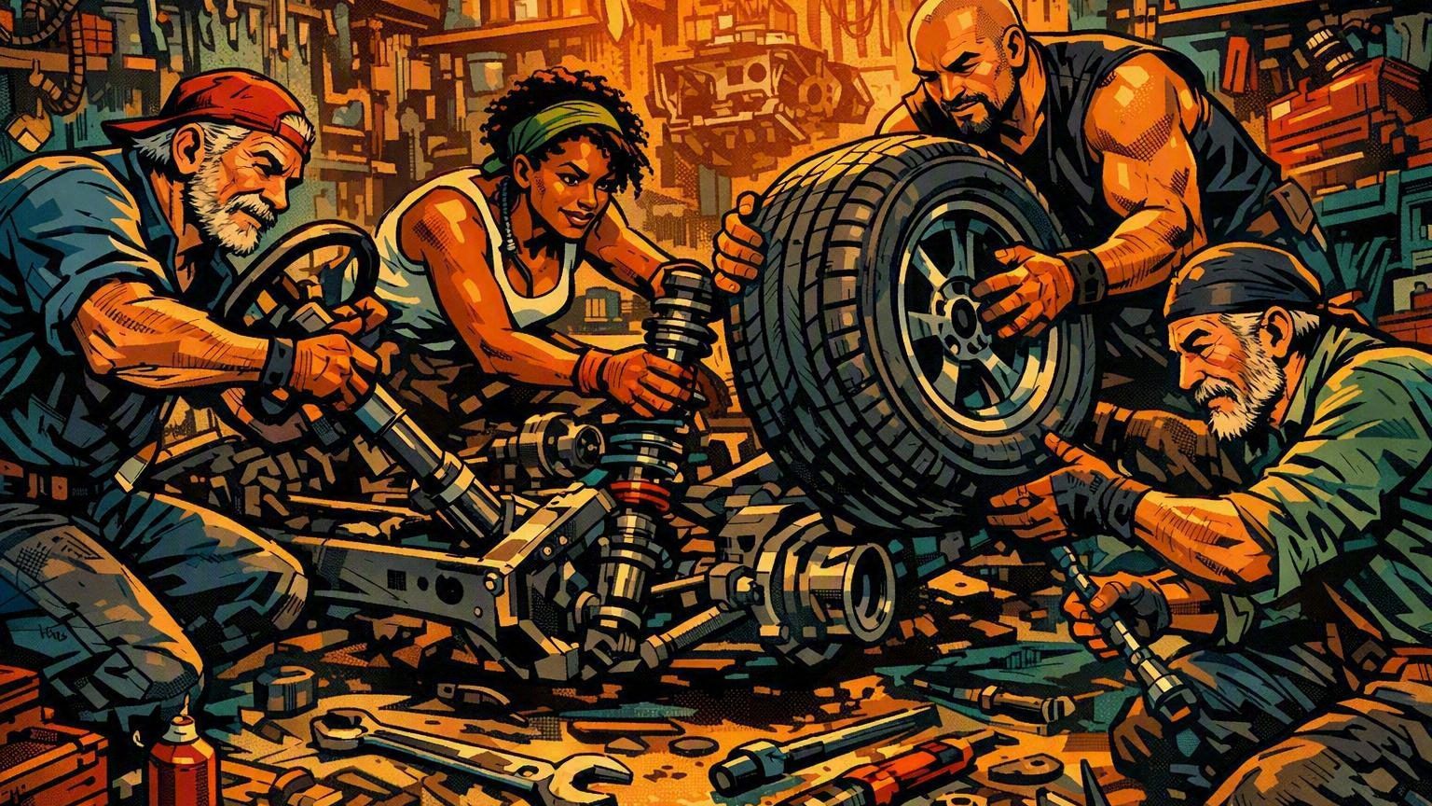
THE CAR TEAMS
Tires. Steering. Suspension. Brilliant at everything outside the engine bay. The old engine always just worked.
4

Slide 5
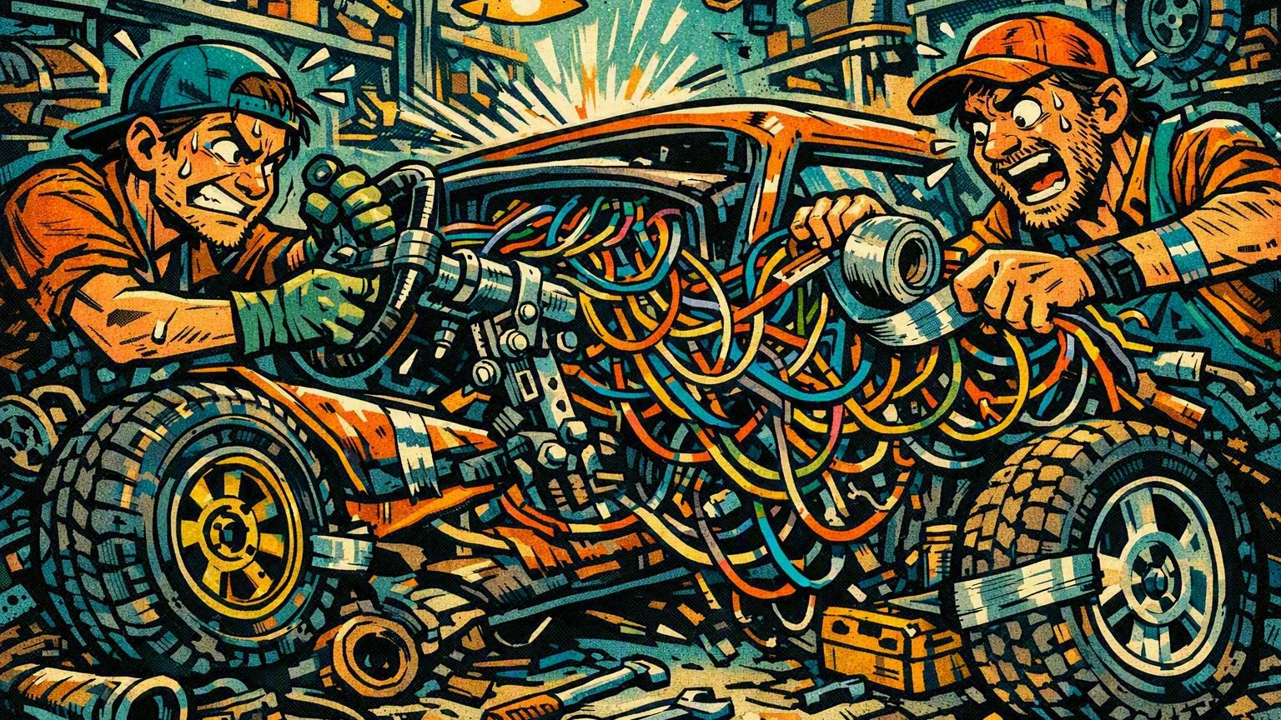
SO THEY IMPROVISE
Rewire the dashboard. Resize the wheels. Invent personas. Patch, glue, retrofit.
5

Slide 6
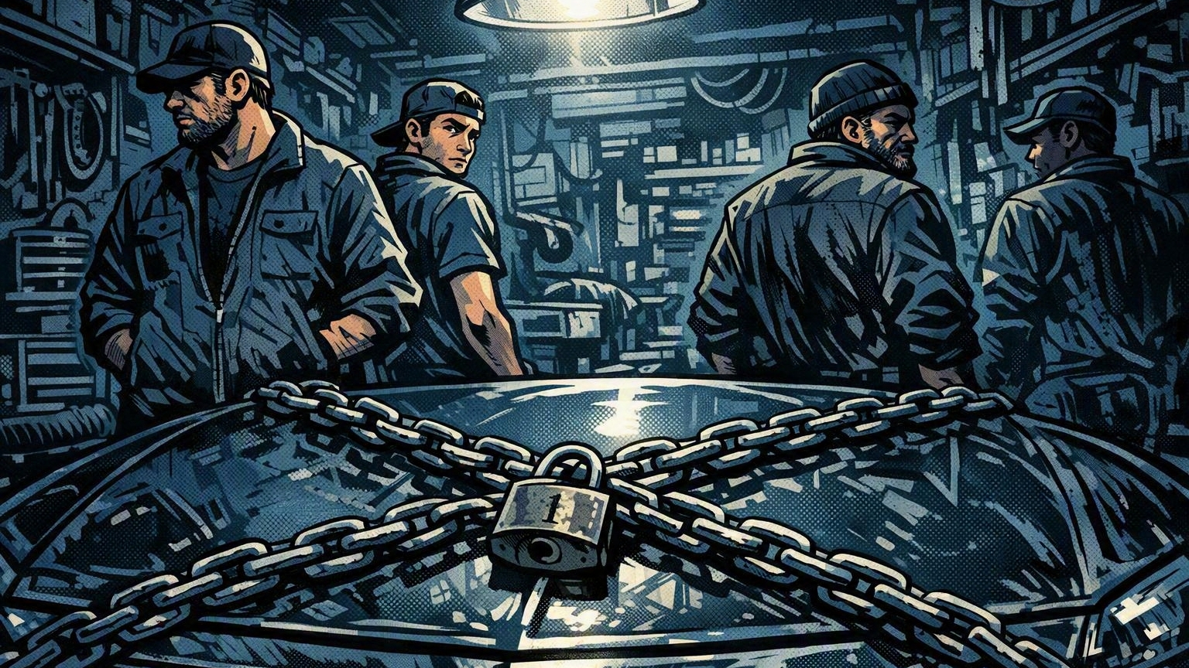
NOBODY POPS THE HOOD
Because the culture taught them the only acceptable answer is motion. Never “stop.” Never “this isn’t our domain.”
6

Slide 7
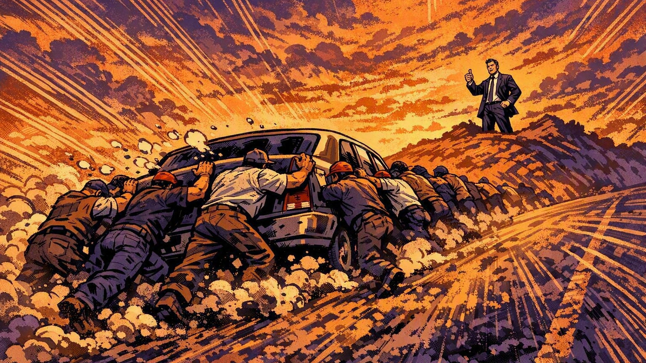
SHOW PROGRESS
So they push the car downhill, and leadership sees movement.
7

Slide 8
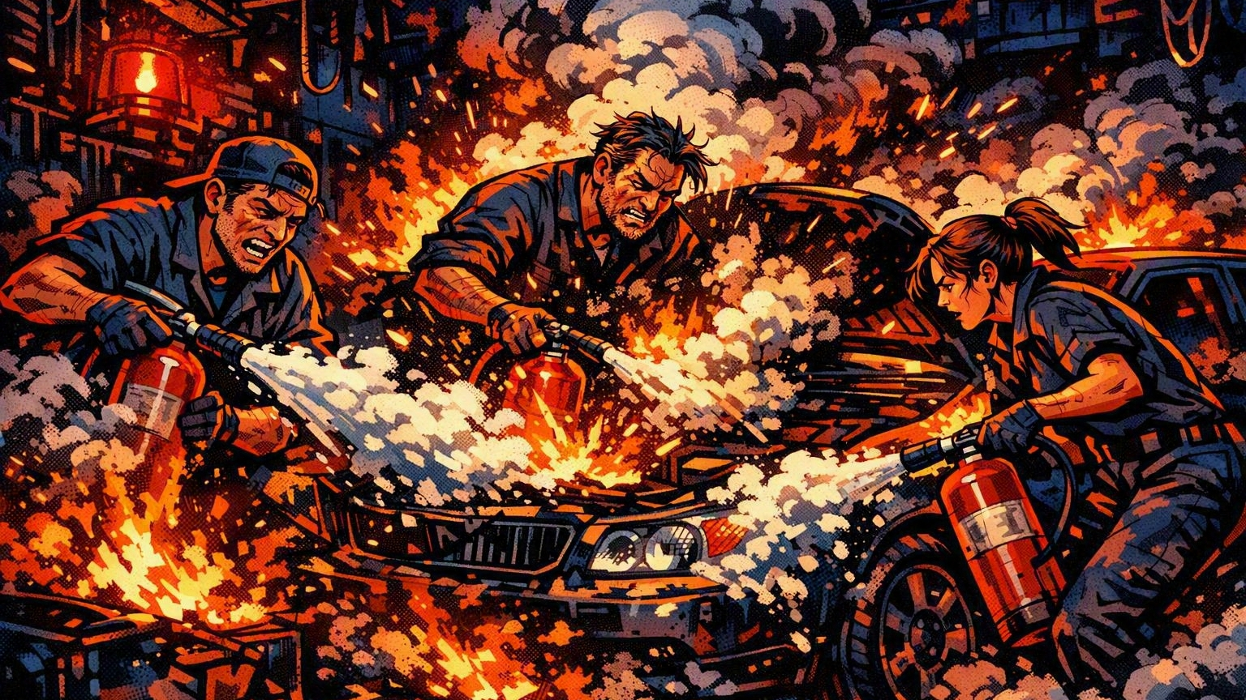
THE RESULT
Cars that move only when pushed. Slow, fragile, and always on fire.
8

Slide 9

NOT A TEAM FAILURE
It’s a system failure. In healthy organizations, “this isn’t our expertise” is the moment everyone applauds.
9

Slide 10
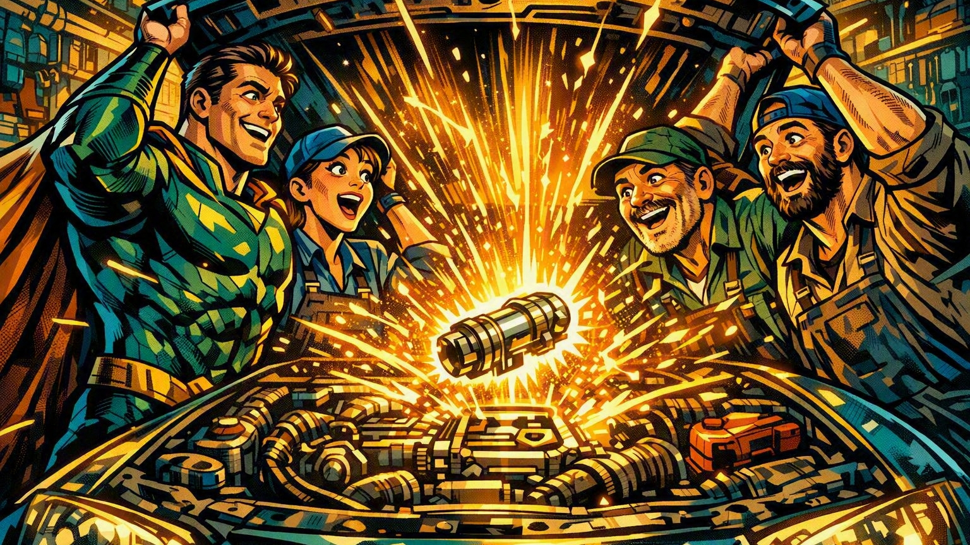
ENTER THE HERO
Someone joins the team, walks past the wheels, and pops the hood.
10

Slide 11
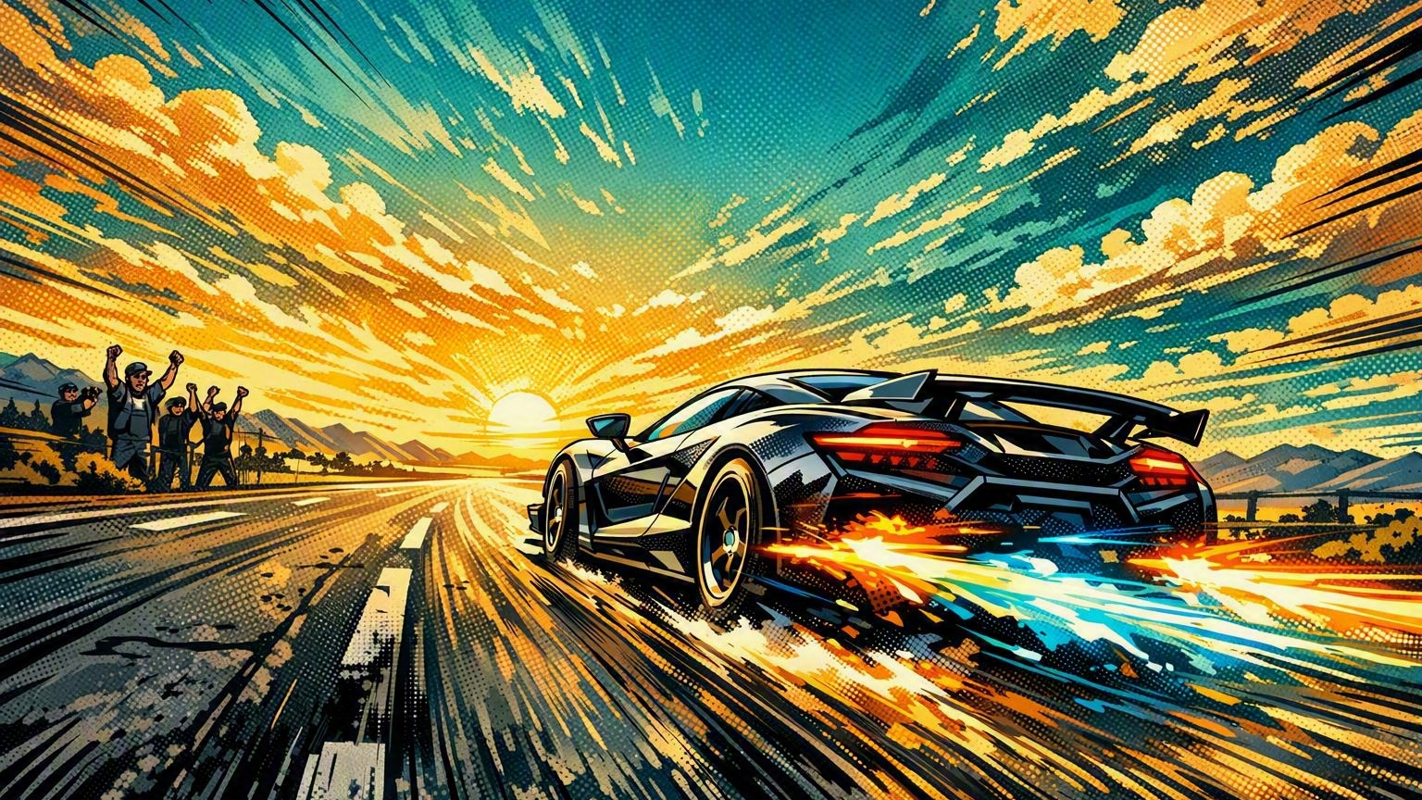
THE OPPORTUNITY
Deliver the missing component. Stop pushing. Start driving.
11

