Slide 1
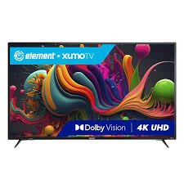

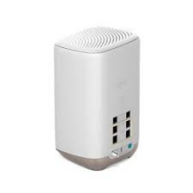
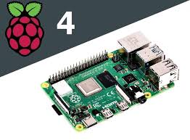
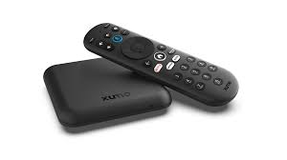
HIGH LEVEL ARCHITECTURE - 1
Physical Connection
Client-2
Client-3
LAN
Client-1
Xfinity Router
Client-4
Rpi connected to CIEC-LAN and also connected to Xifinity-WLAN as client
Devices are connected to Xfinity

Slide 2
Supported Features
cssh Binary Use Case
cssh –n <nt-id> -d <friendly-name>
*Establish ssh connection to the device and record user access data.
cssh –l
*Scans and lists available devices. Displays mac-iP-frinendlyName-currentUserActivity
cssh –a <device-ip> <friendly-name>
*Add a new device without scanning, it can also be used to modify existing device’s friendly name.
cssh –i <device-ip / device-mac / friendly-name>
*Display information such as ports assigned for vnc client and appservice gateway also with ip, device mac, friendly name and current user activity.

