Slide 1

Censored Planet: Measuring Internet Censorship
Globally and Continuously
Benjamin VanderSloot University of Michigan, Winter 2018
Notes:
My own research is broad in scope- however my interests keep leading me to asymmetries in power and the role of Cybersecurity in growing, shrinking, and removing these asymmetries.
This project is under active development, however there is a lot of research that has gone into making it possible over the last few years, enabling some very interesting measurement that may be genuinely useful to policymakers. So we want to engage with as broad an audience as possible as early as possible, as well as take the chance to share some of that research that has been done over the last few years.
Many countries that practice Internet censorship keep the targets, means, or goals of their network interference secret,
reducing public criticism and avoiding accountability.
This lack of transparency makes insight into the censorship ecosystem valuable.
By measuring censorship we gain insights into the
deployment of network interference technologies,
policy changes in censoring nations,
and the targets of interference.
Making opaque censorship practices more transparent at a global scale could help counter the proliferation of these growing restrictions to online freedom.
Today I will talk about a particular project I am working on with Drs. Ensafi, Halderman, and Scott at the University of Michigan on measuring censorship on the Internet.

Slide 2
The goals of this talk...
Provide more color to the phenomenon of network interference
Teach our state of the art in detecting network interference
Describe potential uses for our techniques and data
Notes:
From this talk, I want everyone to walk away with a few interesting points:
I want people to know a bit more about network interference
I want to show how researchers now at UofM used surprising properties of the Internet to detect censorship globally
I want to provide a little food for thought for the international pubpol minds in the room
but first let's step back and remember how the Internet works

Slide 3

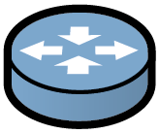



The Internet
Routers
Country A
Country B
Transit Network
Company
ISP
National Firewall
ISP
Server
User
Notes:
The simple view we are presented in early networking classes is this:

Slide 4


The Internet
Router w/ Firewall, IDS, etc.
Country A
Country B
Transit Network
User
Server
Company
ISP
National Firewall
ISP
Notes:
But in reality the Internet is very different from the Ideal view.
For variety of reasons, intermediaries are now intelligent.
For example we see firewalls, antiviruses running on computers, or IDSs.

Slide 5

The Internet
Router w/ Firewall, IDS, etc.
Country A
Country B
Transit Network
User
Server
Company
ISP
National Firewall
ISP
Notes:
Unfortunately, this technology that usually is used for security can harm users.
Whether intentionally or by accident.
If the people who are running these systems are adversarial to the users, suddenly this infrastructure becomes a problem. We call this problem network interference

Slide 6
Network interference is any action by a network intermediary that violates the confidentiality, integrity, or availability of users’ legitimate network traffic.
Notes:
Specifically, Network interference is any action that violates the basic security principles: confidentiality, integrity, or availability.

Slide 7

Network Interference
Turkey shuts down Internet of six million citizens, Oct. 2016
Blocking
Iran used Internet throttling to “preserve calm” during election, Jun. 2013
Throttling
Google received 703 removal requests for bloggers in 2016
Take Down
Notes:
One common example of network interference is censorship.
The most familiar is Blocking, In 2016, there were 15 instances where governments shut down Internet for their citizens.
partial blocking currently occurring for much of Iran right now.
Another type is throttling. For example Iran slowed down Internet during election 2013 to discourage users from accessing information.
Yet another possibility is takedown where a censor demands that the *provider* remove information. In 2016 Google reported that they received more than 700 government takedown requests.

Slide 8
Network Interference
Bahrain government hacked activists with FinFisher spy software (ongoing)
Monitoring
Comcast is inserting ads into customers’ data streams
Tampering
Launching Attacks
“Great Cannon,” the man-in-the-middle attack China used against GitHub, Apr. 2015
Notes:
But Network interference is not just censorship. They are monitoring both targeted and mass surveillance.
There are tampering where an adversary modifies contents between source and destination.
Network interference can *even* enable targeted attacks. One example is Great Cannon

Slide 9
Network Interference
WHAT
WHO
Behaviors that violate confidentiality, integrity, or availability
Blocking Tampering Net neutrality violation Mass surveillance Targeted surveillance Content removal Throttling Denial of Service (DoS) Disinformation
Network intermediaries that may behave adversarially towards users
Governments Consumer ISPs Transit ISPs Cellular providers Content providers Content delivery networks Device manufacturers Hackers for hire Employers
Notes:
In fact, there are many other behaviours and many actors with conflicting agendas.
In order words, network interference is a broad and complex phenomenon. Which means it is a rich area for research with potential to impact ordinary people.
5min

Slide 10
Progress in middlebox technology will bring active interference within reach for increasingly many nations. Need to understand adversarial capabilities, track evolving threats, and attribute attacks to actors.
Notes:
Over the past few years we have seen an alarming level of complex network interference by states that threatens both Internet Freedom and to Internet security broadly.
My hope is that through my research we develop deep understanding of these active interferences, we can efficiently defend against such attacks and develop new sustainable safeguards for the future.

Slide 11
Reports suggest Internet censorship practices are diverse in their methods, targets, timing, differing by regions, as well as across time.
Notes:
A significant challenge to understanding censorship is its variability- network to network, country to country, and time to time.
For that reason, many researchers have been interested in measuring censorship globally and continuously.
There are many reasons why we want to do this: we would like to bring transparency and accountability, to instances where governments practice censorship. This transparency can help to improve defensive technology- tell us where it needs to be deployed. Also, it can inform users about what they are missing, and help others who make international policy decisions in countries that support Internet Freedom know how best to respond.

Slide 12



Measuring Internet Censorship Globally
develop frameworks to detect network interference,
apply these frameworks to understand the behavior of network intermediaries,
and use this understanding to defend against interference.
Notes:
From a computer science perspective, we want to
develop technical solutions to finding out where and when interference is occurring, no matter the technique that is being used
use this data to gain a deeper insight into the characteristics of this interference. Who is doing it? When is it being deployed? What tool is being used? Where is it exactly ? Does this help us understand why?
finally, we want to use any deeper understanding we have on censorship as deployed in the wild to know how best to spend our efforts in the world of censorship resistance.
Today I’ll be focusing on the first step

Slide 13
Measuring Internet Censorship Globally
Networking & Measurement
Building tools for adversarial measurements
Systems
Creating scalable, efficient, and usable tools
Security
Analyzing attacks and adversaries, and
creating defenses to protect users
Social & Political
Understanding ethics/impact of research, and collaborating with domain experts, NGOs, etc.
Notes:
To study network interference in the face of this, we draw on tools from CS and beyond.
Range of networking, advanced in network measurement,traditional system, computer security and even touching aspects of political and social science.

Slide 14


Measuring Internet Censorship Globally
PROBLEM:
How can we detect whether pairs of hosts around the world can talk to each other?
user
?
Site
Notes:
We can state this problem more formally as how can we detect *whether pairs of hosts* in the world can talk to each other? for example whether a use in china can talk to a web site in Sweden.
We want to do this for many places all over the world and for many popular sites.

Slide 15
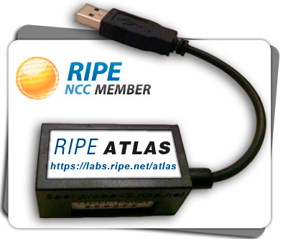
Measuring Internet Censorship Globally
PROBLEM:
How can we detect whether pairs of hosts around the world can talk to each other?
user
STATE OF THE ART:
Run a client somewhere!
?
THREE KEY CHALLENGES:
Coverage, ethics, and continuity
Site
Notes:
Solving this problem is hard, and the best that people came up with is to try to put the instrumentation either at the user or site by installing a software, giving away a raspberry pie or if feasible renting vpns.
(RIPE Atlas, OONI probe)
(PlanetLab)
But these approaches have lots of disadvantages. There are not many volunteer, vps are expensive.
Usually measuring censorship involves test to sensitive domains and can cause risk to participants.
And last but not least, the collected data isn’t continuous
As a result, lack of coverage ethics and continuity prevent us from having a global view.

Slide 16


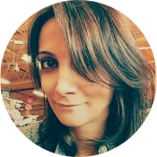

Measuring Internet Censorship Globally
PROBLEM:
How can we detect whether pairs of hosts around the world can talk to each other?
.…from somewhere else in the world?.
user
?
THREE KEY CHALLENGES:
Coverage, ethics, and continuity
Site
Notes:
Several years ago, Jed Crandall and Roya at UNM started thinking about this problem. What if we had a way to detect the user and site can talk to each other from faraway elsewhere in the world?
It wasn't clear whether such a thing was even possible.

Slide 17
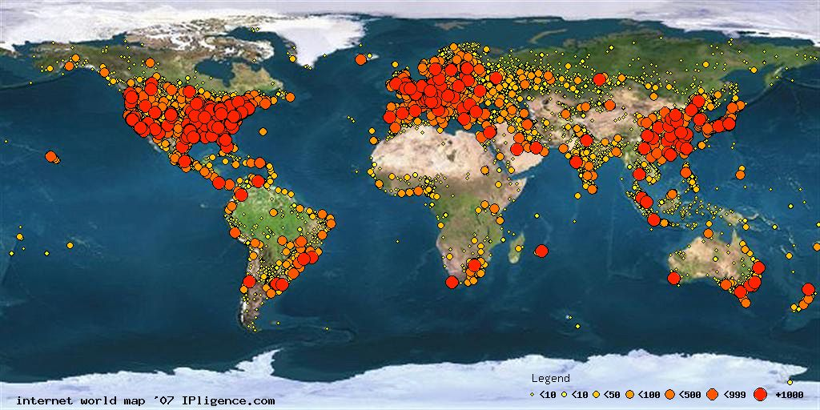
Thinking Like an “Attacker”…
These machines blindly follow rules of protocols, such as TCP/IP.
Can we leverage standard protocol behaviors to detect whether two distant hosts can communicate?
140 million public live IPv4 addresses
Notes:
We have at least 140 million IPs that follow TCP/IP.
That means if I send them TCP IP Packets, they robotically follow the protocols and respond to me.
Then the question is “How can I leverage standard TCP behavior to detect whether two distant hosts can communicate?”

Slide 18


Breaking Down the Problem
Network interference happens at all layers
Resolver
What’s new on cnn.com?
DNS: cnn.com?
IP routing
TCP handshake
(opt) TLS handshake
HTTP requests
Notes:
We focus on Web here:
what does it look like on the wire to look at a website?
All three are targets of censorship, so let's figure out how to measure remotely for all of them

Slide 19
DNS Measurement
Resolver
What’s new on cnn.com?
DNS: cnn.com?
Notes:
So let’s start at the very first step!
pursued independently by Dr Scott and Professor Ensafi before they were at the University of Michigan
DNS Resolvers are all over the Internet, about 20 million of them
But some limit based on who is asking or what is being asked for
4million are open resolvers, in 232 countries
Why don’t we use those to perform DNS lookups from around the world?

Slide 20

DNS Measurement
Functionality
Coverage
Ethics
Continuity
Resolver
THREE KEY CHALLENGES:
Coverage, ethics, and continuity
Notes:
232 countries
We restrict to internet naming infrastructure- not accidentally turned on servers that don’t run on
many definitions, but we
These servers are long running, so we aren’t relying on a laptop being awake or someone turning a computer on after a power outage
A website may be resolved to only one:
IP
Class C Network
ASN
PTR Domain Name
favicon
HTTP headers
…

Slide 21
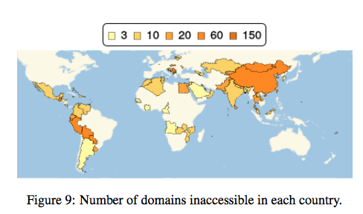
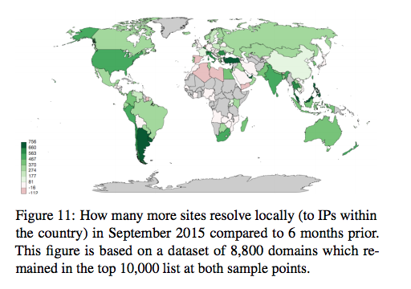
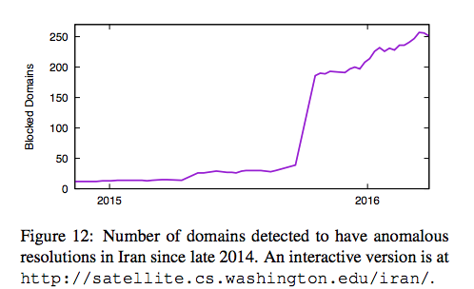
Satellite

Slide 22
TCP/IP Measurement
Resolver
What’s new on cnn.com?
DNS: cnn.com?
IP routing
TCP handshake
Notes:
This is excellent! We can look at the first step. But knowing where CNN is is useless if I can’t talk to it!
DNS resolvers let us perform a lookup as if we are somewhere, but unfortunately no such direct technique exists for IPv4
But, is there any way we can measure it indirectly using those 140million things out there?

Slide 23

TCP/IP Measurement
Spooky Scan uses TCP/IP side channels to detect whether a user and a site can communicate (and in which direction packets are blocked)
user
?
?
Site
Notes:
Spooky scan is a novel technique that uses TCP/IP side channels to remotely, off the path tells you whether a user and site can talk.
* TCP Idle Scan Antirez, (Bugtraq 1998)
* Detecting Intentional Packet Drops on the Internet via TCP/IP Side Channels
Roya Ensafi, Knockel, Alexander, and Crandall (PAM ’14) * Idle Port Scanning and Non-interference Analysis of Network Protocol Stacks Using Model Checking
Roya Ensafi, Park, Kapur, and Crandall (Usenix Security 2010)

Slide 24
TCP/IP Measurement
“User” (Reflector)
Must maintain a global value for IP ID
Site
Open port and retransmitting SYN-ACKs
Measurement Machine
Must be able to spoof packets
Notes:
For spooky scan, the user doesn't need to be end user so we adopt the word reflect from now on.
The reflector must maintain a single global counter to generate IPID values regardless of destination IPs. The value of this counter at anytime reflects how many packets it has generated.
These requirements are very easy to satisfy.

Slide 25
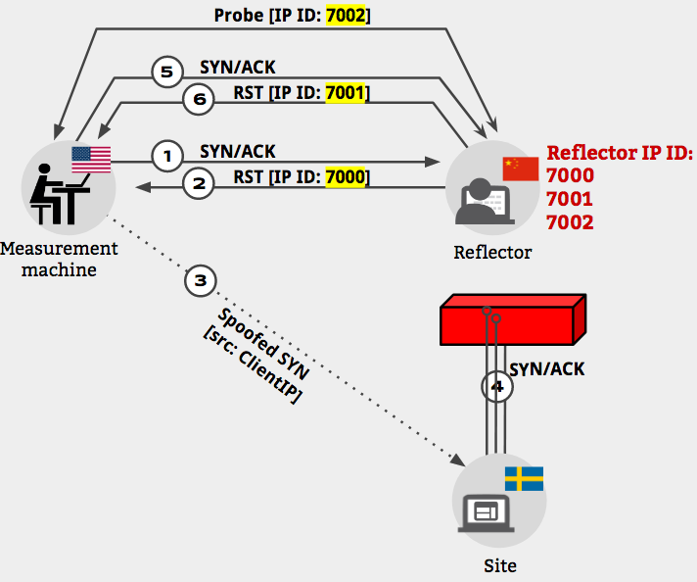
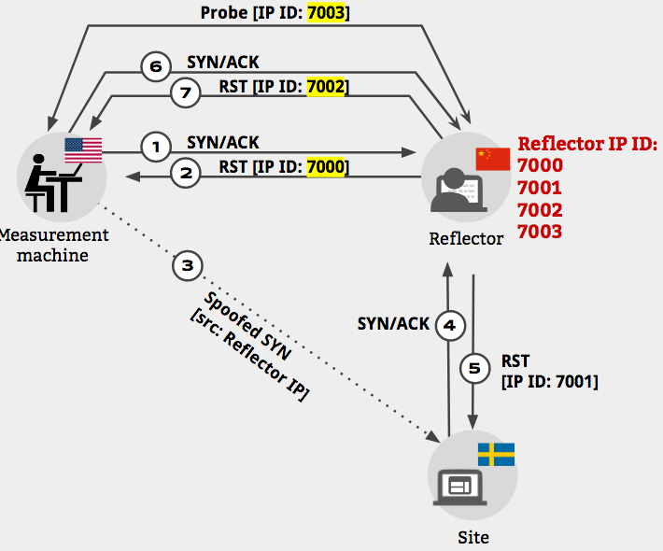
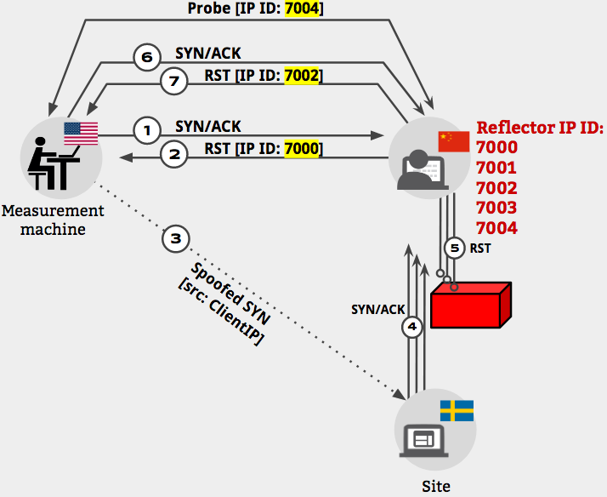
TCP/IP Measurement
Site-to-Reflector Blocked
No Direction Blocked
Reflector-to-Site Blocked
𝚫 IP ID1 = 1
𝚫 IP ID2 = 1
𝚫 IP ID1 = 2
𝚫 IP ID2 = 1
𝚫 IP ID1 = 2
𝚫 IP ID2 = 2
Notes:
These are three different delta IPIDs for three cases therefore we can detect them from each other.

Slide 26
TCP/IP Measurement
Amplifying the signal
Repeating the experiment
Site-to-Reflector Blocked
No Direction Blocked
Reflector-to-Site Blocked
𝚫 IP ID1 = (1 + noise)
𝚫 IP ID2 = noise
𝚫 IP ID1 = (1 + N + noise)
𝚫 IP ID2 = noise
𝚫 IP ID1 = (1 + N + noise)
𝚫 IP ID2 = (1 + N + noise)
Reflector
Notes:
In reality, reflector talks to other hosts beside site and I. The first obvious approach to cope with noise is amplifying our signal. Instead of one Spoofed SYN we can send N spoofed SYN.

Slide 27
TCP/IP Measurement
Coverage:
Scan IPv4 for reflectors: 22 M, 180 countries
Ethical:
Using reflectors two hops from the edge
Heavily rate limit queries to reflectors and sites
Continuity:
Augur doesn’t depend on end users’ availability, and routers have less downtime
Detecting TCP/IP interference:
Using Baysian statistical methods
Coverage
Ethics
Continuity
Functionality
Functionality
Coverage
Ethics
Continuity
Resolver
THREE KEY CHALLENGES:
Coverage, ethics, and continuity
Notes:
22M in 180 countries
We use not the edge devices, not those home routers, but one step further, and rate limit
Infrastructure has great uptime
We have to use some bayseian statistical models to handle all of this noise

Slide 28
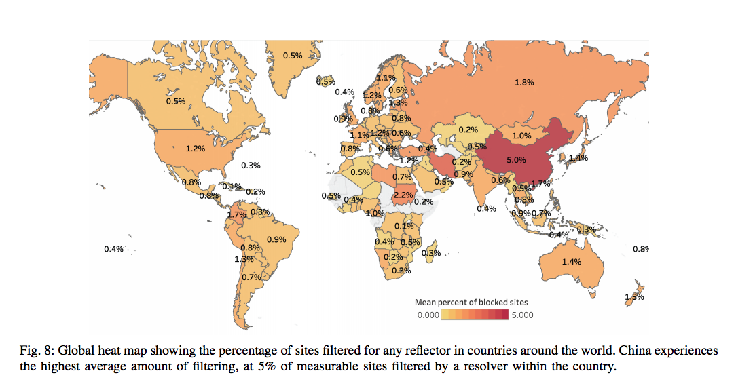
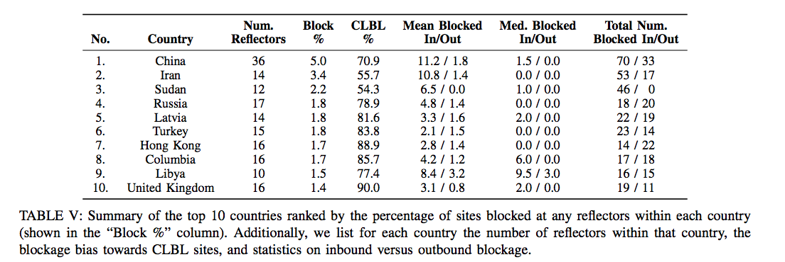
Augur

Slide 29
Application-Layer Measurement
Resolver
What’s new on cnn.com?
DNS: cnn.com?
IP routing
TCP handshake
(opt) TLS handshake
HTTP requests
Notes:
Better yet! We have two steps covered!
But being able to talk to CNN is no good if we can’t ask for news articles or headlines!
Lots of things run on a TCP connection. Web proxies exist, but some only do web
Others inject stuff
Is there any other infrastructure we can use?

Slide 30
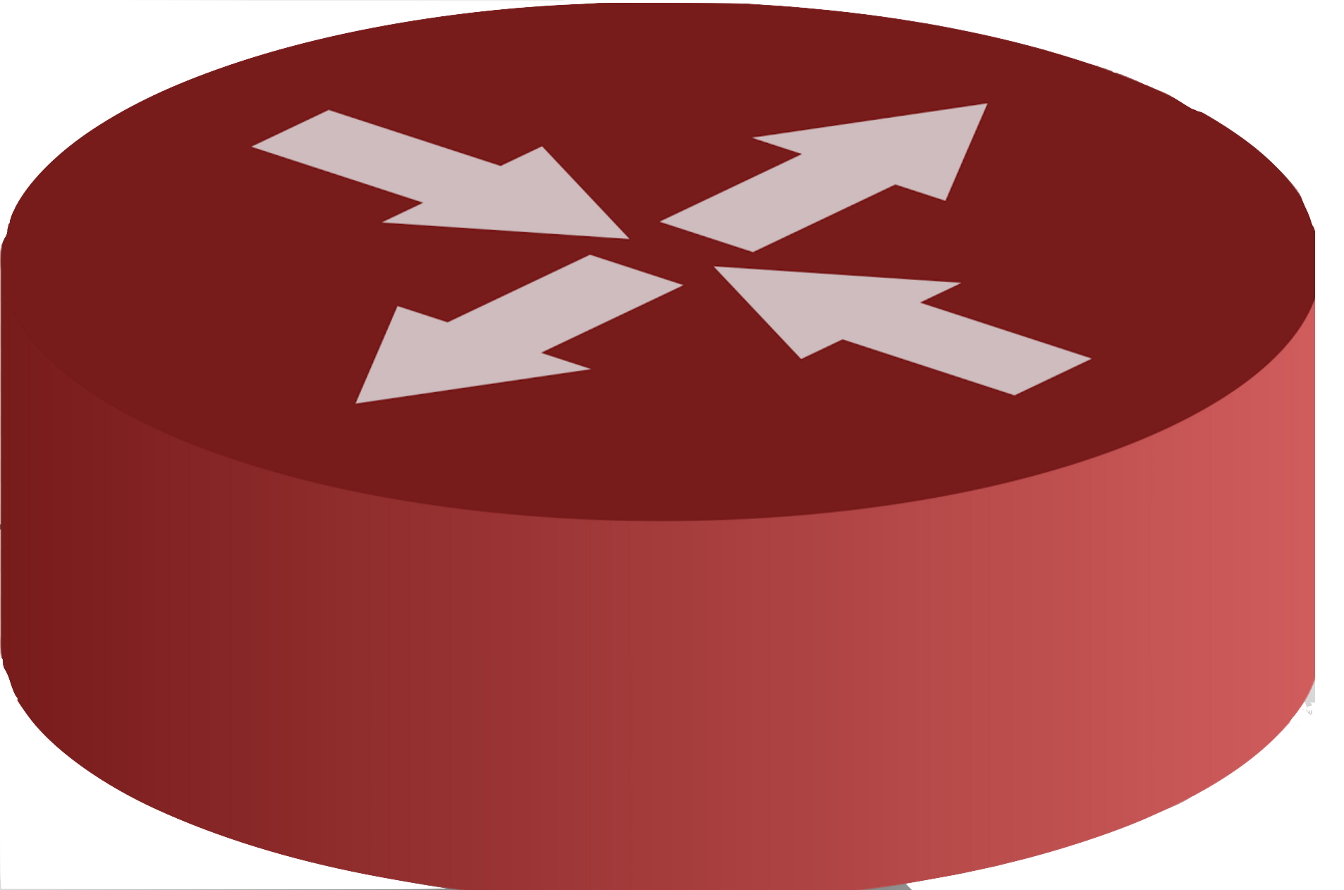


Application-Layer Measurement
PROBLEM:
TCP Handshake
GET https://google.com
RST
RST
user
Server

Slide 31
Application-Layer Measurement
TCP Handshake
GET https://google.com
GET https://google.com
Measurement Machine
Echo Server

Slide 32
Application-Layer Measurement
TCP Handshake
GET https://google.com
GET https://google.com
RST
RST
Measurement Machine
Echo Server

Slide 33
Quack
Quack is a system that uses Echo servers to detect whether a keywords/URLs are blocked
Goal: Scalable, ethical, and statistically robust system to continuously detect application-layer blocking
Functionality
Coverage
Ethics
Continuity
Echo server
Queries
Notes:
Talk about ongoing cleverness… clearer signal

Slide 34
Application-Layer Measurement
Resolver
What’s new on cnn.com?
DNS: cnn.com?
IP routing
TCP handshake
(opt) TLS handshake
HTTP requests

Slide 35
Censored Planet, a system that can provide a continual and global view of Internet censorship
Regular reachability measurements for key websites from countries worldwide
Data collected with Augur, Satellite, and Quack combined with side channels at other network layers
Tools for mapping and comparative analyses across locations and time
Notes:
CHALLENGE:
Need reliable data about how censors’ behavior changes over time
Censored planet is a service with an ambitious goal: detecting network interface using side channels everyday from everywhere.
More importantly, we want to do useful things with that data

Slide 36
Censored Planet could provide any variation on:
Daily tests for tens of thousands of websites across all countries
Near-constant monitoring of a set of ten websites across all countries
Monitoring a sample, stratified by type, of websites across all countries, with arbitrarily complex adaptive strategies

Slide 37
Censored Planet could provide transparency to:
give evidence
discourage proliferation
discover inadvertent blocking
understand autonomy
enable conversations
Notes:
Name and shame

Slide 38
Censored Planet: Measuring Internet Censorship Globally and Continuously
Benjamin VanderSloot University of Michigan, Winter 2018
benvds@umich.edu
Notes:
CP to bring transparency and accountability, to instances where governments practice censorship. This transparency can help to improve defense technology- tell us where it needs to be deployed. Also, it can inform users about what they are missing, and help diplomat and others who make policy decisions know how best to respond to guarantee democracy for all.

Slide 39

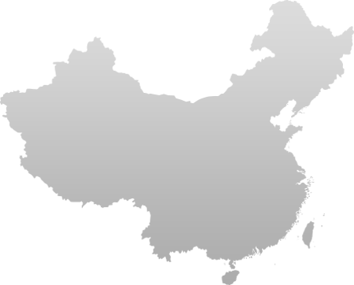



Investigating Interference: China’s Great Cannon
PROBLEM:
Who is responsible for the Distributed Denial of Service Attack (DDoS) against GitHub?
More: “An Analysis of China's Great Cannon”. Marczak, Weaver, Dalek,
Ensafi, Fifield, McKune, Rey, Railton, Deibert, and Paxson
Global Internet
Notes:
An example of how sophisticated network interference can get, I was a part of studying
March 2015, Github (public code repository ) released that they are under Distributed Denial of Service attack. That means GitHub was receiving too many requests from different places that possibly could handle. “This attack was the result of javascript that was maliciously injected into Baidu’s web page.”
Why the attackers were targeting github: because Github was hosting a project: greatfire.org that provides information about chinese censorship and how to circumvent it.
Our team with different skill set from CS to political started investigating the attack while it was still running. We called the system behind this attack great cannon. Here is his how the attack happened

Slide 40
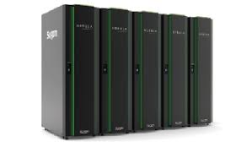
Great Cannon
Is request for Baidu script?
Great Cannon
Target Traffic
REROUTED
GET example.cn/h.js
Global Internet
Notes:
If you requested a page from a server inside china, such as Get example.cn, when passes through Chinese Deep Packet instpection, it would go through.

Slide 41
Great Cannon
Is request for Baidu script?
Great Cannon
Target Traffic
REROUTED
NO
GET example.cn/h.js
Global Internet

Slide 42
Great Cannon
Is request for Baidu script?
1/50 probability?
Great Cannon
Target Traffic
REROUTED
GET hm.baidu.com/h.js
Global Internet
Notes:
But If the request was for baidu, then approximately 1 out of 50 the request was dropped.

Slide 43
Great Cannon
Is request for Baidu script?
1/50 probability?
Great Cannon
YES:
INJECT .js
Target Traffic
REROUTED
Global Internet
Notes:
and instead a malicious java script was injected back to the requesting user.

Slide 44
Great Cannon
Is request for Baidu script?
1/50 probability?
Great Cannon
MANY requests
YES:
INJECT .js
YES:
INJECT .js
Target Traffic
REROUTED
GET hm.baidu.com/h.js
Global Internet
Notes:
This injected javascript then is used to launch distributed denial-of-service attacks to github.

Slide 45
Bringing Accountability
PROBLEM:
Who is behind the Distributed Denial of Service Attack (DDoS) towards GitHub?
Global Internet
Notes:
This attack lasted for 3 weeks and we were lucky to be able to run many experiment while it was happening
E.G learn about details of great cannon, where is it located, what the infrastructure of the system look like….
At the end Because of the prior work and familiarity of our team with GFW, we provide enough evidence to attribute the system behind the attack as likely operating by the Chinese government.
Great Cannon is co-located with the GFW, but separate offensive system, with different capabilities and design. shows significant escalation in state-level information control,
To emphasize on the danger of GC, here is a hypothetical scenario

Slide 46
Bringing Accountability
PROBLEM:
Who is behind the Distributed Denial of Service Attack (DDoS) towards GitHub?
.Great Cannon very likely operated by the Chinese.government..
Global Internet
Notes:
This attack lasted for 3 weeks and we were lucky to be able to run many experiment while it was happening
E.G learn about details of great cannon, where is it located, what the infrastructure of the system look like….
At the end Because of the prior work and familiarity of our team with GFW, we provide enough evidence to attribute the system behind the attack as likely operating by the Chinese government.
Great Cannon is co-located with the GFW, but separate offensive system, with different capabilities and design. shows significant escalation in state-level information control,
To emphasize on the danger of GC, here is a hypothetical scenario

Slide 47
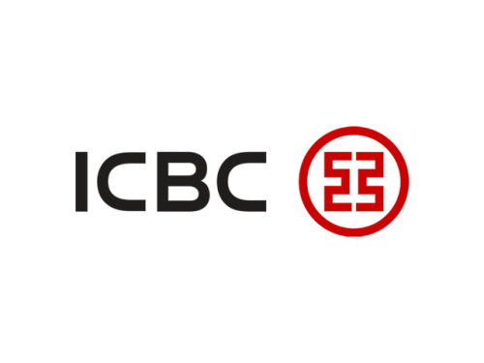
Targeted Exploitation
Attack
Is request from
US Defense Contractor?
Great Cannon
YES:
INJECT 0 day
Target Traffic
REROUTED
GET icbc.com
Global Internet
Notes:
A US defence contractor using a website in china, Great cannon act as a full “man-in-the-middle” (MITM) for targeted flows, and
.

Slide 48
TCP/IP Measurement
Reflector IP ID
Measurement machine
Reflector
Site
Notes:
Spooky scan is a novel technique that uses TCP/IP side channels to remotely, off the path tells you whether a user and site can talk.
* TCP Idle Scan Antirez, (Bugtraq 1998)
* Detecting Intentional Packet Drops on the Internet via TCP/IP Side Channels
Roya Ensafi, Knockel, Alexander, and Crandall (PAM ’14) * Idle Port Scanning and Non-interference Analysis of Network Protocol Stacks Using Model Checking
Roya Ensafi, Park, Kapur, and Crandall (Usenix Security 2010)

Slide 49
TCP/IP Measurement
1
SYN/ACK
Reflector IP ID
Measurement machine
Reflector
Site
Notes:
Spooky scan is a novel technique that uses TCP/IP side channels to remotely, off the path tells you whether a user and site can talk.
* TCP Idle Scan Antirez, (Bugtraq 1998)
* Detecting Intentional Packet Drops on the Internet via TCP/IP Side Channels
Roya Ensafi, Knockel, Alexander, and Crandall (PAM ’14) * Idle Port Scanning and Non-interference Analysis of Network Protocol Stacks Using Model Checking
Roya Ensafi, Park, Kapur, and Crandall (Usenix Security 2010)

Slide 50
TCP/IP Measurement
1
SYN/ACK
Reflector IP ID
7000
2
RST [IP ID: 7000]
Measurement machine
Reflector
Site
Notes:
Spooky scan is a novel technique that uses TCP/IP side channels to remotely, off the path tells you whether a user and site can talk.
* TCP Idle Scan Antirez, (Bugtraq 1998)
* Detecting Intentional Packet Drops on the Internet via TCP/IP Side Channels
Roya Ensafi, Knockel, Alexander, and Crandall (PAM ’14) * Idle Port Scanning and Non-interference Analysis of Network Protocol Stacks Using Model Checking
Roya Ensafi, Park, Kapur, and Crandall (Usenix Security 2010)

Slide 51
TCP/IP Measurement
1
SYN/ACK
Reflector IP ID
7000
2
RST [IP ID: 7000]
Measurement machine
Reflector
3
Spoofed SYN [src: Reflector IP]
Site
Notes:
Spooky scan is a novel technique that uses TCP/IP side channels to remotely, off the path tells you whether a user and site can talk.
* TCP Idle Scan Antirez, (Bugtraq 1998)
* Detecting Intentional Packet Drops on the Internet via TCP/IP Side Channels
Roya Ensafi, Knockel, Alexander, and Crandall (PAM ’14) * Idle Port Scanning and Non-interference Analysis of Network Protocol Stacks Using Model Checking
Roya Ensafi, Park, Kapur, and Crandall (Usenix Security 2010)

Slide 52
TCP/IP Measurement
1
SYN/ACK
Reflector IP ID
7000
2
RST [IP ID: 7000]
Measurement machine
Reflector
3
4
SYN/ACK
Spoofed SYN [src: Reflector IP]
4
Site
Notes:
Spooky scan is a novel technique that uses TCP/IP side channels to remotely, off the path tells you whether a user and site can talk.
* TCP Idle Scan Antirez, (Bugtraq 1998)
* Detecting Intentional Packet Drops on the Internet via TCP/IP Side Channels
Roya Ensafi, Knockel, Alexander, and Crandall (PAM ’14) * Idle Port Scanning and Non-interference Analysis of Network Protocol Stacks Using Model Checking
Roya Ensafi, Park, Kapur, and Crandall (Usenix Security 2010)

Slide 53
TCP/IP Measurement
1
SYN/ACK
Reflector IP ID
7000
7001
2
RST [IP ID: 7000]
Measurement machine
Reflector
3
4
SYN/ACK
Spoofed SYN [src: Reflector IP]
4
5
RST [IP ID: 7001]
Site
Notes:
Spooky scan is a novel technique that uses TCP/IP side channels to remotely, off the path tells you whether a user and site can talk.
* TCP Idle Scan Antirez, (Bugtraq 1998)
* Detecting Intentional Packet Drops on the Internet via TCP/IP Side Channels
Roya Ensafi, Knockel, Alexander, and Crandall (PAM ’14) * Idle Port Scanning and Non-interference Analysis of Network Protocol Stacks Using Model Checking
Roya Ensafi, Park, Kapur, and Crandall (Usenix Security 2010)

Slide 54
TCP/IP Measurement
SA Probe[IP ID: 7002]
6
1
SYN/ACK
Reflector IP ID
7000
7001
7002
2
RST [IP ID: 7000]
Measurement machine
Reflector
3
4
SYN/ACK
Spoofed SYN [src: Reflector IP]
4
5
RST [IP ID: 7001]
Site
Notes:
Spooky scan is a novel technique that uses TCP/IP side channels to remotely, off the path tells you whether a user and site can talk.
* TCP Idle Scan Antirez, (Bugtraq 1998)
* Detecting Intentional Packet Drops on the Internet via TCP/IP Side Channels
Roya Ensafi, Knockel, Alexander, and Crandall (PAM ’14) * Idle Port Scanning and Non-interference Analysis of Network Protocol Stacks Using Model Checking
Roya Ensafi, Park, Kapur, and Crandall (Usenix Security 2010)

