Slide 1
Weather Forecast Tool
SAT4650 2024-Fall Project
Student: Sankardu Varadapureddi
Mentor: Dr. Weihua Zhou

Slide 2
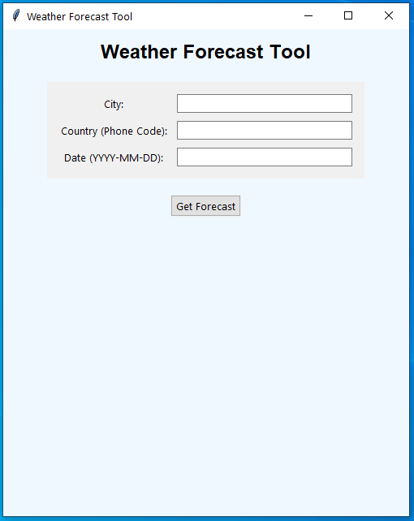
Weather Forecast Application
A Python-based tool to fetch and display weather forecasts.
Uses APIs (Open-Meteo and OpenWeatherMap) to gather data.
Key Features:
Validates user input (city, country, date).
Combines forecasts from multiple sources.
Displays results with appropriate weather icons

Slide 3
Objectives and Long-Term Goal
Objectives
Personal Use: Planning daily activities based on weather forecasts, Choosing the best days for travel or outdoor events.
Educational Purpose: Teaching programming concepts through a practical, interactive project. Demonstrating the integration of APIs and data visualization.
Long-Term Goal
Enhance the weather forecasting tool to provide more accurate, personalized, and real-time weather insights.
Integrate additional APIs, such as historical weather data and regional climate trends.
Support multi-language interfaces to cater to a global audience.
Real time alert system based on pre-defined inputs

Slide 4
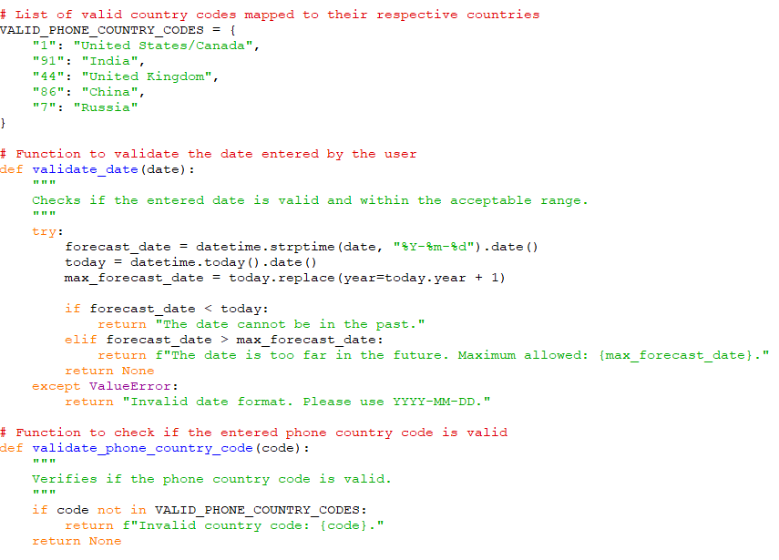
Input Validation
validate_date:
Purpose: Ensures the date is valid, not in the past, and within 16 days from today.
Algorithm:
Parse the date and check against current and maximum allowed dates.
Return errors for invalid or out-of-range dates.
validate_phone_country:
Purpose: Verifies if the country code is valid.
Algorithm:
Check the code against a predefined list of country codes.
Return an error for invalid codes.

Slide 5
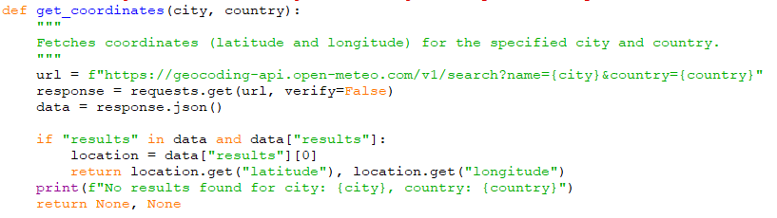
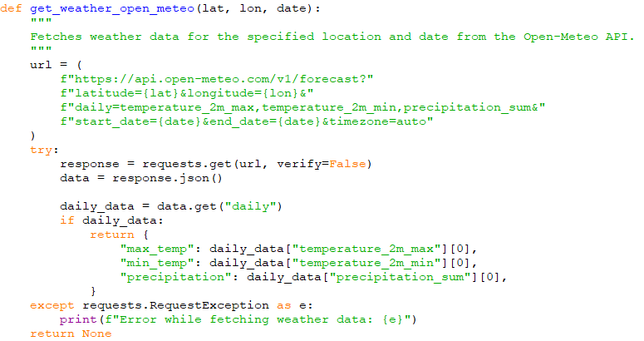
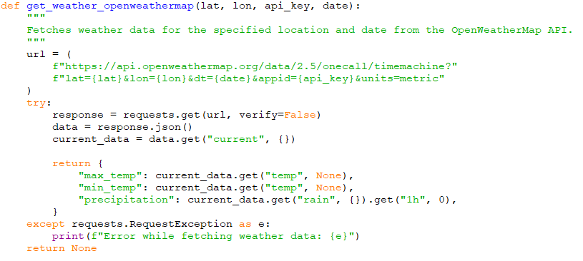
Data Fetching - Fetch Coordinates and Weather Data
get_coordinates:
Purpose: Retrieve latitude and longitude for a city.
Algorithm:
Call the geocoding API and parse the response.
Return coordinates or None if not found.
get_weather_open_meteo:
Purpose: Fetch weather data from Open-Meteo.
Algorithm:
Call the API with location and date.
Extract temperature and precipitation data.
get_weather_openweathermap:
Purpose: Fetch weather data from OpenWeatherMap.
Algorithm:
Call the API and parse the response for temperature and precipitation.

Slide 6
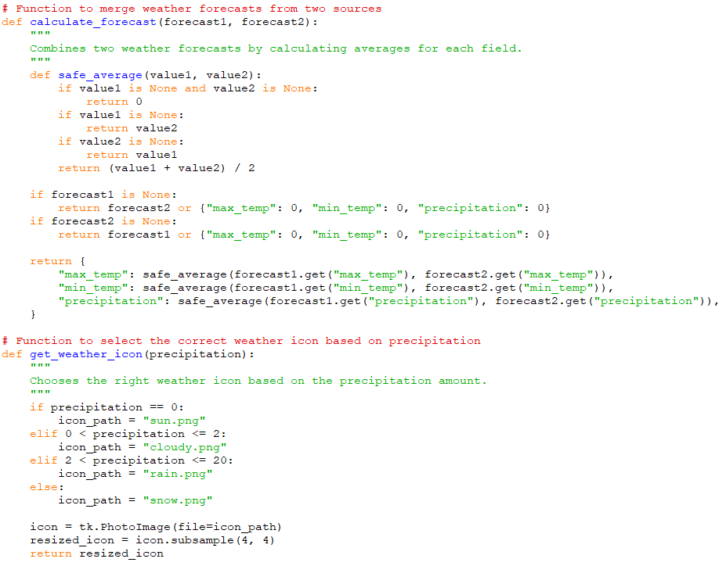
Data Processing - Process and Visualize Forecast Data
calculate_forecast:
Purpose: Combine forecasts from two sources.
Algorithm:
Average temperature and precipitation values.
Handle missing data.
get_weather_icon:
Purpose: Select an appropriate weather icon.
Algorithm:
Map precipitation ranges to icons (e.g., sunny, cloudy, rain, snow).
Return a resized image.

Slide 7
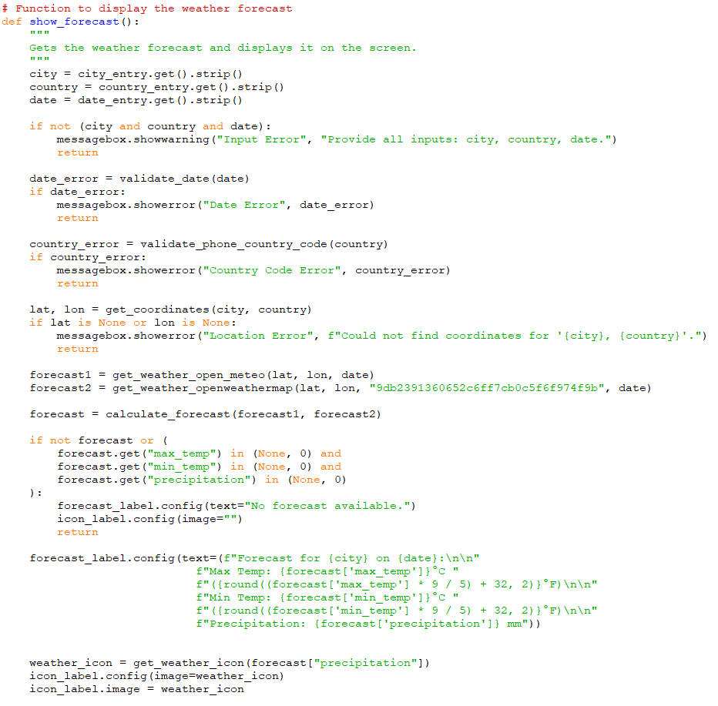
Main Control
show_forecast: Fetch, Validate, and Display Forecast
Purpose: Manage the process of fetching, validating, and displaying the weather forecast.
Algorithm:
Validate user inputs.
Fetch coordinates and weather data.
Combine forecasts and display results.
Handle errors.

Slide 8
Challenges during implementation
SSL verification is disabled since majority of times “geocoding-api.open-meteo.com” resulted in connection issues when fetching geographical coordinates.
Constructing API URLs to fetch data from “Open-Meteo” and “OpenWeatherMap”.
Generating API key in “OpenWeatherMap API” website to get weather forecast data.
In Text entry boxes, ‘strip()’ method is used to avoid unintended spaces in text inputs. e.g.: city = city_entry.get().strip()
Weather forecast websites are expecting dates in YYYY-MM-DD format.
This function work in the data range from today to 7-16 days from today. This is due to limitation from forecast data in websites.

Slide 9
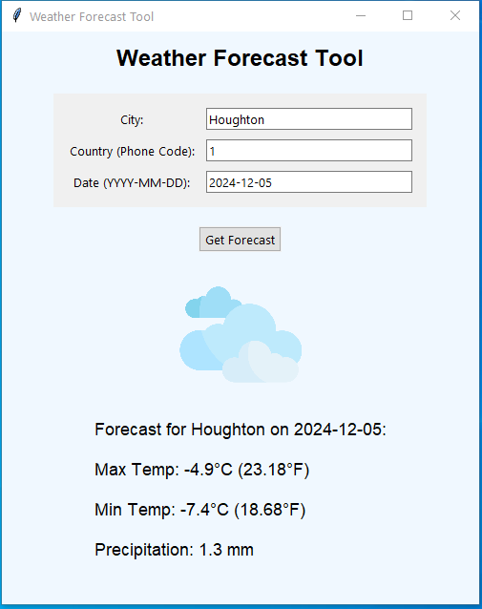
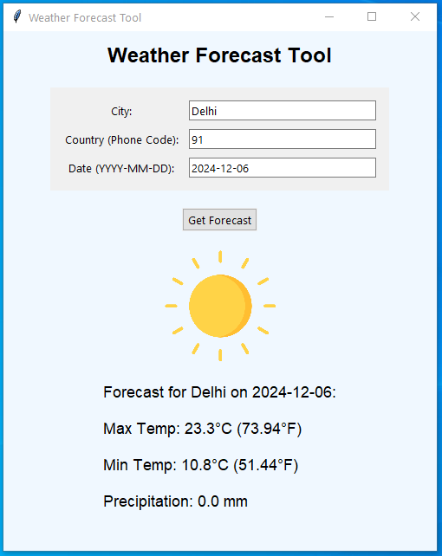
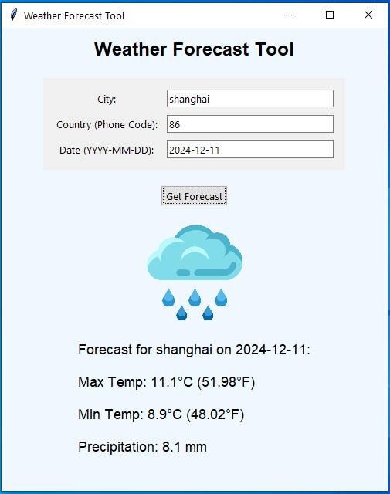
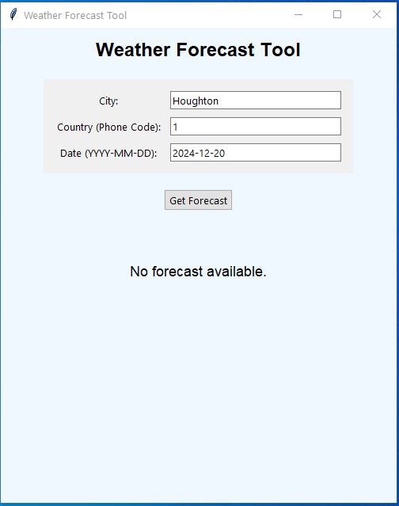
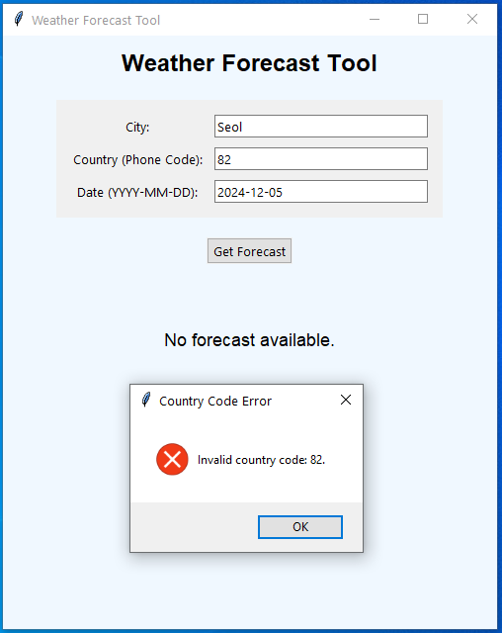
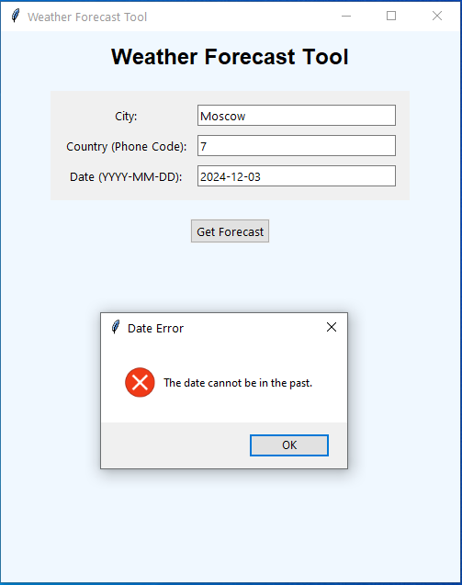

Slide 10
Thank you

