Slide 1
REAL-TIME AGE GENDER DETECTION
CAPSTONE PROJECT
Presented By:
BHARATHVARSH SRINIVASAN– College Of Engineering Guindy(CEG), Anna University
ROLL NO: 2021115020

Slide 2
OUTLINE
Problem Statement
Proposed System/Solution
System Development Approach
Algorithm & Deployment
Result
Conclusion
Future Scope
References

Slide 3
Problem Statement
Women's safety is a critical concern in today's society, with incidents of harassment and violence being reported regularly.
Traditional methods of ensuring safety often fall short in providing real-time assistance to women facing threatening situations.
There's a need for an efficient system that can quickly detect the age and gender of individuals to aid in assessing potential risks and providing timely interventions.

Slide 4
Proposed Solution
Data Collection:
Gather labeled image datasets representing diverse genders.
Utilize both existing and collected datasets for robust training.
Data Preprocessing:
Clean and standardize image data for consistency.
Resize and augment images to enhance dataset variability.
Machine Learning Algorithm:
Implement CNNs for gender classification.
Train models using diverse datasets, optimizing for accuracy.
Deployment:
Develop user-friendly application for real-time gender predictions.
Deploy on accessible platform with scalable infrastructure.
Evaluation:
Assess model performance using accuracy metrics.
Validate on varied test datasets and refine as needed.

Slide 5
System Approach
System Development Approach (Technology Used):
Development revolves around deep learning and Convolutional Neural Networks (CNNs).
Leveraging frameworks like TensorFlow or PyTorch for model training and deployment.
Integration of OpenCV for efficient video stream processing and analysis.

Slide 6
Algorithm & Deployment
Algorithm Selection:
Overview: The chosen algorithm for age and gender detection is Convolutional Neural Networks (CNNs), a deep learning architecture widely used for image classification tasks.
Justification: CNNs are well-suited for image analysis tasks due to their ability to automatically learn relevant features from raw pixel data. Given the complexity and variability in facial features related to age and gender, CNNs are capable of capturing intricate patterns necessary for accurate classification.
Data Input:
Input Features: The algorithm takes as input images containing faces, extracted from various sources including images captured via cameras or video feeds.
Additional Factors: Features such as facial expressions, lighting conditions, and pose may also influence age and gender predictions and are considered during image preprocessing.
Training Process:
Data Preparation: Collected image datasets are preprocessed to standardize sizes and enhance quality. Data augmentation techniques may be employed to increase dataset variability.
Training Methodology: CNNs are trained using labeled image datasets, where images are labeled with corresponding age and gender categories. The model is optimized using techniques such as stochastic gradient descent (SGD) with backpropagation.
Considerations: Techniques like transfer learning may be utilized, where pre-trained CNN models (e.g., VGG, ResNet) are fine-tuned on the specific age and gender classification task. Cross-validation may be employed to assess model performance and prevent overfitting.
Prediction Process:
Real-time Inference: During the prediction phase, the trained CNN model analyzes input images to predict the age and gender of individuals depicted in the images.
Model Output: The algorithm outputs predicted age and gender labels, providing real-time insights into demographic characteristics.
Considerations: The prediction process may consider factors such as varying lighting conditions, facial expressions, and occlusions to improve accuracy in real-world scenarios.

Slide 7
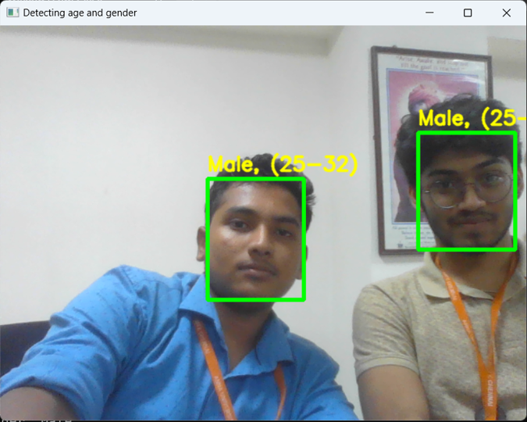
Result

Slide 8
Conclusion
Our project presents a novel approach to addressing the issue of women's safety through real-time age and gender detection.
By leveraging state-of-the-art technologies, we've developed a system that can assist in risk assessment and emergency response, potentially saving lives.
The successful implementation and testing of the system validate its effectiveness in enhancing women's safety in public spaces.

Slide 9
Future scope
Future enhancements could include integrating additional features such as emotion recognition or identifying suspicious behavior patterns.
Expanding the deployment of the system across various public areas and partnering with law enforcement agencies to improve response times.
Continuous refinement of the algorithms and models to further improve accuracy and robustness in diverse environments.

Slide 10
References
[1] Yuxiang Zhou and Hongjun Ni ,” Face and Gender Recognition System Based on Convolutional Neural networks” , Proceedings of 2019 IEEE International Conference on Mechatronics and Automation August 4 - 7, Tianjin, China
[2] Syed Taskeen Rahman ,Arefeen, Subrina,AI Khan “Human Age and Gender Estimation using Facial Image Processing “, proceedings 2020 IEEE Region 10 Symposium (TENSYMP), 5-7 June 2020, Dhaka, Bangladesh.
[3] Mr. Aditya Kulkarni Parth Joshi,Shanunak,Shreyas , “ Detection of Gender and Age using Machine Learning”, proceedings of International Journal for Research in Applied Science & Engineering Technology (IJRASET) pp. 2321-9653
[4] Abdelrahamn Ashraf Mohamed,Marwan,Gamal abdelmonem,Fatima helmy” Face Liveness Detection Using a sequential CNN technique”, proceedings of 2021 IEEE 11th Annual Computing and Communication Workshop and Conference (CCWC) | 978-1-6654-1490-6/21/ ©2021 IEEE | DOI: 10.1109/CCWC51732.2021.9376030
[5] Qili Deng,Yong xu,Jinghua wang,Kai sun” Deep Learning for Gender Recognition”, proceedings of 2015 International Conference on Computers, Communications, and Systems (ICCCS) 02-03 November 2015 | DOI 10.1109/CCOMS.2015.7562902

Slide 11
THANK YOU

