Slide 1

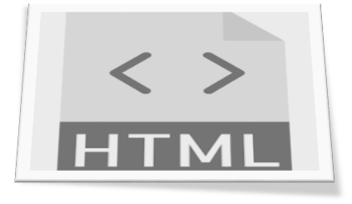

DOM-EXTRACTOR
XPATH MADE EASY

Slide 2




Synopsis
Description:
DOM-Extractor is a tool designed for extracting UI Elements in to XPath format for Functional and GUI Automation(Open Source and Commercial Automation Tools)
Features:
This tool extracts XPath for different objects based on Code Style in POM(Page Object Model) or enum format
This tool extracts XPath for the object types such as Link, Button, Edit field, List field, Radio Button, Checkbox, Text field, Combo Box based on the user selected object type present in the webpage.
This tool generates XPath for the HTML content(i.e HTML content can be part of full page)
Effort Savings -- Manually it will take 1 to 3 hours per page to generate XPaths where as by leveraging this tool it will take 1 min.
User Knowledge – Beginners can use this tool to generate XPath, need not to understand DOM structure
All the Elements XPath will be generated in Unique format.
Kiran Edupuganti
Sreelatha Javvaji
Vithal Bonker
Bharath Vatrapu

Slide 3


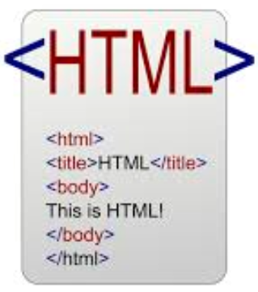


Architecture
DOM-Extractor tool interacts with HTML webpage to generate XPath of the elements present in the webpage
DOM-Extractor read the HTML Page to generate Xpath for the object type as selected in the tool.
DOM-Extractor Tool generates the notepad file with the list of elements in the unique format

Slide 4
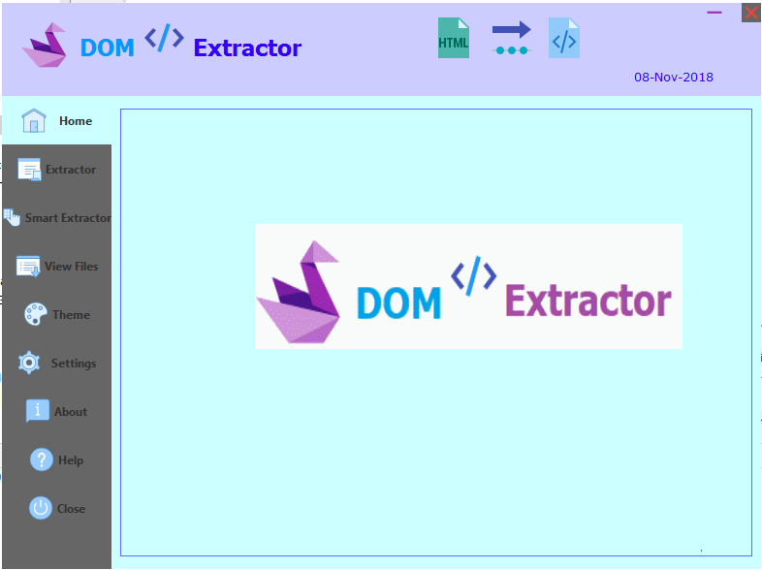
DOM-Extractor - Snapshot
Below screenshot represents the DOM-Extractor tools, description of each tab explained in the subsequent slide.

Slide 5
DOM-Extractor - Tabs
Tab | Description
Home | Home tab describes the DOM-Extractor tool functionality on a high level.
Extractor | From Extractor tab user can extract Xpath based on the select URL or the file which contains HTML content.
Smart Extractor | The purpose of Smart Extractor tab is user can extract Xpath for the specified portion of the webpage based on the HTML content selected on the browser which is in running status.
View Files | From View Files tab user can view the existing extracted files which are already generated. From this tab user also has a privilege to delete the files which are not required for future reference.
Theme | From Theme tab, user has a privilege to customize the tool background colors.
Settings | From Settings tab, User should provide local path of the folder where extracted files need to be saved. User should provide local path of Browser drivers folder. User should select default browser on which objects need to be captured.(i.e Chrome, IE etc)
About | About tab provides information related to DOM-Extractor tool platform details.
Help | Help tab describes how to use DOM-Extractor tool with detailed information.
Close | From Close tab user can Terminate the tool.

Slide 6


