Slide 1











Padeli Hyeti –
Padel Player Finder
A real HTTP client-server application for finding players and organizing Padel games
THE PROBLEM
OUR SOLUTION
Padel players need a simple way to find suitable players and join available games.
Padeli Hyeti connects browser clients to a centralized Flask server and persistent SQLite database.
TEAM MEMBERS
REPOSITORY
APPLICATION PREVIEW
3-member university project team
github.com/bvbvbv54/Paddelni
Two-browser client demo
PROJECT IMAGE
Real HTTP + Wireshark evidence

Slide 2


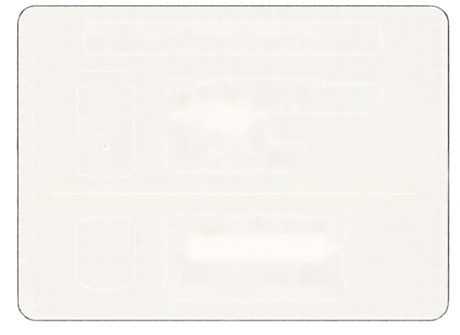















System and Network Architecture
Three physical computers communicating over a private network
NETWORK INFORMATION
Server address
PHYSICAL SERVER COMPUTER
192.168.54.6
Flask HTTP Server
Server port
Port: 8000
Protocol: HTTP
8000
Protocol
HTTP
Request
HTTP
Request
HTTP
SQLite Database
Centralized storage
Shared by all clients
Network
HTTP
Response
HTTP
Response
Wi-Fi LAN / private network
CLIENT COMPUTER 1
CLIENT COMPUTER 2
Browser
PRIVATE LAN NETWORK
Browser
Athlete 1
Athlete 2
Both clients communicate with the same backend,
so data created by one player can be discovered by another player.

Slide 3































Application Implementation
Core components of the Padeli Hyeti system
Project File Structure (Example)
padeli_hyeti/
app/
Frontend
Backend
_init_.py
routes.py
HTML5, CSS3, Jinja templates
Minimal JavaScript
Browser-based interaction
Python 3, Flask
Session authentication
JSON API endpoints
Server-side validation
templates/
base.html
index.html
login.html
static/
css/
Database
Security
style.css
js/
SQLite
Persistent storage
Foreign keys
Unique constraints
Parametrized SQL queries
Werkzeug password hashing
Passwords never stored in plaintext
CSRF protection
HTTP-only session cookies
Private profile information protected
main.js
database/
database.py
padeli_hyeti.db
utils/
auth.py
run.py
Basic security suitable for controlled university demonstration, not production-grade.

Slide 4
03 / THE DEMO FLOW
One game. Two clients. Four HTTP steps.
The server keeps one shared SQLite record; both browsers read the same result.
01
CLIENT 1
02
CLIENT 2
03
CLIENT 2
04
CLIENT 1
→
→
→
POST /api/games
GET /games/5
POST /api/games/5/join
GET /games/5
Create Game 5
→ 201 Created
Find the same game
→ 200 OK
Join the game
→ 200 OK
Refresh participants
→ 2 of 4
Proof: Client 1 sees Client 2 in the participant list after the join.
PADELI HYETI / COMPUTER NETWORKS
04

Slide 5
04 / CREATE
Client 1 creates the game.
Request on the left. Response on the right.
REQUEST
RESPONSE
POST /api/games HTTP/1.1
HTTP/1.1 201 Created
Host: 192.168.54.6:8000
TCP: 192.168.54.66:61170 → :8000
Content-Type: application/json
Content-Length: 128
Content-Type: application/json
Content-Length: 358
→
success: true
message: "Game created. You are the first participant."
data: id=5 • title="game"
location="padel megrine" • date=2026-10-22 • time=14:00
required_level=Intermediate • max_players=4
participant_count=1 • available_places=3 • status=available
{"title":"game",
"location":"padel megrine",
"date":"2026-10-22", "time":"14:00",
"required_level":"Intermediate", "max_players":"4"}
PADELI HYETI / COMPUTER NETWORKS
05

Slide 6
05 / JOIN
Client 2 joins the same game.
Request on the left. Response on the right.
REQUEST
RESPONSE
POST /api/games/5/join HTTP/1.1
HTTP/1.1 200 OK
Host: 192.168.54.6:8000
TCP: 192.168.53.7:50155 → :8000
Content-Type: application/json
Content-Length: 2
Content-Type: application/json
Content-Length: 334
→
success: true
message: "You joined the game."
data: id=5 • title="game"
location="padel megrine" • date=2026-10-22 • time=14:00
required_level=Intermediate • max_players=4
participant_count=2 • available_places=2 • status=available
Origin: http://192.168.54.6:8000
Referer: /games/5
X-CSRF-Token: [redacted]
{}
PADELI HYETI / COMPUTER NETWORKS
06

Slide 7
06 / IMPLEMENTATION
The HTTP types used by the project.
Only implemented methods and observed response codes are shown here.
GET
POST
PUT
OBSERVED RESPONSES
Read pages, players
and game details
Register, login,
create, join, feedback
Update the logged-in
player profile
200 OK • 201 Created • 400 Bad Request
401 Unauthorized • 404 Not Found • 409 Conflict
GET /games/5 → Flask view code
@bp.get("/games/<int:game_id>")
def game_detail(game_id: int):
database = get_db()
row = fetch_game(game_id)
if row is None:
abort(404)
participants = database.execute(...)
The browser GET enters this real view, reads SQLite,
loads participants, and returns the page—or a real 404.
PADELI HYETI / COMPUTER NETWORKS
07

Slide 8
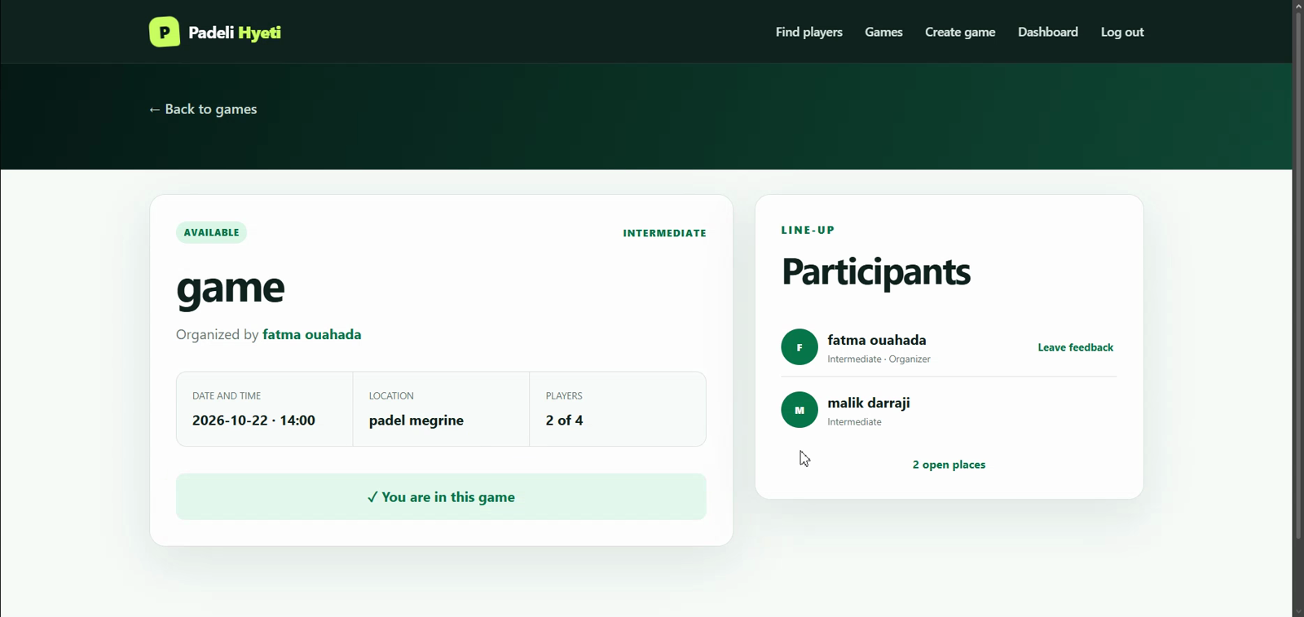
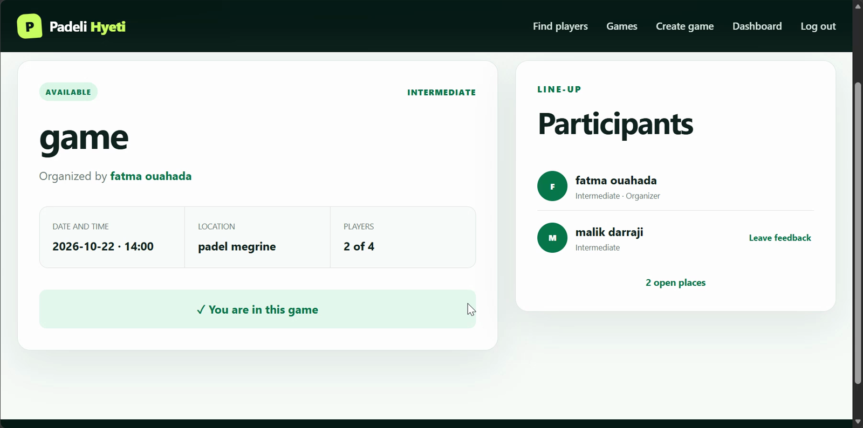
08 / TWO CLIENTS
One shared game, shown twice.
Click a green play label during the presentation to open the trimmed recording.
CLIENT 1 / CREATED + REFRESHED
CLIENT 2 / FOUND + JOINED
Participant list: 2 of 4
▶ PLAY CLIENT 1 CLIP
Join confirmation is visible
▶ PLAY CLIENT 2 CLIP
PADELI HYETI / COMPUTER NETWORKS
08

Slide 9
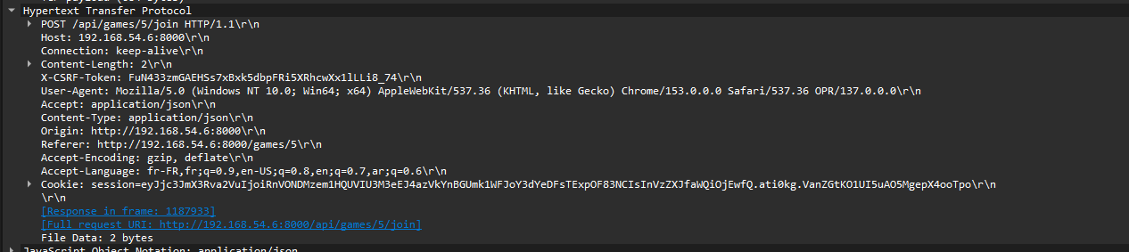
09 / WIRESHARK EVIDENCE
Find one request. Read one response.
The screenshot is the real join packet; the filter makes it easy to isolate.
FILTER
tcp.port == 8000
REQUEST
POST /api/games/5/join
Client 2 → Server
RESPONSE
REQUEST frame 1187931 • POST /api/games/5/join • body: {}
HTTP/1.1 200 OK
Content-Length: 334
frame 1187933
RESPONSE frame 1187933 • 200 OK • participant_count: 2
Source: wiresharkpresentation.pcapng • session token redacted
PADELI HYETI / COMPUTER NETWORKS
09

Slide 10
10 / BONUS — QUERY
QUERY captured: request → response.
Real packet pair from queryvalid.pcapng; request frame 1400, response frames 1401–1403.
FRAME 1400 / REQUEST / CAPTURED
FRAMES 1401–1403 / RESPONSE / CAPTURED
QUERY /api/query?resource=games HTTP/1.1
HTTP/1.1 200 OK
Host: 192.168.54.6:8000
TCP: 192.168.53.7:60520 → :8000
User-Agent: curl/8.21.0
Accept: application/json
Body: none
→
Server: Werkzeug/3.1.8 • Python/3.13.5
Content-Type: application/json
Content-Length: 1599
Connection: close
success: true
message: "QUERY request handled; games retrieved."
data.method: "QUERY" • data.count: 5
data.games: public catalogue (1599-byte JSON body)
Read-only, non-standard HTTP method
PADELI HYETI / COMPUTER NETWORKS
10

