Slide 1
PADELI
HYETI
A real two-client Flask application for finding and joining Padel games.
LIVE LAN DEMO
Clients 192.168.54.66 + 192.168.53.7 → Server 192.168.54.6:8000
HTTP • SQLite • Flask • Wireshark
01

Slide 2
01 / ARCHITECTURE
One server. Two browsers. One shared state.
Every action travels as an HTTP request to the same Flask process and SQLite database.
FLASK SERVER
CLIENT 1
192.168.54.6:8000
CLIENT 2
192.168.54.66
HTTP request →
← HTTP response
192.168.53.7
Routes • Sessions • Validation
Creates Game 5
Organizer session
Discovers Game 5
Joins the session
SQLite database
created once on the server
PADELI HYETI / COMPUTER NETWORKS
02

Slide 3
02 / USER JOURNEY
The live workflow in four moves.
The same workflow is visible in the browser, the server log, and the packet capture.
01
02
03
04
REGISTER + LOGIN
→
CREATE
→
JOIN
→
VERIFY
Each browser starts its own session.
Client 1 creates a real game row.
Client 2 joins through the API.
Organizer sees 2 of 4 participants.
Evidence used in this deck: two browser recordings + wiresharkpresentation.pcapng
PADELI HYETI / COMPUTER NETWORKS
03

Slide 4
03 / THE TEST RECORD
Game 5 is the shared database row.
These values are taken from the captured POST /api/games request.
GAME 5
WHY THIS MATTERS
game
The creator is inserted as participant #1 automatically.
LOCATION
DATE
padel megrine
2026-10-22
Capacity: 4
After Client 2 joins: 2 / 4
TIME
LEVEL
14:00
Intermediate
PADELI HYETI / COMPUTER NETWORKS
04

Slide 5
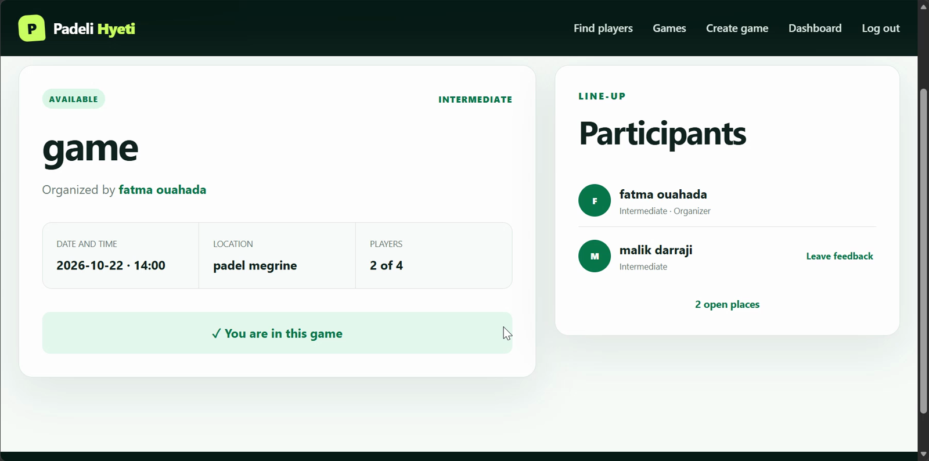
04 / BROWSER PROOF
Client 2 joins the open game.
This frame is extracted from the Edge recording used in the live test.
CLIENT 2
Join succeeded
The browser received the server response and displayed the shared game.
POST /api/games/5/join
HTTP 200 OK
PADELI HYETI / COMPUTER NETWORKS
05

Slide 6
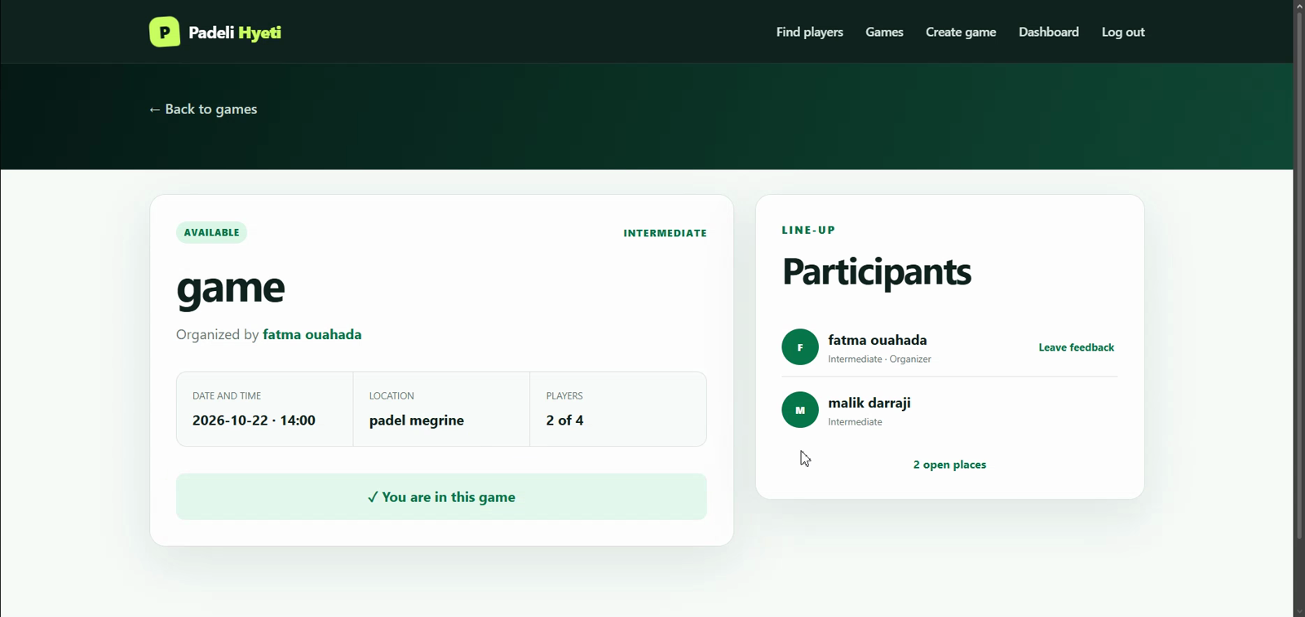
05 / SHARED STATE
The organizer sees the second player.
The second browser changed the database; the first browser reads that same state back.
CLIENT 1
2 of 4 players
Organizer refresh confirms both names in the participant list.
GET /games/5
HTTP 200 OK
PADELI HYETI / COMPUTER NETWORKS
06

Slide 7
06 / HTTP TRACE
Create → join → refresh.
The PCAP gives us a short, explainable story instead of a wall of packets.
POST /api/games
1
201 CREATED
192.168.54.66 → 192.168.54.6:8000
POST /api/games/5/join
2
200 OK
192.168.53.7 → 192.168.54.6:8000
GET /games/5
3
200 OK
Organizer reads the updated participant list
Frames: create 1181873 → 1181903 • join 1187931 → 1187933 • refresh 1189240
PADELI HYETI / COMPUTER NETWORKS
07

Slide 8
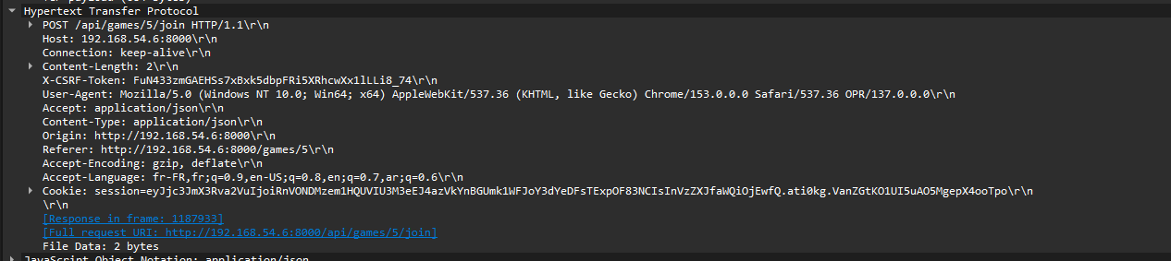
07 / WIRESHARK
Filter the evidence down to one request.
Use the filter first; then click the HTTP row to inspect the request line and response.
DISPLAY FILTER
tcp.port == 8000
For the join only:
ip.src == 192.168.53.7 &&
http.request.uri == "/api/games/5/join"
Real source: wiresharkpresentation.pcapng
Expected result: POST request → 200 OK
The screenshot keeps the packet view authentic while the session-cookie area is redacted.
PADELI HYETI / COMPUTER NETWORKS
08

Slide 9
08 / OPTIONAL BONUS
QUERY: a real non-standard HTTP method.
The endpoint is read-only and returns the same public game catalogue as GET /api/games.
POWERSHELL / CURL
RESPONSE SHAPE
curl.exe -X QUERY
"http://127.0.0.1:8000/api/query?resource=games"
{
"success": true,
"data": {
"method": "QUERY",
"games": [...],
"count": N
}
}
No browser plug-in or mock data: Flask receives method QUERY and queries SQLite.
Read-only • database-backed • HTTP 200
PADELI HYETI / COMPUTER NETWORKS
09

Slide 10
09 / SECURITY BONUS
What a passive MITM view can read.
We used Wireshark to demonstrate the risk safely; no ARP spoofing was run on the shared Wi-Fi.
VISIBLE
RISK
MITIGATION
HTTP request line
Headers
Response status
Plain HTTP is readable
to an on-path observer
(dummy accounts only)
Use HTTPS/TLS
for real credentials
and public networks
For an active MITM experiment, use only an isolated lab network with owned devices and explicit authorization. The presentation evidence here is passive packet capture.
PADELI HYETI / COMPUTER NETWORKS
10

Slide 11
10 / DEMO PLAN
A clean 90-second story.
Show the browser proof first, then the network proof.
1
Client 1 logs in and creates Game 5.
FILES READY
2
Client 2 finds the game and clicks Join.
• Clean PPTX
• Client recordings
• Wireshark PCAP
• 112 automated tests
• README + NETWORK_LAB.md
3
Client 1 refreshes: 2 of 4 players.
4
Wireshark filter shows POST and 200/201.
5
Optional: run QUERY and show the JSON response.
Padeli Hyeti: one shared game, visible from both clients.
PADELI HYETI / COMPUTER NETWORKS
11

