Slide 1











Padeli Hyeti –
Padel Player Finder
A real HTTP client-server application for finding players and organizing Padel games
THE PROBLEM
OUR SOLUTION
Padel players need a simple way to find suitable players and join available games.
Padeli Hyeti connects browser clients to a centralized Flask server and persistent SQLite database.
TEAM MEMBERS
REPOSITORY
APPLICATION PREVIEW
[INSERT TEAM
MEMBER NAMES]
[INSERT FINAL
GITHUB REPOSITORY LINK]
[INSERT FINAL
HOME PAGE SCREENSHOT]
PROJECT IMAGE
[INSERT TEAM OR PROJECT IMAGE IF REQUIRED]

Slide 2


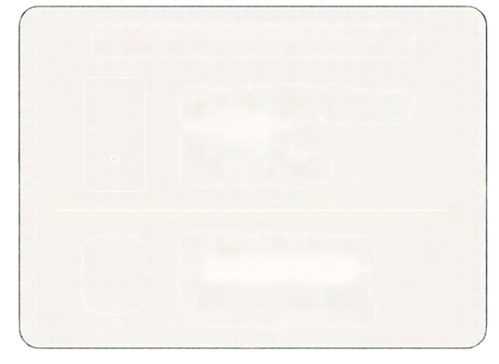















System and Network Architecture
Three physical computers communicating over a private network
NETWORK INFORMATION
Server address
PHYSICAL SERVER COMPUTER
[INSERT SERVER PRIVATE IPV4]
Flask HTTP Server
Server port
Port: 8000
Protocol: HTTP
8000
Protocol
HTTP
Request
HTTP
Request
HTTP
SQLite Database
Centralized storage
Shared by all clients
Network
HTTP
Response
HTTP
Response
[INSERT PRIVATE LAN NAME OR DESCRIPTION]
CLIENT COMPUTER 1
CLIENT COMPUTER 2
Browser
PRIVATE LAN NETWORK
Browser
Athlete 1
Athlete 2
Both clients communicate with the same backend,
so data created by one player can be discovered by another player.

Slide 3
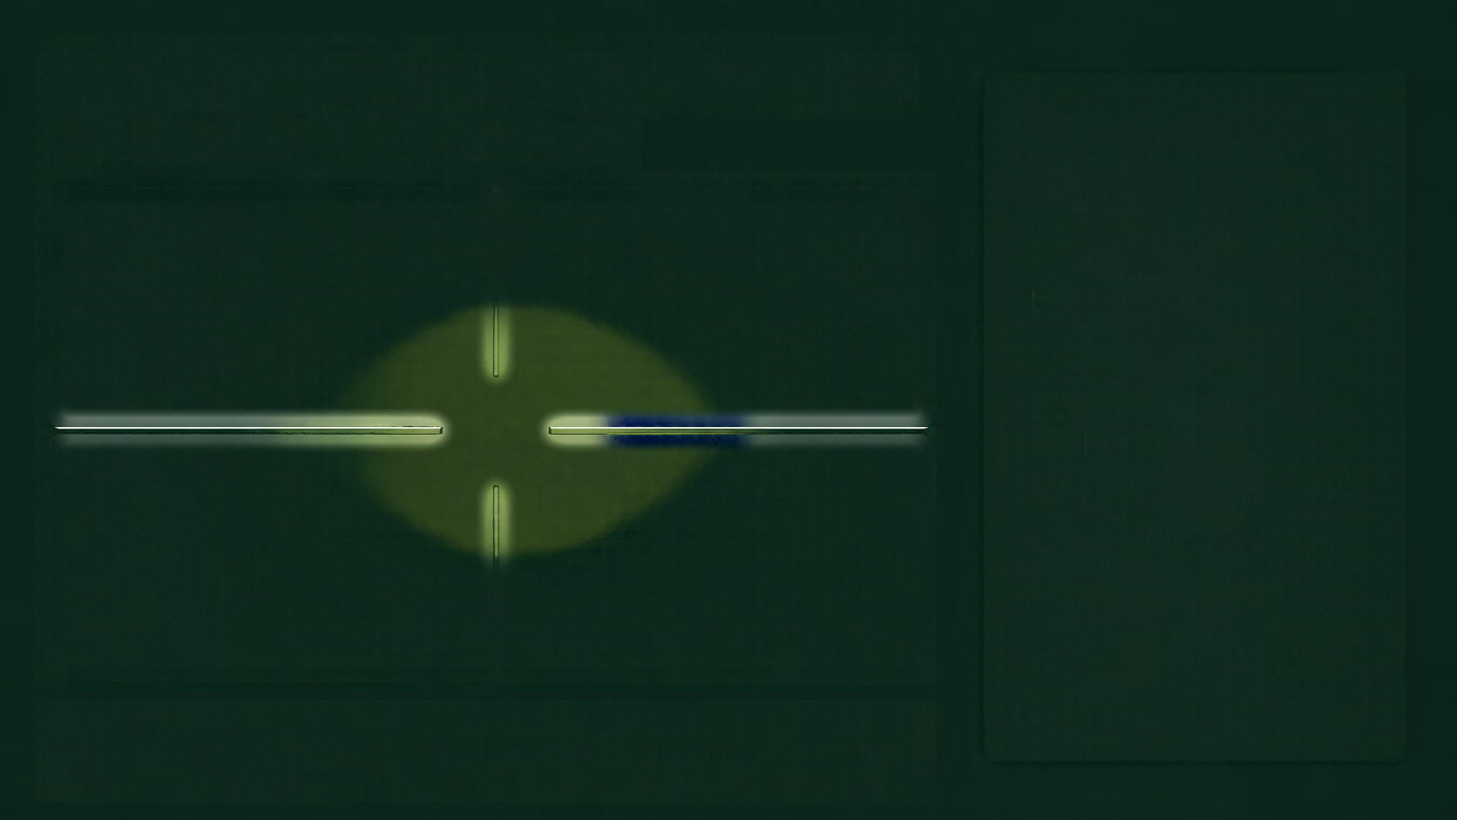






























Application Implementation
Core components of the Padeli Hyeti system
Project File Structure (Example)
padeli_hyeti/
app/
Frontend
Backend
_init_.py
routes.py
HTML5, CSS3, Jinja templates
Minimal JavaScript
Browser-based interaction
Python 3, Flask
Session authentication
JSON API endpoints
Server-side validation
templates/
base.html
index.html
login.html
static/
css/
Database
Security
style.css
js/
SQLite
Persistent storage
Foreign keys
Unique constraints
Parametrized SQL queries
Werkzeug password hashing
Passwords never stored in plaintext
CSRF protection
HTTP-only session cookies
Private profile information protected
main.js
database/
database.py
padeli_hyeti.db
utils/
auth.py
run.py
Basic security suitable for controlled university demonstration, not production-grade.

Slide 4
03 / THE SHARED RECORD
Game 5, in one glance.
The same row is created by Client 1 and read by Client 2.
GAME 5
game
WHERE
WHEN
LEVEL
PLAYERS
padel megrine
2026-10-22 • 14:00
Intermediate
2 / 4 after join
SQLite stores this once on the server.
PADELI HYETI / COMPUTER NETWORKS
04

Slide 5
04 / CREATE
Client 1 creates the game.
Request on the left. Response on the right.
REQUEST
RESPONSE
POST /api/games
201 Created
192.168.54.66
→ 192.168.54.6:8000
→
game id: 5
title • location • date • time
required_level • max_players
Organizer becomes
participant #1
PADELI HYETI / COMPUTER NETWORKS
05

Slide 6
05 / JOIN
Client 2 joins the same game.
Request on the left. Response on the right.
REQUEST
RESPONSE
POST /api/games/5/join
200 OK
192.168.53.7
→ 192.168.54.6:8000
→
participant_count: 2
body: {}
The join is visible
from both browsers.
PADELI HYETI / COMPUTER NETWORKS
06

Slide 7
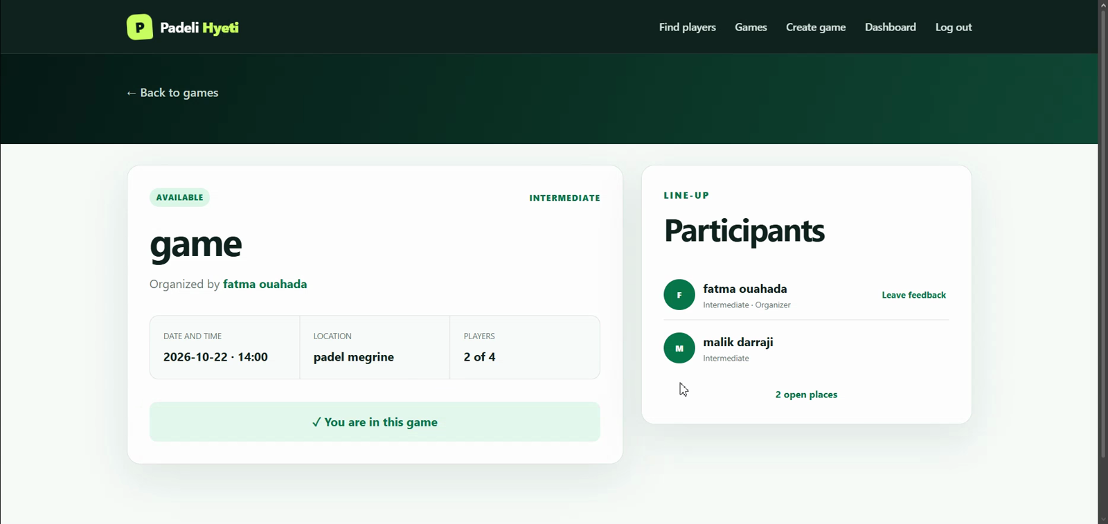
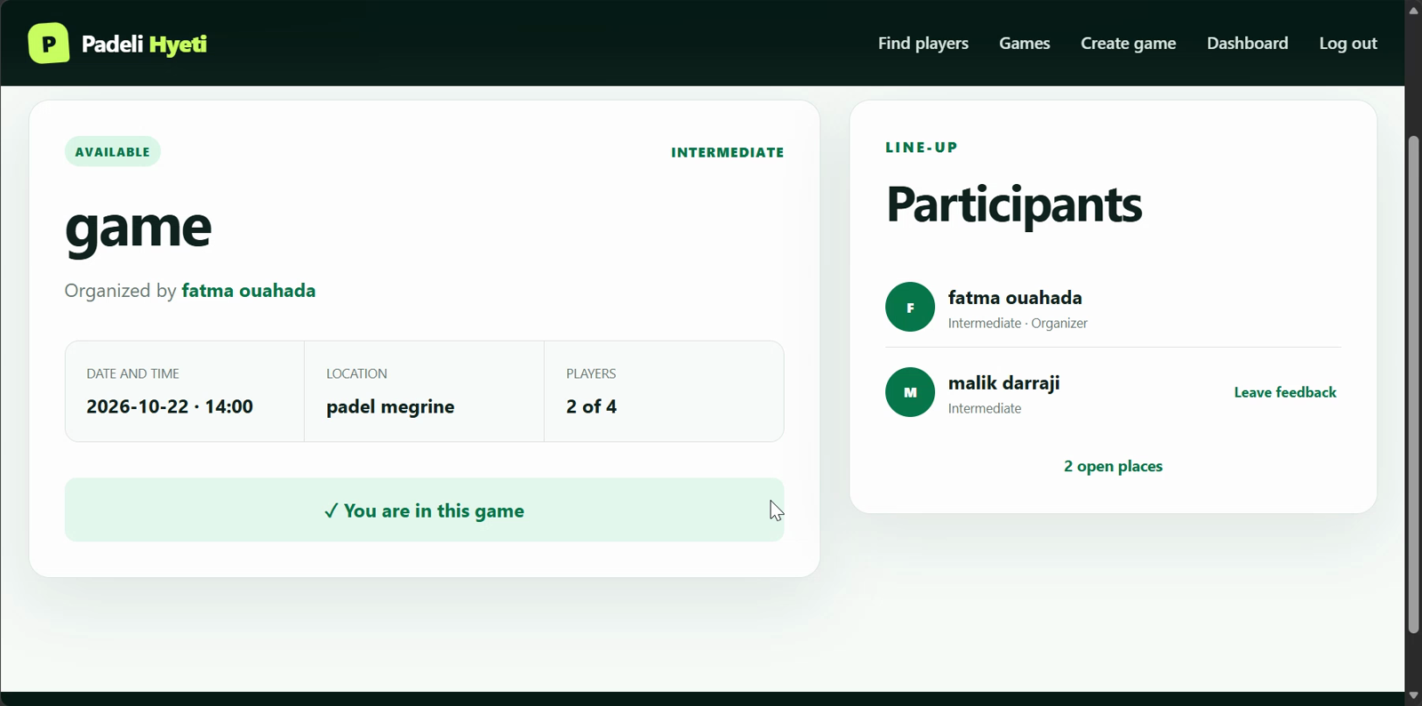
06 / TWO CLIENTS
One shared game, shown twice.
Click a green play label during the presentation to open the trimmed recording.
CLIENT 1 / CREATED + REFRESHED
CLIENT 2 / FOUND + JOINED
Participant list: 2 of 4
▶ PLAY CLIENT 1 CLIP
Join confirmation is visible
▶ PLAY CLIENT 2 CLIPS
PADELI HYETI / COMPUTER NETWORKS
08

Slide 8
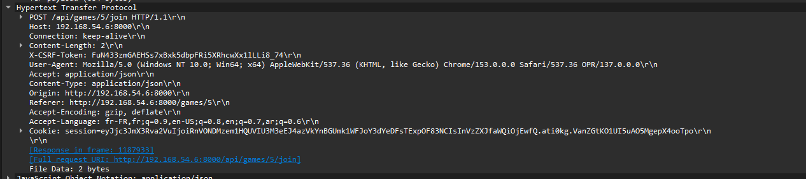
07 / WIRESHARK + BONUSES
Find one request. Read one response.
The screenshot is the real join packet; the filter makes it easy to isolate.
FILTER
tcp.port == 8000
REQUEST
POST /api/games/5/join
Client 2 → Server
RESPONSE
Real PCAP: wiresharkpresentation.pcapng
200 OK
frame 1187933
QUERY bonus: curl.exe -X QUERY /api/query?resource=games
MITM note: passive HTTP capture only; use HTTPS for real credentials.
PADELI HYETI / COMPUTER NETWORKS
09

