Slide 1

OOP COURSE PROJECT
Betul Vera Cengiz
EDIfuc-23
20232212

Slide 2
CONTEXT PAGE
1- Introduction
2- Body/Analysis
3- Results and Summary

Slide 3
1- Introduction
a) What is my application and description?
My application is a Snake Game implemented using Python and Pygame. It features classic snake gameplay where the player controls a snake to collect food, grow in size, and avoid collisions with walls and itself.
The topic covers game development, specifically focusing on the implementation of the classic Snake Game and enhancing it with modern features such as saving and loading game states.

Slide 4
b) How to run the program?
To run the program, ensure you have Python and Pygame installed on your system.
Execute the snake_game.py file by running the command python snake_game.py in your terminal or command prompt.
c. How to use the program?
Use the arrow keys on your keyboard to control the direction of the snake.
Avoid colliding with the walls and the snake's own body to keep playing and increase your score by collecting food.

Slide 5
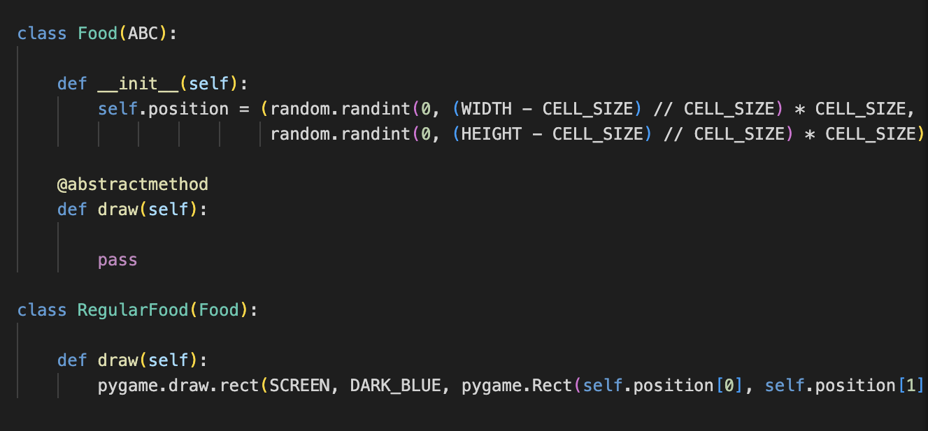
2- Body/Analysis: Object-Oriented Programming Pillars
a) Polymorphism
Polymorphism refers to the use of the same function name, but with different versions, for multiple types.
Polymorphism is obvious in my game where different game objects (Snake, Food) implement the same methods defined in their abstract superclass.

Slide 6
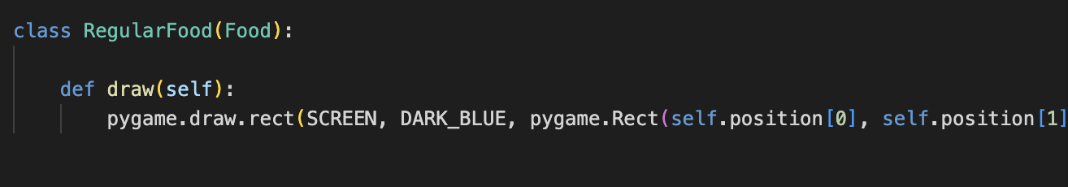
b) Inheritance
Inheritance is a mechanism where a new class is derived from an existing class. The new class, known as the child or subclass, inherits attributes and methods from the parent or superclass. Attributes and methots goes to the next class.
In my Snake Game, inheritance can be used to create different types of game objects by inheriting from a common base class.

Slide 7
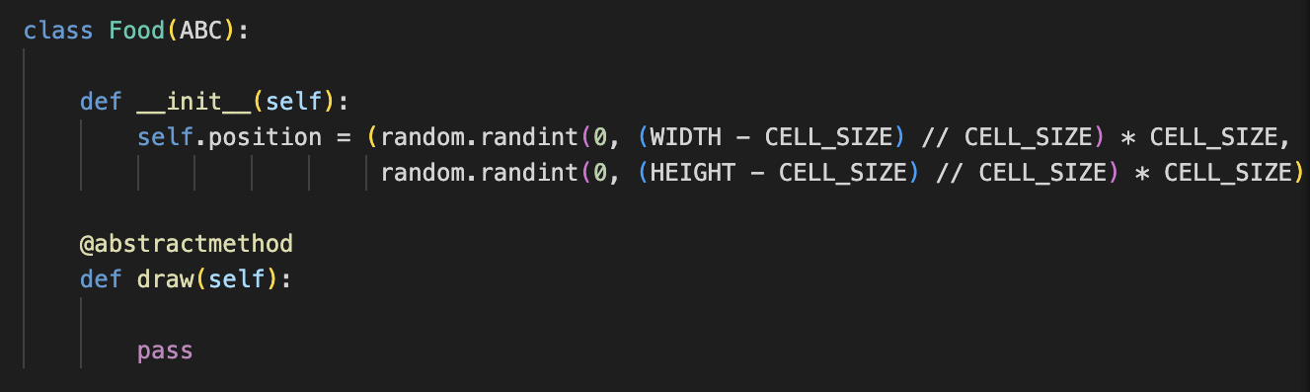
c) Abstraction
Abstraction involves hiding the complex implementation details and showing only the necessary features of an object. It helps in reducing programming complexity and effort. Abstract class that hides the details of food creation and drawing, allowing subclasses to define specific behaviors.
We have an abstract class Food that inherits from ABC (Abstract Base Class). This class contains an abstract method draw, declared using the @abstractmethod
@abstractmethod

Slide 8
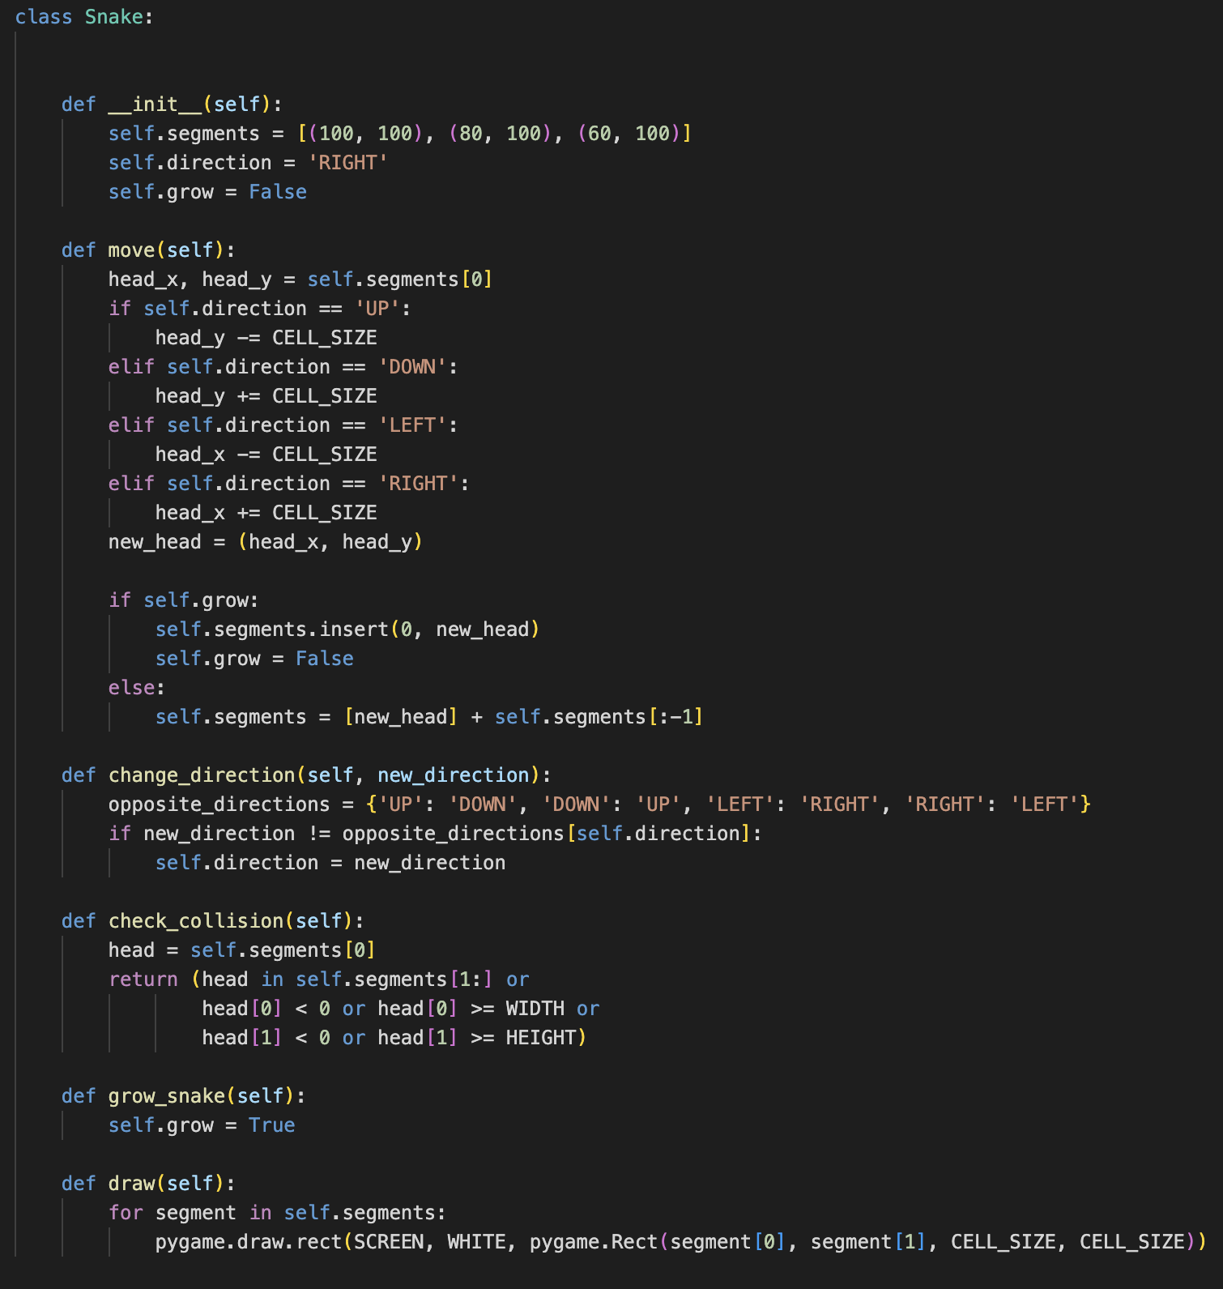
d) Encapsulation
Encapsulation allows you to define controlled access to data stored inside objects of your class. This allows you to write clean, readable, and efficient code and prevent accidental changes or deletion of your class data.
In my Snake Game, encapsulation is used to define the properties and behaviors of the Snake, Food, and Game classes. These classes encapsulate their respective attributes and methods.

Slide 9
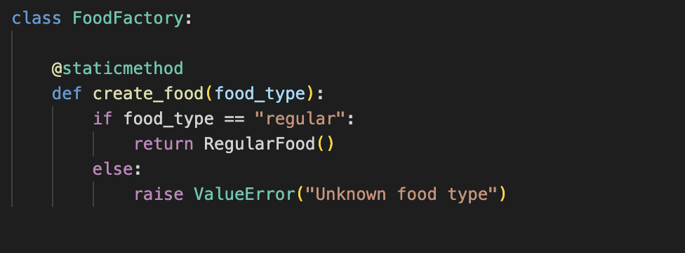
Design Patterns
1- Factory Method Pattern
The Factory Method Pattern defines an interface for creating an object, but lets subclasses alter the type of objects that will be created. Factory pattern allow the creation of objects without specifying the exact class of object that will be created, promoting loose coupling and scalability in code.
This pattern can be used to create different types of game objects without specifying the exact class of the object that will be created.
@staticmethod
The Factory Method Pattern allows the game to create different types of food dynamically based on the specified type. This approach is flexible and easy to extend, making it suitable for scenarios where different types of objects with varying behaviors are needed.

Slide 10
2- Singleton Pattern
The Singleton Pattern ensures that a class has only one instance and provides a single point of access to it.
The Game class can be implemented as a singleton to ensure there is only one game state being managed at any given time.
class Game is a whole example for singleton pattern.
The Singleton Pattern is suitable here to ensure there is only one game state, preventing conflicts and inconsistencies in the game logic.

Slide 11
3- Results and Summary
To see “Results” functional requirement:
I could evaluate the performance of your game based on various metrics such as user engagement, gameplay statistics, and user feedback.
Analyzing how well the game meets its objectives and whether it provides an enjoyable gaming experience. Additionally, consider any bugs or issues encountered during testing and how they were resolved.
How it would be possible to extend my application?
I could add Additional Features like different game mode. Improved Graphics and Sound, Customization Options to each player.

