Slide 1





Introduction to
Parallel and Distributed Programming
CS7
Multi-core Programming - OpenMP
Sachin D N

Slide 2
Agenda
Lab 4
Writing programs that use OpenMP.
Using OpenMP to parallelize many serial for loops with only small changes to the source code.
Task parallelism.
Explicit thread synchronization.
Standard problems in shared-memory programming.

Slide 3
Lab 4
Lab 4: Converting a sequential program to a multi-threaded version
Use openMP to improve Lab 2 code on slave nodes, compare pthreads and openMP code performance. implement mutex and deadlock prevention

Slide 4
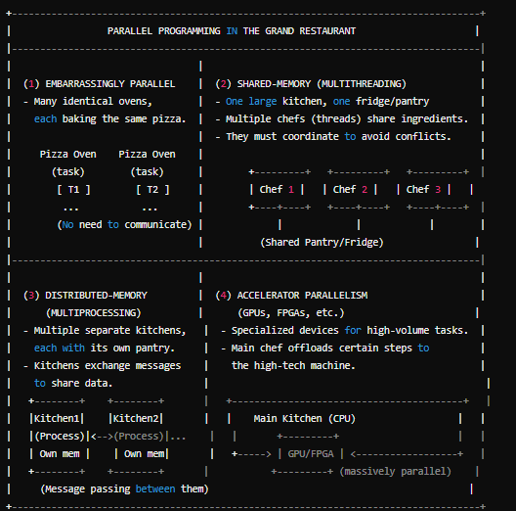

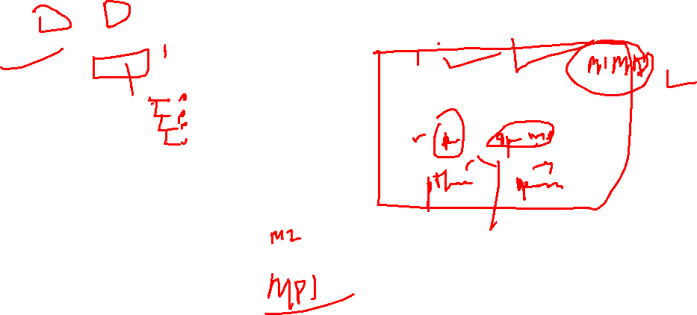

Slide 5


MPI vs OpenMP
MPI | OpenMP
Available from different vendors and gets compiled on Windows, macOS, and Linux operating systems.. | An add-on in a compiler such as a GNU compiler and Intel compiler.
Supports parallel computation for distributed-memory and shared-memory systems. | Supports parallel computation for shared- memory systems only.
A process-based parallelism. | A thread-based parallelism.
With MPI, each process has its own memory space and executes independently from the other processes. | With OpenMP, threads share the same resources and access shared memory.
Processes exchange data by passing messages to each other. | There is no notion of message-passing. Threads access shared memory.
Process creation overhead occurs one time. | It depends on the implementation. More overhead can occur when creating threads to join a task.

Slide 6
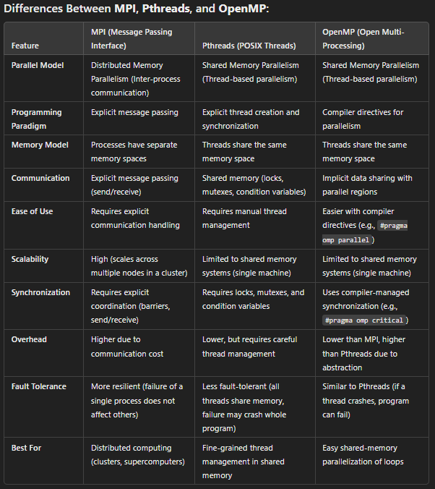

Slide 7
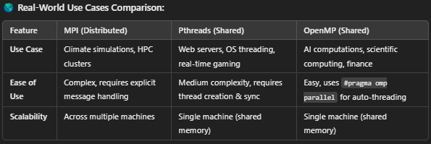
Introduction to OpenMP vs. MPI & Pthreads
MPI (Message Passing Interface): Used for distributed-memory parallelism across multiple nodes. Processes communicate via explicit message passing.
Pthreads (POSIX Threads): Shared-memory programming API that requires explicit thread management (thread creation, synchronization).
OpenMP (Open Multi-Processing): Shared-memory API using compiler directives for easy loop parallelization and automatic thread management.

Slide 8
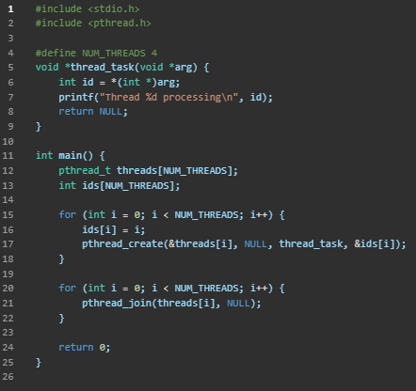
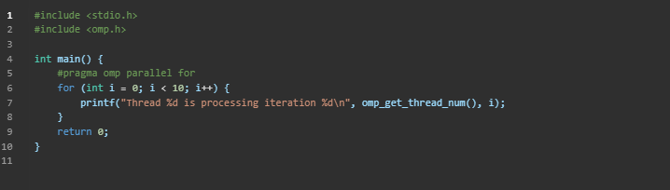
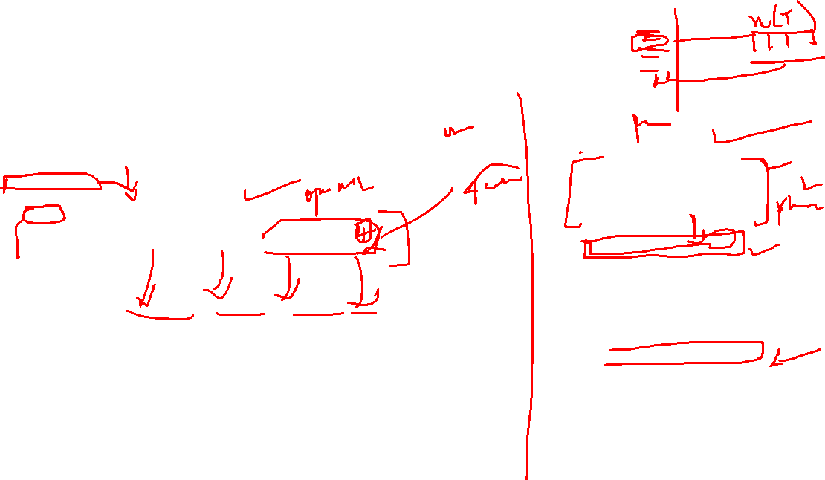
OpenMP in Action – Loop Parallelization
OpenMP allows easy incremental parallelization of serial programs.
Uses compiler directives, reducing developer effort compared to Pthreads.
Parallelizing a loop in C using OpenMP vs. Pthreads:
OpenMP Example (Easy Parallelization)
Equivalent Pthreads Code (More Manual Effort)

Slide 9

OpenMP vs. MPI & Pthreads
Shared-Memory vs. Distributed Memory:
OpenMP and Pthreads use shared memory, where all threads access the same address space.
MPI, on the other hand, is for distributed memory systems, where processes communicate via message passing.
Ease of Use – Compiler Directives vs. Explicit Threading:
OpenMP simplifies parallel programming by using compiler directives (e.g., #pragma omp parallel).
Pthreads requires manual thread management, including creation, synchronization, and explicit workload distribution.
Parallelization of Existing Code:
OpenMP allows incremental parallelization of existing serial programs with minimal modifications.
Pthreads and MPI require explicitly writing parallel code from scratch.
Hardware & Compiler Dependency:
OpenMP requires compiler support for parallel execution (e.g., GCC, Intel, Clang).
Pthreads is a library-based approach that works with any C compiler supporting the Pthreads library.
Thread Management & Control:
Pthreads provides low-level control over thread creation, scheduling, and synchronization.
OpenMP delegates these decisions to the compiler and runtime system, making it easier but less flexible for complex thread interactions.

Slide 10
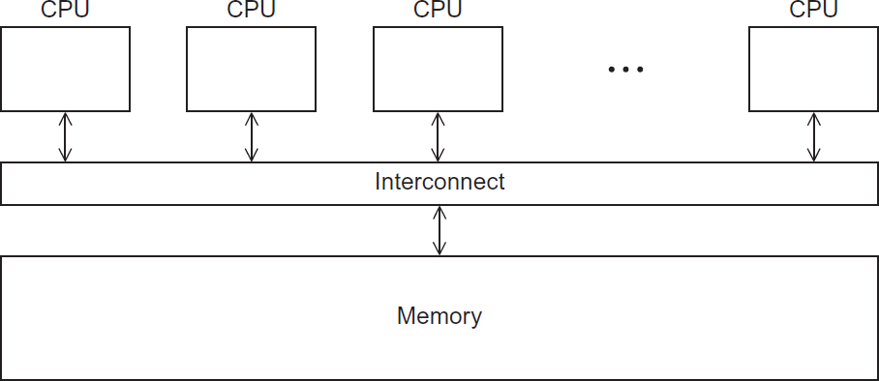

A shared memory system

Slide 11
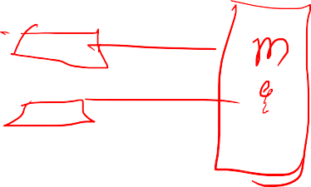
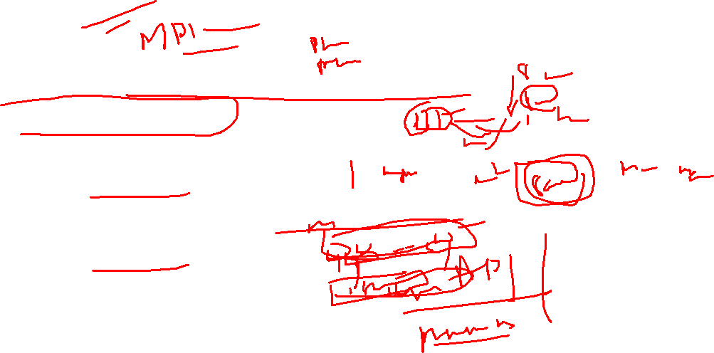
OpenMP
An API for shared-memory parallel programming.
MP = multiprocessing
Designed for systems in which each thread or process can potentially have access to all available memory.
System is viewed as a collection of cores or CPU’s, all of which have access to main memory.

Slide 12
Pragmas
Special preprocessor instructions.
Typically added to a system to allow behaviors that aren’t part of the basic C specification.
Compilers that don’t support the pragmas ignore them.
#pragma

Slide 13
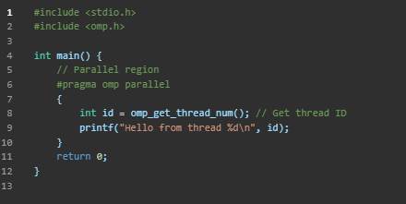
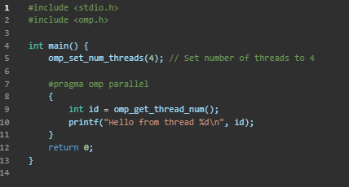

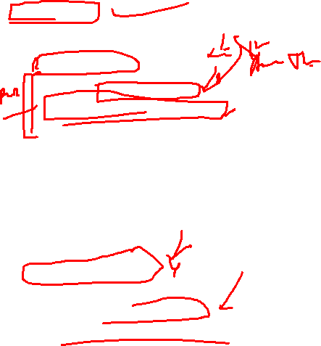
Writing Your First OpenMP Program
gcc -fopenmp hello.c -o hello
./hello
Hello from thread 0
Hello from thread 1
Hello from thread 2
Hello from thread 3
...
Controlling Number of Threads

Slide 14
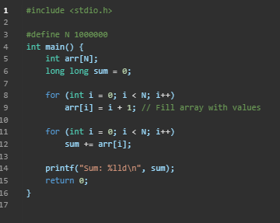
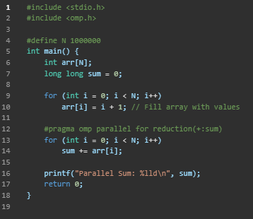
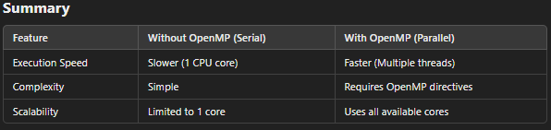
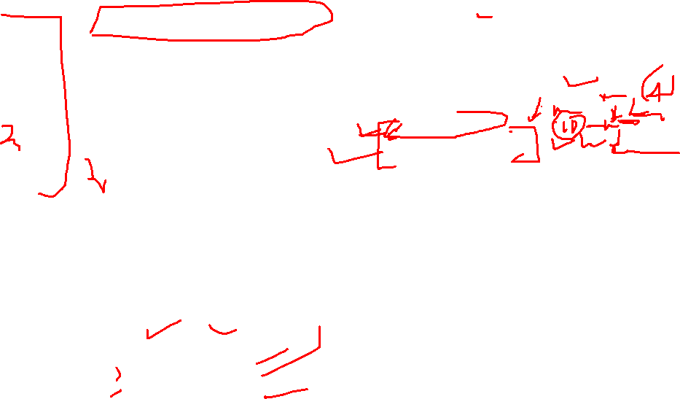
Real-World Use Case: Summing an Array Using OpenMP
gcc -fopenmp sum.c -o sum
./sum
Parallel Sum: 500000500000
Serial Version (Without OpenMP)
Parallel Version Using OpenMP
Problem: The loop runs sequentially, making it slow for large arrays.
Explanation:
#pragma omp parallel for → Tells OpenMP to parallelize the loop.
reduction(+:sum) → Ensures all threads safely add to sum.

Slide 15

OpenMp pragmas
# pragma omp parallel
Most basic parallel directive.
The number of threads that run
the following structured block of code is determined by the run-time system.

Slide 16
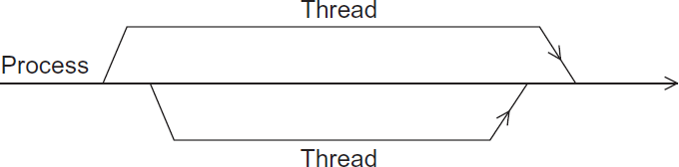

A process forking and joining two threads

Slide 17


clause
Text that modifies a directive.
The num_threads clause can be added to a parallel directive.
It allows the programmer to specify the number of threads that should execute the following block.
# pragma omp parallel num_threads ( thread_count )

Slide 18
Of note…
There may be system-defined limitations on the number of threads that a program can start.
The OpenMP standard doesn’t guarantee that this will actually start thread_count threads.
Most current systems can start hundreds or even thousands of threads.
Unless we’re trying to start a lot of threads, we will almost always get the desired number of threads.

Slide 19


Some terminology
In OpenMP parlance the collection of threads executing the parallel block — the original thread and the new threads — is called a team, the original thread is called the master, and the additional threads are called slaves.

Slide 20
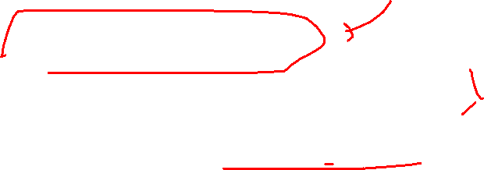
In case the compiler doesn’t support OpenMP
# include <omp.h>
#ifdef _OPENMP # include <omp.h> #endif

Slide 21

In case the compiler doesn’t support OpenMP
# ifdef _OPENMP
int my_rank = omp_get_thread_num ( );
int thread_count = omp_get_num_threads ( ); # else
int my_rank = 0;
int thread_count = 1; # endif

Slide 22
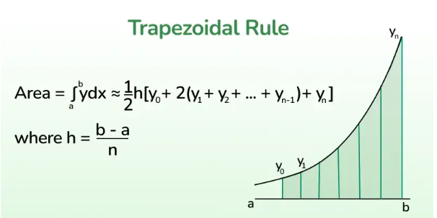

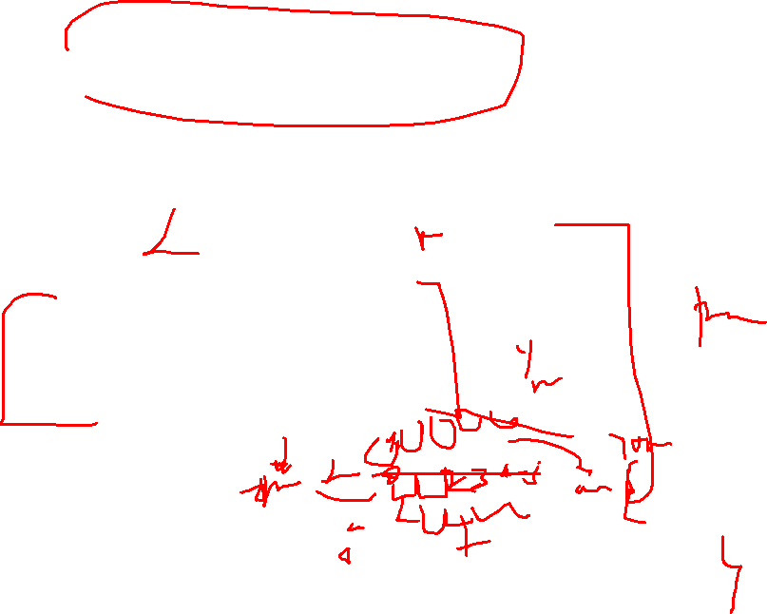
The Trapezoidal Rule

Slide 23
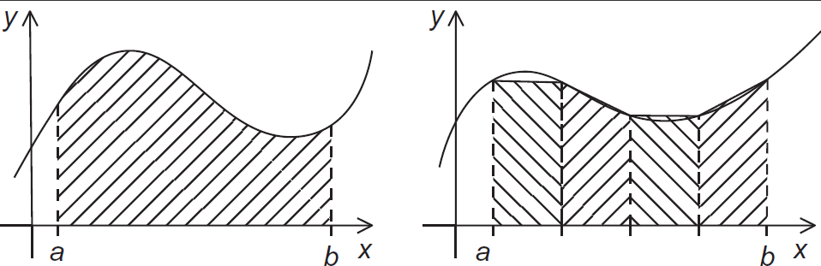
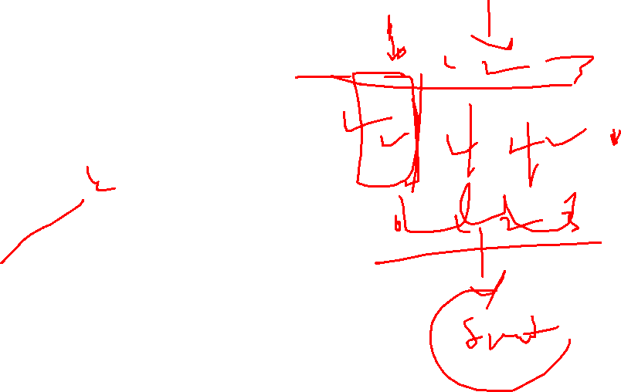
The trapezoidal rule

Slide 24
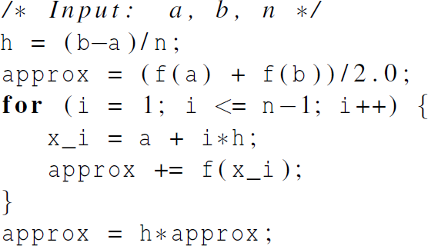

Serial algorithm

Slide 25

A First OpenMP Version
1) We identified two types of tasks:
a) computation of the areas of individual trapezoids, and
b) adding the areas of trapezoids.
2) There is no communication among the tasks in the first collection, but each task in the first collection communicates with task 1b.

Slide 26
A First OpenMP Version
3) We assumed that there would be many more trapezoids than cores.
So we aggregated tasks by assigning a contiguous block of trapezoids to each thread (and a single thread to each core).

Slide 27
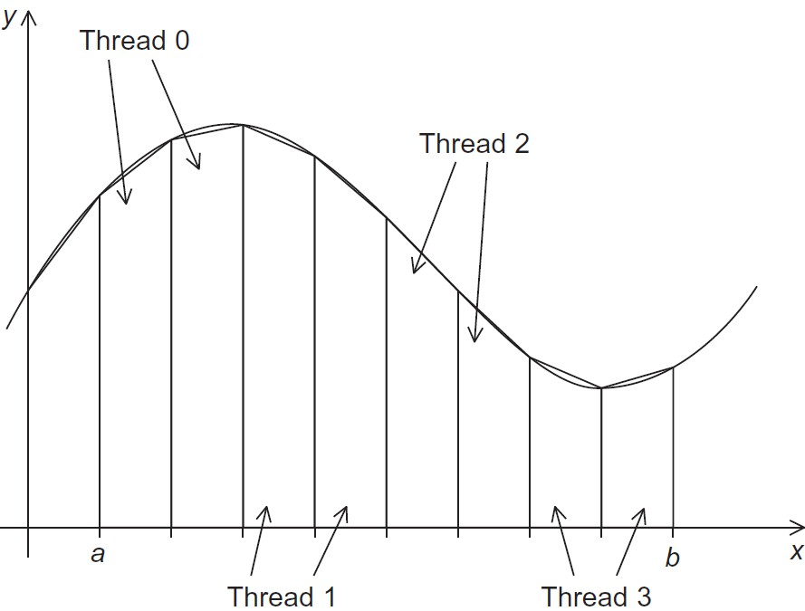

Assignment of trapezoids to threads

Slide 28
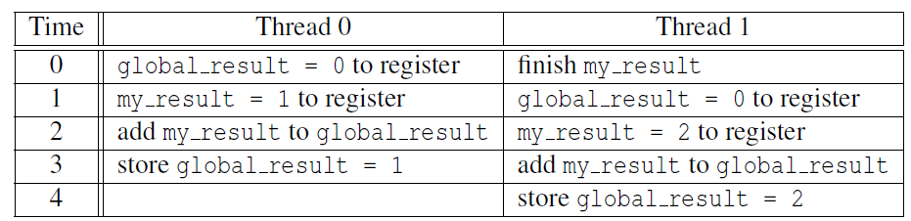


Unpredictable results when two (or more) threads attempt to simultaneously execute:
global_result += my_result ;

Slide 29
Mutual exclusion
# pragma omp critical
global_result += my_result ;
only one thread can execute
the following structured block at a time

Slide 30
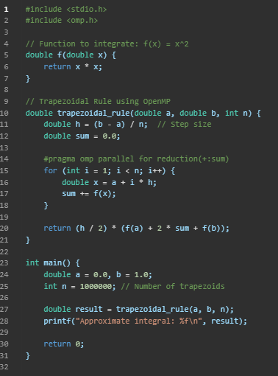

The function f(x) = x^2 is defined.
trapezoidal_rule() calculates the integral:
The interval [a,b][a, b][a,b] is divided into n subintervals.
OpenMP is used with #pragma omp parallel for reduction(+:sum) to parallelize the summation step.
The main() function calls trapezoidal_rule() and prints the result.

Slide 31
Why OpenMP?
OpenMP allows parallel execution across multiple CPU cores.
The reduction(+:sum) ensures that multiple threads safely update sum without conflicts.
This improves performance for large n.

Slide 32

Scope of Variables
In serial programming, the scope of a variable consists of those parts of a program in which the variable can be used.
In OpenMP, the scope of a variable refers to the set of threads that can access the variable in a parallel block.

Slide 33


Scope in OpenMP
A variable that can be accessed by all the threads in the team has shared scope.
A variable that can only be accessed by a single thread has private scope.
The default scope for variables declared before a parallel block is shared.

Slide 34

The Reduction Clause
We need this more complex version to add each thread’s local calculation to get global_result.
Although we’d prefer this.

Slide 35
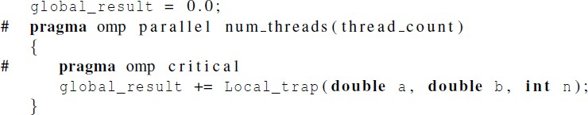
If we use this, there’s no critical section!
If we fix it like this…
… we force the threads to execute sequentially.

Slide 36


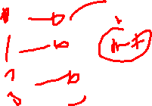
We can avoid this problem
by declaring a private variable inside the parallel block and moving the critical section after the function call.

Slide 37

Reduction operators
A reduction operator is a binary operation (such as addition or multiplication).
A reduction is a computation that repeatedly applies the same reduction operator to a sequence of operands in order to get a single result.
All of the intermediate results of the operation should be stored in the same variable: the reduction variable.

Slide 38


A reduction clause can be added to a parallel directive.
+, *, -, &, |, ˆ, &&, ||

Slide 39
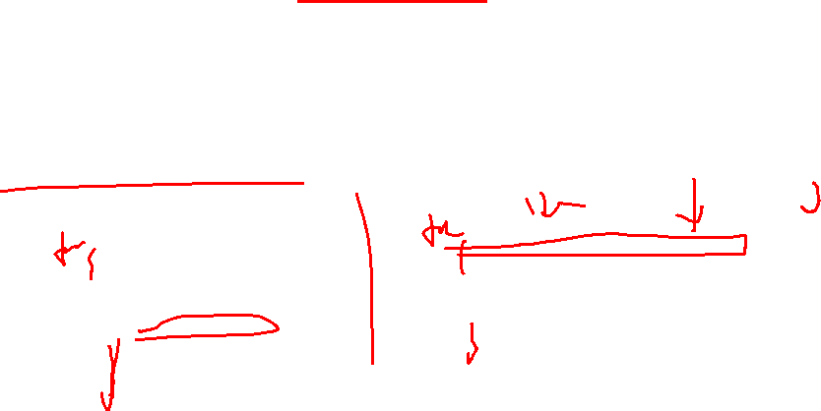
The “Parallel For” Directive
Forks a team of threads to execute the following structured block.
However, the structured block following the parallel for directive must be a for loop.
Furthermore, with the parallel for directive the system parallelizes the for loop by dividing the iterations of the loop among the threads.

Slide 40
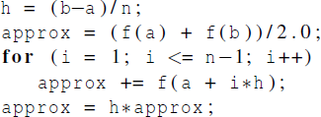
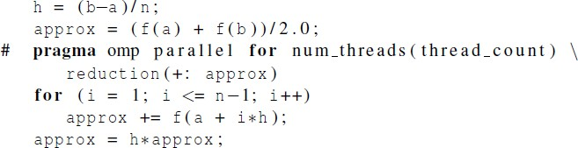

Slide 41
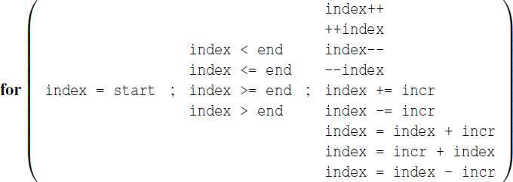

Legal forms for parallelizable for statements
the legal forms of for loops that can be safely parallelized using tools like OpenMP. When a loop is parallelized, different iterations of the loop can run at the same time. However, for this to work correctly, the loop must follow specific rules:

Slide 42
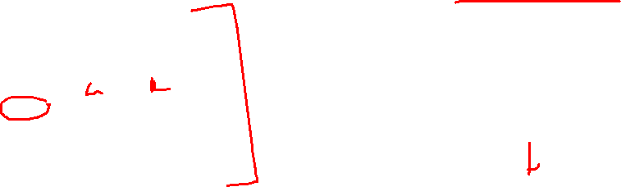
2. Condition:
The loop's condition must use the index in a simple comparison, like:
1. Initialization:
index = start;
index < end
index <= end
index >= end
index > end
int i;
for (i = 0; i < 10; i++) {
// Do something
}
for (i = 0; i < 100; i++) {
// Valid for parallelization
}

Slide 43

3. Increment/Decrement:
index++ // Increase by 1
++index // Increase by 1
index-- // Decrease by 1
--index // Decrease by 1
index += incr // Increase by a set amount
index -= incr // Decrease by a set amount
index = index + incr // Same as above
index = incr + index // Same as above
index = index - incr // Decrease by a set amount
For a loop to be parallelizable:
The loop index should change in a predictable way.
The loop's start, end, and step should be clearly defined.
If these conditions are met, OpenMP and similar tools can safely split the work across multiple threads, improving performance.
for (i = 0; i <= 50; i += 5) {
// Valid for parallelization
}

Slide 44

Caveats
The variable index must have integer or pointer type (e.g., it can’t be a float).
The expressions start, end, and incr must have a compatible type. For example, if index is a pointer, then incr must have integer type.

Slide 45
Caveats
The expressions start, end, and incr must not change during execution of the loop.
During execution of the loop, the variable index can only be modified by the
“increment expression” in the for statement.

Slide 46

Data dependencies
fibo[ 0 ] = fibo[ 1 ] = 1;
for (i = 2; i < n; i++)
fibo[ i ] = fibo[ i – 1 ] + fibo[ i – 2 ];
note 2 threads
fibo[ 0 ] = fibo[ 1 ] = 1;
# pragma omp parallel for num_threads(2)
for (i = 2; i < n; i++)
fibo[ i ] = fibo[ i – 1 ] + fibo[ i – 2 ];
but sometimes
we get this
1 1 2 3 5 8 13 21 34 55
this is correct
1 1 2 3 5 8 0 0 0 0

Slide 47

What happened?
OpenMP compilers don’t check for dependences among iterations in a loop that’s being parallelized with a parallel for directive.
A loop in which the results of one or more iterations depend on other iterations cannot, in general, be correctly parallelized by OpenMP.

Slide 48

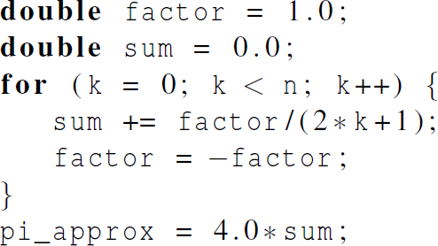

Estimating π

Slide 49
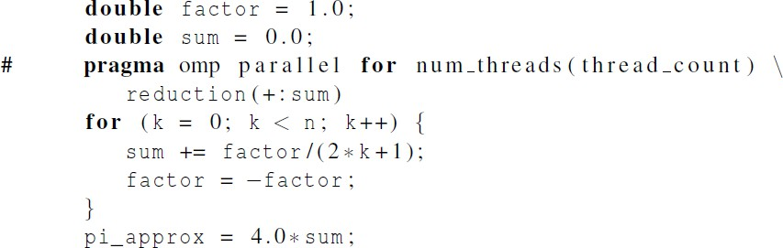
OpenMP solution #1
loop dependency

Slide 50
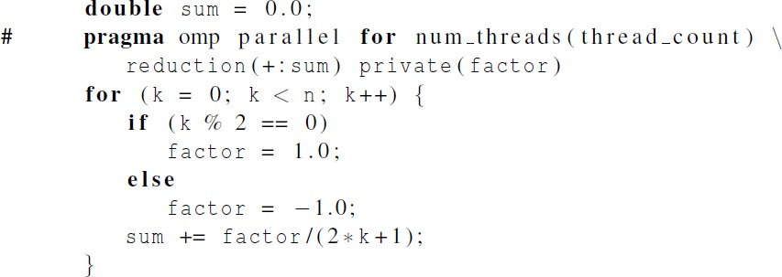

OpenMP solution #2
Insures factor has
private scope.

Slide 51
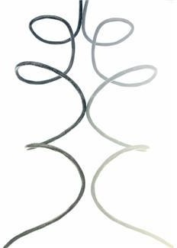
More About Loops in OpenMP: Sorting

Slide 52
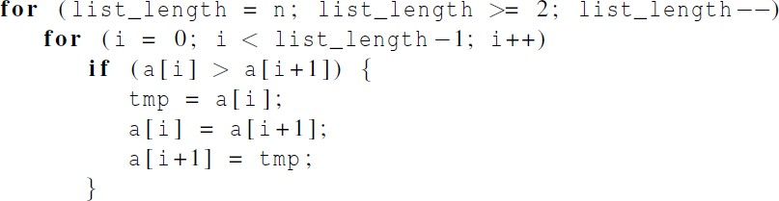

Bubble Sort

Slide 53
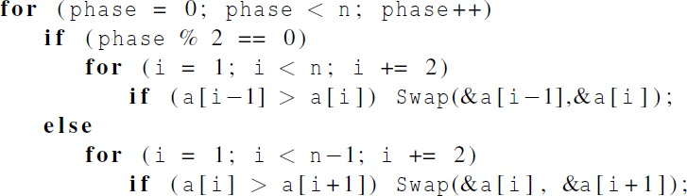
Serial Odd-Even Transposition Sort

Slide 54
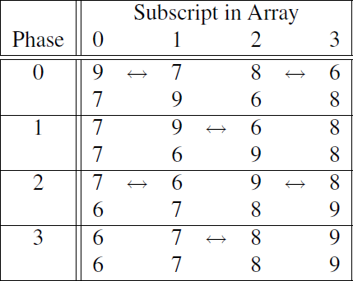
Serial Odd-Even Transposition Sort

Slide 55
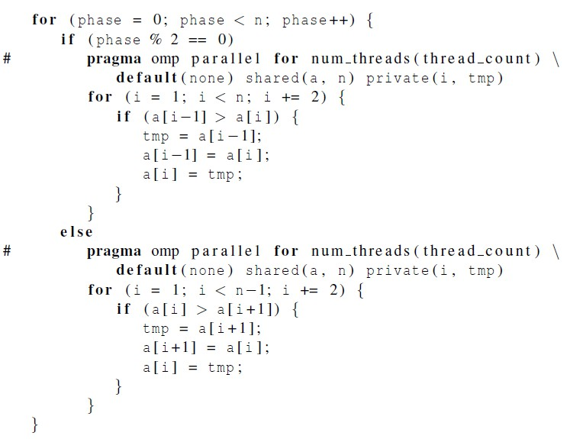
First OpenMP Odd-Even Sort

Slide 56
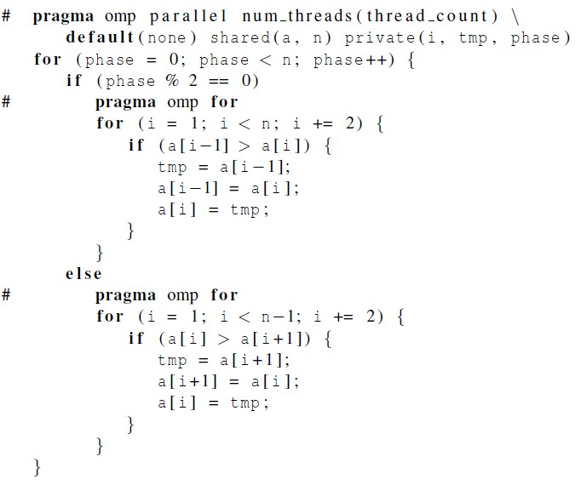
Second OpenMP Odd-Even Sort

Slide 57
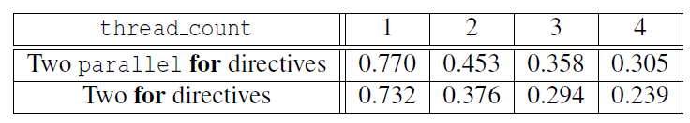

Odd-even sort with two parallel for directives and two for directives. (Times are in seconds.)

Slide 58

Scheduling Loops

Slide 59

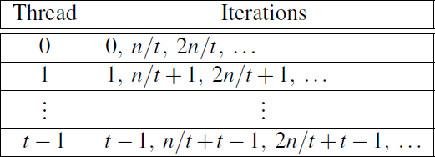

We want to parallelize this loop.
Assignment of work
using cyclic partitioning.

Slide 60
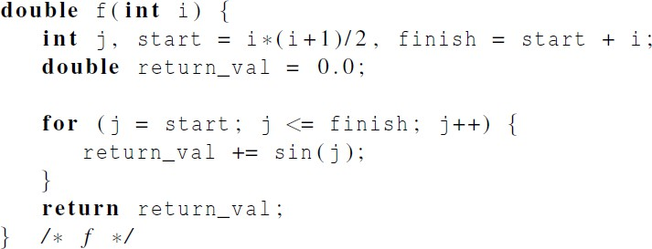
Our definition of function f.

Slide 61

Results
f(i) calls the sin function i times.
Assume the time to execute f(2i) requires approximately twice as much time as the time to execute f(i).
n = 10,000
one thread
run-time = 3.67 seconds.

Slide 62

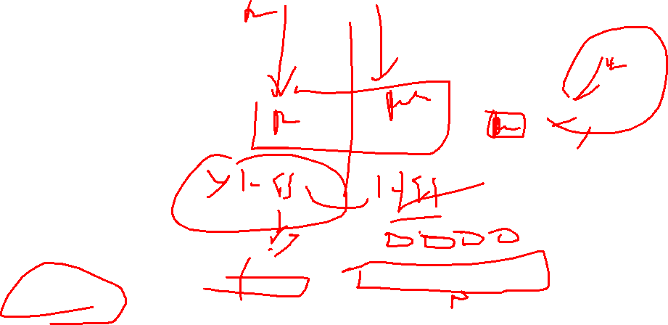
Results
n = 10,000
two threads
default assignment
run-time = 2.76 seconds
speedup = 1.33
n = 10,000
two threads
cyclic assignment
run-time = 1.84 seconds
speedup = 1.99

Slide 63
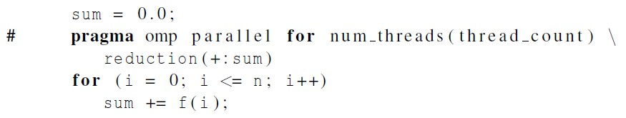
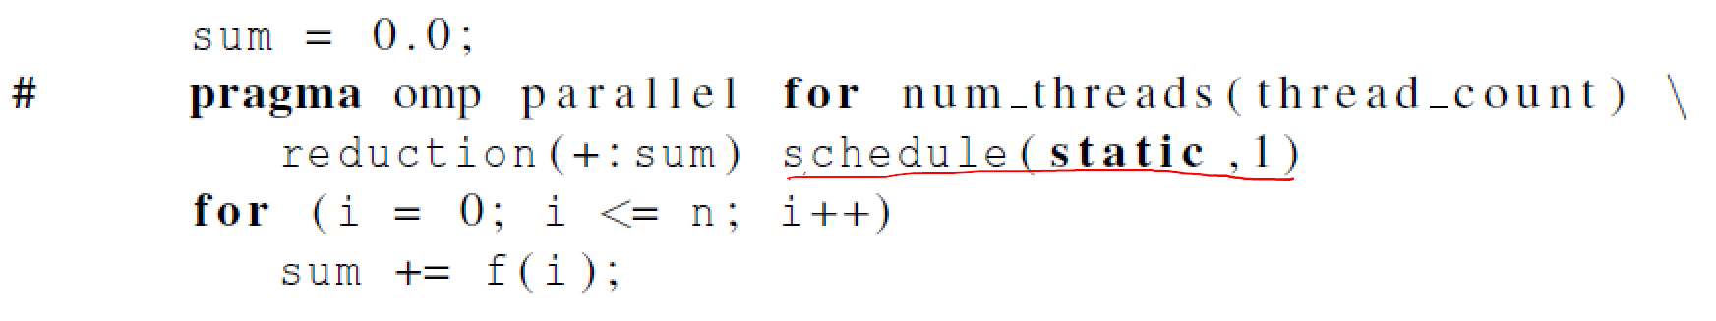

The Schedule Clause
Default schedule:
Cyclic schedule:

Slide 64

schedule ( type , chunksize )
Type can be:
static: the iterations can be assigned to the threads before the loop is executed.
dynamic or guided: the iterations are assigned to the threads while the loop is executing.
auto: the compiler and/or the run-time system determine the schedule.
runtime: the schedule is determined at run-time.
The chunksize is a positive integer.

Slide 65

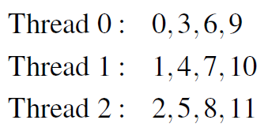

The Static Schedule Type
twelve iterations, 0, 1, . . . , 11, and three threads

Slide 66


The Static Schedule Type
twelve iterations, 0, 1, . . . , 11, and three threads

Slide 67

The Static Schedule Type
twelve iterations, 0, 1, . . . , 11, and three threads

Slide 68
The Dynamic Schedule Type
The iterations are also broken up into chunks of chunksize consecutive iterations.
Each thread executes a chunk, and when a thread finishes a chunk, it requests another one from the run-time system.
This continues until all the iterations are completed.
The chunksize can be omitted. When it is omitted, a chunksize of 1 is used.

Slide 69


The Guided Schedule Type
Each thread also executes a chunk, and when a thread finishes a chunk, it requests another one.
However, in a guided schedule, as chunks are completed the size of the new chunks decreases.
If no chunksize is specified, the size of the chunks decreases down to 1.
If chunksize is specified, it decreases down to chunksize, with the exception that the very last chunk can be smaller than chunksize.

Slide 70


Assignment of trapezoidal rule iterations 1–9999 using a guided schedule with two threads.

Slide 71
The Runtime Schedule Type
The system uses the environment variable OMP_SCHEDULE to determine at run-time how to schedule the loop.
The OMP_SCHEDULE environment variable can take on any of the values that can be used for a static, dynamic, or guided schedule.

Slide 72


Producers and Consumers

Slide 73
Queues
Can be viewed as an abstraction of a line of customers waiting to pay for their groceries in a supermarket.
A natural data structure to use in many multithreaded applications.
For example, suppose we have several “producer” threads and several “consumer” threads.
Producer threads might “produce” requests for data.
Consumer threads might “consume” the request by finding or generating the requested data.

Slide 74

Message-Passing
Each thread could have a shared message queue, and when one thread wants to “send a message” to another thread, it could enqueue the message in the destination thread’s queue.
A thread could receive a message by dequeuing the message at the head of
its message queue.

Slide 75


Message-Passing

Slide 76


Sending Messages

Slide 77


Receiving Messages

Slide 78

Termination Detection
each thread increments this after completing its for loop

Slide 79

Startup (1)
When the program begins execution, a single thread, the master thread, will get command line arguments and allocate an array of message queues: one for each thread.
This array needs to be shared among the threads, since any thread can send to any other thread, and hence any thread can enqueue a message in any of the queues.

Slide 80

Startup (2)
One or more threads may finish allocating their queues before some other threads.
We need an explicit barrier so that when a thread encounters the barrier, it blocks until all the threads in the team have reached the barrier.
After all the threads have reached the barrier all the threads in the team can proceed.

Slide 81


The Atomic Directive (1)
Unlike the critical directive, it can only protect critical sections that consist of a single C assignment statement.
Further, the statement must have one of the following forms:

Slide 82
The Atomic Directive (2)
Here <op> can be one of the binary operators
Many processors provide a special load-modify-store instruction.
A critical section that only does a load-modify-store can be protected much more efficiently by using this special instruction rather than the constructs that are used to protect more general critical sections.

Slide 83

Critical Sections
OpenMP provides the option of adding a name to a critical directive:
When we do this, two blocks protected with critical directives with different
names can be executed simultaneously.
However, the names are set during compilation, and we want a different critical section for each thread’s queue.

Slide 84


Locks
A lock consists of a data structure and functions that allow the programmer to explicitly enforce mutual exclusion in a critical section.

Slide 85


Locks

Slide 86



Using Locks in the Message-Passing Program

Slide 87


Using Locks in the Message-Passing Program

Slide 88
Some Caveats
You shouldn’t mix the different types of mutual exclusion for a single critical section.
There is no guarantee of fairness in mutual exclusion constructs.
It can be dangerous to “nest” mutual exclusion constructs.

Slide 89



Matrix-vector multiplication

Slide 90


Matrix-vector multiplication
Run-times and efficiencies
of matrix-vector multiplication (times are in seconds)

Slide 91

Thread-Safety

Slide 92
Concluding Remarks (1)
OpenMP is a standard for programming shared-memory systems.
OpenMP uses both special functions and preprocessor directives called pragmas.
OpenMP programs start multiple threads rather than multiple processes.
Many OpenMP directives can be modified by clauses.

Slide 93




Concluding Remarks (2)
A major problem in the development of shared memory programs is the possibility of race conditions.
OpenMP provides several mechanisms for insuring mutual exclusion in critical sections.
Critical directives
Named critical directives
Atomic directives
Simple locks

Slide 94
Concluding Remarks (3)
By default most systems use a block-partitioning of the iterations in a parallelized for loop.
OpenMP offers a variety of scheduling options.
In OpenMP the scope of a variable is the collection of threads to which the variable is accessible.

Slide 95
Concluding Remarks (4)
A reduction is a computation that repeatedly applies the same reduction operator to a sequence of operands in order to get a single result.

Slide 96
Thank you
Queries

