Slide 1

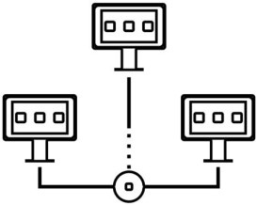

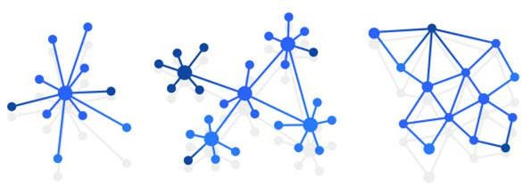

Introduction to
Parallel and Distributed Programming
CS2
Communication
Dr. Sachin D N

Slide 2
Agenda
Lab 1
IPC fundamentals
Sockets
Remote procedural call

Slide 3
Lab 1
Discover nodes and status to create a group/cluster
Set of nodes must discover other nodes and form a group that can communicate and track membership status and health when added to a cluster.
Assume a master-slave architecture and designate a master node to drive
this status collection and state maintenance. Slaves send heartbeats to their master. Why shouldn't the master initiate this? Helps with scale/fault tolerance.
Master collects resource status on slaves, current utilisation etc. Master
detects a slave crash and lets others know.
Demonstrate using multi-node communication to implement a simple cluster
management protocol for membership and health/resource status.
Use secures transport mechanisms (SSL), so nodes cannot impersonate. Use basic secure socket programming, RPC etc.
Slaves can crash and rejoin.

Slide 4
IPC Fundamentals
What is IPC?
Definition: IPC (Inter-Process Communication) refers to the mechanisms that allow processes to communicate and share data with each other.
Purpose: Enables processes to work together, share resources, and synchronize their actions.
Common IPC Methods:
Pipes: Used for communication between related processes (e.g., parent and child processes).
Message Queues: Allows processes to send and receive messages in a structured way.
Shared Memory: Enables processes to share a region of memory for faster communication.
Sockets: Used for communication over a network or between processes on different machines.

Slide 5
Why do processes communicate?
To share resources
Client/server paradigms
Inherently distributed applications
Reusable software components
Other good software engineering reasons

Slide 6
The Basic Concept of IPC
A process needs to send data to a receiving process
Sender wants to avoid details of receiver’s condition
Receiver wants to get the data in an organized way

Slide 7
IPC from the OS Point of View
Private address space
Private address space
OS address space
Process A
Process B

Slide 8
Fundamental IPC Problem for the OS
Each process has a private address space
Normally, no process can write to another process’s space
How to get important data from process A to process B?

Slide 9
OS Solutions to IPC Problem
Fundamentally, two options
Support some form of shared address space
Shared memory
Use OS mechanisms to transport data from one address space to another
Files, messages, pipes, RPC

Slide 10
Fundamental Differences in OS Treatment of IPC
Solutions
Shared memory
OS has job of setting it up
And perhaps synchronizing
But not transporting data
Messages, etc
OS involved in every IPC
OS transports data

Slide 11
Desirable IPC Characteristics
Fast
Easy to use
Well defined synchronization model
Versatile
Easy to implement
Works remotely

Slide 12
IPC and Synchronization
Synchronization is a major concern for IPC
Allowing sender to indicate when data is transmitted
Allowing receiver to know when data is ready
Allowing both to know when more IPC is possible

Slide 13
IPC and Connections
IPC mechanisms can be connectionless or require connection
Connectionless IPC mechanisms require no preliminary setup
Connection IPC mechanisms require negotiation and setup before data flows

Slide 14
Connectionless IPC
Data simply flows
Typically, no permanent data structures are shared in OS by the sender
and receiver
+ Good for quick, short communication
Less efficient for large, frequent communications
Each communication takes more OS resources per byte

Slide 15
Connection-oriented IPC
Sender and receiver pre-arrange IPC delivery details
OS typically saves IPC-related info for them
Pros/cons pretty much the opposites of connectionless IPC

Slide 16


Basic IPC Mechanisms
File System:
Description: Processes communicate by reading from and writing to files. One process writes data to a file, and another process reads from it.
Use Case: Logging systems where one process writes logs to a file, and another process reads and processes those logs.
Advantages: Simple to implement, persistent storage.
Disadvantages: Slow, not suitable for real-time communication.
for message loss.
Process A
Data
Process B

Slide 17
Message-based IPC
Message-Based:
Description: Processes communicate by sending and receiving messages. Messages are typically stored in a queue until the receiving process is ready to process them.
Use Case: Chat applications where messages are sent between users.
Advantages: Decouples sender and receiver, supports asynchronous communication.
Disadvantages: Overhead of message management, potential for message loss.
OS
Process A
Process B
Data sent from A to B
B’s message queue

Slide 18
Procedure Call IPC
Procedure Call:
Description: One process invokes a procedure or function in another process, often using Remote Procedure Call.
Use Case: Distributed systems where a client process calls a function on a server process.
Advantages: Simple and direct communication, synchronous.
Disadvantages: Tight coupling, potential for performance bottlenecks.
main () {
.
.
.
server();
.
.
.
.
call();
.
.
.
Data as parameters
Data as return values
}
Process A
Process B

Slide 19
Shared Memory IPC
Shared Memory:
Description: Processes share a common region of memory that they can read from and write to.
Use Case: High-performance computing applications where multiple processes need to access and modify the same data quickly.
Advantages: Fast communication, efficient for large data transfers.
Disadvantages: Requires synchronization mechanisms to avoid conflicts, complex to implement.
main () {
.
.
.
print(x);
.
.
.
.
x = 10
.
.
.
write variable x
x: 10
read variable x
}
Process A
Process B

Slide 20
Comparison of IPC Mechanisms
File System: Simple, persistent, but slow.
Message-Based: Decoupled, supports async, but has overhead.
Procedure Call: Direct, simple, but tightly coupled.
Shared Memory: Fast, efficient, but requires synchronization.

Slide 21
Synchronizing in IPC
How do sending and receiving process synchronize their communications?
Many possibilities
Based on which process block when
Examples that follow in message context, but more generally applicable

Slide 22
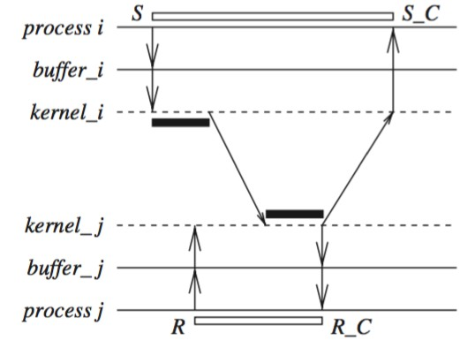
Blocking Send, Blocking Receive
Both sender and receiver block
Sender blocks till receiver receives
Receiver blocks until sender sends
Often called message rendezvous

Slide 23
Non-Blocking Send, Blocking Receive
Sender issues send, can proceed without waiting to discover fate of message
Receiver waits for message arrival before proceeding
Essentially, receiver is message-driven

Slide 24
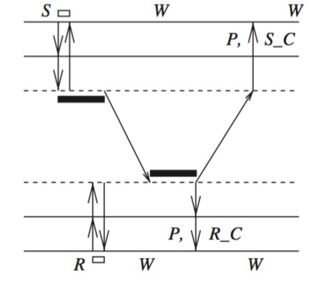
Non-Blocking Send, Non-Blocking Receive
Neither party blocks
Sender proceeds after sending message
Receiver works until message arrives
Either receiver periodically checks in
non-blocking fashion
Or some form of interrupt delivered

Slide 25
Addressing in IPC
How does the sender specify where the data goes?
In some cases, the mechanism makes it explicit (e.g., shared memory and
RPC)
In others, there are options

Slide 26
Direct Addressing
Sender specifies name of the receiving process
Using some form of unique process name
Receiver can either specify name of expected sender
Or take stuff from anyone

Slide 27
Indirect Addressing
Data is sent to queues, mailboxes, or some other form of shared data
structure
Receiver performs some form of read operations on that structure
Much more flexible than direct addressing

Slide 28
Duality in IPC Mechanisms
Many aspects of IPC mechanisms are duals of each other
These mechanisms have the same power
First recognized in context of messages vs. procedure calls
IPC mechanisms can be simulated by each other

Slide 29
So which IPC mechanism to build/choose/use?
Depends on the model of computation
And on the philosophy of the user
In particular cases, hardware or existing software may make one perform better

Slide 30
Typical UNIX IPC Mechanisms
Different versions of UNIX introduced different IPC mechanisms
Pipes
Message queues
Semaphores
Shared memory
Sockets
RPC

Slide 31
Pipes
Only IPC mechanism in early UNIX systems (other than files)
Uni-directional
Unformatted
Uninterpreted
Interprocess byte streams
Accessed in file-like way

Slide 32
Pipe Details
One process feeds bytes into pipe
A second process reads the bytes from it
Potentially blocking communication mechanism
Requires close cooperation between processes to set up
Named pipes allow more flexibility

Slide 33
Pipes and Blocking
Writing more bytes than pipe capacity blocks the sender
Until the receiver reads some of them
Reading bytes when none are available blocks the receiver
Until the sender writes some
Single pipe with bounded capacity can’t cause deadlock

Slide 34
UNIX Message Queues
Introduced in System V Release 3 UNIX
Like pipes, but data organised into messages
Message components include
Type identifier
Length
Data

Slide 35
Semaphores
Also introduced in System V Release 3 UNIX
Mostly for synchronization only
Since they only communicate one bit of information
Often used in conjunction with shared memory

Slide 36
UNIX Shared Memory
Also introduced in System V Release 3
Allows two or more processes to share some memory segments
With some control over read/write permissions
Often used to implement threads packages for UNIX

Slide 37
Sockets
Introduced in 4.3 BSD
A socket is an IPC channel with generated endpoints
Great flexibility in its characteristics
Intended as building block for communication
Endpoints established by the source and destination processes

Slide 38
UNIX Remote Procedure Calls
Procedure calls from one address space to another
On the same or different machines
Requires cooperation from both processes
In UNIX, often built on sockets
Often used in client/server computing

Slide 39
More on Sockets
Created using the socket() system call
Specifying domain, type, and protocol
Sockets can be connected or connectionless
Each side responsible for proper setup/access

Slide 40
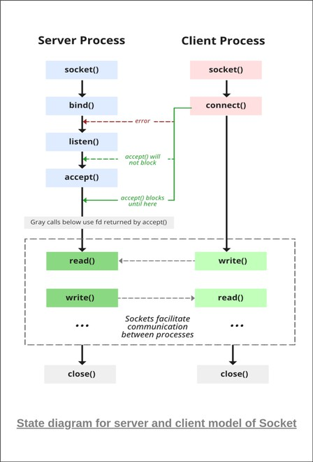

Slide 41
Sockets
A socket is defined as an endpoint for communication.
Concatenation of IP address and port.
The socket 161.25.19.8:1625 refers to port 1625 on host 161.25.19.8
Communication consists between a pair of sockets
Low level: Sends/receives a stream of bytes
Sockets are either connection-oriented (TCP) or connectionless (UDP)

Slide 42

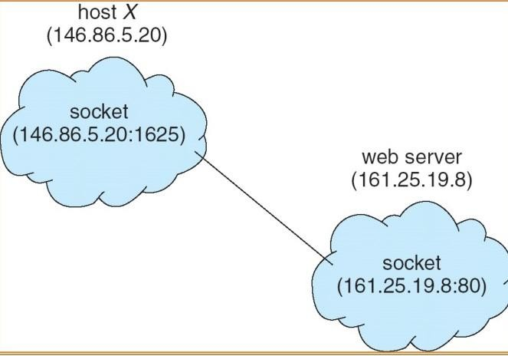

Socket Communication

Slide 43
Socket Domains
the socket domain describes a protocol family used by the socket
Generally related to the address family
Domains can be:
Internal protocols
Internet protocols
IMP (interface message processors) link layer protocols

Slide 44
Socket Types
The socket type describes what the socket does
Several types are defined
SOCK_STREAM
SOCK_DGRAM
SOCK_SEQPACKET
SOCK_RAW
SOCK_RDM (reliable data gram w/o ordering guarantees)

Slide 45
Socket Protocols
This parameter specifies a particular protocol to be used by the socket
Must match other parameters
Not all protocols usable with all domains and types
Generally, only one protocol per socket type available

Slide 46
Some Examples of Sockets
Socket streams
Socket sequential packets
Socket datagrams

Slide 47
Socket Streams
Of type SOCK_STREAM
Full-duplex reliable byte streams
Like 2-way pipes
Requires other side to connect

Slide 48
Socket Sequential Packets
Similar to streams
But for fixed-sized packets
So reads always return a fixed number of bytes
Allow easy use of buffers

Slide 49
Socket Datagrams
Like sequential packets
But non-reliable delivery
Which implies certain simplifications
And lower overhead
send(), rather than write(), used to send data

Slide 50
Socket Options
Connection or connectionless
Blocking or non-blocking
Out-of-band information
Broadcast
Buffer sizes (input and output)
Routing options
And others

Slide 51
Binding Sockets
Binding prepares a socket for use by a process
Sockets are typically bound to local names
For IPC on a single machine
Often accessed using descriptors
Requires clean-up when done
Binding can be to IP addresses, as well

Slide 52
Connecting to Sockets
Method for setting up the receiving end of a socket
In local domain, similar to opening file
Multiple clients can connect to a socket
Program establishing socket can limit connections

Slide 53
Remote Procedural Call
Method of calling procedures in other address spaces
Either on the same machine
Or other machines
Attempts to provide interface just like local procedure call
Request/reply communications model

Slide 54
RPC Case Studies
RPC in Cedar
UNIX RPC

Slide 55
Semantics of RPC
Similar to regular procedure call
Calling procedure blocks
Parameters transferred to called procedure
Called procedure computes till it returns
Return value delivered to calling procedure
Calling procedure continues

Slide 56
High-Level RPC Mechanics
Hide details from applications
Clients pass requests to stub programs
Client-end stub sends request to server stub
Server-end stub calls user-level server
Results travel in reverse direction
Network transport or OS actually moves data

Slide 57
Diagram of RPC in Action
Client (caller)
Server (callee)
call reply
reply call
Client stub
Server stub
OS or Network

Slide 58
What do the stubs do?
Stubs handle complex details like:
Marshaling arguments
Message construction
Data format translation
Finding the server process

Slide 59
Setting Up RPC
Caller must have a way to find the called procedure
But it can’t be found at link time
Unlike local procedure
Potential servers must make their presence known

Slide 60
Registering Servers
Either register the server at a “well-known” port
Or register it with a name server
Which in turn is at a “well-known” port
Calling procedure “addresses” RPC to that port

Slide 61
Binding to a Service
A client process binds to the service it wants
Two major sub-problem:
Naming
Location

Slide 62
Binding: The Naming Problem
How does a caller name the server program?
Depends on the RPC mechanism
And perhaps the protocol or type within it
Do you name the server explicitly?
Or do you name the service and let some other authority choose which
server?

Slide 63
Binding: The Location Problem
Where is the remote server?
Some naming schemes make it explicit
Some don’t
If it’s not explicit, system must convert symbolic names to physical locations

Slide 64
Binding in Cedar RPC
Client applications bind to a symbolic name
Composed of:
Type
Instance
Type is which kind of service
Instance is which particular implementer

Slide 65
Locating Cedar RPC Service
Names do not contain physical location
So Cedar consults a database of services
Services register with database
Binding call automatically looks up location in database

Slide 66
Binding in UNIX RPC
bind() system call used by servers
Allows servers to bind naming/location information to particular socket
connect() system call used by clients
Using information similar to that bound by the server
Automatic code generation hides details

Slide 67
UNIX Binding Information
Like most socket operations, it’s flexible
Fill in all or part of a socket address data structure
Create an appropriate socket
Then call bind to link socket to address information
connect works similarly

Slide 68
UNIX Binding Example
On server side, struct sockaddr_un sin; int sd;
strcpy(sin.sun_path,”./socket”);
sd = socket(AF_UNIX, SOCK_STREAM, 0); bind(sd, &sin, sizeof(sin));

Slide 69
UNIX Binding Example, Con’t
For client side, struct sockaddr_un sin; int sd;
strcpy(sin.sun_path, “./socket”);
sd = socket(AF_UNIX, SOCK_STREAM, 0); connect(sd, &sin, sizeof(sin));

Slide 70
Locating Remote Services in UNIX RPC
Similar to Cedar methods
Register services with the portmapper
The portmapper is typically called through automatically generated code
the portmapper runs on each machine
Another service (e.g., NIS) deals with intermachine requests

Slide 71
Using RPC
Once it’s bound, how does the client use RPC?
Just call the routines
As if they were local
And the results come back

Slide 72
What’s happening under the covers?
When a client calls a remote routine, he really calls a local stub program
Stub program packages up request to remote server
And sends it to local transport code
When reply arrives, local transport code returns results to stub
Which returns to client program

Slide 73
What happens at the server side?
A request comes in to the RPC transport code
It routes it to the appropriate server stub
Which converts it into a local procedure call
Which is made within the context of the server

Slide 74
Conceptual Diagram of RPC
call_procedure();
client program continues
Message from client
stub to server stub
Client stub converts
message to return value
Network transport
Network transport
Message received by server stub
Return value formatted as message to client stub
call_procedure();
return(…);

Slide 75
Transport for RPC
In Cedar, special-purpose RPC transport protocol
In UNIX RPC, can use either UDP or TCP for transport
Typically, a protocol is chosen automatically by the stub generator program

Slide 76
Other RPC Issues
Mostly related to intermachine RPC
Data format conversions
Security and authentication
Locating remote services
Multipacket RPC

Slide 77
Remote Procedure Call
Implementation:
Request-response message passing (under covers!)
“Stub” provides glue on client/server
Client stub is responsible for “marshalling” arguments and “unmarshalling” the
return values
Server-side stub is responsible for “unmarshalling” arguments and “marshalling” the return values.
Marshalling involves (depending on system)
Converting values to a canonical form, serializing objects, copying arguments passed by reference, etc.

Slide 78
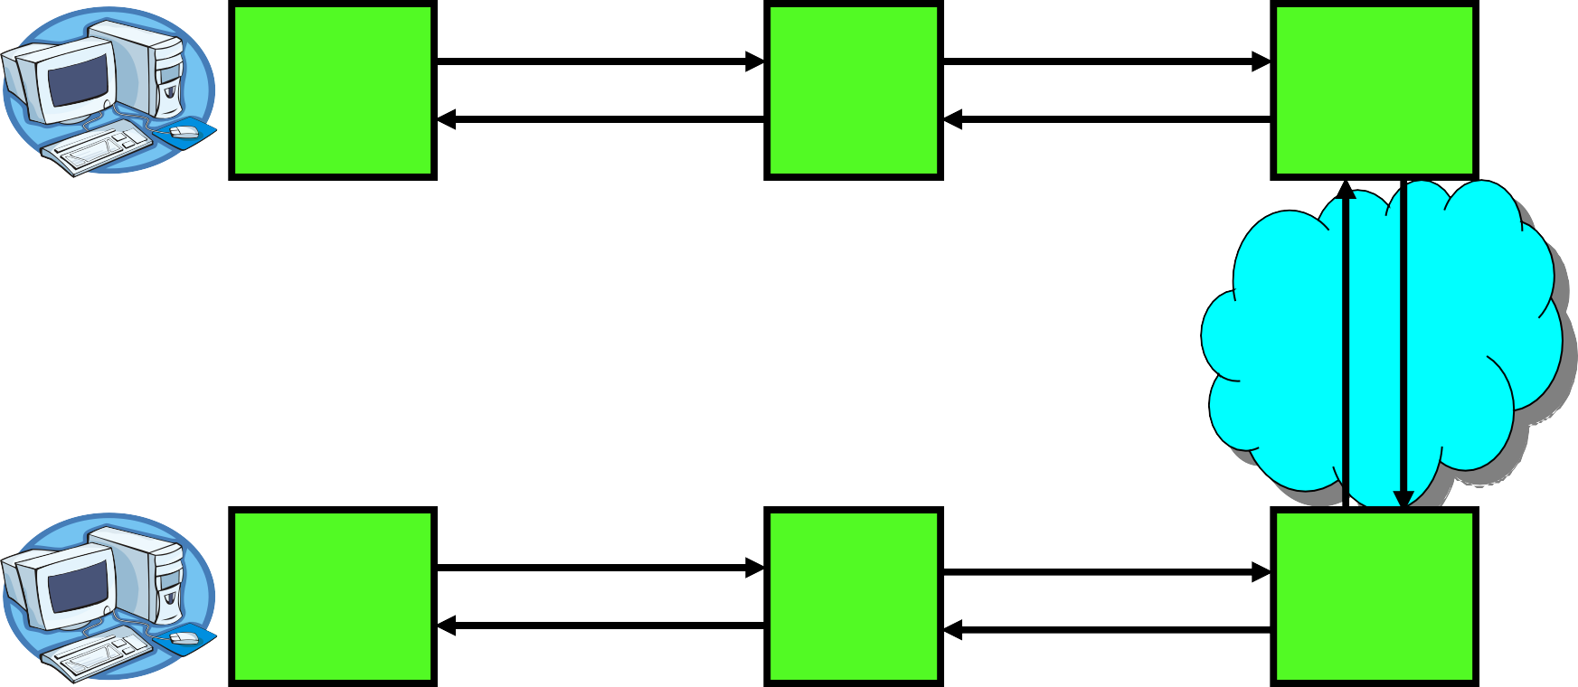
RPC Information Flow
bundle args Client
Client (caller)
call
send
Packet Handler
Stub unbundle ret vals
return
receive
mbox2
Machine A
Network
Network
Machine B
bundle ret vals Server
Stub
mbox1
Server (callee)
return
call
send
receive
Packet Handler
unbundle args

Slide 79
Problems with RPC
Non-Atomic failures
Different failure modes in distributed system than on a single machine
Consider many different types of failures
User-level bug causes address space to crash
Machine failure, kernel bug causes all processes on same machine to fail
Some machine is compromised by malicious party
Before RPC: whole system would crash/die
After RPC: One machine crashes/compromised while others keep working
Can easily result in inconsistent view of the world
Did my cached data get written back or not?
Did server do what I requested or not?
Answer? Distributed transactions/Byzantine Commit
Performance
Cost of Procedure call « same-machine RPC « network RPC
Means programmers must be aware that RPC is not free
Caching can help, but may make failure handling complex

Slide 80
Cross-Domain Communication/Location Transparency
How do address spaces communicate with one another?
Shared Memory with Semaphores, monitors, etc…
File System
Pipes (1-way communication)
“Remote” procedure call (2-way communication)
RPC’s can be used to communicate between address spaces on different machines or the same machine
Services can be run wherever it’s most appropriate
Access to local and remote services looks the same
Examples of modern RPC systems:
CORBA (Common Object Request Broker Architecture)
DCOM (Distributed COM)
RMI (Java Remote Method Invocation)

Slide 81
Thank You!

