Slide 1
ACMP(Oracle Application Change Management Pack)
Kishor K . Agrawal

Slide 2
Oracle Application Change Management Pack
Oracle Application Change Management Pack for Oracle E-Business Suite provides a centralized view to monitor and orchestrate changes across multiple Oracle E-Business Suite systems. Oracle Application Change Management Pack for Oracle E-Business Suite offers the capabilities to manage changes introduced by customizations, patches during implementation or maintenance activities.
Oracle Application Change Management Pack for Oracle E-Business Suite is a part of the Oracle Enterprise Manager Grid Control system that provides top-down system management of the entire IT infrastructure.
Notes:
Usar nos grafico o AZUL como cor principal. (no lugar do verde aqui). Tambem incluir uma variacao de cores mais coorporate, baseado em azuis, para os resultados financeiros. O numero da pagina deve estar abaixo lado direiro, mudar o espada de lugar.

Slide 3
Oracle Application Change Management Pack
Oracle Application Change Management Pack for Oracle E-Business Suite contains three main components:
Patch Manager allows you to deploy patches across Oracle E-Business Suite instances from a single console. Patch Manager integrates with My Oracle Support and can automatically download and deploy patches across multiple (single or multi-node) Oracle E-Business Suite instances. Both Oracle E-Business Suite patches as well as patches created with Customization Manager, are supported.
Customization Manager automates the process of packaging, releasing, deploying, and migrating customizations for a Oracle E-Business Suite instances. These custom packages can then be patched to Oracle E-Business Suite instances like any other Oracle Patch either using the Oracle Applications DBA (AD) utilities or using Patch Manager.
Setup Manager extends the capabilities of Oracle iSetup by providing functional configuration change management capabilities across multiple Oracle E-Business Suite instances
Notes:
Usar nos grafico o AZUL como cor principal. (no lugar do verde aqui). Tambem incluir uma variacao de cores mais coorporate, baseado em azuis, para os resultados financeiros. O numero da pagina deve estar abaixo lado direiro, mudar o espada de lugar.

Slide 4
Major Benefits of Oracle Application Change Management Pack • Simplifies the mechanism of arranging changes across multiple Oracle E-Business Suite systems. • Improves user productivity by automating the deployment of changes. • Reduces human errors by providing a standards based change deployment framework. • Provides notifications to specified users of updates to the Oracle E-Business Suite systems. Application Change Management Pack helps provides these benefits from the central Oracle Enterprise Manager console which allows you to manage the entire application environment
Notes:
Usar nos grafico o AZUL como cor principal. (no lugar do verde aqui). Tambem incluir uma variacao de cores mais coorporate, baseado em azuis, para os resultados financeiros. O numero da pagina deve estar abaixo lado direiro, mudar o espada de lugar.

Slide 5
Setting Up Credentials ,Creating Roles, Notifications Setup
When using the Oracle Application Change Management Pack for Oracle E-Business
Suite, you will need to access Oracle E-Business Suite instances.
You can set up credentials for these instances for every user as a one-time setup step instead of entering them every time you need to access an instance.
Please note that preferred credentials are not shared across users
Application Change Management Pack supports segregation of duties to different users
based on the roles assigned in Oracle Enterprise Manager.
You have the option of sending e-mail notifications to users regarding updates to the
Oracle E-Business Suite systems. To have these notifications sent successfully, you must
have the system set up properly

Slide 6
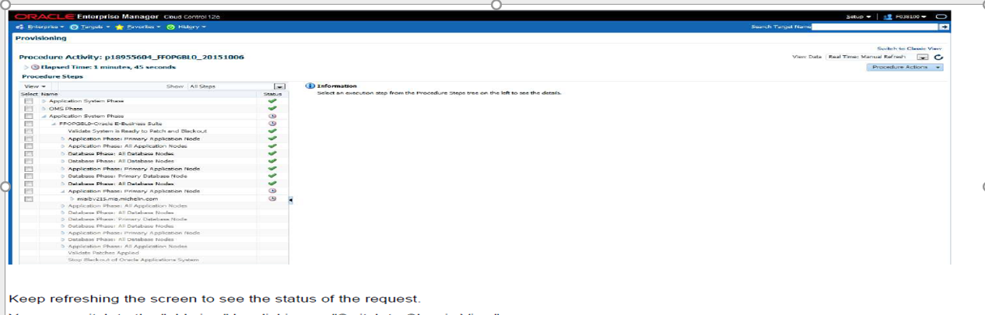
Patch Manager Home
The Patch Manager Home tab lists your patch runs according to their status:
Completed, Scheduled, Saved, Pending Approval, Approved, and Rejected.
You can click on a Patch Run name to view its details

Slide 7
Running a Patching Procedure
Oracle provides you with patching procedures that are best practices for patching
Oracle E-Business Suite
Prerequisites:-
You have the option of downloading an Oracle patch directly from My Oracle
Support through Patch Manager or downloading the patch first to a central location
on the Oracle Management Server (OMS) and then using Patch Manager to deploy it .
To create a Patch Run:
On the Patch Run Details page, enter the details below.
• Patch Run Name - Enter a user-friendly name for the patch run. You can search
on this name later on.
• Description
• Justification
• Requester - The default value is the user name with which you are signed in.
• Notification E-mail(s)

Slide 8
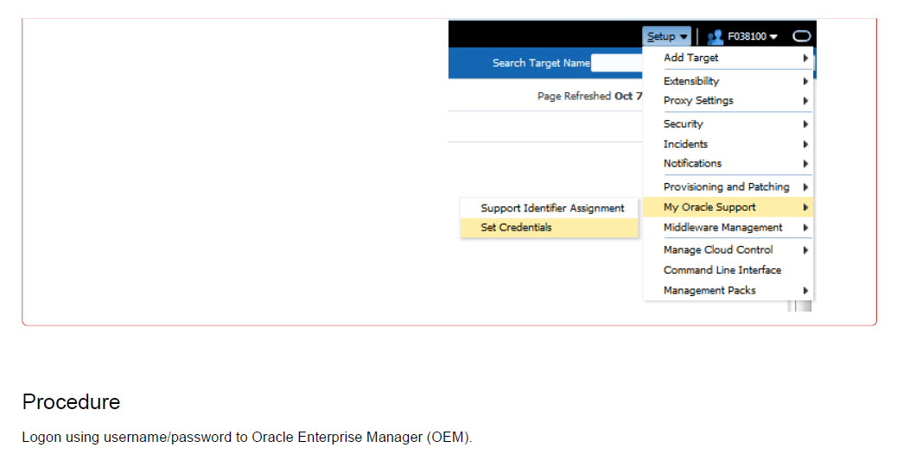
Running a Patching Procedure

Slide 9
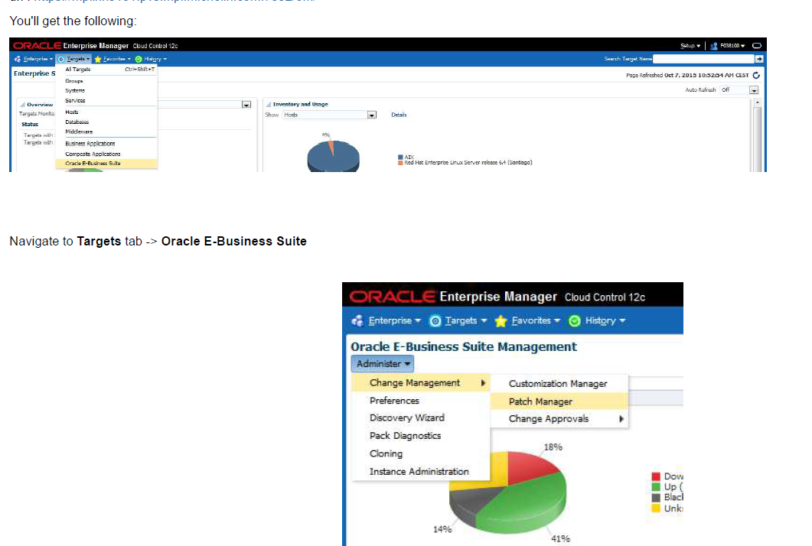
Running a Patching Procedure

Slide 10

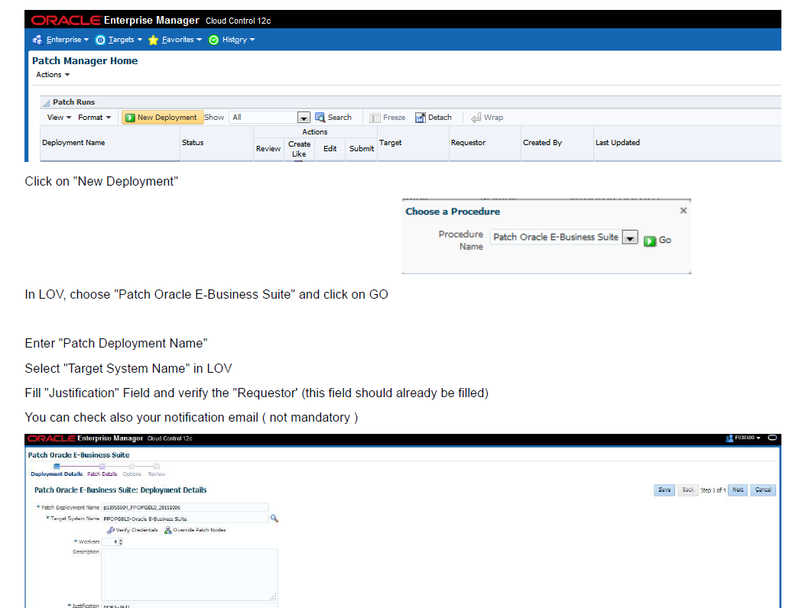
Running a Patching Procedure

Slide 11
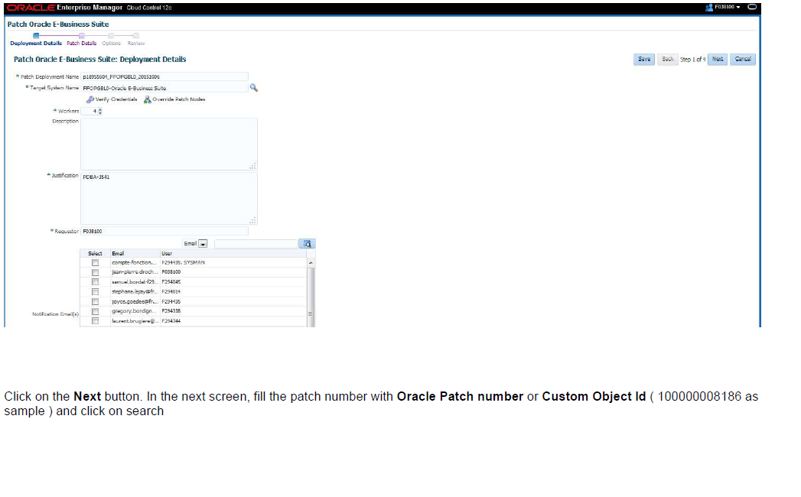
Running a Patching Procedure

Slide 12
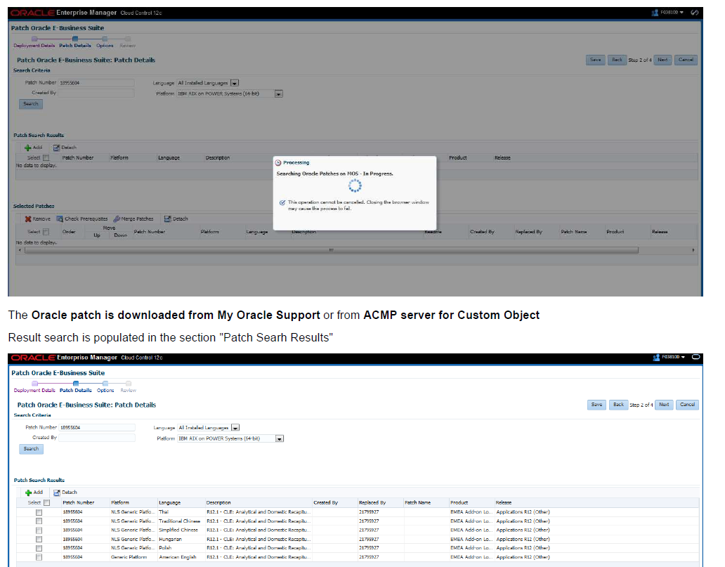
Running a Patching Procedure

Slide 13
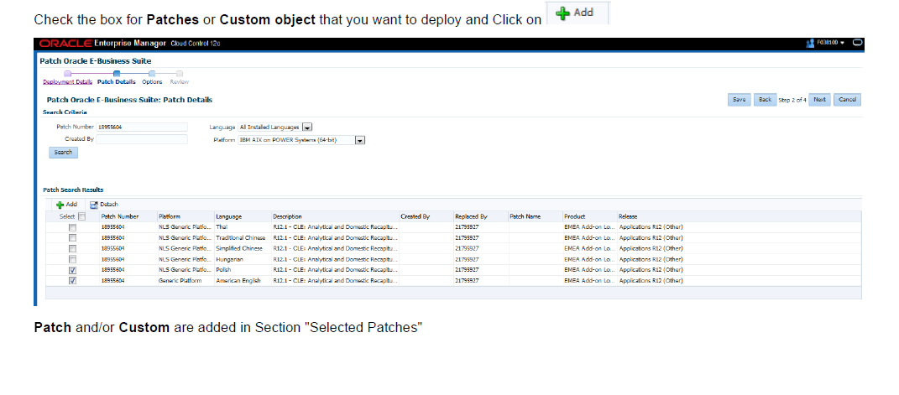
Running a Patching Procedure

Slide 14
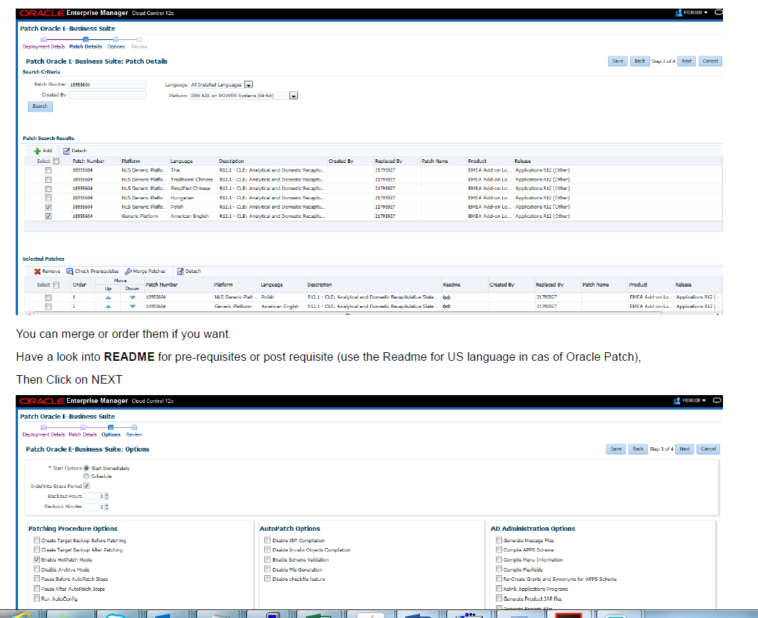
Running a Patching Procedure

Slide 15
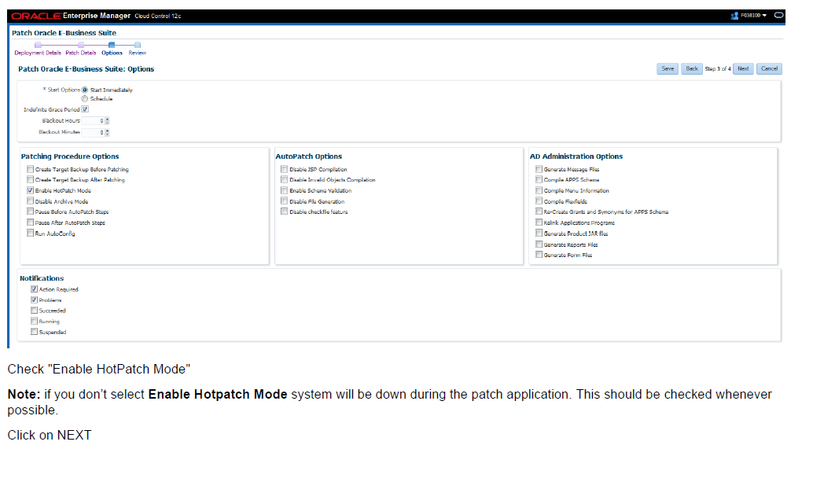
Running a Patching Procedure

Slide 16
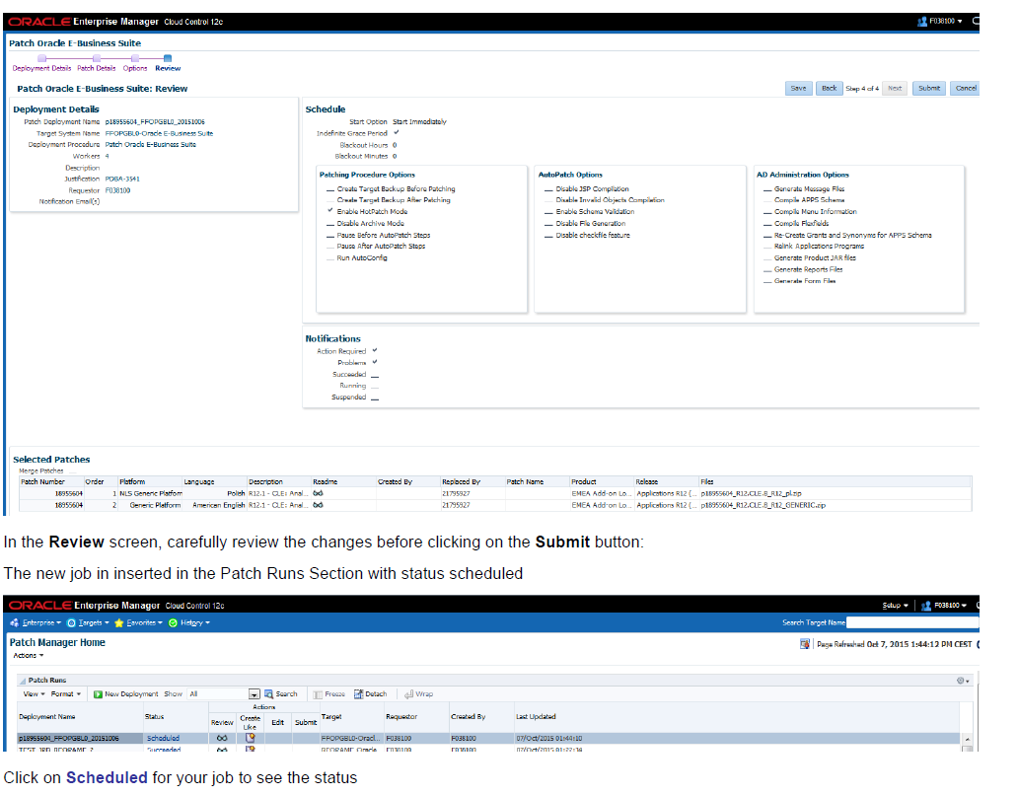
Running a Patching Procedure

Slide 17
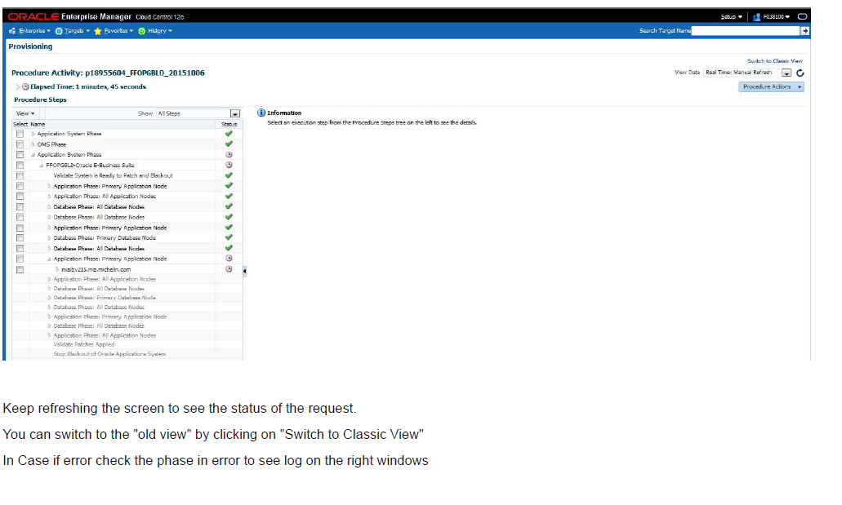
Running a Patching Procedure

Slide 18
Thank You, Kishor Agrawal.

