Slide 1
Configuration Factory Overview of activities and responsibilities
Date : 19 JAN 2017

Slide 2




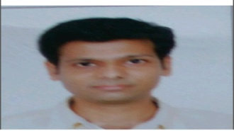
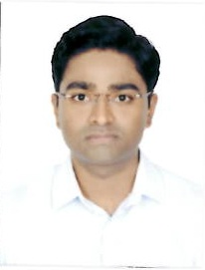


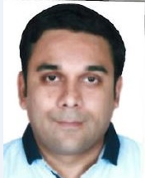

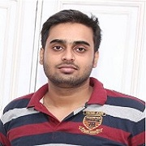
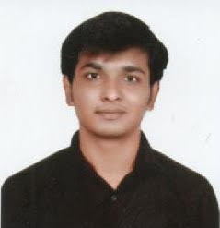
Configuration Factory Scope of activities and mutualization skills available today
JDE: DevOps (transition in progress currently)
JEDAIR CNC activities full scope (Indus + Prod)
Core Model CNC activities part scope (Indus + Prod)
JDE: SPI activities
SPI handle JDE related interfaces and flows
Support as well as AD scope
JDE:CNC Implementation
CNC implementation including deployments, security, trouble-shooting, configurations
ERP-BB: PRIVAS DBA Support activities
Deployments in Prod environments
OEBS appl maintenance, administration, cloning, patching, trouble-shooting
support data conversion activities
Transition in progress
JDE:CNC Support and deployment activities
CNC support activities including deployments, security, trouble-shooting, configurations
ERP-BB: OEBS 11i activities
OEBS 11i legacy appl monitoring, maintaining, cloning
on demand patching, upgrades, SSL certificate renewals
JDE: CNC User administration activities
user administration activities
Security and Qsoft (applying SOD rules)
Config
activities
ERP-BB: User administration activities
user administration activities-all 3 zones
dashboard reporting
ERP-BB: AOL Build activities
R12 AOL activities for projects
ERP-BB: AOL L3 MS3 activities
L3 R12 AOL related PRP ticket activities
roles & responsibilities creation in project mode
JDE: Configuration management role
JEDAIR and Core Model Configuration management activities
ensuring CM Plan compliances, audits etc
ERP-BB: SPI activities
deployments in non-Prod environments
trouble shooting with developers

Slide 3
Configuration Factory Vision, Benefits, Challenges and Plans
Benefits:
Dependencies reduced in some areas – by creating back-ups and ensuring continuity of services
Internal governance structure for better and tighter co-ordinations
Improved communications, sharing of risks and mitigation plans among stakeholders
Closer interactions between team members, meetings and sharing of updates, Increase in up-skilling opportunities
Vision:
Increase level of motivation within the team members and make the team a vibrant one
Challenges:
Some activities are not very motivating
Defining team members’ growth paths is a challenge
on DevOps JDE: the governance and planning was not very clear – it’s improving now
JDE side: not much visibility on the 2017-H1 projects
Plans:
Conduct regular team meetings/forums, provide updates, collect feedback→ in progress and on-going
Provide growth opportunities (lead positions…) → in progress
Management interactions at individual levels → in progress
Continue to iron out some administrative issues → done
Encourage knowledge sharing, up-skilling and cross-skilling trainings → in progress and on-going

Slide 4
Thanks for your Attention

