Slide 1
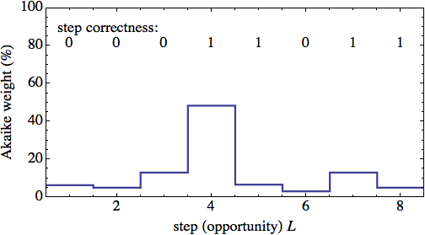
Measuring the Moment of Learning with an Information-Theoretic Approach
Brett van de Sande
Arizona State
University
Notes:
Looking a an outline of my talk...

Slide 2
Step correctness: For each opportunity to apply a skill, a student gets 1 if they get it right on first try without any hints, 0 otherwise.
Question: when did they learn the skill?
Answer: we don't know, but ...
Probability of learning just before step L
No learning
Notes:
Looking a an outline of my talk...

Slide 3
Outline
Motivation: moment of learning for individual students
The step function model
The Akaike Information Criterion (AIC)
  Multi-model approach
  Weighted gain
Application to Andes log data
Notes:
Results from earlier work suggest need for improving help-giving policies, but that doing it by hand is too inefficient and error prone.
One ingredient we will need is to determine when students learn a skill. Discuss models of learning.

Slide 4
Motivation: moment of learning for individual students
Want to know if a particular hint or help given to the student resulted in learning or if a particular action by the student resulted in learning
Need fine-grained estimate of when student learns skill
Must include associated uncertainty
Intelligent tutor systems allow step-by-step embedded assessment of student

Slide 5
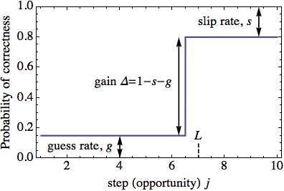
The step function model
Assign Knowledge Component (KC) to each problem-solving step
Use correct/incorrect on step as measure of learning: 00101110111
Use step function as model
Learning is instantaneous “AHA moment”
Slip and guess like BKT
Δ = 1-s-g is performance gain
Notes:
Explain backwards chaining (maybe not best from Physics point of view), we prefer top-down
Hints often in sequence: point: some aspect of the problem, general strategy/knowledge, “do this”

Slide 6
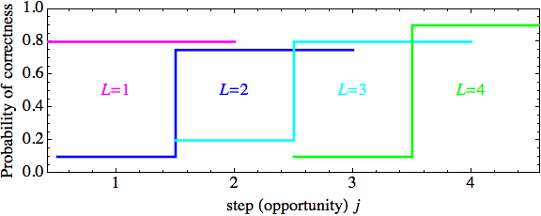
Akaike Information Criterion (AIC)
Treat step function for each L as separate sub-model
Notes:
Raj reported that students generally left the study with a positive attitude towards Andes (in contrast to Lab Study 1).

Slide 7
Fit sub-model L to student data using maximum likelihood, with likelihood LL
LL + (correction for L=1) is the Akaike weight wL
AIC tells us that wL is the relative probability that sub-model L is closest to being correct
Notes:
Raj reported that students generally left the study with a positive attitude towards Andes (in contrast to Lab Study 1).

Slide 8
Akaike weight wL is the relative probability that sub-model L is closest to being correct → probability that the student learned the skill just before step L
Notes:
Raj reported that students generally left the study with a positive attitude towards Andes (in contrast to Lab Study 1).

Slide 9
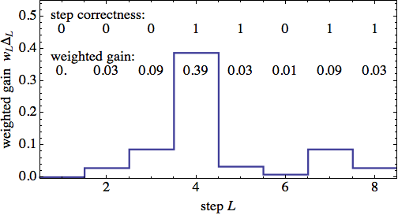
Weighted gain
For sub-model L, define weighted gain wL ΔL
Measure of effectiveness of any help or action by student
Average gain <Δ>=∑L wL ΔL
<Δ>=0.66
Notes:
Raj reported that students generally left the study with a positive attitude towards Andes (in contrast to Lab Study 1).

Slide 10
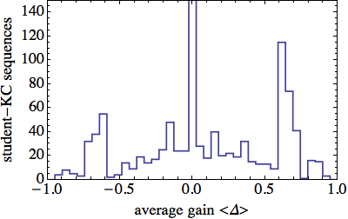
Application to Andes log data
12 students from St. Anselm College using Andes for a 2-semester intro physics course
2017 student-KC sequences: 0101101001...
30,030 problem-solving steps
Histogram student-KC sequences vs. <Δ>
Huge peak at 0
Dominated by short sequences

Slide 11
Conclusion
Want to assess individual student learning to determine effectiveness of help or student activity
Need estimate of when KC learned along with uncertainty
AIC gives method for doing this
Use step function as simple model
log data from Andes physics tutor shows learning but data is noisy

