Slide 1
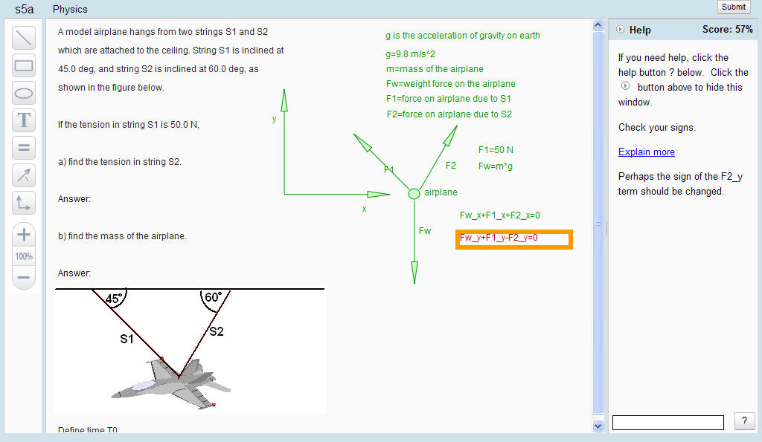
Andes3 is like power-point, but gives
correct (green) vs. incorrect (red) feedback
help messages
Click here for “what’s wrong” and “next step help”

Slide 2
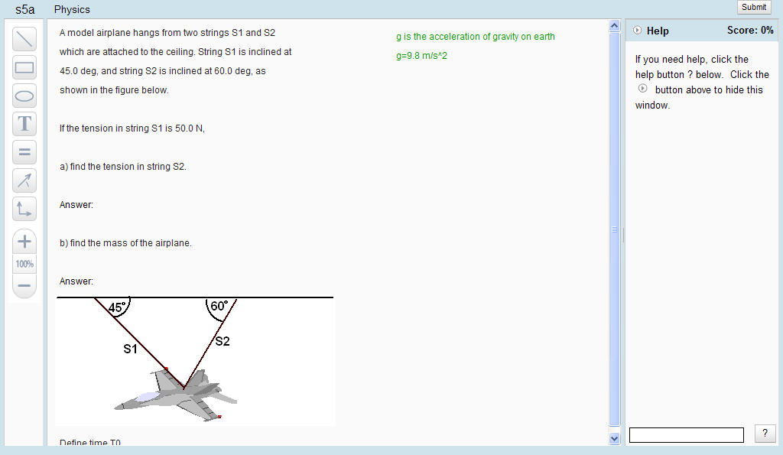
Workbench appearance for starting a problem

Slide 3
Workbench layout
help window
tools
predefined variables
region for drawing bodies, vectors and entering variable definitions and equations

Slide 4
Andes3 Workbench Toolbar
define body tools
text entry tool
equation entry tool
vector variable entry tool
axes drawing tool

Slide 5
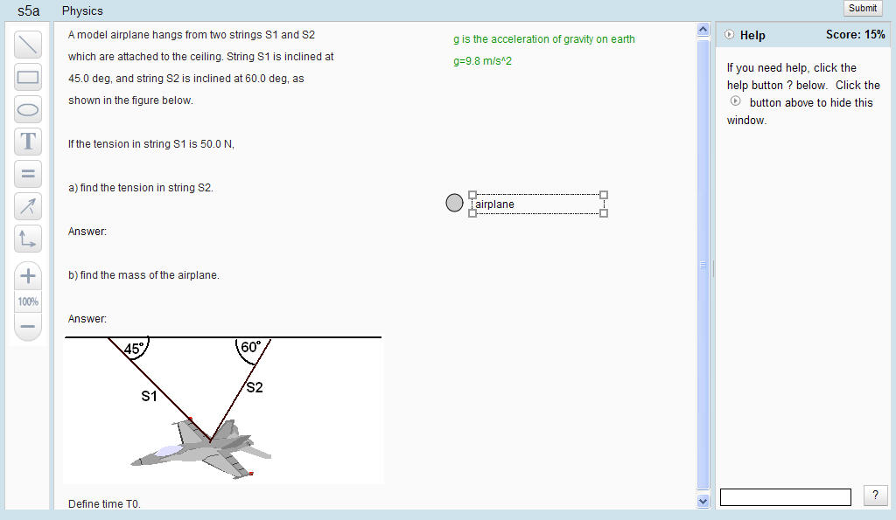
Drawing and labeling bodies
first, click here
second, drag out a circle
third, type a name, then press enter

Slide 6
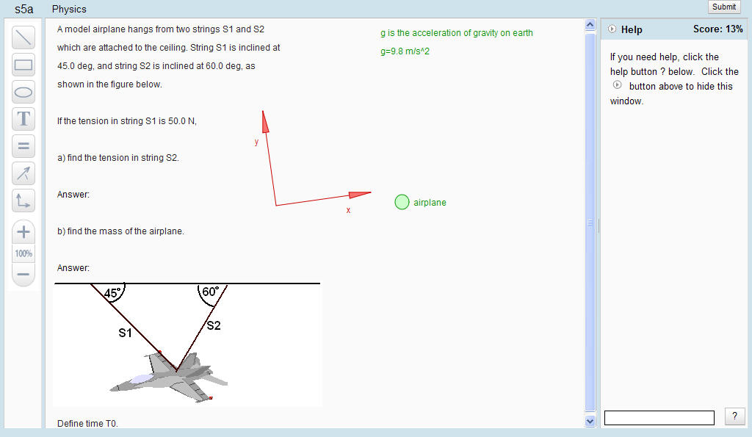
Drawing a coordinate axis
first, click here
second, drag out and rotate the axes
an angle will be shown when rotating, where 0 means x-axis is horizontal
Notes:
Can’t show angle while rotating axes because it can’t be captured using Snagit. Perhaps one could capture a fram from a Camtasia recording.

Slide 7
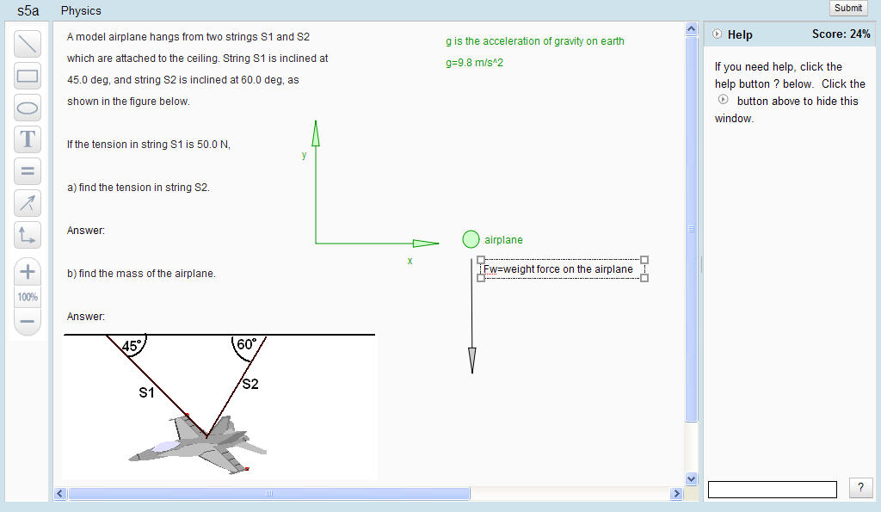
Drawing a vector
third, enter the name of the vector and press enter
first, click here
second, drag out the vector in the proper direction

Slide 8
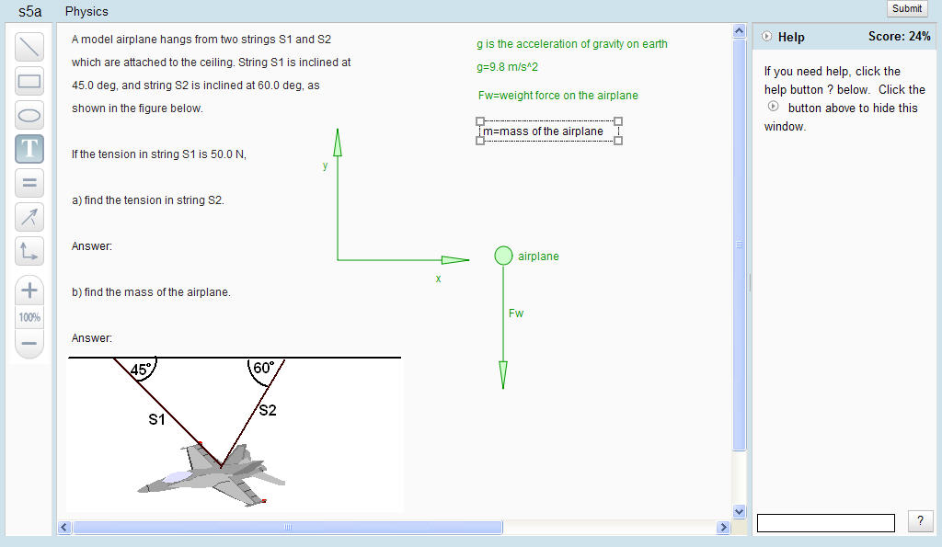
Defining a scalar variable
second, drag out a dialog box
first, click here
third, enter a definition of the scalar variable and press enter

Slide 9
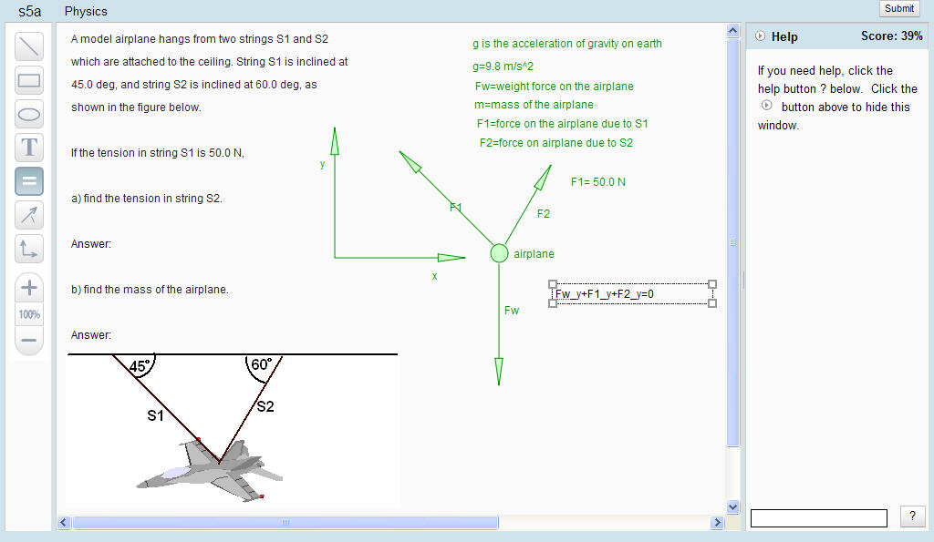
Entering an equation
second, drag out a box
first, click here
third, enter the equation and press enter

Slide 10
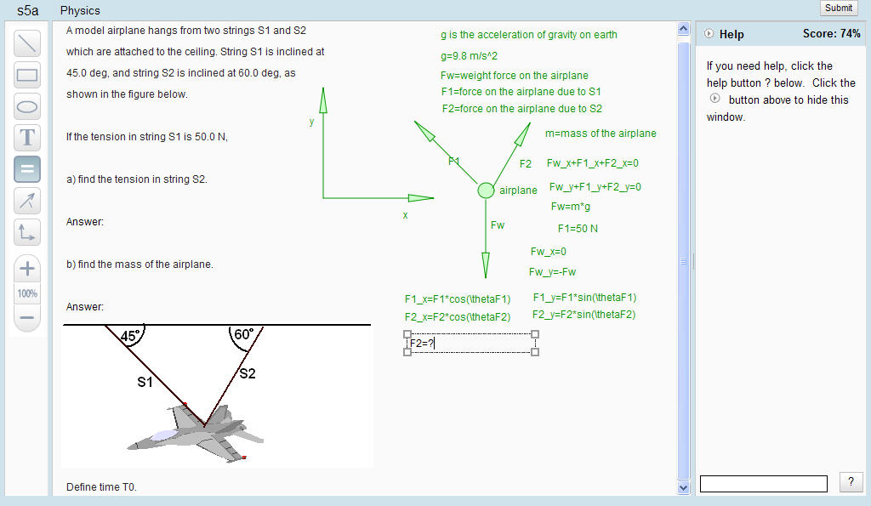
Telling Andes to solve your equations
first, enter all equations required to solve for a variable
second, click here
third, drag out box and enter variable to be solved for and press enter

Slide 11
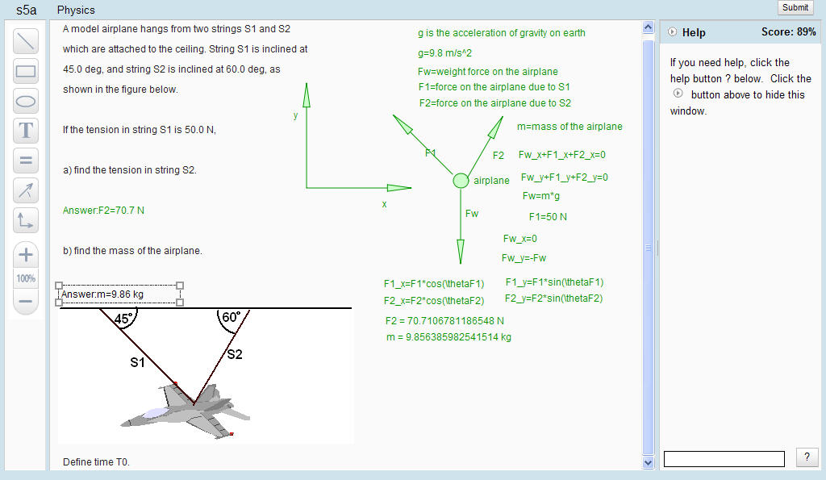
Entering answers and submitting your solutions
second, click here to submit your solution
first, double click on “answer”, enter answer to 3 places, press enter.

Slide 12
Viewing and interpreting your score breakdown
Not available yet.

