Slide 1
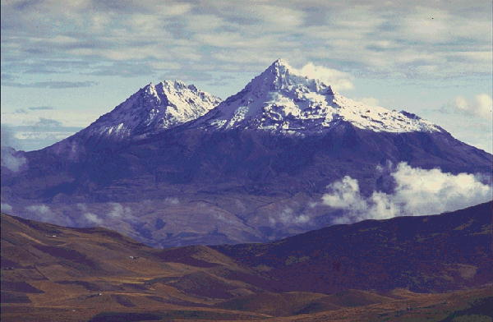
Adaptive help giving for physics homework problems
Brett van de Sande and Kurt VanLehn
Arizona State University

Slide 2
Outline
Introduction to Andes
  Example problem & usage
  Help-giving strategies
2 lab studies: New user behavior on a free-form user interface
In vivo study: Random-help policy
Machined learned help policy

Slide 3
Andes from the student’s perspective: an example from statics
Students at the USNA took an average of 15 minutes (median 13 minutes) to solve this.

Slide 4
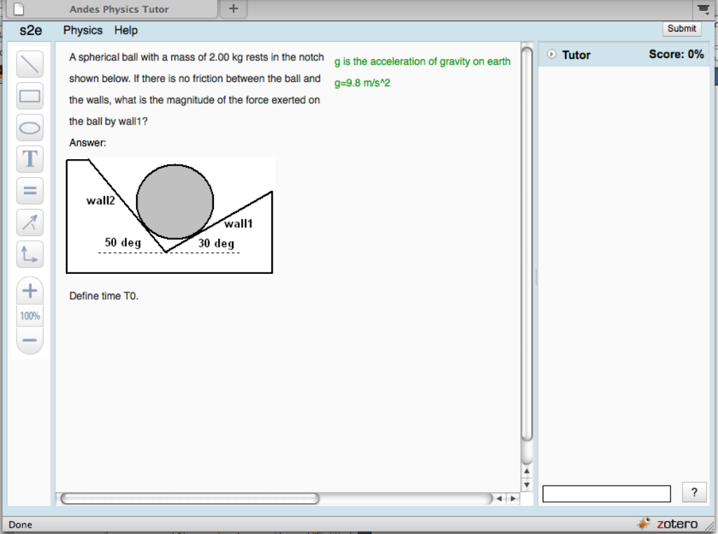
Notes:
Statics problem: find the force exerted by wall1.
This is what student sees at the beginning: problem statement & drawing area,
toolbar, and Tutor pane. Emphasize comment box.
(capture area 840x624 including tab and below canvas)

Slide 5
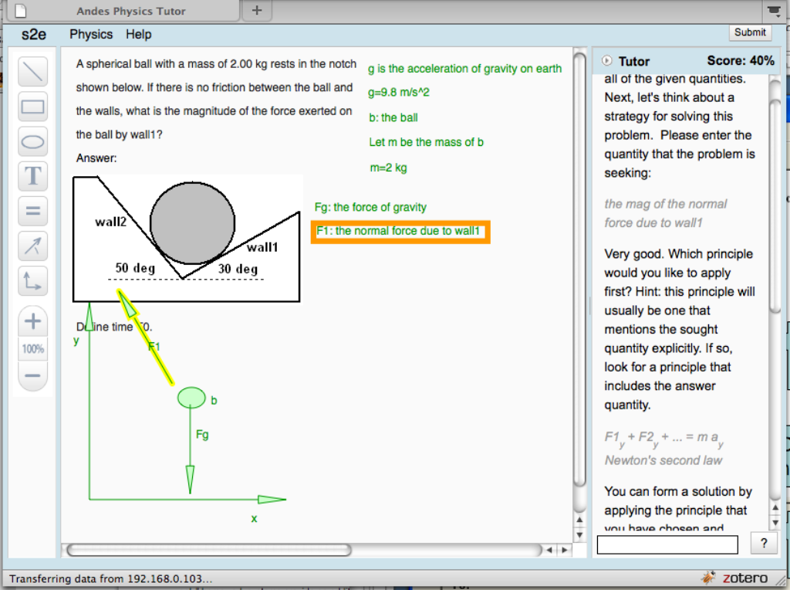
Define variables
Upon request, Andes gives hints for what to do next
Draw free body diagram
Define coordinates
(3 choices for this problem)
Notes:
Partially completed solution …
Andes teaches student good problem solving techniques.
Define variables, draw diagrams, define coordinates.

Slide 6
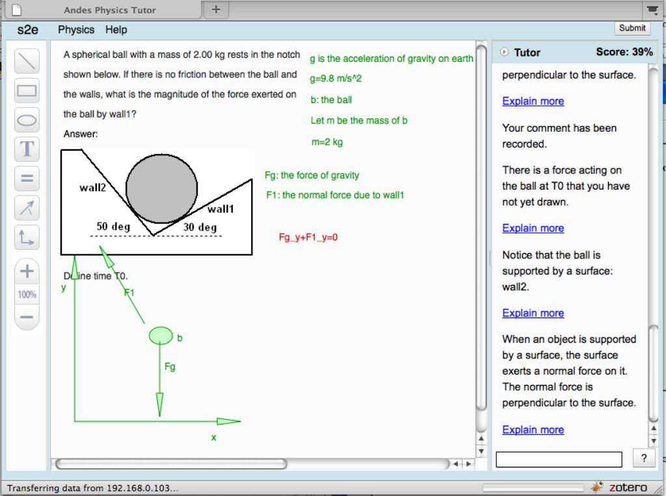
Immediate red/green feedback for student actions
Principles-based help for incorrect entry
Notes:
Red/green gives immediate feedback for each student entry.
In fact, the student has forgotten to draw one of the forces, the hints point this out.
Hint sequence: increasingly explicit.

Slide 7
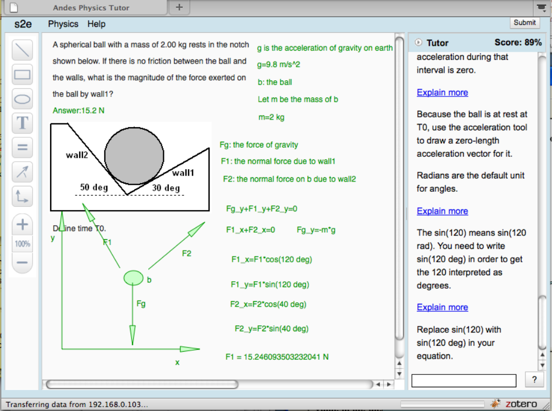
Completed Problem
score
Final answer only small part of solution
Notes:
Completed problem.
Andes computes numerical value: note that the final answer,
and numerical values are de-emphasized.
Score based on having all the needed equations, vectors drawn, axes,
needed scalars defined, with penalty for incorrect entries (turned red) and for
excessive help usage (bottom-out hints).

Slide 8
Usage
Homework component of standard two-semester Introductory course
Over 500 problems, covering most topics
Used in classrooms since 2000, main partners:
  US Naval academy, MD
  Watchung Hills Regional High school, NJ
  St. Anselm College, NH
Notes:
This is sample of courses where I had the data available: 2000 hours, corresponds to about 100 students taking 2-semester course using andes mostly for homework.
Also, large use from other courses and “Open & Free” version

Slide 9
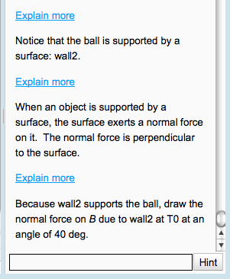
Help giving: what Andes does
Immediate red/green for all student entries
Evaluate wrong entries, error-specific hints
Lead student through solution (“Next Step Help”) with general strategy hints:
    “Draw a free body diagram.”
    “Apply Newton’s Second Law.”
  And step hints:
    “Write an equation for …”
    “Draw a velocity vector.”
Hint sequences for a step:
  Point
  Teach
  Bottom-out
Notes:
Explain backwards chaining (maybe not best from Physics point of view), we prefer top-down
Hints often in sequence: point: some aspect of the problem, general strategy/knowledge, “do this”

Slide 10
Meta-Hints
  “You should watch the Introductory Video.”
  “You seem confused, maybe you should ask for help.”
Explain user interface actions
  Click on help button
  Click on link in hint for further help
  Notation for labeling objects like vectors or bodies.
Notes:
“Start over” is frequent strategy of human tutors.

Slide 11
2 lab studies: New user experience on a free-form user interface
Lab Study 1: Dec. 2010. 10 students, 2 hours, solving problems in Andes, talk-aloud protocol.
Analysis:
  Floundering Metric: number of seconds (or transactions) between transactions that turn green.
  Characterize major points where students got stuck.
  Biggest issue is student getting stuck, effective help is available, but they don't ask for it.
Notes:
Raj reported that students generally left the study with a positive attitude towards Andes (in contrast to Lab Study 1).

Slide 12
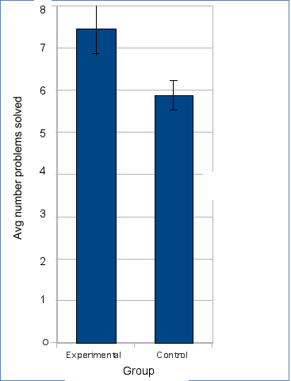
Lab Study 2: April 2011. 2 conditions: normal Andes vs. new unsolicited hints policy. 17 students in each conditions, 2 hours, solving problems, talk-aloud protocol.
Students made significantly more progress with unsolicited hints.
Notes:
Raj reported that students generally left the study with a positive attitude towards Andes (in contrast to Lab Study 1).

Slide 13
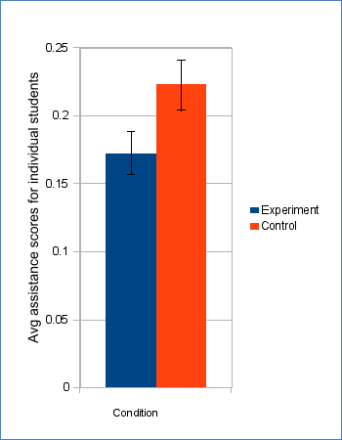
And they need less help.
Assistance score is average number of hints plus errors per solution step.
Notes:
Can not conclude that there was more mastery in experimental condition: would need to turn off spontaneous hints at some point to determine that.

Slide 14
In vivo study:
Random-help policy
UW Platteville, 118 students. Tutor randomly chooses policy:
  After error, give unsolicited hint or not?
  Give bottom-out hint first or not?
Use log data to train machine learned help policy.
Notes:
2X2 policy choices, randomly choose default behavior vs. change and then choose from 2X2.
Normally use external post-test but typically very far away from the point where policy choice was made.
In this case we have an outcome that is close to the point where the policy choice was made.
Lasted 1 week, 120 hours of log data.
Problems with getting students started. Conclusion: intro problems were optional (so no one did them), students started up in middle of course with hard problems.

Slide 15
Machine learned help policy
Idea: use skill (knowledge component) mastery as reward for machine learning.
Model of learning to estimate point of learning for each student and KC.
Use point of learning as reward for preceding help policies. Use (small) slip rate P(S) as reward for post-learning help policies.
Identify list of candidate features to characterize student state.
Apply reinforcement learning to data from In Vivo Study 2 to determine optimal help policy.
Notes:
Use step function: constant “guess rate”, moment of learning, constant “slip rate”
Reinforcement learning with a “direct search” strategy.

Slide 16
For each relevant transaction, determine:
  Student state
  Policy that was used
  Whether help was effective
Compare policy with machine-learned policy
Proposed policy | Log policy | Help effective | Reward
Help effective?
log policy
Proposed policy
Policy model
State 1
State 2
State 3
State 4
State 5
State 6
transaction

Slide 17
In Vivo study 3
Version of Andes with dynamic calculation of student state; find machine learned hinting policy for that state; give help based on policy.
7 students in experimental condition and 7 in control condition, for each homework set, for entire two-semester course
Use moment of learning for each skill to determine if experimental condition is more effective.
Running now at St. Anselm College
Notes:
This is what we are working on now.
Next: apply machine learned help policy to Andes and try it out on students. Ideally, a 3-condition experiment with Andes default, machine learned, and random-help, and external pretest-post test. Have St. Anselm this summer, but too few students.
Write paper on In Vivo Study 2, machine learning.

