Slide 1
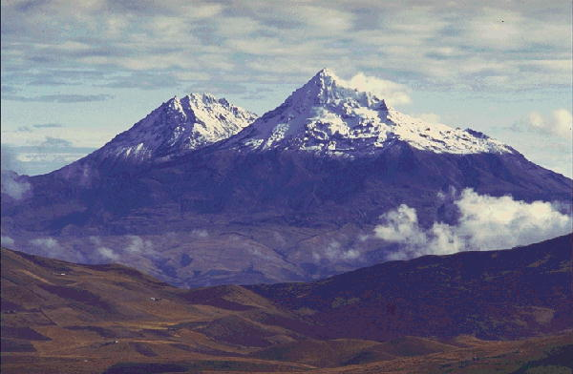
Adaptive help giving for physics homework problems
Brett van de Sande and Kurt VanLehn
Arizona State University

Slide 2
Outline
Introduction to Andes
  Example problem
  Help-giving strategies
Summarize results from earlier work
Strategy for improving help policies
Models of learning
In vivo study: Random-help policy
Constructing a machined learned help policy
In vivo study: Machine learned help
Notes:
Results from earlier work suggest need for improving help-giving policies, but that doing it by hand is too inefficient and error prone.
One ingredient we will need is to determine when students learn a skill. Discuss models of learning.

Slide 3
Introduction to Andes
An example from statics
Students at the USNA took an average of 15 minutes (median 13 minutes) to solve this

Slide 4
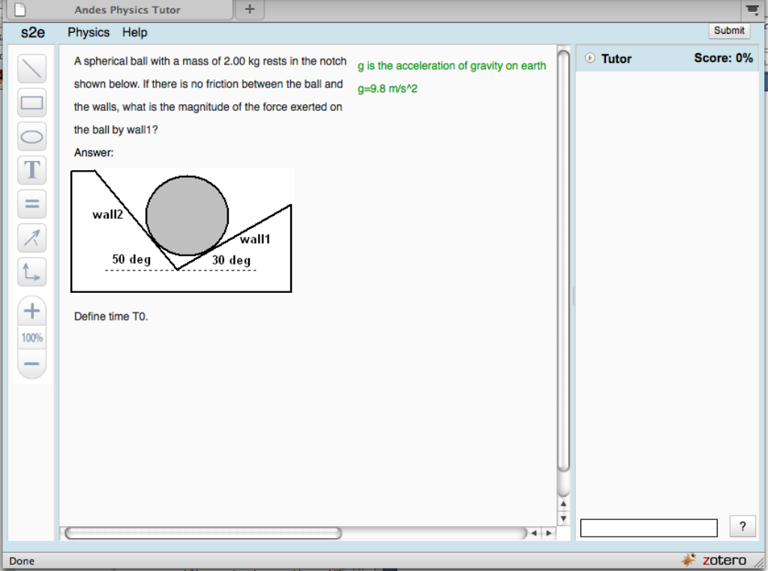
Notes:
Statics problem: find the force exerted by wall1.
This is what student sees at the beginning: problem statement & drawing area,
toolbar, and Tutor pane. Emphasize comment box.
(capture area 840x624 including tab and below canvas)

Slide 5
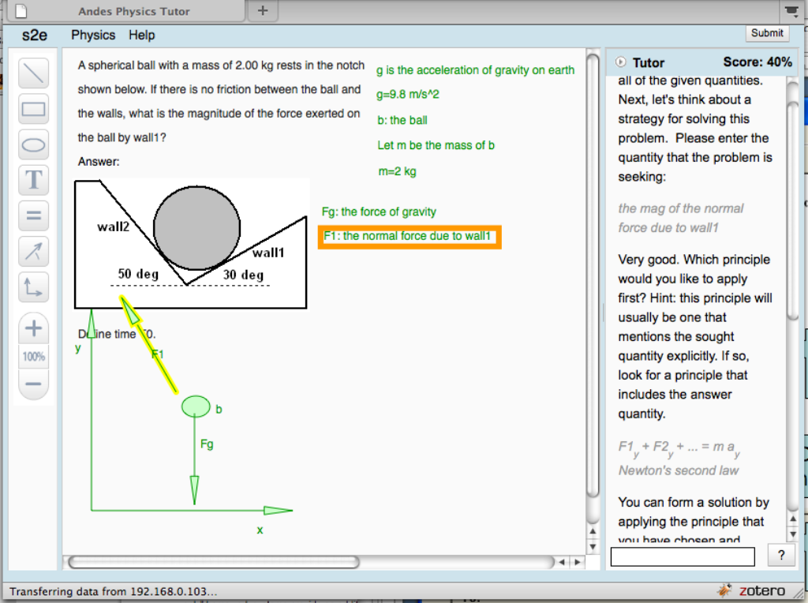
Define variables
Upon request, Andes gives hints for what to do next
Draw free body diagram
Define coordinates
(3 choices for this problem)
Notes:
Partially completed solution …
Andes teaches student good problem solving techniques.
Define variables, draw diagrams, define coordinates.

Slide 6
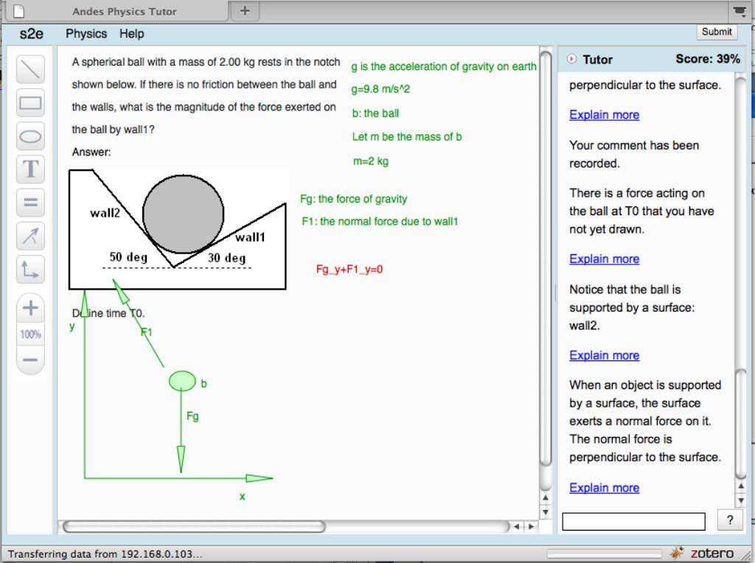
Immediate red/green feedback for student actions
Principles-based help for incorrect entry
Notes:
Red/green gives immediate feedback for each student entry.
In fact, the student has forgotten to draw one of the forces, the hints point this out.
Hint sequence: increasingly explicit.

Slide 7
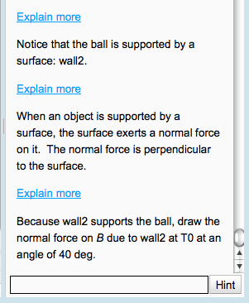
Help giving: what Andes does
Immediate red/green for all student entries
Evaluate wrong entries, error-specific hints
Lead student through solution (“Next Step Help”) with general strategy hints:
    “Draw a free body diagram.”
    “Apply Newton’s Second Law.”
  And step hints:
    “Write an equation for …”
    “Draw a velocity vector.”
Hint sequences for a step:
  Point
  Teach
  Bottom-out
Notes:
Explain backwards chaining (maybe not best from Physics point of view), we prefer top-down
Hints often in sequence: point: some aspect of the problem, general strategy/knowledge, “do this”

Slide 8
Meta-Hints
  “You should watch the Introductory Video.”
  “You seem confused, maybe you should ask for help.”
Explain user interface actions
  Click on help button
  Click on link in hint for further help
  Notation for labeling objects like vectors or bodies.
Notes:
“Start over” is frequent strategy of human tutors.

Slide 9
Summarize results from earlier work
First lab study: Students often do not ask for help when they are stuck, even if they show signs of frustration (e.g. repetitive behaviors)
Second lab study: Providing unsolicited hints for UI/Andes convention related errors improves performance
In vivo analysis: Obvious improvements to help-giving policies may be unsuccessful. E. g. Hint given to floundering students to “watch the Intro Video” rarely works.
Notes:
Raj reported that students generally left the study with a positive attitude towards Andes (in contrast to Lab Study 1).

Slide 10
Summarize the summary
Improved help-giving policies:
  are needed
  can help students
  but may be non-intuitive, so ample verification is necessary.
Verification via conventional experimental methods (one experimental iteration per policy change) is time consuming
Notes:
Raj reported that students generally left the study with a positive attitude towards Andes (in contrast to Lab Study 1).

Slide 11
Strategy for improving help policies
Select help-giving policies to be varied
Andes with random help policy
Deploy in classroom
Log data
Notes:
Raj reported that students generally left the study with a positive attitude towards Andes (in contrast to Lab Study 1).

Slide 12
Strategy for improving help policies
Select features for student state
Model of learning
Select help-giving policies to be varied
Determine state & policy for each step
Determine step when KC is learned
Find machine-learned help policy
Andes with random help policy
Extract steps for each student-KC
Andes with machine learned help policy
Deploy in classroom
Log data
Notes:
Raj reported that students generally left the study with a positive attitude towards Andes (in contrast to Lab Study 1).

Slide 13
In vivo study:
Random-help policy
Select help-giving policies to be varied
UW Platteville, 118 students. Tutor randomly chooses policy:
  After error, give unsolicited hint or not?
  Give normal hint sequence or give bottom-out hint first?
Andes with random help policy
Deploy in classroom
Log data
Notes:
2X2 policy choices, randomly choose default behavior vs. change and then choose from 2X2.
Normally use external post-test but typically very far away from the point where policy choice was made.
In this case we have an outcome that is close to the point where the policy choice was made.
Lasted 1 week, 120 hours of log data.
Problems with getting students started. Conclusion: intro problems were optional (so no one did them), students started up in middle of course with hard problems.

Slide 14
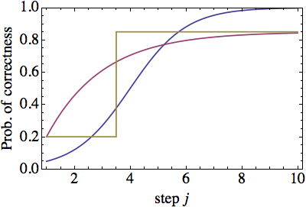
Models of learning
Model of learning
Bayesian Knowledge Tracing (BKT):
  3 parameters
  1-P(S)-A e^{-β j}
Logistic model:
  2 parameters
  1/(1+exp(-β(j-j0)))
Step model
  3 parameters
  If j<L then g else s
Notes:
2X2 policy choices, randomly choose default behavior vs. change and then choose from 2X2.
Normally use external post-test but typically very far away from the point where policy choice was made.
In this case we have an outcome that is close to the point where the policy choice was made.
Lasted 1 week, 120 hours of log data.
Problems with getting students started. Conclusion: intro problems were optional (so no one did them), students started up in middle of course with hard problems.

Slide 15
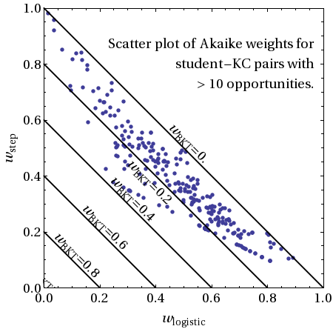
Which model is best?
Want to apply to individual student and KC
Want point of learning, and slip rate
For each student & KC, correct steps (first attempt turns green) labeled with 1 else 0
Akaike weight is relative probability of model being best explanation
Use AIC as fit criterion, with student data from summer 2011, St. Anselm college
1 = wBKT + wlogit + wstep
Model of learning
Notes:
2X2 policy choices, randomly choose default behavior vs. change and then choose from 2X2.
Normally use external post-test but typically very far away from the point where policy choice was made.
In this case we have an outcome that is close to the point where the policy choice was made.
Lasted 1 week, 120 hours of log data.
Problems with getting students started. Conclusion: intro problems were optional (so no one did them), students started up in middle of course with hard problems.

Slide 16
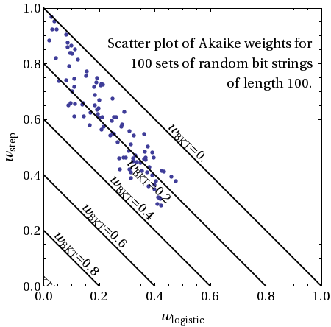
Too good to be true?
Would expect some points to favor BKT
Generate random bit strings of 100 steps: 001010100101101110010...
Model of learning
All models should fit this data set equally well
Should see weights centered at:
wBKT = wlogit = wstep = 1/3
Conclusion: AIC may be failing
Notes:
2X2 policy choices, randomly choose default behavior vs. change and then choose from 2X2.
Normally use external post-test but typically very far away from the point where policy choice was made.
In this case we have an outcome that is close to the point where the policy choice was made.
Lasted 1 week, 120 hours of log data.
Problems with getting students started. Conclusion: intro problems were optional (so no one did them), students started up in middle of course with hard problems.

Slide 17
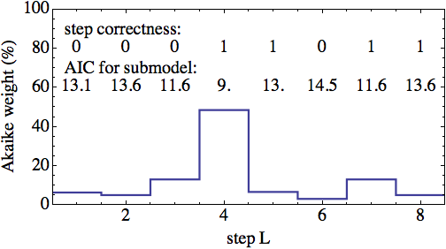
When does learning occur?
Correct step (first attempt turns green) labeled with 1 else 0
Apply Akaike weights to step model with fixed L and determine relative probability of L being at certain j.
Determine step when KC is learned

Slide 18
Reward
Assume transactions directly before “moment of learning” have effective help, using discount factor γ=1/2
Don't make any assumptions about other transactions
Determine step when KC is learned
More effecitve help?
Skill mastery
1
γ²
γ
1
0
less effective help?
transaction

Slide 19
Student state
Select features for student state
Must be computable in real time
Examples:
  Number of steps since last green (floundering)
  Length of problem solution (problem difficulty)
  Number of times student has applied relevant skill in class
  Number of help requests in current problem
  Number of seconds since last transaction
Could be result of a model of student (e.g. a Hidden Markov Model): probability student has learned given skill
State 1
State 2
State 3
State 4
State 5
State 6
transaction

Slide 20
For each relevant transaction, determine:
  Student state
  Policy that was used
  Whether help was effective
Compare policy with machine-learned policy
Determine state & policy for each step
Find machine-learned help policy
Proposed policy | Log data policy | Just before learning? | Reward
 |  | yes
 |  | yes
 |  | no
 |  | no
Just before learning?
Log data policy
Proposed policy
“ “
Policy model
Update policy model to maximize reward
State 1
State 2
State 3
State 4
State 5
State 6
transaction

Slide 21
In vivo study: machine learned help
Improved help version of Andes with dynamic calculation of student state; find machine learned hinting policy for that state; give help based on policy.
Run at St. Anselm College May-July 2012, 14 students, for entire two-semester course
For each homework set, randomly assign half of students to each condition
Andes with machine learned help policy
Deploy in classroom
Notes:
This is what we are working on now.
Next: apply machine learned help policy to Andes and try it out on students. Ideally, a 3-condition experiment with Andes default, machine learned, and random-help, and external pretest-post test. Have St. Anselm this summer, but too few students.
Write paper on In Vivo Study 2, machine learning.

Slide 22
Analysis
For each student/KC pair find:
  p(e), p(c) = Probability that KC was learned during experimental or control condition
  L = step where learning occurred
  Δ = 1-s-g = performance gain
For each KC and experimental condition, average L and Δ over students, weighted by p(e), p(c)
1
Δ=1-s-g
0
L
step
Notes:
This is what we are working on now.
Next: apply machine learned help policy to Andes and try it out on students. Ideally, a 3-condition experiment with Andes default, machine learned, and random-help, and external pretest-post test. Have St. Anselm this summer, but too few students.
Write paper on In Vivo Study 2, machine learning.

Slide 23
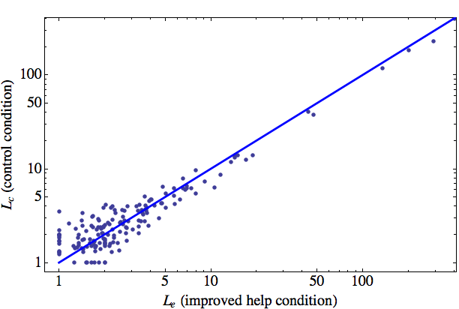
Scatter plot of (Le,Lc) for each KC
164 different KC's, including UI skills
Although L varies widely, no large changes in L between conditions
Weighted average of Le-Lc = -0.05±0.04 (p=0.12)
Ideally, Le<Lc and points would lie to left of blue line.
Notes:
This is what we are working on now.
Next: apply machine learned help policy to Andes and try it out on students. Ideally, a 3-condition experiment with Andes default, machine learned, and random-help, and external pretest-post test. Have St. Anselm this summer, but too few students.
Write paper on In Vivo Study 2, machine learning.

Slide 24
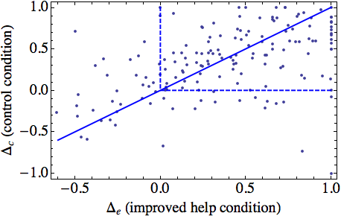
Scatter plot of (Δe,Δc) for each KC
Significant number of KCs with Δ < 0
Probably due to physics HW assignment style: problems ramp quickly in complexity
Individual points have large errors
Weighted average of Δe-Δc = 0.008±0.038 (p=0.41)
Ideally, Δe > Δc and points would be to right of blue line
Notes:
This is what we are working on now.
Next: apply machine learned help policy to Andes and try it out on students. Ideally, a 3-condition experiment with Andes default, machine learned, and random-help, and external pretest-post test. Have St. Anselm this summer, but too few students.
Write paper on In Vivo Study 2, machine learning.

Slide 25
Conclusion
Method for continuous improvement to help giving policies using in situ assessment
Need valid criterion for model selection
Completed one cycle of iterative process: need larger sample sizes
Conjecture: inclusion of preemptive hints (hints before student attempts step) may be crucial for Andes

