Slide 1
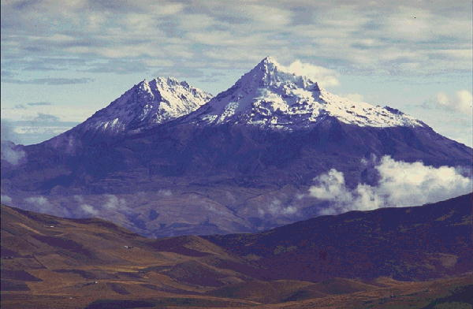
Adaptive help giving for physics homework problems
Brett van de Sande and Kurt VanLehn
Arizona State University

Slide 2
Outline
Introduction to Andes
  Example problem & usage
  Help-giving strategies
First experiment: New user behavior on a free-form user interface
Second experiment: Random-help policy
Third experiment: Machine learned help policy

Slide 3
Andes from the student’s perspective: an example from statics
Students at the USNA took an average of 15 minutes (median 13 minutes) to solve this.

Slide 4
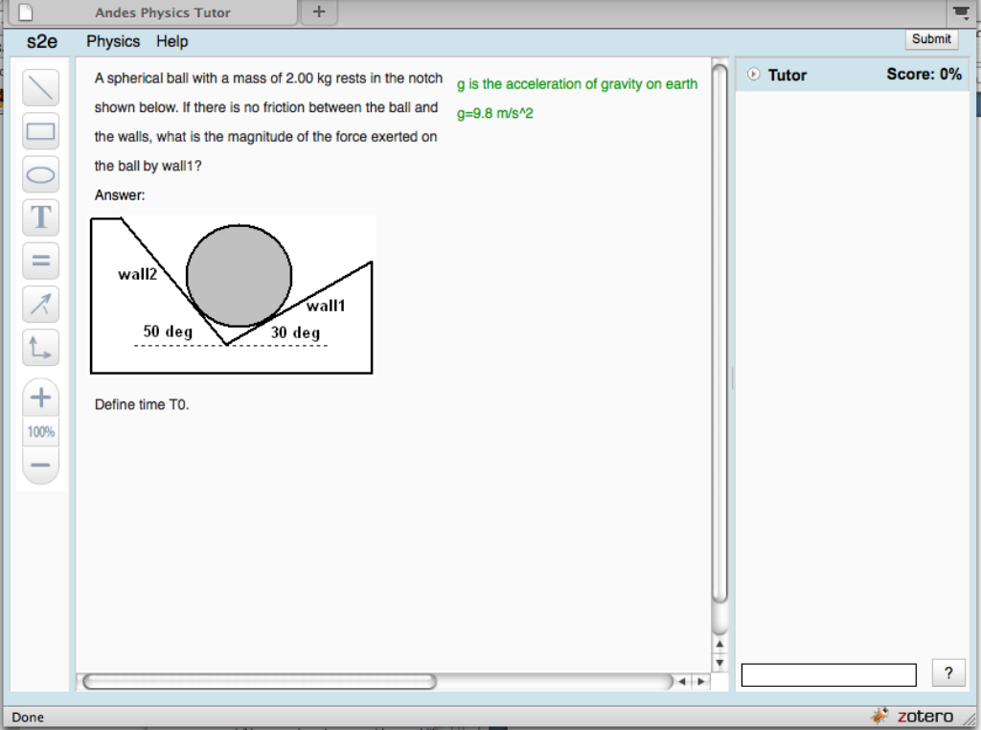
Notes:
Statics problem: find the force exerted by wall1.
This is what student sees at the beginning: problem statement & drawing area,
toolbar, and Tutor pane. Emphasize comment box.
(capture area 840x624 including tab and below canvas)

Slide 5
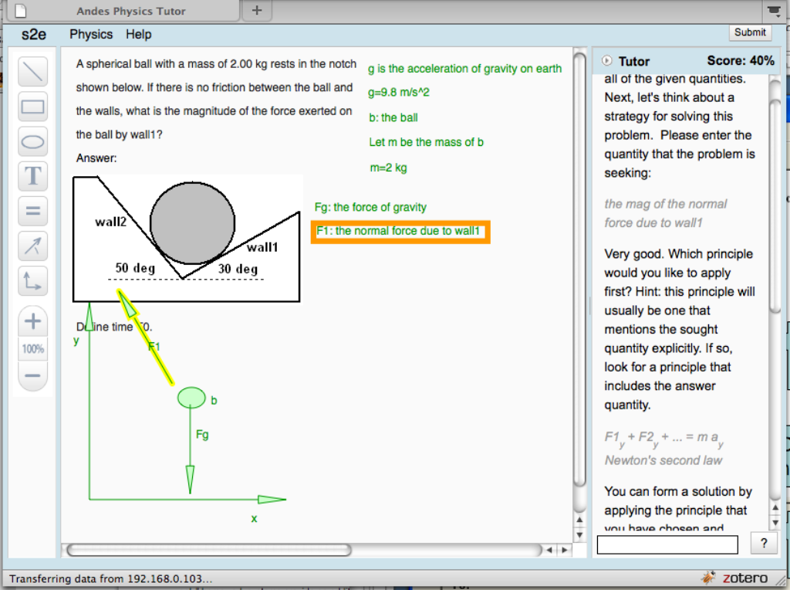
Define variables
Upon request, Andes gives hints for what to do next
Draw free body diagram
Define coordinates
(3 choices for this problem)
Notes:
Partially completed solution …
Andes teaches student good problem solving techniques.
Define variables, draw diagrams, define coordinates.

Slide 6
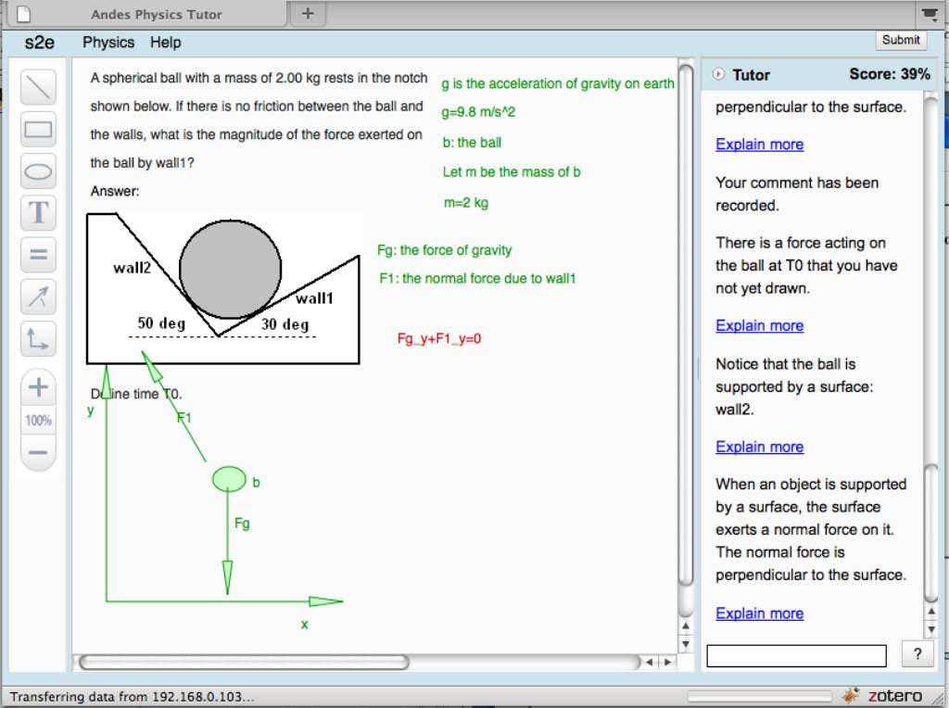
Immediate red/green feedback for student actions
Principles-based help for incorrect entry
Notes:
Red/green gives immediate feedback for each student entry.
In fact, the student has forgotten to draw one of the forces, the hints point this out.
Hint sequence: increasingly explicit.

Slide 7
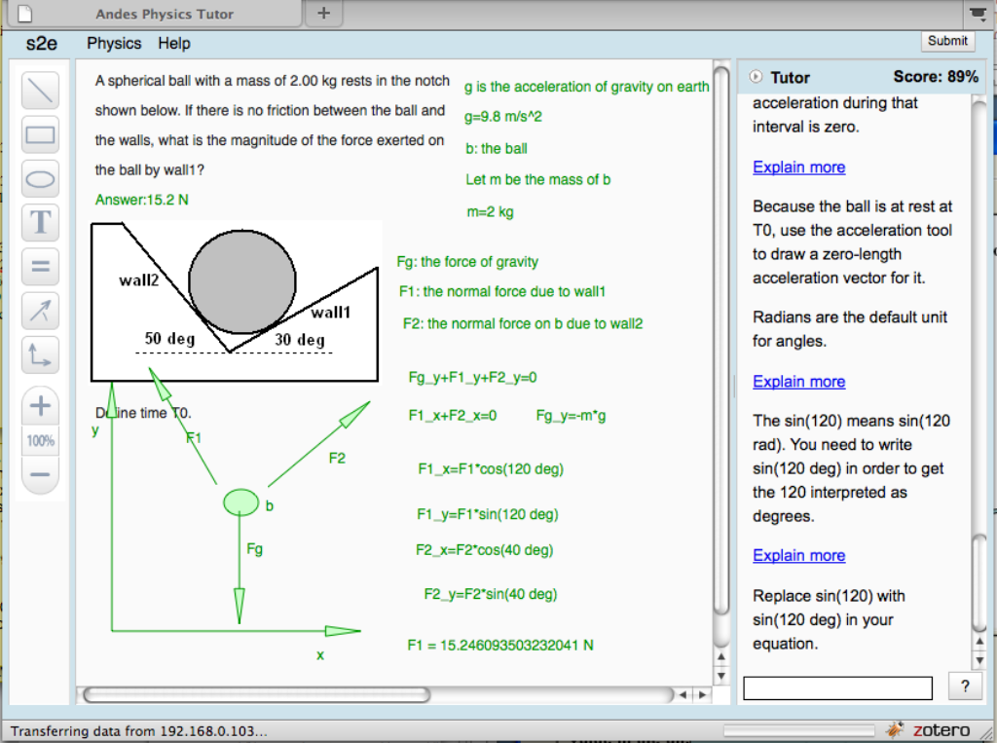
Completed Problem
score
Final answer only small part of solution
Notes:
Completed problem.
Students tend to substitute in numerical values too soon.
Andes computes numerical value: note that the final answer,
and numerical values are de-emphasized.
Score based on having all the needed equations, vectors drawn, axes,
needed scalars defined, with penalty for incorrect entries (turned red) and for
excessive help usage (bottom-out hints).

Slide 8
Usage
Homework component of standard two-semester Introductory course
Over 500 problems, covering most topics
Used in classrooms since 2000
  US Naval academy, MD
  Watchung Hills Regional High school, NJ
  St. Anselm College, NH

Slide 9
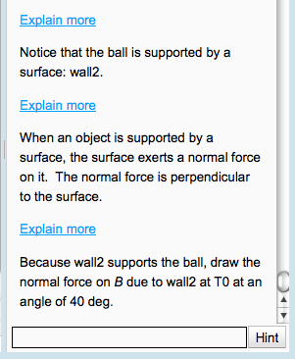
Help giving: what Andes does
Immediate red/green for all steps
Evaluate wrong entries, error-specific hints
Lead student through solution (“Next Step Help”) with general strategy hints:
    “Draw a free body diagram.”
    “Apply Newton’s Second Law.”
  And step hints:
    “Write an equation for …”
    “Draw a velocity vector.”
Hint sequences for a step:
  Point
  Teach
  Bottom-out
Notes:
Explain backwards chaining (maybe not best from Physics point of view), we prefer top-down
Hints often in sequence: point: some aspect of the problem, general strategy/knowledge, “do this”

Slide 10
Meta-Hints
  “You should watch the Introductory Video.”
  “You seem confused, maybe you should ask for help.”
Explain user interface actions
  Click on help button
  Click on link in hint for further help
  Notation for labeling objects like vectors or bodies.
Notes:
“Start over” is frequent strategy of human tutors.

Slide 11
Machine Learned Help Policy

