Slide 1


Cryptocurrency Price Forecasting
&
Portfolio optimization

Slide 2
Agenda
1
Context & Tasks
2
Data preparation
3
Feature selection
4
Modeling & Evaluation
5
Portfolio creation

Slide 3
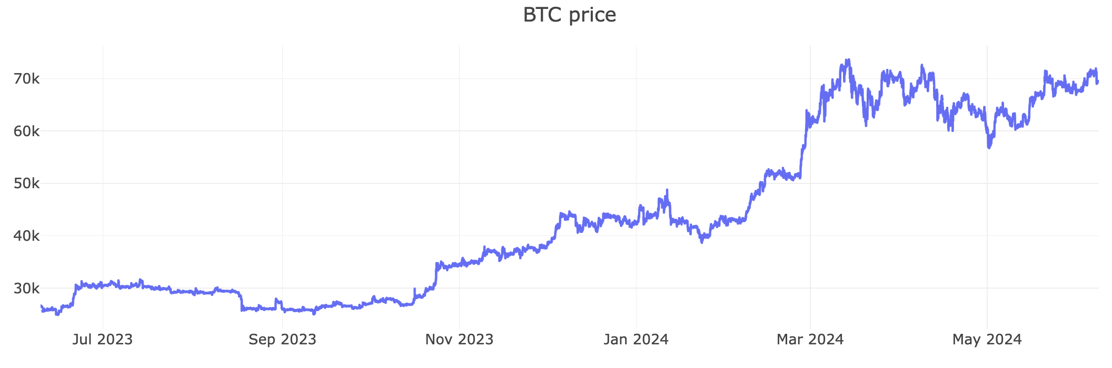
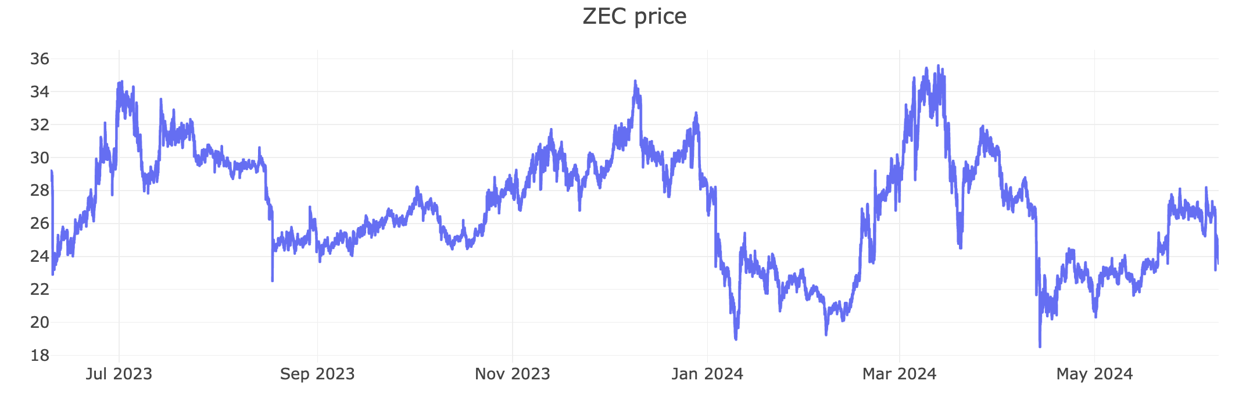
Context
56 crypto currencies
1 year of data (generally)
1 min frequency
Min price: 0.000059 WIN
Max price: 73,656 BTC

Slide 4

Tasks
1
Predict prices
2
Optimize portfolio
3

Slide 5
Data Preparation
1
Data Cleaning
2
Data Transformation
Missing values: separate model for each currency
Remove outliers: no
Errors in the dataset: close price previous period does not equal open price next period (minimal due to rounding)
Frequency: aggregation 15 minutes
Preprocessing: PCA
Modelling: MinMax normalization (SVM)
Feature selection
Cross validation
3
4
Cross validation for model testing
Train set: 1000 observation

Slide 6
Data Exploration
Correlation matrix close price
Correlation matrix price %

Slide 7
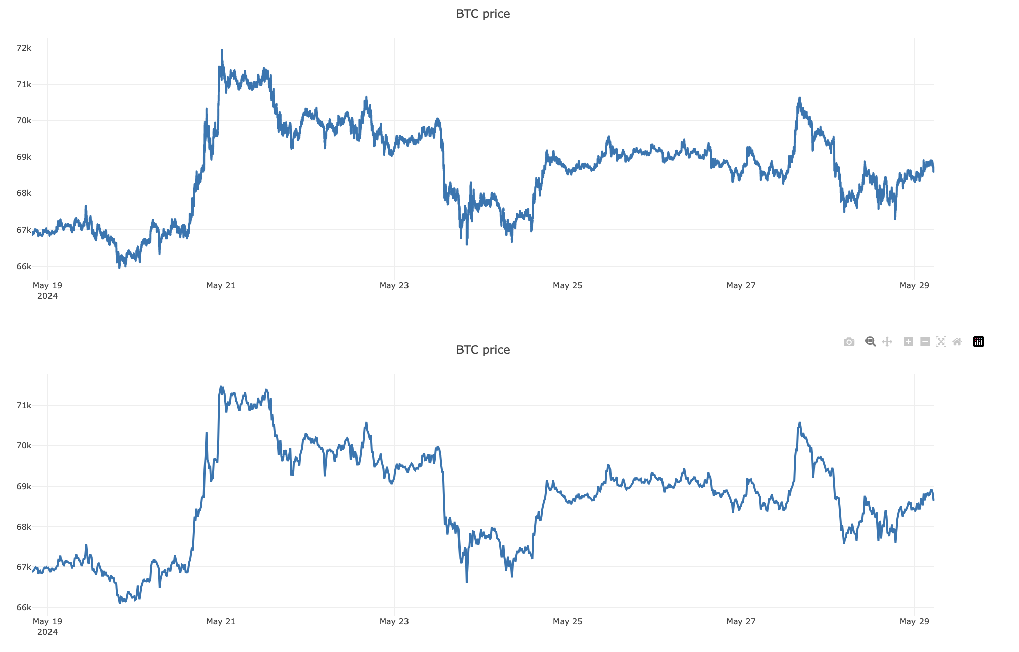
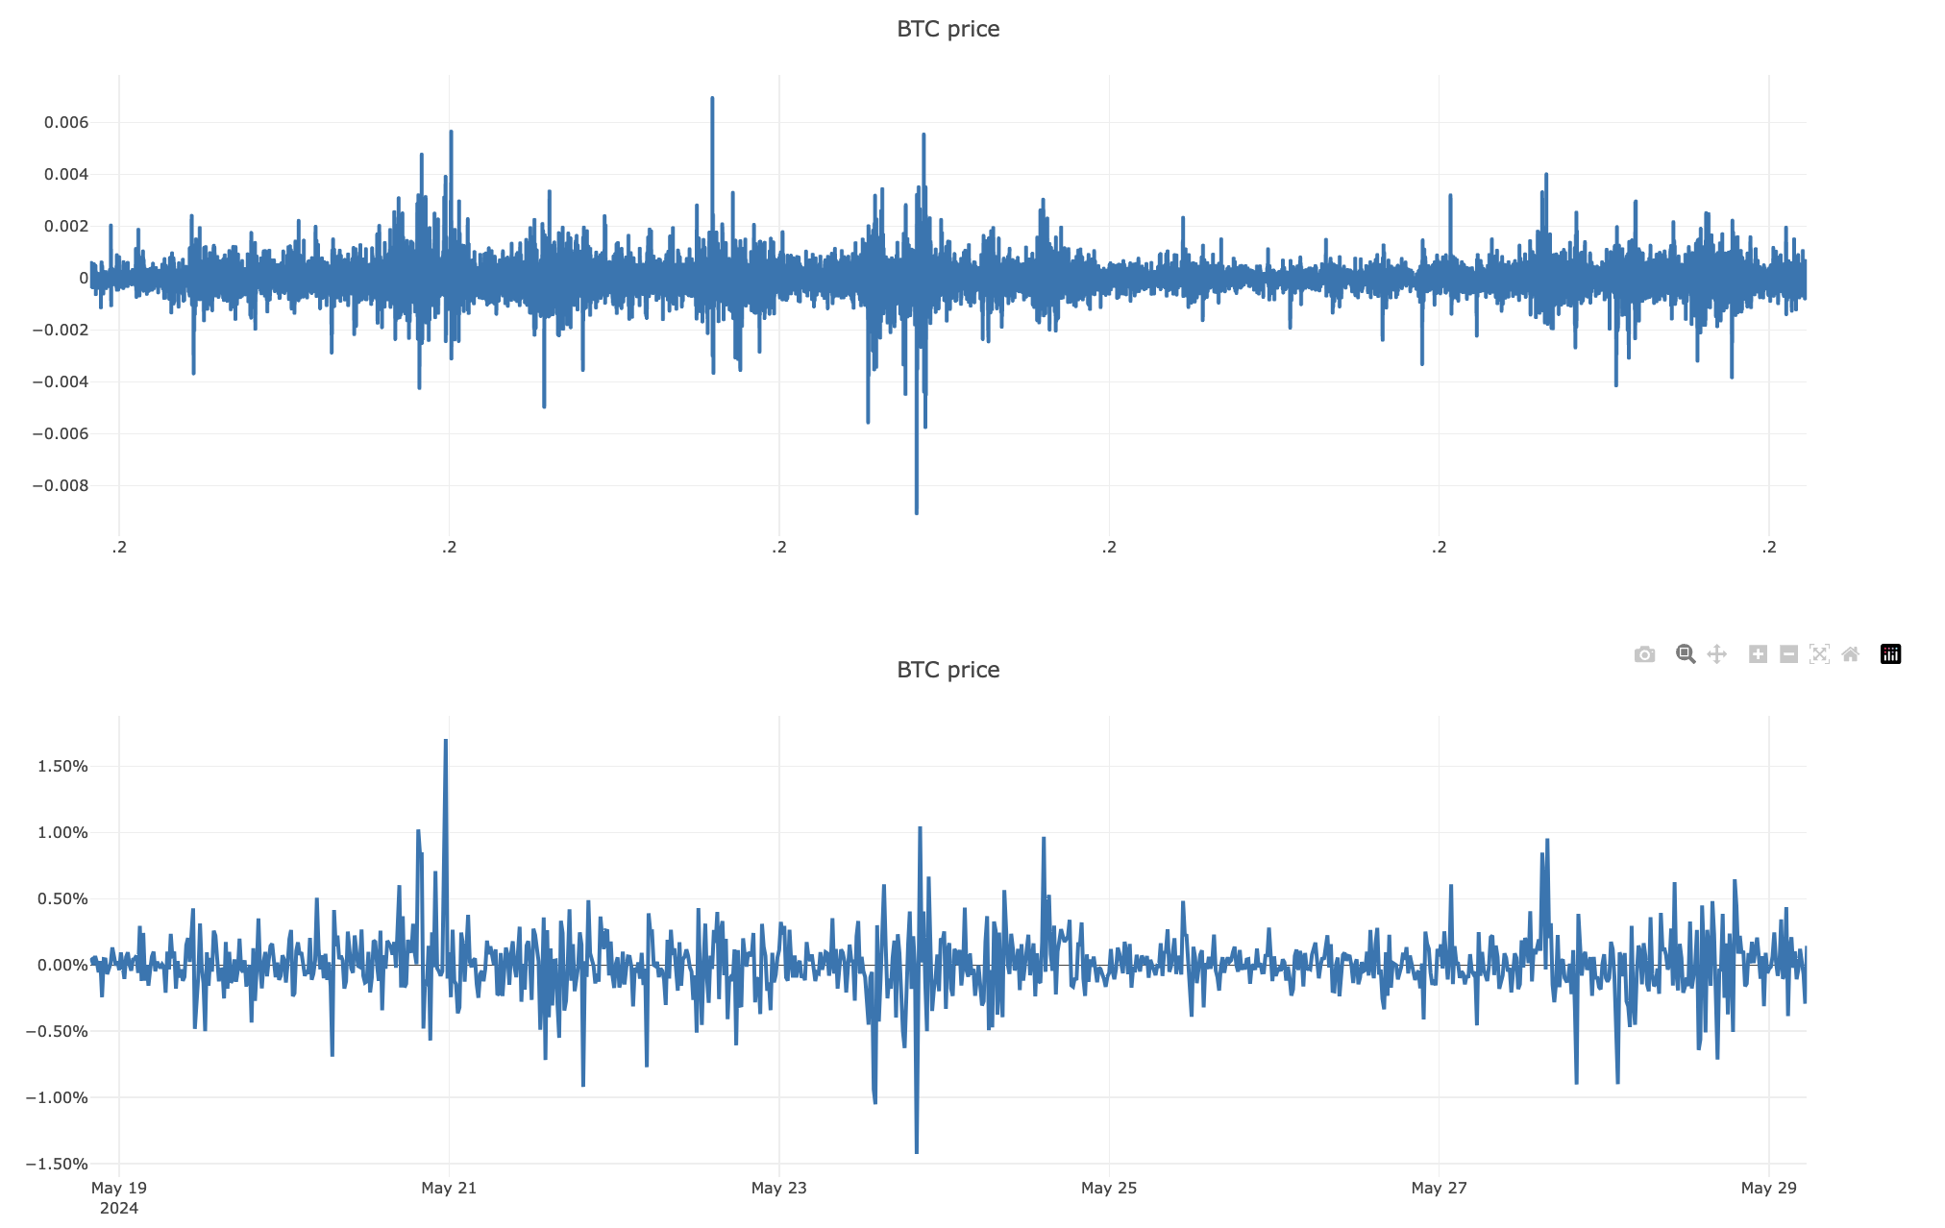
Resampling
Time span: 2024-05-18 19:45:00 ---> 2024-05-29 05:30:00

Slide 8
Feature Engineering
Time-related
Year
Month
Day
Rolling stats
Moving average
Moving std
Equal weight
EMW
Day of week
Weekend
Hour
Other
Lags
H-L relative to Close price
MACD*
Literature
Tweets
Macro variables
*MACD: moving average convergence divergence

Slide 9
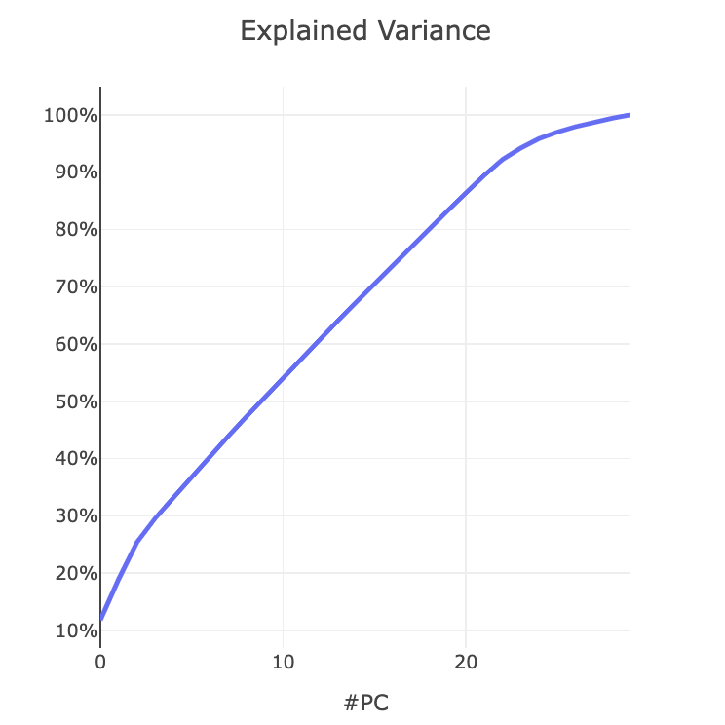
Feature Selection
BTC example
Initial
59
VIF
(threshold 10, 23 iterations)
37
PCA
(3 components)
14

Slide 10
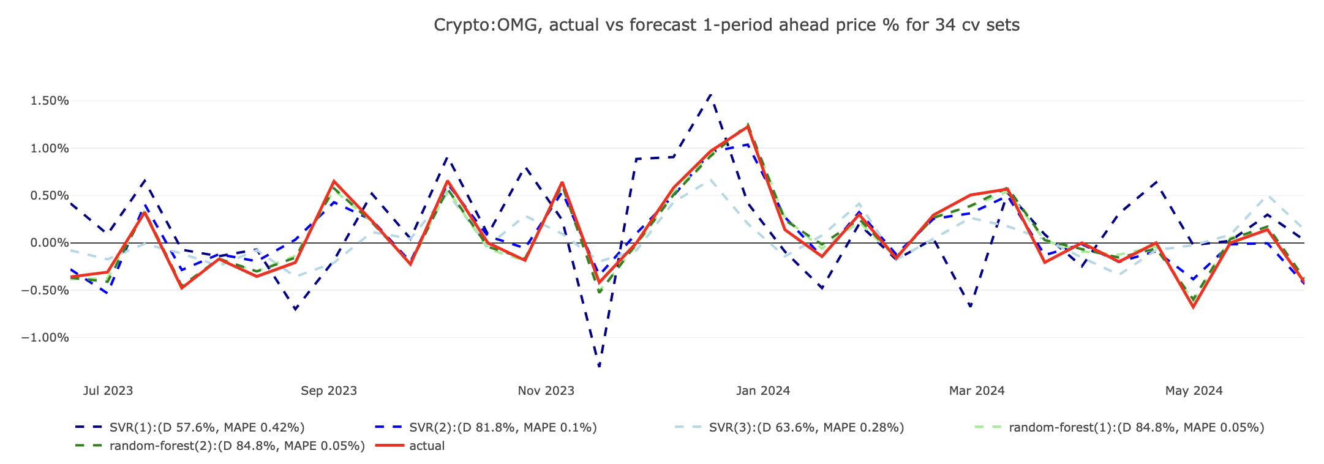
Model Selection I
ARIMA
Linear Regression
Support Vector Regression:
{'kernel':'linear','gamma':0.2,'C':10,'epsilon':0.05}
{'kernel':'rbf','gamma':0.2,'C’:5,'epsilon':0.01}
{'kernel':'poly','gamma':0.2,'C’:2'epsilon':0.05}
Random Forest
{'n_estimators’:30,'random_state’:0}
{'n_estimators’:50,'random_state’:3}

Slide 11
Model Selection I
ARIMA
Linear Regression
Support Vector Regression:
{'kernel':'linear','gamma':0.2,'C':10,'epsilon':0.05}
{'kernel':'rbf','gamma':0.2,'C’:5,'epsilon':0.01}
{'kernel':'poly','gamma':0.2,'C’:2'epsilon':0.05}
Random Forest
{'n_estimators’:30,'random_state’:0}
{'n_estimators’:50,'random_state’:3}

Slide 12
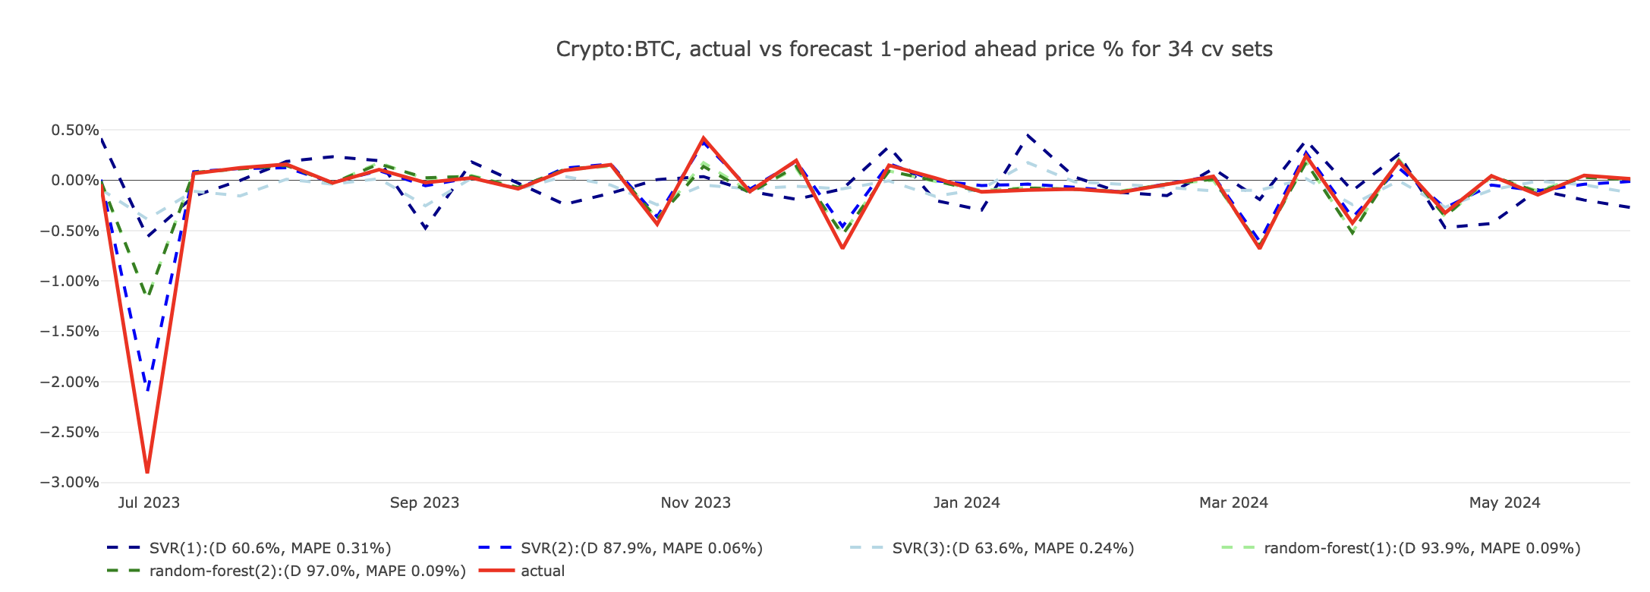
Model Selection I

Slide 13
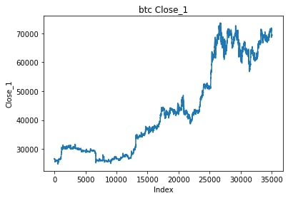
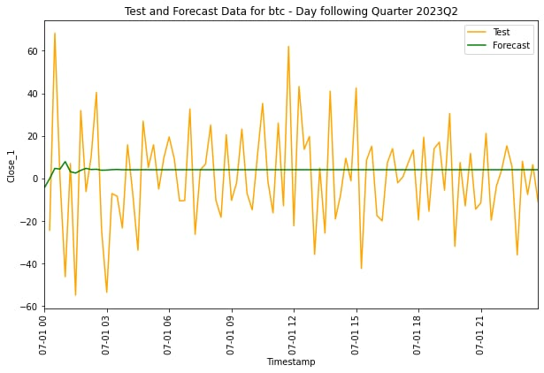
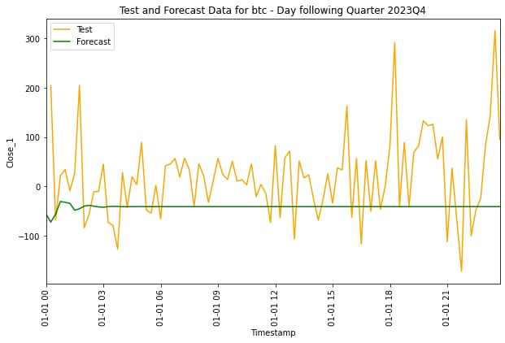
Model Selection ARIMA (1)
Train set
2023 Q1 prediction and test
2023 Q2 prediction and test

Slide 14
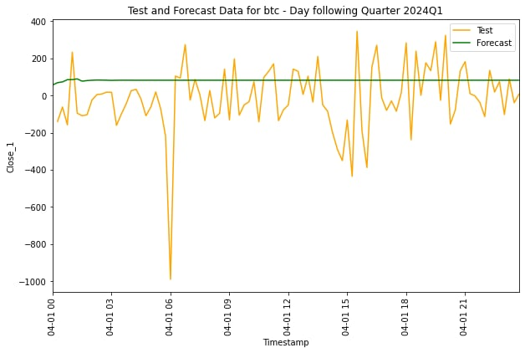
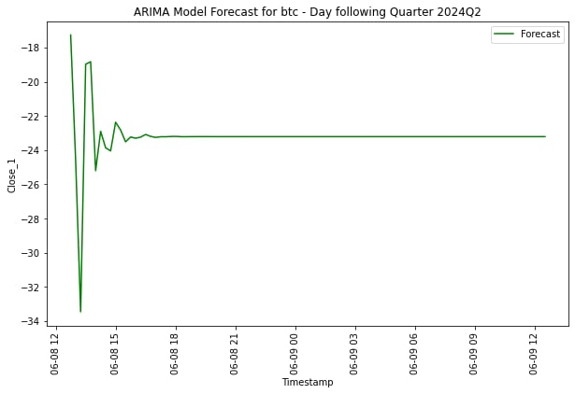
Model Selection ARIMA (2)
2023 Q3 prediction and test
2023 Q4 prediction and test
2024 Q1 prediction

Slide 15
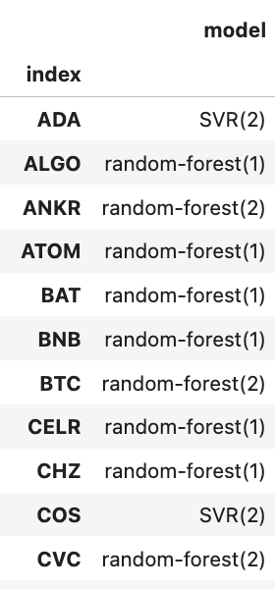
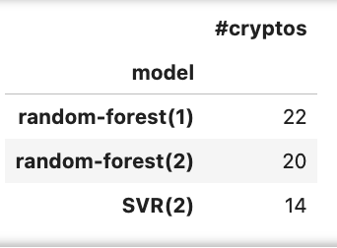
Model Selection II

Slide 16
Portfolio selection
Initial investment: 10,000 USD
Transaction costs: 0.25%
Returns optimal weights by Maximizing Sharpe ratio*
Tested on:
latest data from Binance (47 data points): 15 minutes, 1hour
historical data
*Expected portfolio return/ std: std based on last 1000 observations returned

Slide 17
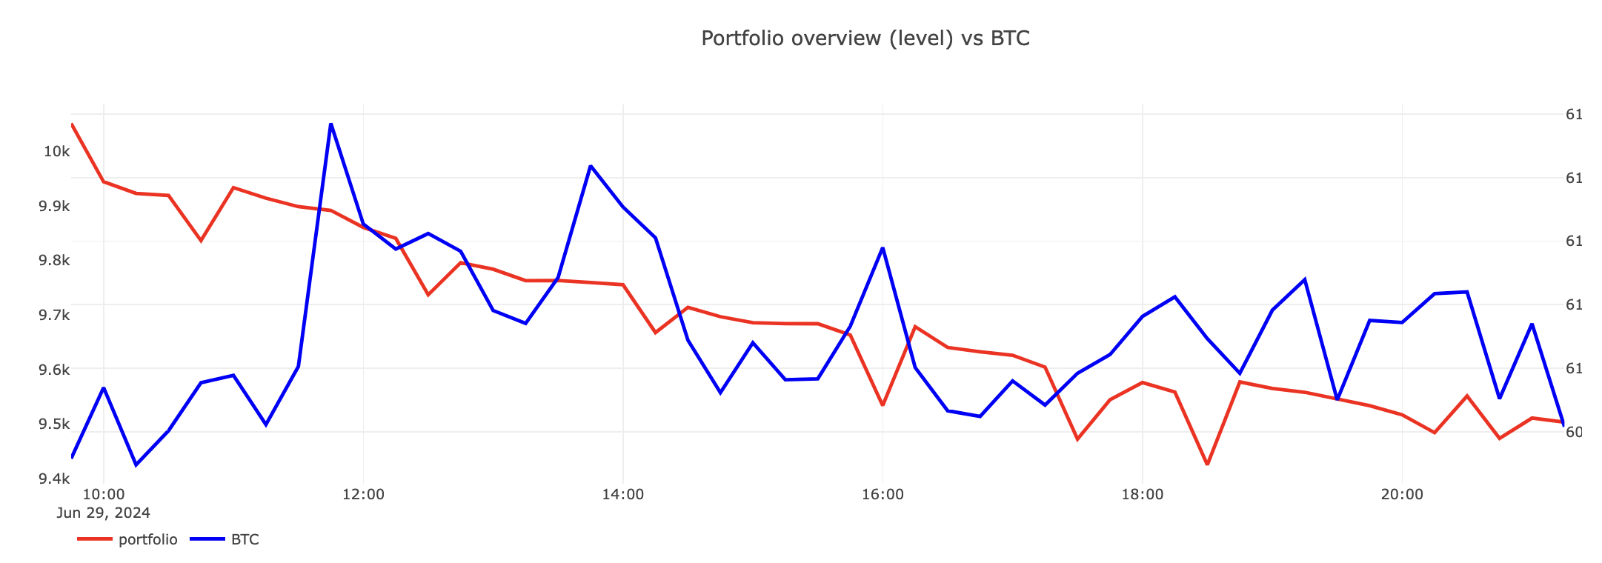
Portfolio performance (BTC)
Recalculating weights every 15 minutes

Slide 18
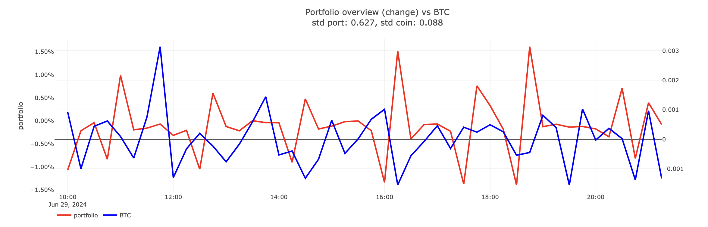
Portfolio performance (BTC)
Recalculating weights every 15 minutes

Slide 19
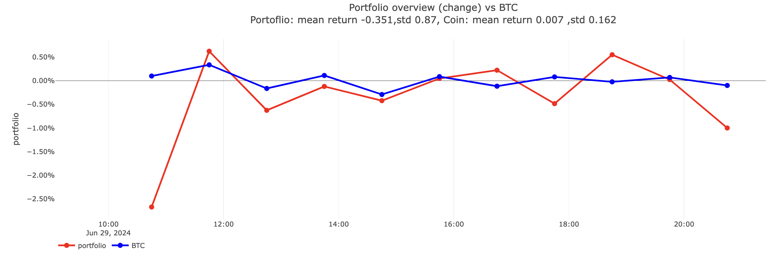
Portfolio performance (BTC)
Recalculating weights every hour

Slide 20
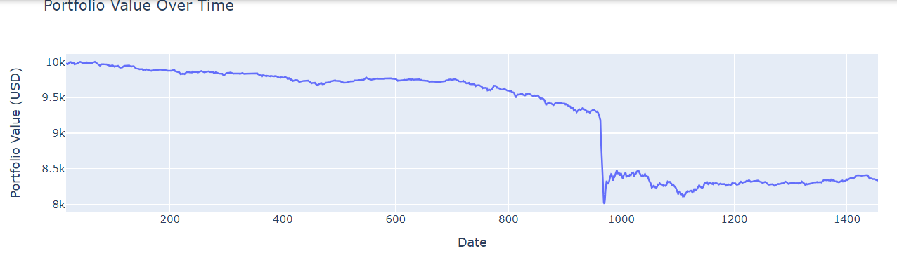
Portfolio performance with different forecasting models
Linear regression – 1 day

Slide 21
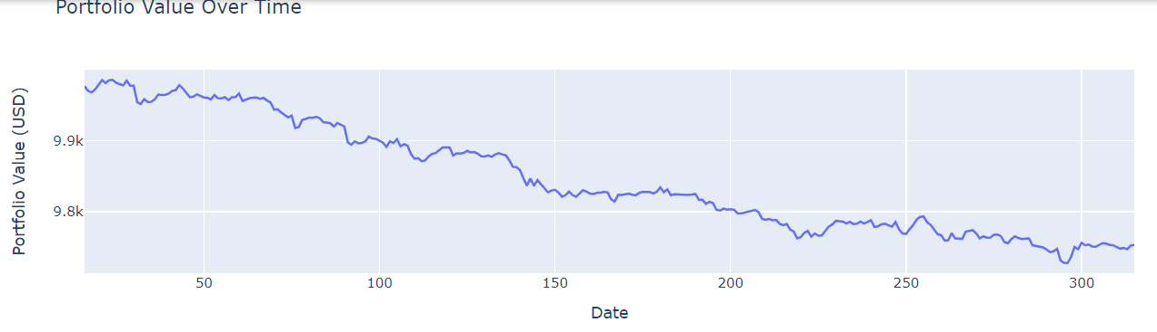
Portfolio performance with different forecasting models
ARIMA – 5 hours

Slide 22
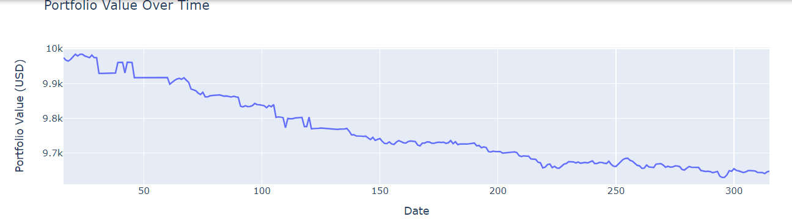
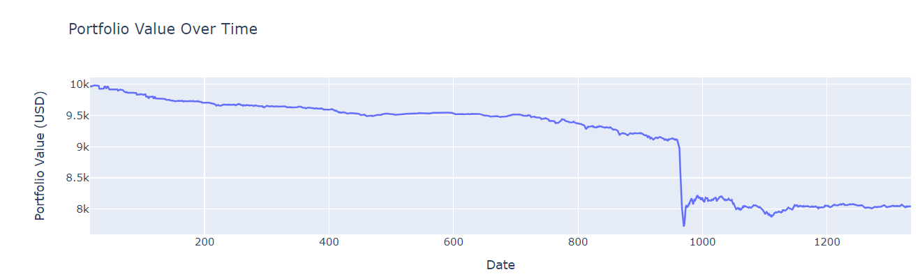
Portfolio performance with different forecasting models
ARIMA and XGBoost – 5 hours and 1 day

Slide 23
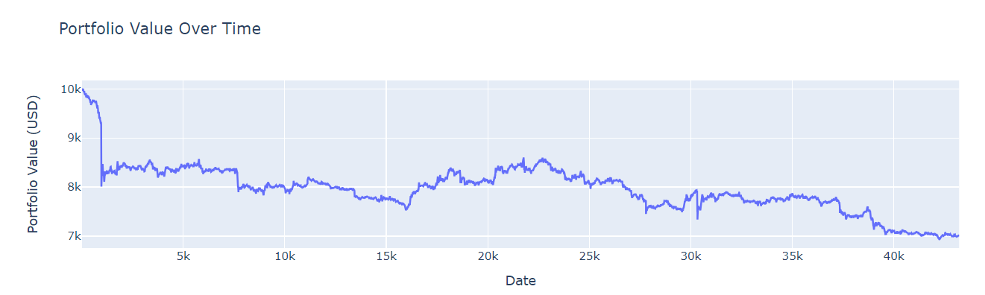
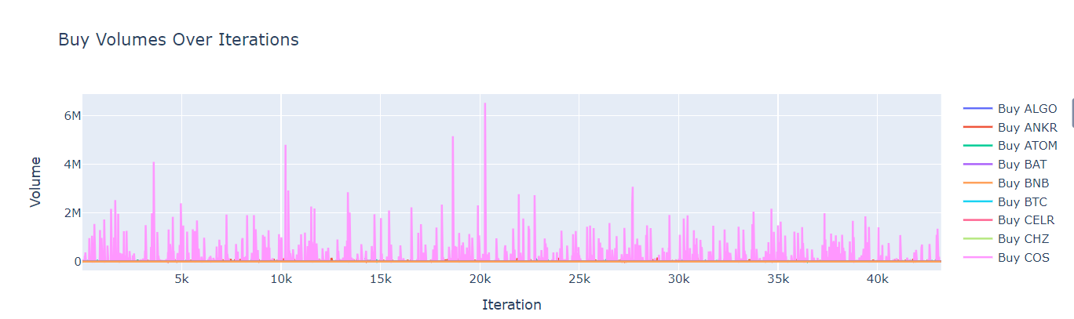
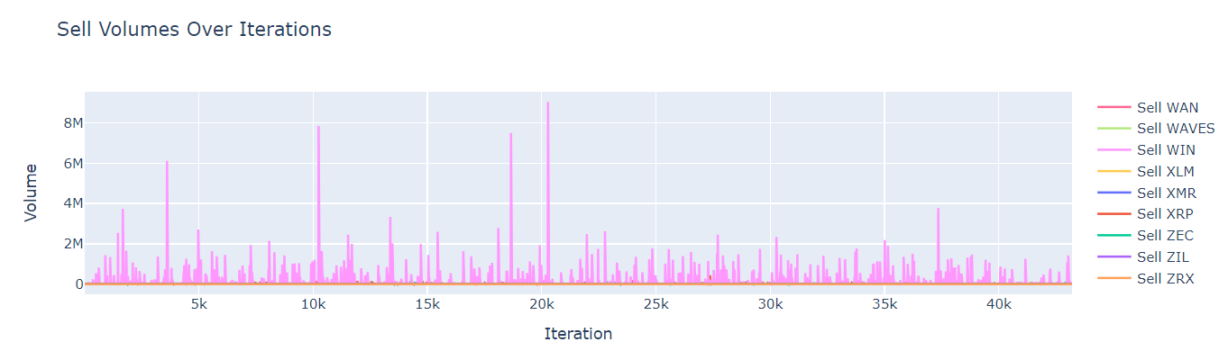
Portfolio performance with different forecasting models
Linear regression – 30 days

