Slide 1
VIVE ‘Where entertainment meets innovation’ Group-2
By:
Venkat Sai Kiran Bachu (VXB220061)
Rupa Reddy Nandikonda (RXR230021)
Akshara Reddy Mutyala (ARM230002)
Sai Vakula Bikkumandla (SXB220214)

Slide 2
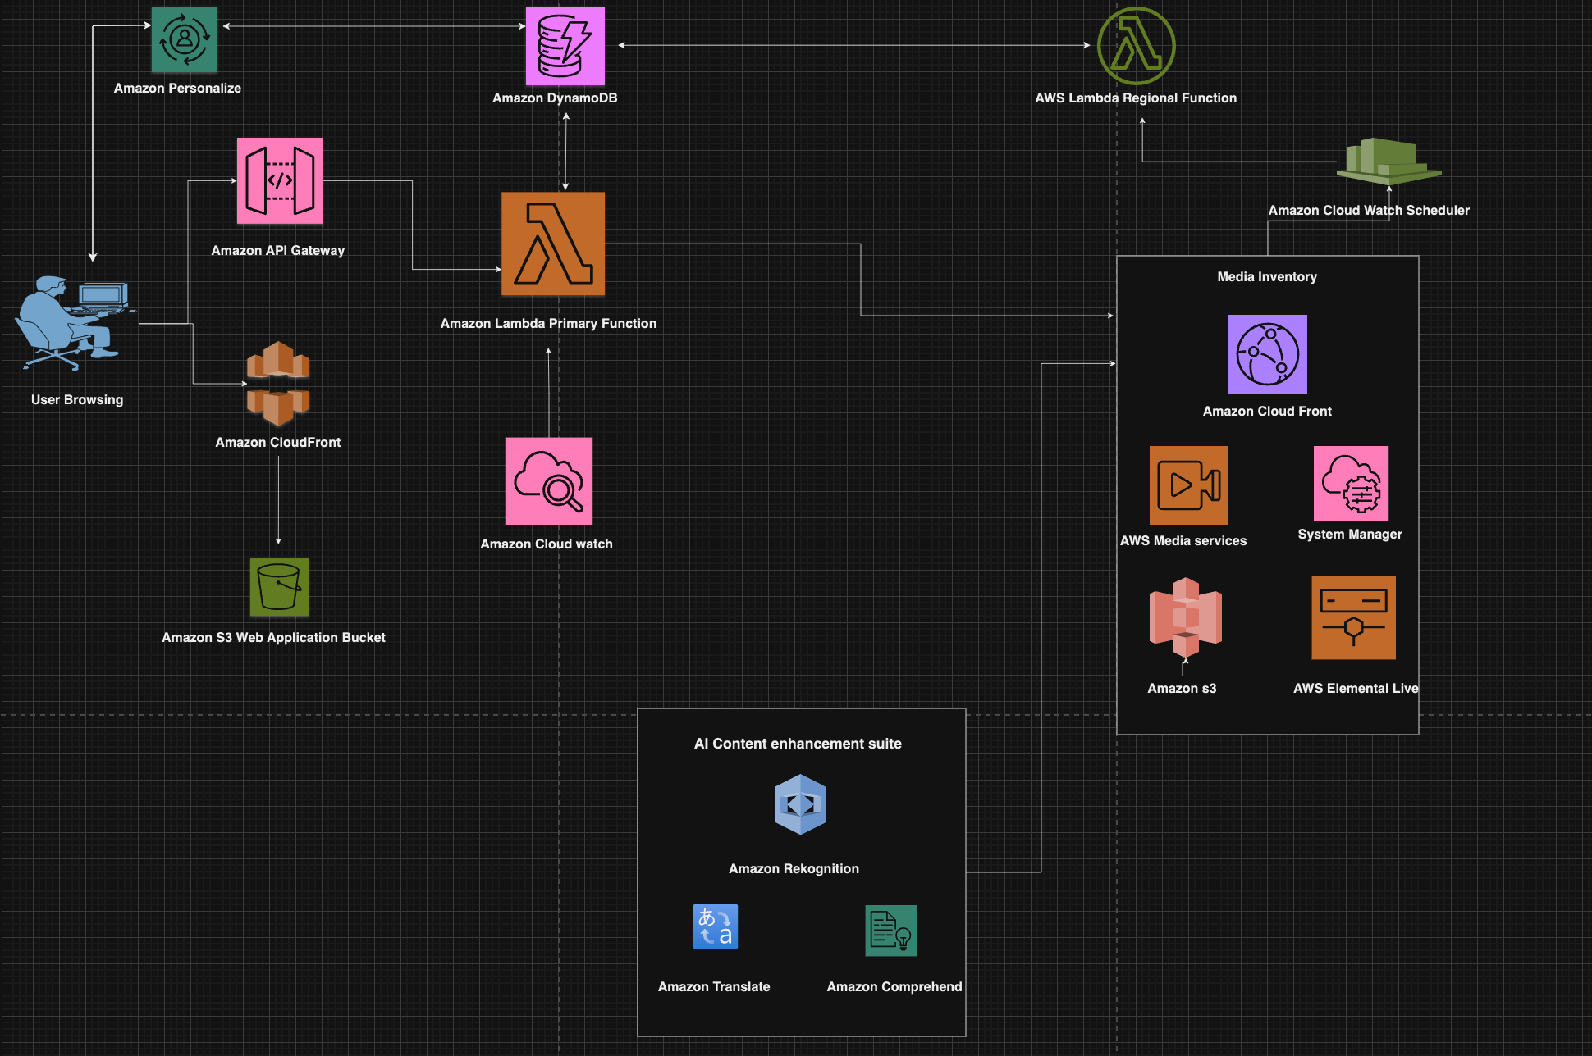
AWS Cloud Architecture

Slide 3
Business Requirements:
•⁠ ⁠Scalability: Our project's architecture has to be highly scalable, with the ability to
handle and maintain workloads, especially in high usage times like the release of
popular media content or live events. The architecture can continuously scale to
accommodate increased demand without any kind of performance issues, ensuring
smooth going.
•⁠ ⁠High availability: At times, media and entertainment services must be accessible
around the clock to satisfy consumer demands. Our architecture is designed with
redundancy and fault tolerance to ensure continuous service availability 24/7.
•⁠ ⁠Content delivery: Efficient content delivery is critical for media and entertainment
services. The project will support content delivery networks (CDNs) for fast and
reliable distribution of media content to end-users globally, reducing delay and
improving user experience.

Slide 4
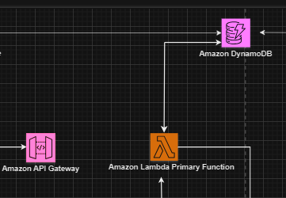
Key Components
Amazon API Gateway: API Gateway acts as the traffic director for our applications or services, ensuring that requests from users are securely routed to the right backend systems, allowing users to interact with our application seamlessly.
Amazon Lambda Primary Function: This refers to a Lambda function that is configured to run in the primary AWS region associated with your account. When you create a Lambda function without specifying a region, it is typically deployed in the primary region by default. This means that the function will execute in the primary region's data centers.

Slide 5
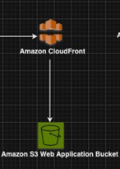
Amazon CloudFront: Amazon CloudFront is a fast content delivery network (CDN) service that securely delivers data, videos, applications, and APIs to customers globally with low latency and high transfer speeds.
Amazon S3: Amazon S3 is an object storage service that offers industry-leading scalability, data availability, security, and performance.

Slide 6
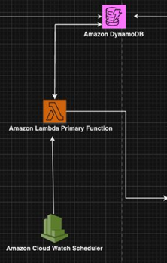
Amazon Cloud Watch Scheduler: Amazon CloudWatch Scheduler allows you to create custom schedules to automate actions within your AWS environment.
Amazon DynamoDB: Amazon DynamoDB is a fully managed NoSQL database service that provides fast and predictable performance with seamless scalability.

Slide 7
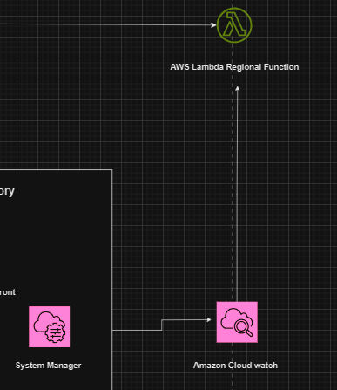
Amazon Lambda Regional Function: “Regional Function" specifically indicates that the Lambda function is deployed to a specific AWS region other than the primary one. AWS Lambda allows you to deploy functions in multiple regions, which can be useful for various reasons such as reducing latency for users in different geographic locations or ensuring high availability by running functions in multiple regions simultaneously.
Amazon CloudWatch: Amazon CloudWatch is like a watchtower for cloud resources. It keeps an eye on things like servers, databases, and applications, collecting data and providing insights to help you monitor, troubleshoot, and optimize AWS infrastructure.

Slide 8
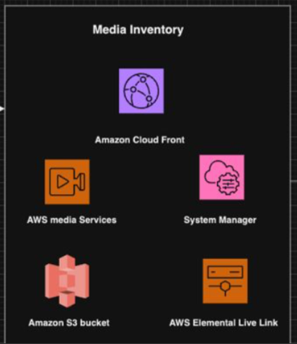
Media Inventory
AWS Media Services: AWS Media Services offer a range of services for processing, storing, and delivering media content at scale.
AWS Systems Manager: AWS Systems Manager provides a unified user interface so you can view operational data from multiple AWS services and automate operational tasks across your AWS resources.
AWS Elemental Live Link: AWS Elemental Live Link is a service that helps you send high-quality video feeds from one location to another in real-time. It's like a reliable pipeline for broadcasting live events or streams, ensuring that your content reaches viewers without delays or interruptions.

Slide 9
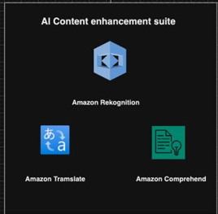
AI Content Enhancement Suite
Amazon Rekognition: Amazon Rekognition is a deep learning-based image and video analysis service that can identify objects, people, text, scenes, and activities in images and videos.
Amazon Translate: Amazon Translate is a neural machine translation service that delivers fast, high-quality, and affordable language translation.
Amazon Comprehend: Amazon Comprehend is like a super-smart reading assistant that helps you understand what a bunch of text is all about. It reads through paragraphs, articles, or even social media posts and figures out the main topics, feelings, or important information.
Amazon Personalize: Amazon Personalize is a machine learning service that enables developers to create individualized recommendations for customers.

Slide 10
AWS Pricing
AWS Service | Quantity | Cost(USD per month)
Amazon API Gateway | 5,000,000 requests | $15.00
Amazon DynamoDB | 5,500,000 reads/writes | $6.00
AWS Lambda | 750,000 seconds | $9.00
Amazon CloudWatch | 20-30 GB logs, 14 metrics | $2.00
Amazon S3, CloudFront |  | Free/ No cost

Slide 11
THANK YOU

