Slide 1
Designing a Coprocessor using Xilinx AXI Bus CprE 581
Aaron Mills, Blake Vermeer
Date: 12/15/2014

Slide 2
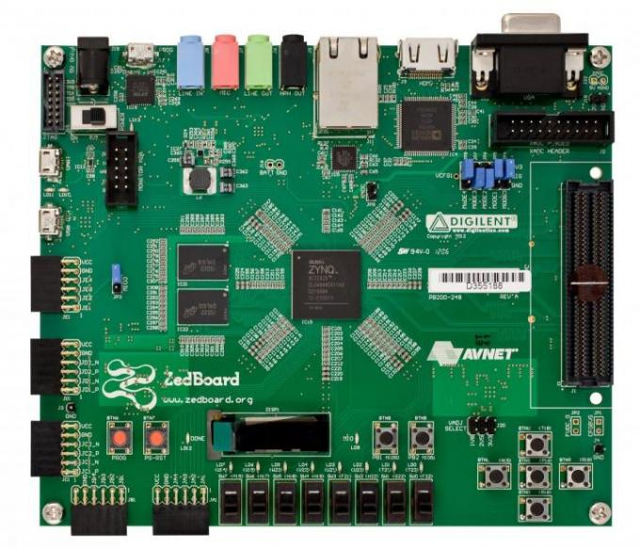
Project Goals
True Random Number Generator (TRNG) major components:
Entropy Source (based on prior research)
cryptographic hash stage
Explore the performance implications of several interface techniques on Xilinx Zync-7000 core
Identify performance bottlenecks

Slide 3
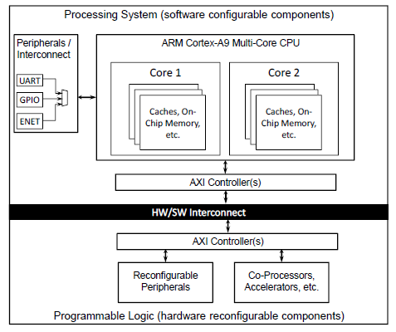
Coprocessor Integration
Zynq Coprocessor can be attached to CPU in several ways
Memory-mapped IO (through register, easiest)
High-speed DMA link from programmable logic (PL) to on-chip SRAM, offchip DRAM
Accelerator Coherency Port—High-speed DMA link from PL to L1 cache (fastest)

Slide 4
Memory-Mapped Peripheral Template
User Logic contains 32 registers
X

Slide 5
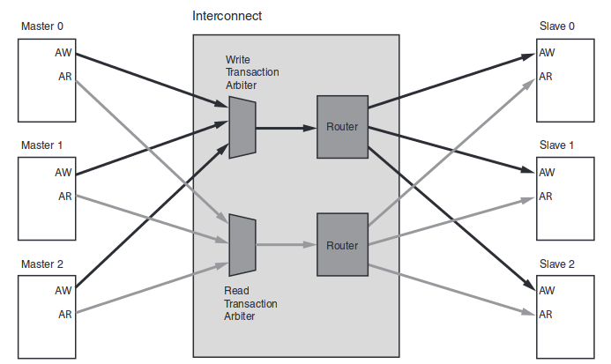
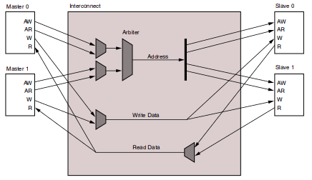
AXI Interconnect Structure
The Zynq-7000 processor has two different interconnect options for the AXI bus:
1. Sparse Crossbar 2. Shared Access

Slide 6
Sparse Crossbar Interconnect
Build around a shared-address multiple-data (SAMD) topology
One central address arbitrator
Advantage
Allows for multiple read and write data paths between devices
Disadvantage
Requires more logic to implement than the shared access interconnect mode

Slide 7
Shared Access Interconnect
Only a single device can use the bus at any one time
Priority given to read requests
One central address arbitrator
Advantage
Requires less logic to implement than the sparse crossbar interconnect mode
Disadvantage
Lower performance than sparse crossbar interconnect mode

Slide 8
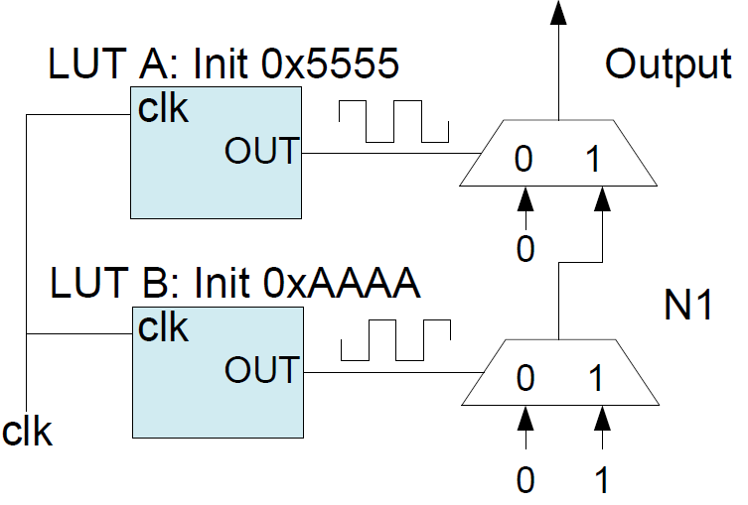
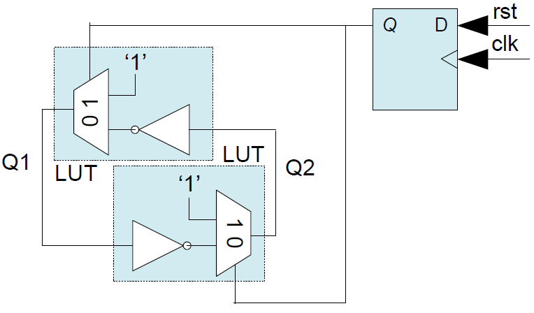
User Logic -- TRNG
Physically Unclonable Function
Unpredictable hardware structure which produces a 1 or 0 based on silicon delay properties
Anderson PUF
Memory PUF

Slide 9
Verify AXI clock
v1 = Xil_In32(AXILITE_BB_REG(31));
usleep(1000);
v2=Xil_In32(AXILITE_BB_REG(31));
printf("diff: %u\n\r",v1,v2-v1);
Diff: 99931 (roughly 100k)
1 / (1ms / 100k ) = 100Mhz

Slide 10
Code Optimization
//<- read timer here
for(i=0;i<100000;i++){
v1 = *(volatile u32 *) AXILITE_BB_REG(31);
}
//<- read timer here
mov r3, #0
str r3, [fp, #-8]
b .L6
.L7:
mov r3, #124
movt r3, 28064
ldr r3, [r3, #0]
str r3, [fp, #-40]
ldr r3, [fp, #-8]
add r3, r3, #1
str r3, [fp, #-8]
.L6:
ldr r2, [fp, #-8]
movw r3, #34463
movt r3, 1
cmp r2, r3
ble .L7
movt r2, 28064
.L6:
subs r3, r3, #1
ldr r1, [r2, #124]
bne .L6
-O3
Total time (ms): 13.000296
7692308 Hz ~ 7.7Mhz (reads per sec)

Slide 11
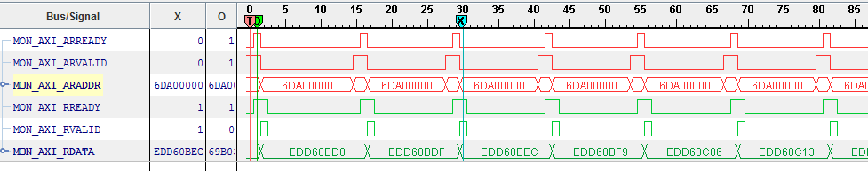
Chipscope Waveform
13 clocks from one read to the next
100Mhz bus clk / 13 = 7692308 Hz ~ 7.7M reads per sec

Slide 12
AXI Bus Throughput
Setup | Total Time (ms) | Tranfer Rate (Mbps)
AXI-Lite (32-bit) | 13 | 246
AXI4 64-bit (1x 32-bit word transfer) | 15 | 213
AXI4 64-bit (2x 32-bit word transfer) | 18 | 355

Slide 13
Conclusion
Achievements
Researched the various bus-interfacing options available on the Zynq-7000 SoC
Successfully established AXI bus data transfers between the ARM CPU and the TRNG custom core
Tested the impact of several bus transfer modes on throughput
Possible Future Work
Test and compare the TRNG structure on the high speed (streaming) AXI bus interface option as well as the implications on the CPU software side

