Slide 1

Sentiment Analysis on Song Lyrics
Group 15
Venkata Harshita Bathala - 1002204412
Kanksha Mannem - 1002203798
Yamini Saraswathi Nuthalapati - 1002210620

Slide 2
Introduction
Music is a universal form of expression, and song lyrics play a key role in conveying emotions and ideas. Sentiment analysis, a technique in natural language processing (NLP), allows us to examine and quantify these emotions systematically. Applying sentiment analysis to song lyrics helps uncover emotional patterns, explore themes such as love, sadness, or hope, and analyze how artists express their thoughts and feelings through words.

Slide 3
Project Description
This project classifies song lyrics into positive, negative, or neutral sentiments using sentiment analysis. It aims to uncover emotional patterns, provide personalized music recommendations, and analyze trends across genres and time periods.
Lyrics will be cleaned by removing HTML tags, non-alphabetical words, and stop words, applying lemmatization, and converting text to lowercase. Algorithms like LSTM, RNN, TF-IDF, and Word2Vec will be evaluated to identify the most effective method for sentiment classification.
Key objectives:
- Classify lyrics by sentiment (positive, negative, neutral).
- Provide personalized music recommendations.
- Analyze emotional trends in music.
The project delivers insights into lyrical emotions and improves music discovery.

Slide 4
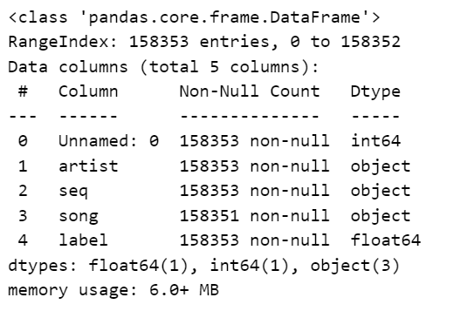
Loading the Data
The first step involves loading the dataset into a Pandas Data Frame for inspection. This helps us gain insight into the structure of the data, including its columns and data types.
The dataset contains the following columns:
Unnamed
Artist: The name of the song artist
Seq: The sequence of lyrics
Song: The song title
Label: A numerical value representing an aspect of the song, possibly sentiment.

Slide 5
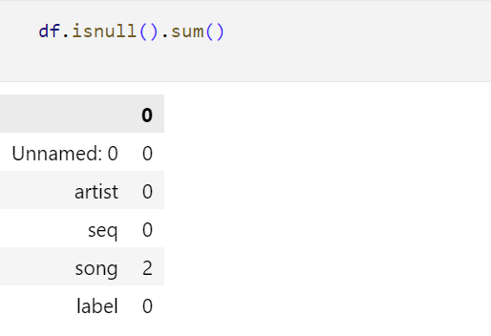
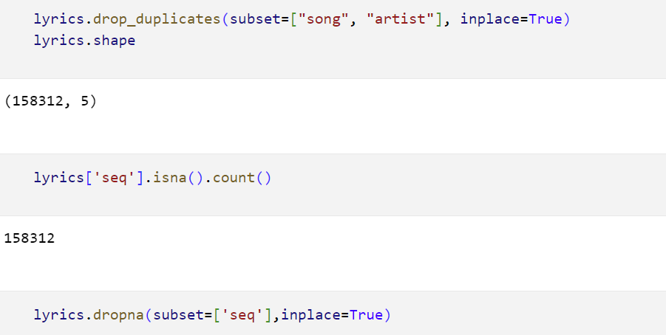
Handling the Missing Data
Before proceeding with model building, it's important to check for any missing or null values in the dataset to prevent the data negatively affect model performance and introduce bias. If any missing values are found, they can be handled by either removing the rows or using imputation techniques.
On the current dataset, we are checking for null or missing values and removing those entries along with the unnamed column which has no importance.

Slide 6
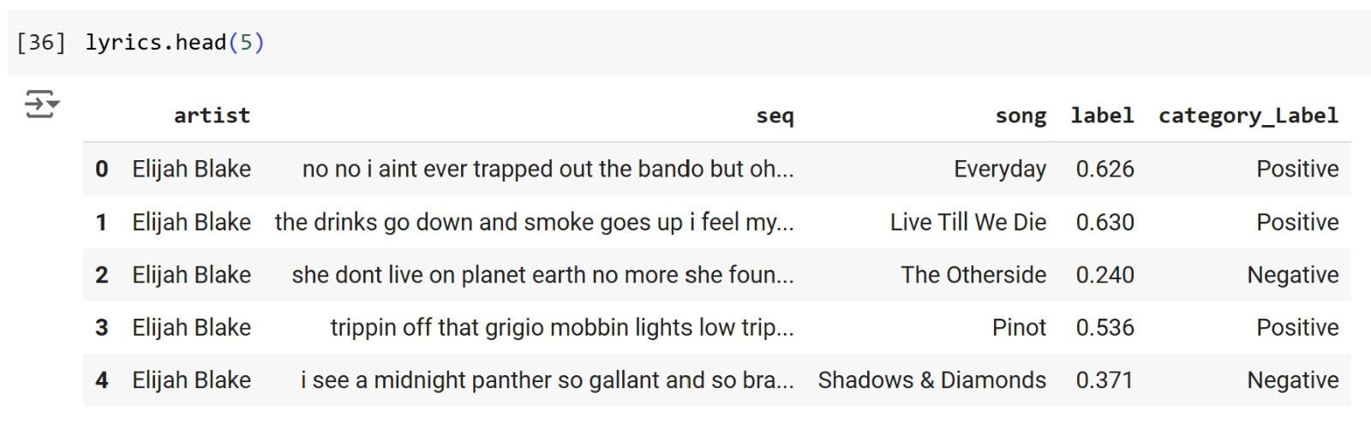
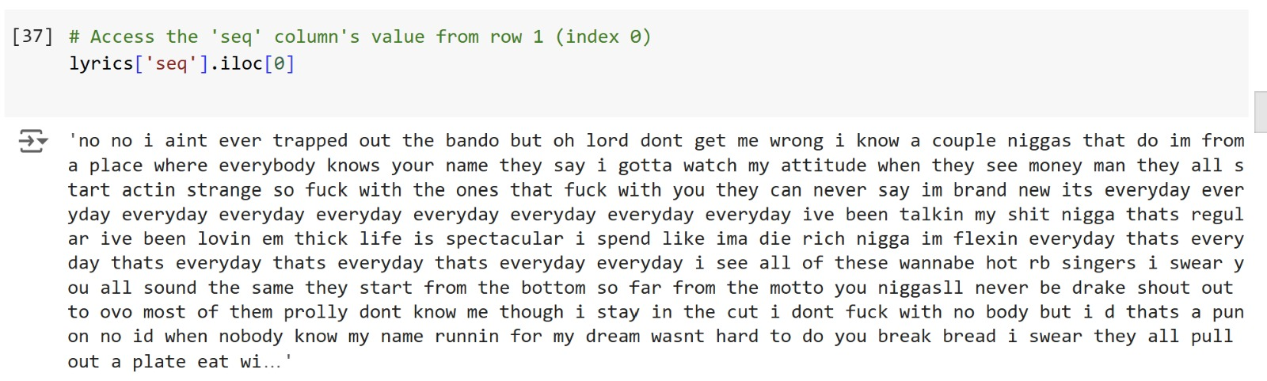
Data Cleaning and Preprocessing
The dataset was cleaned to ensure consistency and remove noise. Duplicates, HTML entities, and irrelevant entries were removed, and all lyrics were converted to lowercase. Special characters and non-informative patterns like "la," "ha," and "ohhh" were stripped. Only English lyrics were retained, and stop words with no semantic value were eliminated. A new column, *Category Label*, was added to classify lyrics as Positive, Negative, or Neutral, ensuring the data is ready for analysis.

Slide 7
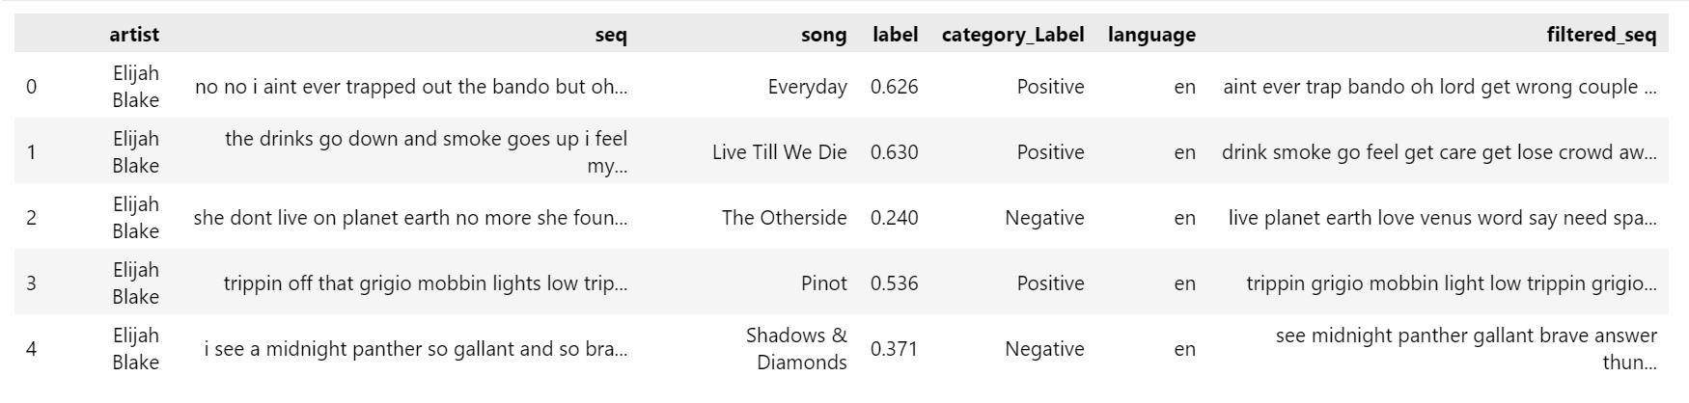
Normalizing Text Data
The dataset is normalized to improve model performance. Steps include:
- **Tokenization**: Splitting text into words and converting it into structured numerical sequences.
- **Lemmatization**: Converting words to their base forms.
For analysis, the "seq" column with song lyrics is transformed into sequences of integers, where each integer represents a specific word from the word index.

Slide 8
Data Preprocessing & Word Embedding
Data Augmentation :
Data augmentation involves creating additional data by applying techniques like duplication, transformations, or synthetic generation to improve class balance and enhance model performance.
Stratified Sampling Split:
Utilized stratified random sampling to split the dataset into training and testing sets, maintaining the proportion of each class in both subsets for reliable model evaluation.
Purpose:
Word embedding is a technique used to represent words in a continuous vector space, capturing semantic relationships and contextual meanings, allowing models to understand linguistic similarities.
Techniques Implemented:
Implemented Word2Vec to transform lyrics into numerical vectors, enabling deeper analysis and improved performance in sentiment analysis tasks by leveraging the relationships between words based on their contexts.

Slide 9
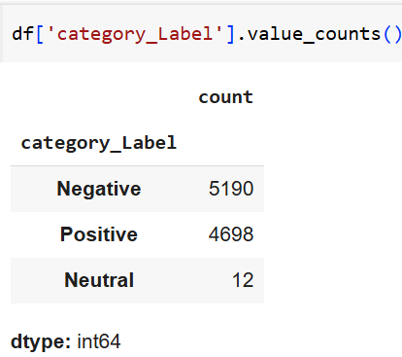
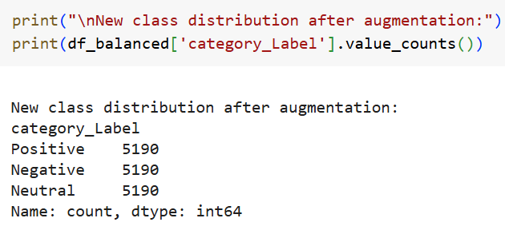
Data Augmentation
Before augmentation
After augmentation

Slide 10
Bi-Directional BERT Model

Slide 11
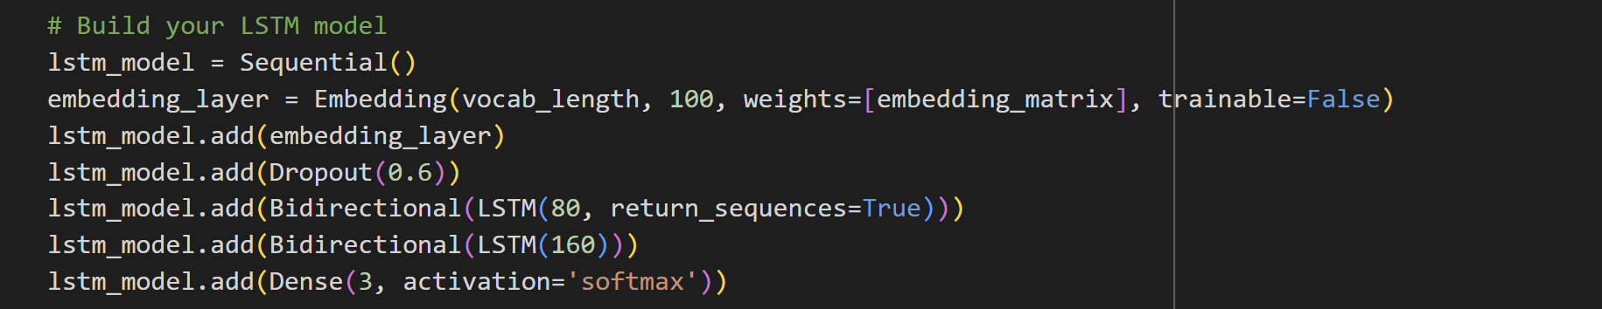
Training the Model
Building the Model:
Developed an initial baseline model, then optimized its performance by tuning key hyperparameters in a second model, resulting in improved accuracy.
This comparison highlights how hyperparameter tuning can enhance model effectiveness.

Slide 12
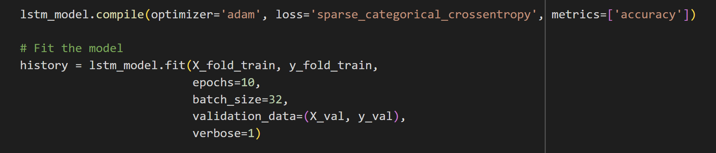
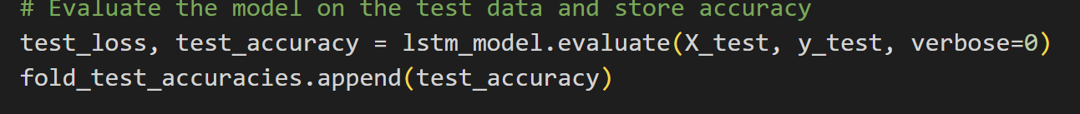
Fitting and Testing the Model

Slide 13
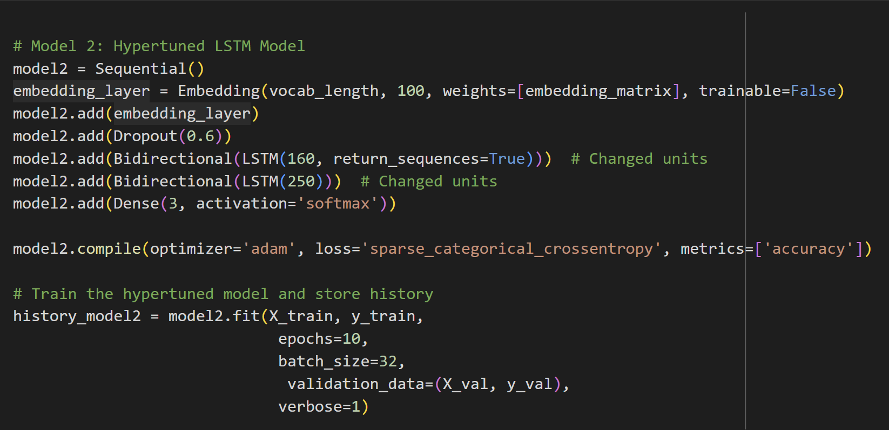
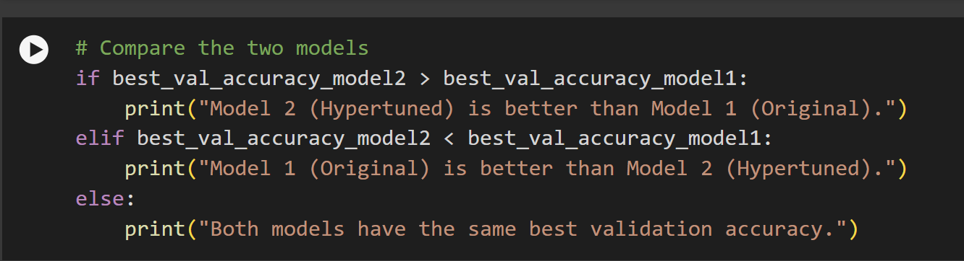
Tuning Hyperparameters:

Slide 14

Accuracy of the Model:
Model 1:
Model 2: (Hypertuning Model)

Slide 15
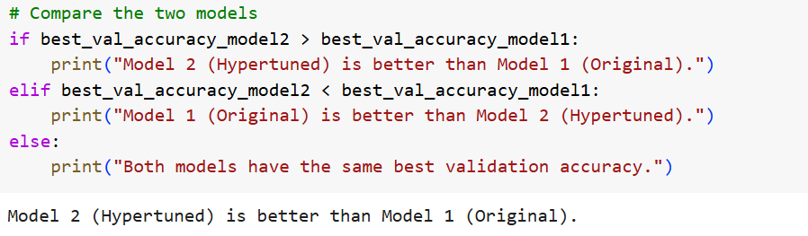
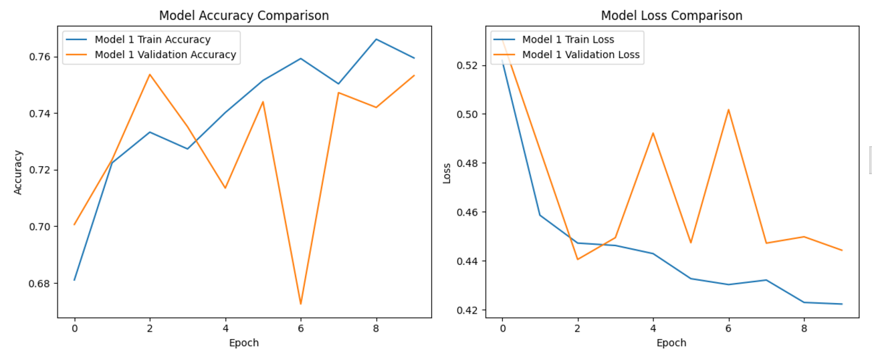
Choosing Best Model
Graphical Representation of Best Model’s Accuracies:

Slide 16
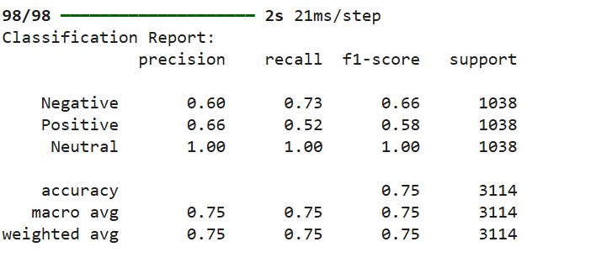
Testing Accuracy
Classification Report:

Slide 17
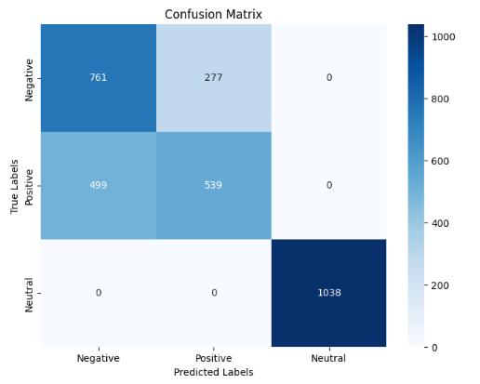
Confusion Matrix: Evaluates the performance of the trained model by comparing the actual labels with the predicted labels

Slide 18

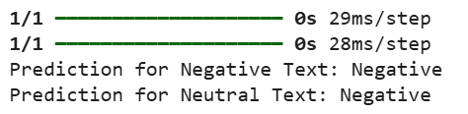
Prediction:
Processed and tokenized new song lyrics, then utilized the trained LSTM model to predict sentiment, generating class labels based on the highest predicted probabilities.
Prediction:

Slide 19
BERT MODEL

Slide 20
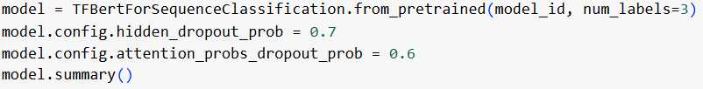
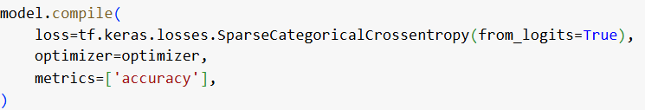
Training the Model
Initialize BERT Model
Compile the Model

Slide 21
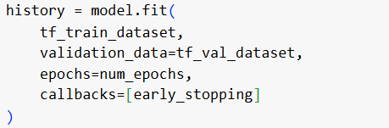

Fitting the Model
Accuracy of the model

Slide 22
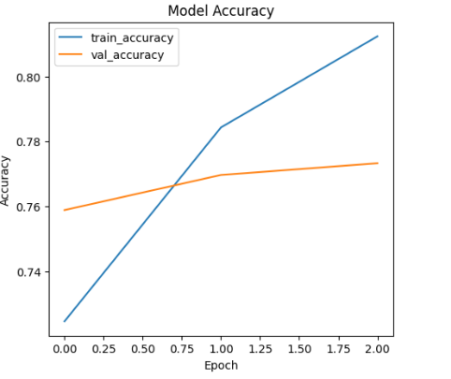
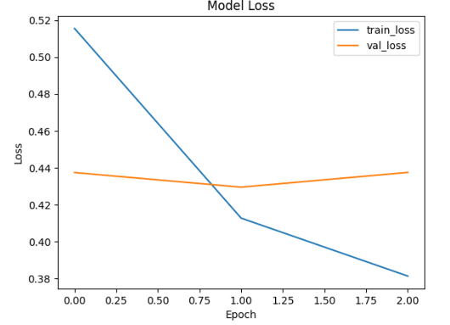
Graphical Representation Accuracies:

Slide 23
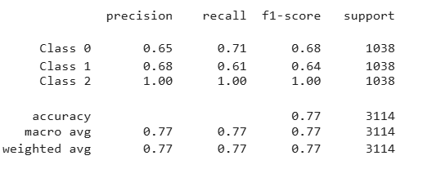
Testing
Classification Report:

Slide 24
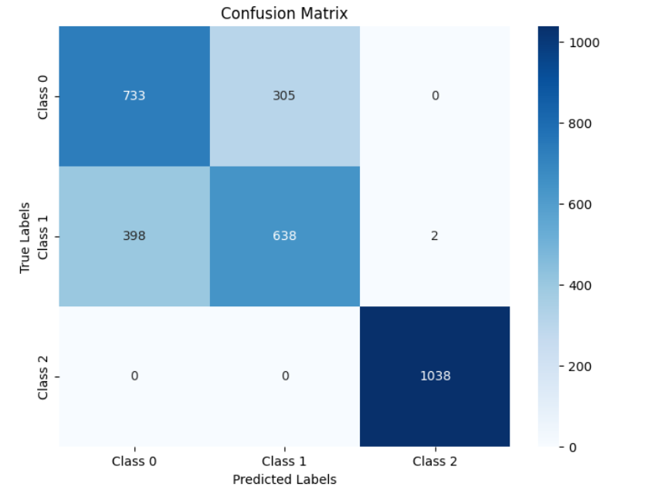
Confusion Matrix

Slide 25


Prediction:

Slide 26
Future Enhancements
Although BERT has proven to be highly effective in this task, there are still several areas for potential improvement:
• Class imbalance: A more balanced approach could be implemented by limiting the oversampling of the Neutral class to a smaller, manageable number and equalizing the Positive and Negative classes to match the count. of more efficient transformer models such as DistilBERT or TinyBERT, which are lighter and faster without significant loss of performance.
• Cross-Validation with Larger Datasets: While Stratified K-Fold cross-validation was initially explored, it was not fully implemented due to computational constraints. Running the model with full cross-validation on a larger, more diverse dataset could provide more reliable performance estimates and help further refine the model

Slide 27

Thank You

