Slide 1

OBSTACLE DECTECTION ASSISTANT FOR THE VISUALLY IMPAIRED
R V COLLEGE OF ENGINEERING
BENGALURU-560059
(An Autonomous Institution Affiliated to VTU, Belagavi)
1RV17EC181 VINAY VARMA B
1RV17EC131 SACHIN GOYAL

Slide 2
Table of Contents
Introduction
Motivation
Objective
Survey
Methodology
Work carried out till date
Results
Conclusion
Work Plan
References

Slide 3
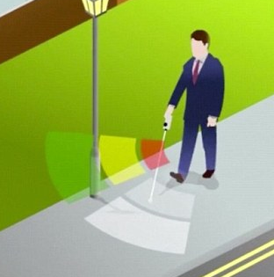
Introduction
Brief overview of the considered topic
Not to exceed more than 2 slides.
The basic concept of this project is to detect if there is an obstacle

Slide 4
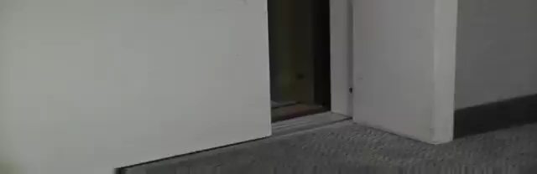

Slide 5
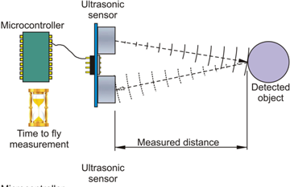
This topic use the ultrasonic waves to calculate the distance between the user and the obstacle.

Slide 6
Motivation
Currently there are thousands of blind people all over the globe.
The find it very difficult while crossing the road or reaching to their respective destination with the help any other individual and when they encounter stairs especially.
The traditional stick cannot help to detect the obstacles in front or the potholes in the way. It is outdated.
Hence there is a need to update it using today's technology

Slide 7
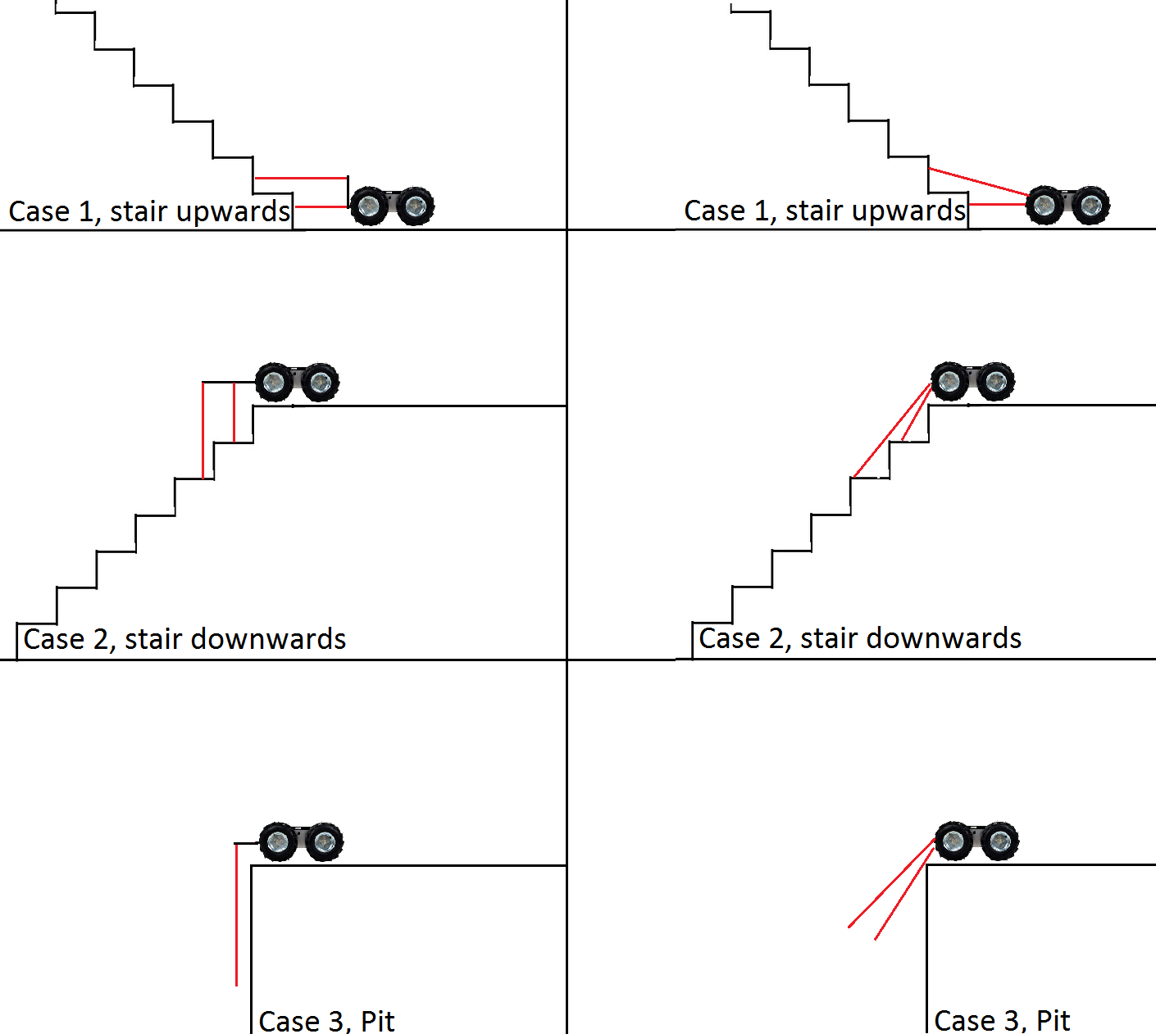

Slide 8
Objective
To detect the obstacles before the person, without out even touching it with the traditional stick.
To detect any water while walking on the road.
To detect ascending and descending stair cases.
To detect the dark lighting conditions.
To warn them never ever the above situations are met with the help of a vibration motor or buzzer.

Slide 9
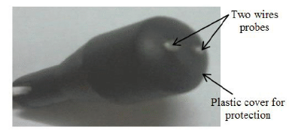
Literature Survey
To achieve the said objective briefly state the findings from the current published works
Consider IEEE journals for the survey
In the survey we focused mainly on :
Water sensor: A water sensor is located at the base of the stick to have precaution against the wet surface which it can causing slipping on the floor and thus can hurt. When the water sensor comes in contact of the wet surface, it produces an electrical signal which trigger the Arduino controller and alarms against a wet floor.

Slide 10
Methodology
Explain in steps the detailed methodology
If required use block diagram

Slide 11
Specifications

Slide 12
Work carried out till date
Design / simulation / Implementation (Not to exceed more than 5 slides)
Explanation of simulation tools / kits is not required

Slide 13
Results
We are able to
1. Detect the obstacles
2. The wet floor
3. Even the dark condition.
Currently working on
1. The detection of stair case and
2. Positioning of all our sensors.

Slide 14
Conclusion
With the proposed architecture,
If constructed with at most accuracy, the blind people will able to move from one place to another without others help, Which leads to increase autonomy for the blind.
The developed smart stick that is incorporated with multiple sensors will help in navigating the way while walking and keep alarming the person if any sign of danger or inconvenience is detected.

Slide 15
Work Plan
Collect the information regarding all the sensors which we are going to install the cane.
Refer papers regarding the test results which are obtained.
Work on the accuracy of the dectection of stairs mainly downstairs.
Implement all the sensors at once with an arduino in the final phase.

Slide 16
References
IOSR Journal of Computer Engineering (IOSR-JCE) e-ISSN: 2278-0661,p-ISSN: 2278-8727, Volume 19, Issue 3, Ver. II (May.-June. 2017), PP 86-90
Conference Paper: Second International Conference on Advances in Bio-Informatics and Environmental Engineering - ICABEE 2015, At Italy
International Journal of Advanced Computer Science and Applications, Vol. 4, No. 6, 2013

