Slide 1
Overview of Project Xbrowser Software Engineering COMP 4110 University of Massachusetts Lowell Fall 2020 Instructor: Dr. James Daly* *Please direct all inquiries to the instructor.
Team members:
Researcher: Tarpan Patel
PROGRAMMER: JOSHUA MICHAUD
Web Developer: Ben Viscosi
Tech Lead: BILL FIGLIOLINI
PROJECT MANAGER: MARCELLO BARBERI

Slide 2
The Problem
Web developers need to test their code often
Local refreshing on web browsers
Similar tools exist but they're restricted to the browser running the site

Slide 3
The solution
XBrowser
Upload, edit, and save code with built-in editor
Streamline web development process
Run code across multiple browsers in real time
Increased productivity
Apply styling to code and update browsers on each save
Helps save time

Slide 4
Domain research
Researched online editors (CodePen, CodeSandbox, etc.)
Researched online browser testers (Browserling, LambdaTest, BrowserStack)
Constraints
Be as compatible with other browsers as possible
Allow testing on as many browsers as possible

Slide 5
Technologies Used
Highlighting (PrismJS)
Yarn
NodeJS
Vue.JS Framework
GitHub
Repository for team website
Repository for Xbrowser

Slide 6
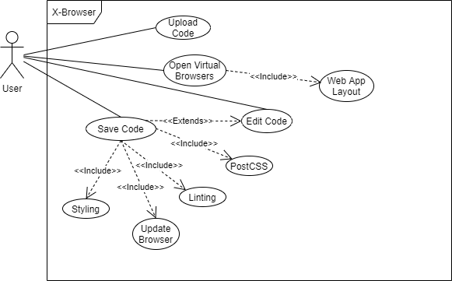
XbrOWSER (USE CASE)

Slide 7
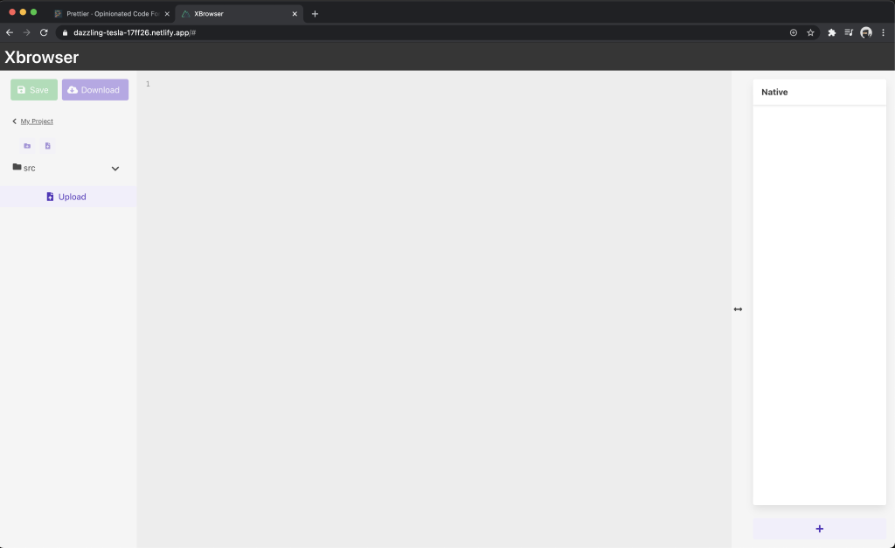
PROTOTYPE (Launch Xbrowser) Uploading

Slide 8
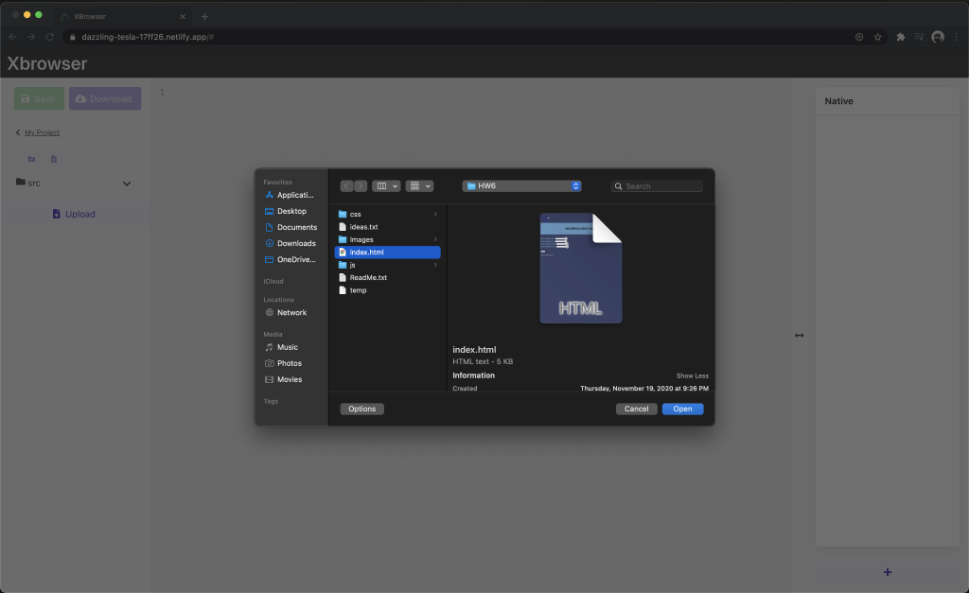
PROTOTYPE (Upload files)

Slide 9
PROTOTYPE (Launch Xbrowser) creating/ editing

Slide 10
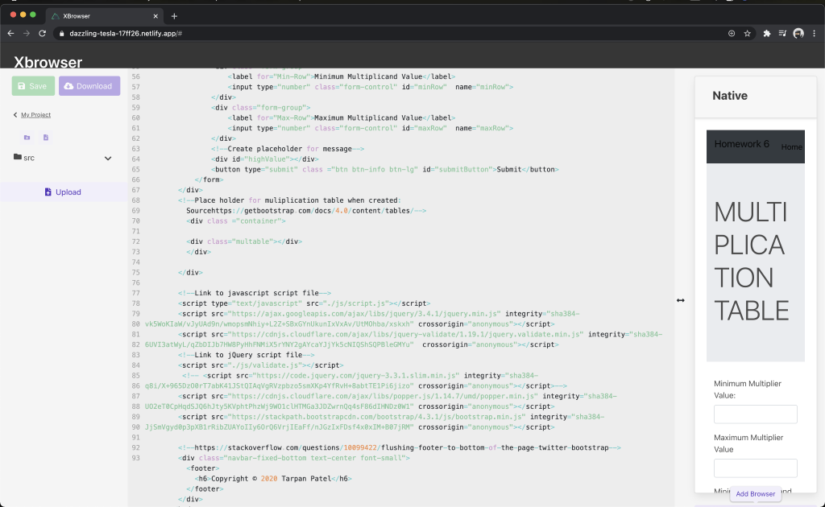
PROTOTYPE (EDIT FILE)

Slide 11
PROTOTYPE (Launch Xbrowser) Adding more browsers

Slide 12
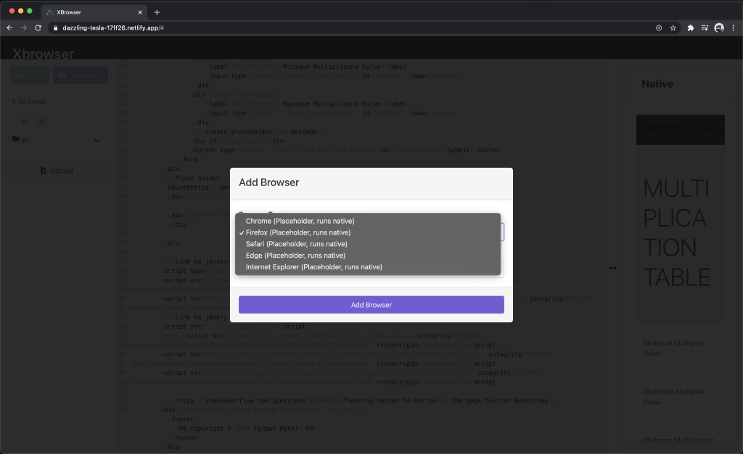
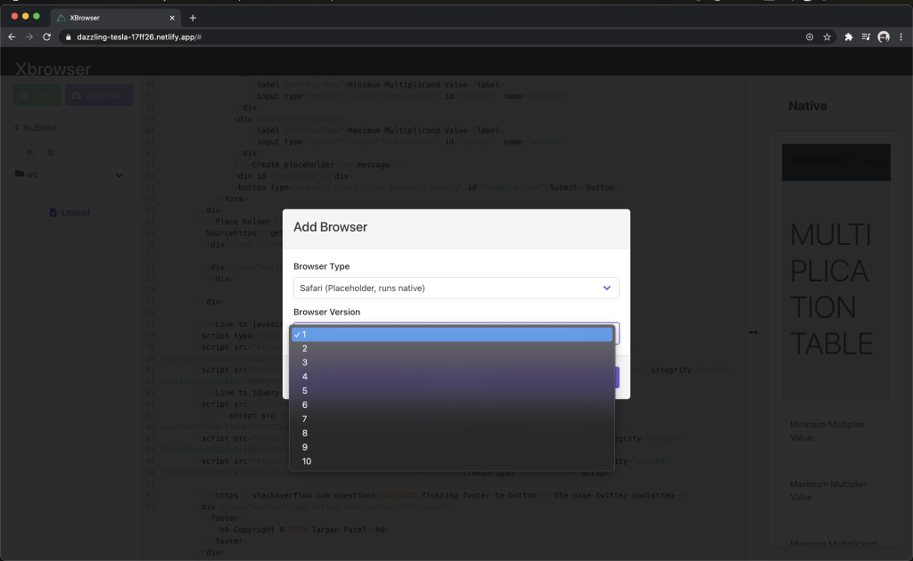
PROTOTYPE (Select version & Browser)

Slide 13
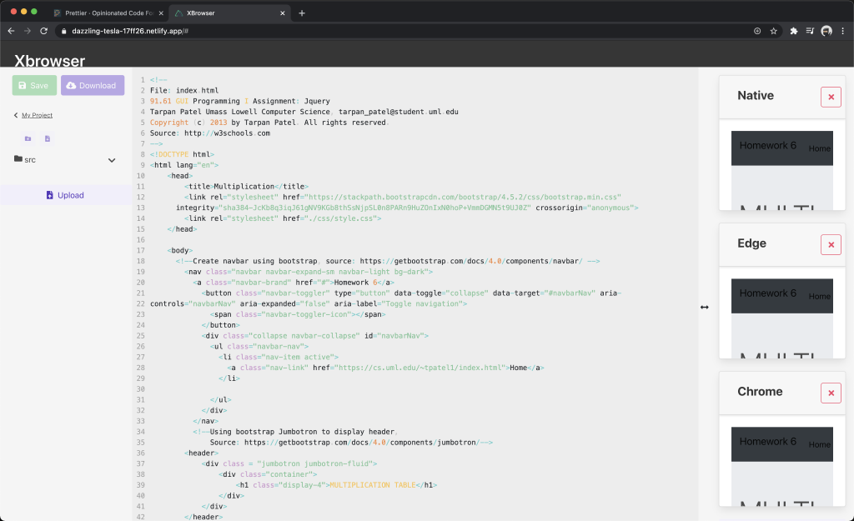
PROTOTYPE (View multiple Browsers)

Slide 14
What we accomplished
Available Features:
Add browser
Upload code
Edit code
Render live updates to browsers

Slide 15
WHAT'S NEXT?
Currently Disabled:
Download files
Upload multiple files
Expand Browsers view
Add folder
Add new files

