Slide 1
EDA on Play Store App Using POWErbi
By Vishnu B
GitHub Link – https://github.com/bvishnub/Exploratory-Data-Analysis-on-Play-Store-App-PowerBI
Email Id – vishnub195@gmail.com
LinkedIn- https://www.linkedin.com/in/bvishnub

Slide 2
Index
Project Overview and Objective
Dataset
Setup and Requirements
Key Visualizations
Interactivity Features
Use of DAX Functions
Play store App dashboard
Key Insights for Playstore App Dashboard
Ratings and Reviews Analysis
Key insights for Ratings and Reviews Analysis
Revenue Analysis
Revenue Analysis Key Insights
Sentiment Count
Downloads – Decomposition Tree

Slide 3
Project Overview and Objective
Project Overview
This project extends the Exploratory Data Analysis (EDA) of Play Store data previously conducted using Python. The current extension leverages Microsoft Power BI to provide advanced visualizations and interactive analysis. This shift to Power BI aims to enhance data exploration capabilities and facilitate deeper insights through interactive dashboards.
Objective
Build upon the initial Python EDA to create interactive dashboards in Power BI.
Enhance data visualization with Power BI's advanced features.
Provide deeper insights into app performance, user ratings and review analysis, and revenue analysis.

Slide 4
Dataset
The project utilizes the cleaned version of the dataset used in the previous EDA. The dataset source is the AlmaBetter Team.
There are two datasets:
Play Store Data
User Review Data

Slide 5
Setup and Requirements
To work with this project, you need:
Microsoft Power BI Desktop: Ensure you have the latest version installed.
Playstore Dataset: The cleaned dataset in CSV format, as prepared in the Python project.

Slide 6
Key Visualizations
Play Store App Dashboard
Provides a comprehensive overview of download trends across various attributes, including app categories, types, age groups etc. This dashboard allows users to quickly assess how different factors influence app downloads.
Ratings and Reviews Analysis Dashboard
Offers an in-depth analysis of app ratings and user reviews. This dashboard visualizes rating distributions and review trends to help users evaluate app performance and user satisfaction.
Revenue Analysis Dashboard
Analyzes revenue trends by visualizing app pricing and revenue categories. This dashboard provides insights into financial performance and helps understand revenue patterns across different app price ranges.

Slide 7
Interactivity Features
Drill-Down: Explore data at different levels of detail, from categories to app levels.
Drill-Through: Navigate from summary data to detailed views, e.g., clicking on an app category to view performance metrics.
Slicers: Interactive filtering options for attributes such as app types.
Filters: Refine data views by applying conditions, such as filtering by year.
Cross Filters: Dynamic interaction between visualizations. Selecting a category updates related visualizations.
Clear Filter: Reset all slicers and filters to their default state.

Slide 8
Use of DAX Functions
Measures: Aggregate measures for key insights
Total Revenue: Aggregates total revenue from paid apps.
Total Installs: Calculates total app installations.
Total Apps: Counts the total number of apps.
Total Reviews: Summarizes total user reviews.
Average App Size: Computes average app size in megabytes.
Average Rating: Calculates average user rating.
Calculated Columns: Detailed categorization and analysis
Price Category: Categorizes apps into price ranges.
Android Versions: Classifies apps by supported Android versions.
Rating Average in Stars: Converts ratings to a star format.
Revenue: Calculates revenue based on installs.
Size Category: Groups apps into size ranges.
Calculated Tables: Organizes data by time periods
Calendar Table: Includes Year, Month, and Quarter columns for time-based analysis.

Slide 9
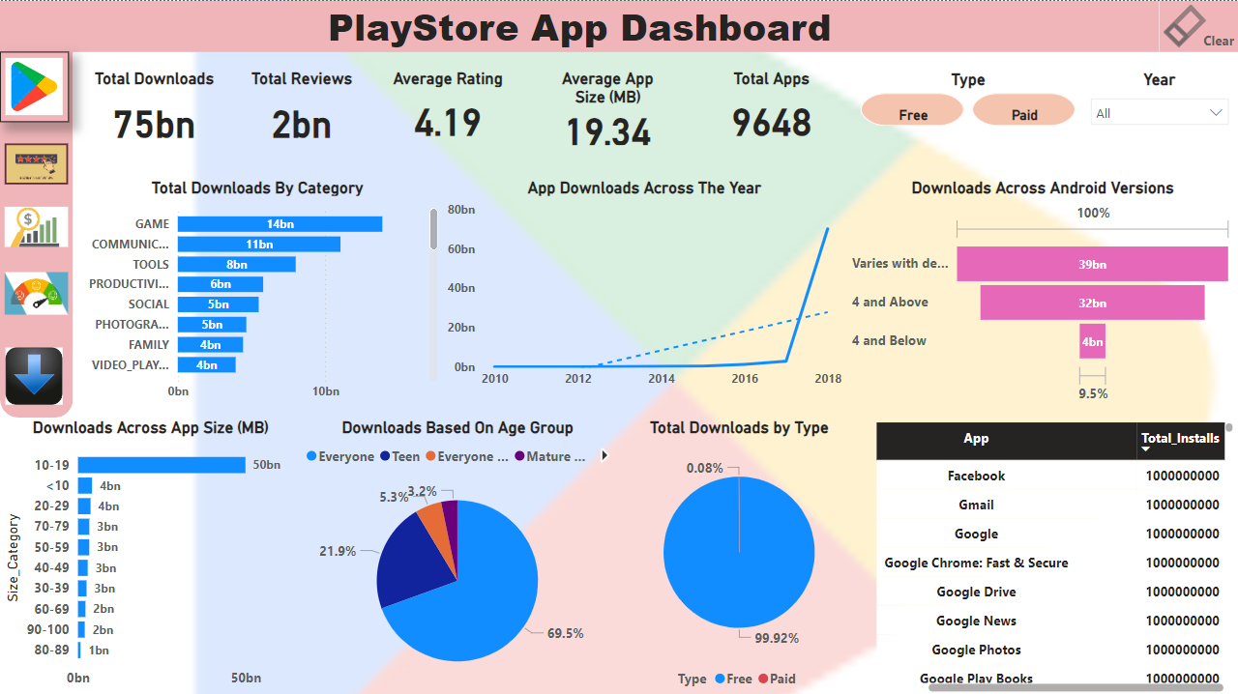
Play store App dashboard

Slide 10
Key Insights for Playstore App Dashboard
The Game category is the most popular, with the highest downloads in both paid and free sections.
Top genres include Communication, Tools, and Productivity.
Apps with sizes between 10-19 MB are most preferred, with 50 billion downloads.
Free apps are more popular with maximum Installs.
The "Everyone" age group is the most popular, accounting for 69.5% of downloads.
The "Varies with Device" Android version is most popular and can be considered while new apps.
Data cards provide quick insights into total downloads, average ratings, total reviews, average app size, and total app count.
We can look at the download trend across the year and months using drill down feature. Also most Installs are done in August and July months and sudden increase in download trend can be observed post 2017.
Decomposition charts offer detailed understanding of trends by category, year, quarter, and genre.

Slide 11
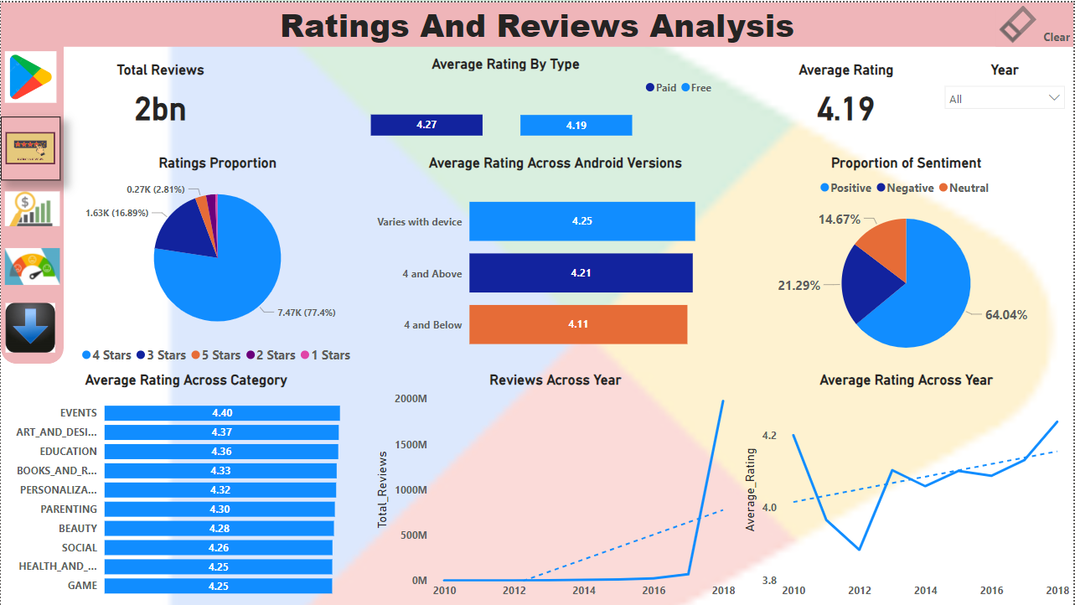
Ratings and Reviews Analysis

Slide 12
Key insights for Ratings and Review Analysis
Most ratings are 4 stars (77.4%) with a total of 7.47k in count.
Total of 2bn reviews are received for apps.
Paid apps have a higher average rating (4.27) compared to free apps (4.19).
Overall average rating is 4.19.
The Events category has the highest average rating (4.40), while Art and Design and Education follow, despite having fewer installs.
"Varies with Android Versions" is preferred and has the highest ratings i.e. 4.25.
Positive sentiment accounts for 64% of total reviews.
We can also observe in sentiment count section that , Games and Health and Fitness Categories are leading with maximum positive sentiment count , also it can observed that maximum negative count sentiment category is also Game category , however same is due to maximum proportion of available apps under games category in play store.

Slide 13
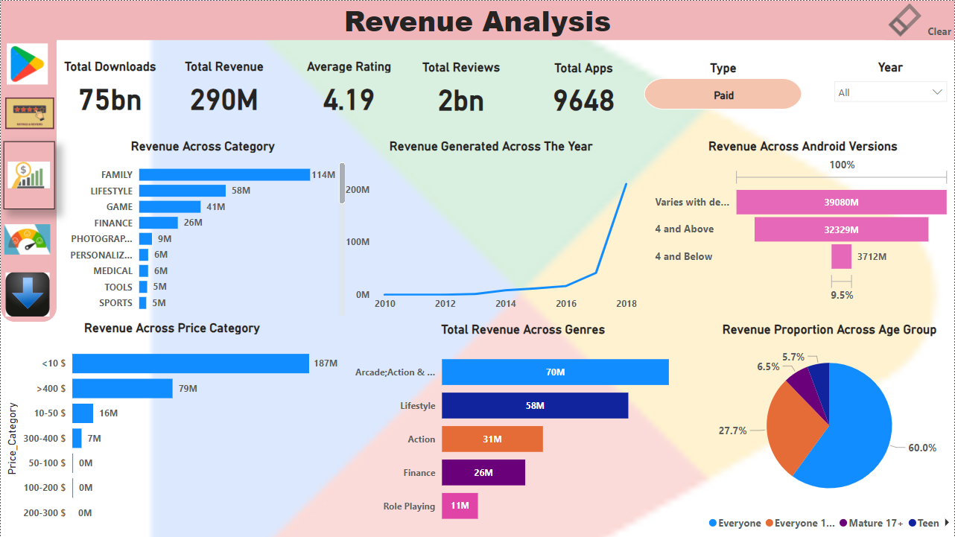
Revenue Analysis

Slide 14
Revenue Analysis Key Insights
Family Lifestyle and Game categories are major revenue contributors.
The most popular price category is <$10.
Revenue trends are analyzed by year, month, and quarter using drill down feature.
Data cards provide quick insights into total downloads, revenue, average rating, and total paid apps.
Around 60% of revenue comes from the "Everyone" age group.
Android Version 4 and above is most preferred under paid section with highest revenue. contribution.
Top genres for revenue generation include Arcade, Action, Adventure, and Lifestyle.

Slide 15
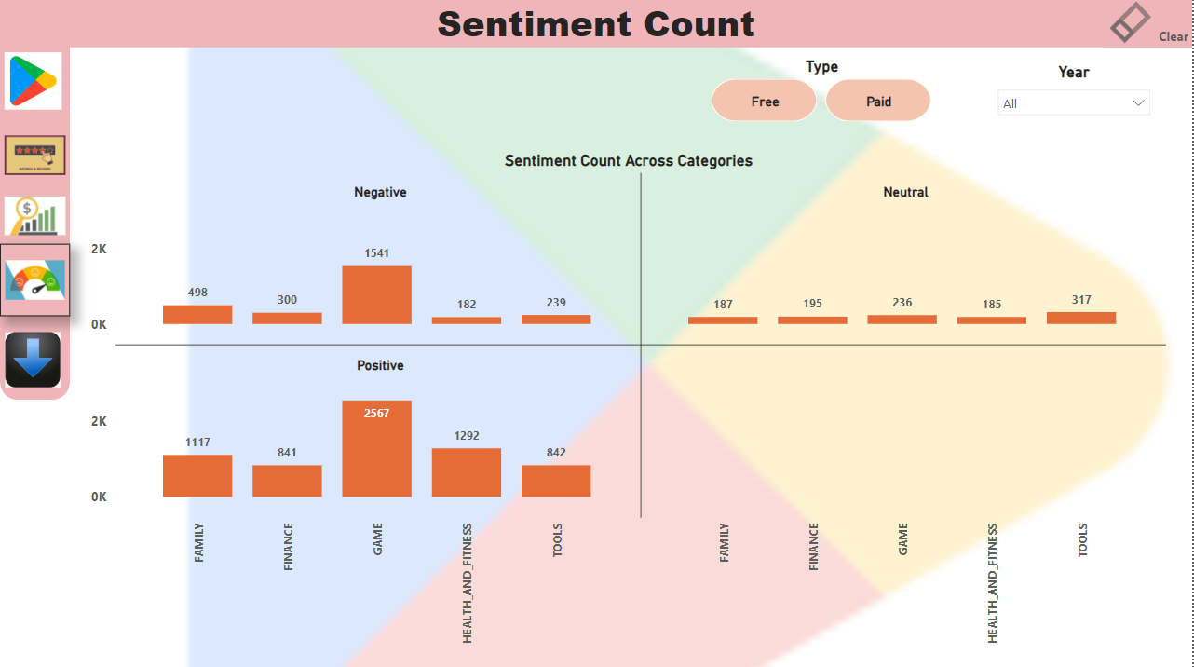
Sentiment Count

Slide 16
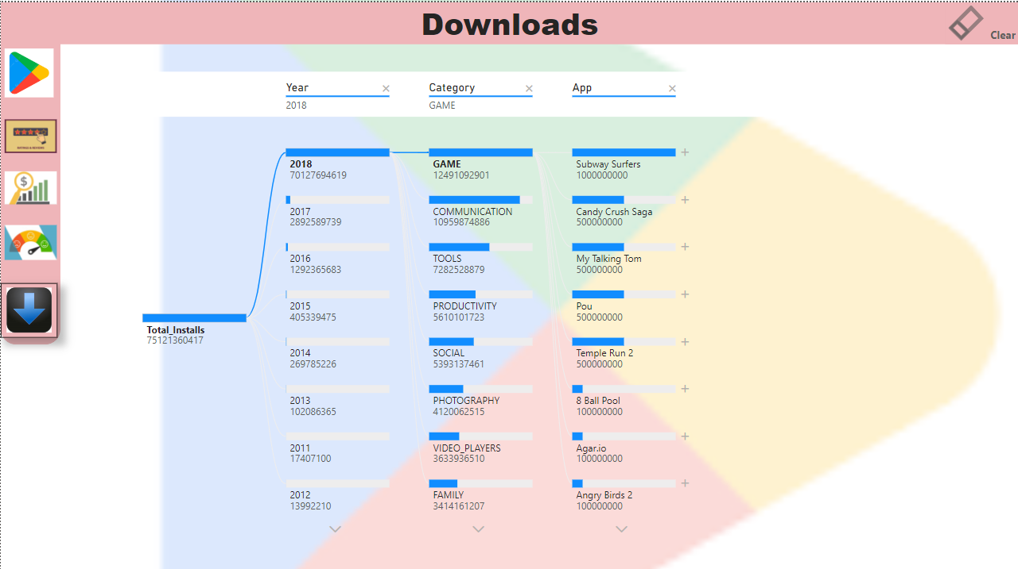
Downloads

Slide 17
Thank you ☺

