Slide 1
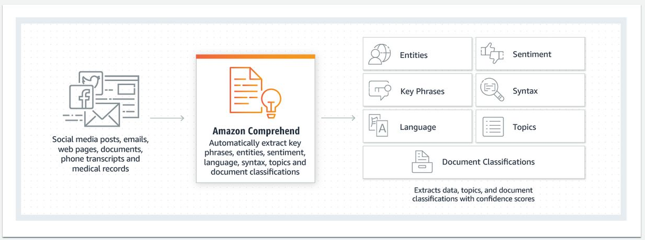
Amazon Comprehend
NLP and text analytics service within AWS (deep learning-based)

Slide 2
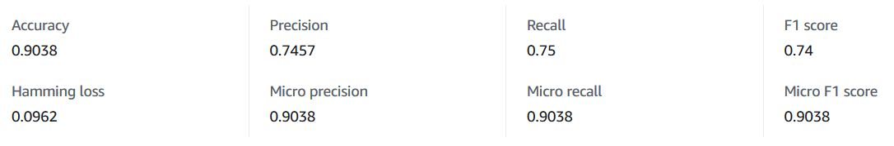
Custom Classification model
The Custom Classification and Entities APIs can train a custom NLP model to categorize text and extract custom entities. Asynchronous inference requests are measured in units of 100 characters, with a 3 unit (300 character) minimum charge per request. You are charged $3 per hour for model training (billed by the second) and $0.50 per month for custom model management. Asynchronous classification and entity recognition: $0.0005 PER UNIT (=100 chars)
Lyrics classifier: training took 35 minutes (~500 song lyrics, 5 artists); classifications: 6 min / track;
number of labels (artists): 5; number of trained documents (lyrics): 477; number of test documents: 52
Peformance:

Slide 3
Task 1: Biohazard (part of training docs)_
[{"Name": "Biohazard", "Score": 0.9792}, {"Name": "The+Gathering", "Score": 0.0165}, {"Name": "The+Dandy+Warhols", "Score": 0.0022}]}
Own model: Biohazard
Armageddon, a new death is dawnin', I like the smell of napalm in the morning, four riders of the apocalypse descend from the north, a fear in my eye, I behold a pale horse. Armageddon, no time to cry we all die as the sky turns red, the missles start to fly. Factionstake action, eleven families rule, millennium approaches, survival of the roaches. Body armor will make you feel calmer or safe from the drama, deplow stealth military bombers, ass out, get down on your knees and pray; illuminati takes your soul on the eve of judgement day as the armies of darkness irradicate life and we all go to hell and satan fucks your wife. Strife, ter- ror without a minute to pray, human beings at odds, peace becomes dis- aray, I'm humongous from Mad Max, Lord of the Wasteland with crazy ill troops all at my command, don't you ever fall victim to my master plan, I'm the dealer of death and here's your motherfuckin' hand.

Slide 4
Task 2: The Dandy Warhols
Track 1
[{"Name": "The+Dandy+Warhols", "Score": 0.931}, {"Name": "Body+Count", "Score": 0.0325}, {"Name": "Sex+Pistols", "Score": 0.0215}]}
Own model: Body Count
Track 2
[{"Name": "Sex+Pistols", "Score": 0.7989}, {"Name": "The+Dandy+Warhols", "Score": 0.1917}, {"Name": "The+Gathering", "Score": 0.0057}]}
Own model: Sex Pistols
I was a shift shake shoe shake child around I used to live down town down in trucker town I was the baddest, baddest, baddest around But it was fifteen years since I heard a sound They said look it, look it, come on down 'Cause when the law start shaking, a shaking 'em down They're called the last of the outlaw truckers around 'Cause I'm me, see Jacked up on java and nicotine Whoa-oh please believe me I know what I mean By the time we get to Texas he was lying 'em down With the bag 'o bodies all covered the ground I said now look it, look it, look what I found Short, come out and you know I left the armload of M16's back home I served 68 missions in da nang alone Now I'm a one more mission, that's you and that's right 'Cause I'm me, see Jacked up on Meth and Dexedrine Whoa-oh, please believe me I know what I mean And I'm clean Oh, I'm getting right pious now But if you'd seen what I've seen Oh you know what I mean

Slide 5
Task 3: The Gathering (short lyrics, insufficient training material)
Track 1
{"Name": "Sex+Pistols", "Score": 0.7463}, {"Name": "The+Dandy+Warhols", "Score": 0.2422}, {"Name": "The+Gathering", "Score": 0.0067}]}
Own model: Body Count
Track 2
{"Name": "The+Dandy+Warhols", "Score": 0.978}, {"Name": "The+Gathering", "Score": 0.0125}, {"Name": "Sex+Pistols", "Score": 0.0043}]}
Own model: Body Count
I close your eyes with my mouth Now you don't see anything But you feel my breath all over I can feel you too Although i don't really know you I don't really care Cry with me, make my day Tomorrow all will be gone All the sweetness and all the fun No, i don't want to know Although i don't really know you I don't really care Now that you're gone i don't know How to really feel inside Baring the hope to see you again I guess i never will Now that i do really know you Yes, i really care!

Slide 6
Task 4: Ice-T (Body Count project head)_
Track 1
[{"Name": "Body+Count", "Score": 0.8314}, {"Name": "The+Dandy+Warhols", "Score": 0.1131}, {"Name": "The+Gathering", "Score": 0.0309}]}
Own model: Body Count
Track 2
[{"Name": "Body+Count", "Score": 0.7323}, {"Name": "The+Dandy+Warhols", "Score": 0.1201}, {"Name": "Sex+Pistols", "Score": 0.111}]}
Own model: Body Count
Ten years ago I used to listen to rappers flow Talkin' bout the way They rocked the mic at the disco I liked how that shit was goin' down With my own sound So I tried to write rhymes Somethin' like them, my boys said, "That ain't you Ice, That shit sounds like them." So I sat back, thought up a new track Didn'T fantasize, kicked the pure Facts. Motherfuckers got scared Cause they weas unprepaired who would tell it how it relly was? Who dared? A motherfucker from the West Coast L.A. South Central fool Where the Crips and the Bloods play When I wrote about parties It didn't fit Six in the Mornin' That was the real shit O.G. Original Gangster When I wrote about parties Someone always died When I tried to write happy Yo I knew I lied, I lived a life of crime Why play ya blind? A simple look and anyone with two cents would know I'm

Slide 7
Task 5: Public Image Ltd (post-Sex Pistols)_ _
Track 1
[{"Name": "The+Dandy+Warhols", "Score": 0.9712}, {"Name": "Body+Count", "Score": 0.0106}, {"Name": "The+Gathering", "Score": 0.0104}]}
Own model: Body Count
Track 2
[{"Name": "Sex+Pistols", "Score": 0.435}, {"Name": "The+Gathering", "Score": 0.2619}, {"Name": "Body+Count", "Score": 0.1526}]}
Own model: Body Count
Hello. Hello. Hello. Hello. Hello. Hello. Ha, Ha, Ha, Ha, Ha. You never listen to word that I said You only seen me For the clothes that I wear Or did the interest go so much deeper It must have been The colour of my hair. Public image. What you wanted was never made clear Behind the image was ignorance and fear You hide behind his public machine Still follow the same old scheme. Public image. Two sides to every story Somebody had to stop me I'm not the same as when I began I will not be treated as property. Public image. Two sides to every story Somebody had to stop me I'm not the same as when I began It's not a game of Monopoly. Public image. Public image you got what you wanted The Public Image belongs to me It's my entrance My own creation My grand finale My goodbye Public image. Public image. Goodbye.a

Slide 8
Task 6: Powerflo (post-Biohazard)_
Track 1
[{"Name": "Biohazard", "Score": 0.9862}, {"Name": "The+Gathering", "Score": 0.0084}, {"Name": "Body+Count", "Score": 0.0041}]}
Own model: Body Count
Track 2
[{"Name": "Body+Count", "Score": 0.993}, {"Name": "Biohazard", "Score": 0.0045}, {"Name": "The+Gathering", "Score": 0.0014}]}
Own model: Body Count
Evidence, resistance, apathy, perdition Evidence, resistance, apathy, perdition I come forth with a vengeance, escaping my death sentence True rebel, and I care not if I offend you with my presence Seeker of my own path, inventor of my own math Those wanting to destroy me will die slowly in a bloodbath Willing to battle the serpent that rattles Beware what he preaches, your brains he will scrabble War on the spirit, the mind and the soul I'll die a free man that nothing controls Down with all tyrants, I stand in defiance Anarchy, chaos, in sighting a riot There ain't no solution, I come to a conclusion Fight for my rights, fuck all the bullshit Evidence, resistance, apathy, perdition Evidence, resistance Here I stand, wounded but not broken The gods hear my prayers even before I even spoke them The journey must continue, I fight on like a Hessian Forgiving those who hate me and thankful for my blessings Mindful of the fact that tomorrow's not a given I bow to carry on, and to stay ambition driven Cloaked in solid armor, sword and shield protect me I stand by my world, you can take me or reject me

Slide 9
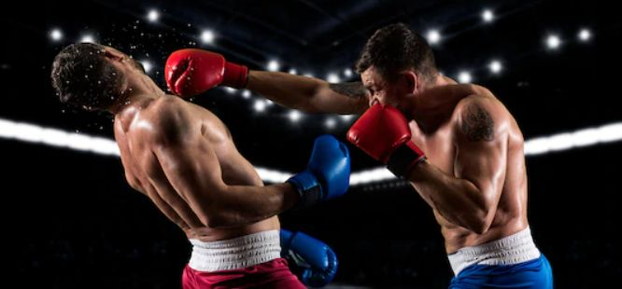
Successful predictions…
Amazon comprehend: 6
Own model: 3
… out of 11

