Slide 1


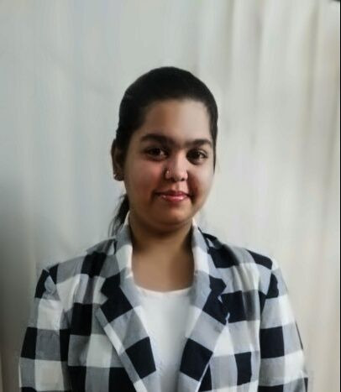
RedHat
About Me :
Name : B V JHANSI SAKETA
College : ANURAG GROUP OF INSTITUTIONS
Github : https://github.com/bvjhansisaketa

Slide 2
My learning : W1
RedHat
Achievements : I am glad to be part of this internship because it has helped me to learn and explore more technical and non – technical skills which are required for a professional. I got to know about learn.redhat.com and more. I have understood the way how to start a project by SCQ method. I am able to learn the concepts of Linux and python training.
Learning : It is a great learning for me and enjoying the sessions and training. It is more of a fun learning especially, Kahoot quiz is type of fun learning. I am able to understand both concepts and practical part.
Linux: Virtual box, basics and commands.
Python training: programming using python , files, function,etc

Slide 3
RedHat
ATTENDANCE SYSTEM USING CCTV(ML/AI)
SCQ:
Situation: Nowadays, companies are using biometric system for attendance which has its uses but also disadvantage like invasiveness, high cost, time taking if more no of persons all of sudden
Challenge: Cost(more), time(more)
Question: if not this, what can be used and what technology?
User Stories:
As manager, I want to have a attendance system using CCTV, so that it can automatically take attendance through face detection. The device should be connected to database.
As a manager, I want to know the timing details of employs ie: entry and exit timings
As a manager/Adminster, I should get the details of detected employs and strangers face details into my login page.

