Slide 1

Merger (proof of concept)

Slide 2
Solution for
Maintaining a current Set of Documents (not just drawings)
Maintaining BVNDH transmittal

Slide 3
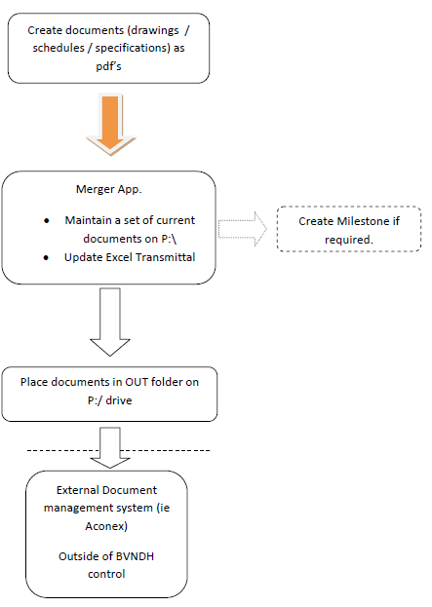
Workflow

Slide 4
Demo

Slide 5
Gotchas
Documents need to be added to transmittal manually
New issues will always be added last
Will fail if a to be superseded document is open

Slide 6
Development Status
Beta 4
(current)
Beta 5
Beta 6
Distribution rules
Basic Aconex integration

