Slide 1
An introduction to CompuCell3D (CC3D)
Motivation for cell-based modeling
The GGH model, a basic description
Effective energy and GGH simulation dynamics
Translating biology into effective energy terms
Maybe for next time? – Navigating CC3D simulations and Python scripting for CC3D

Slide 2
Motivation for cell-based modeling
Continuum models are appropriate when modeling, e.g., non-cellular materials and dense tissues whose bulk mechanical properties are more important than autonomous cell behaviors.

Slide 3
Motivation for cell-based modeling
Subcellular models are appropriate when trying to grasp how molecular-scale events lead to cell-level behaviors (e.g., addressing the question of how actin remodeling is regulated at the molecular level and how this impacts a cell’s or cell-cell interface’s behavior)

Slide 4
Motivation for cell-based modeling
Cell-based models are a natural “bridge” between understanding subcellular details and understanding how the cell behaviors that emerge from those details lead to tissue-scale phenomena.
In both life and in cell-based models, cells serve as the “units of integration” that connect molecular events to larger-scale morphology.
In the case of cell-based models, we typically choose not to explicitly model molecular events, focusing instead of the output of those events, the cell characteristics (though there are exceptions to this)
Deciding which cell behaviors on which to focus, and how best to model them, is part of the art of constructing cell-based models

Slide 5
Motivation for cell-based modeling
“Why not model all of the cells in our tissue of interest at subcellular detail? Wouldn’t we learn more that way than by treating cell characteristics phenomenologically?”
Subcellular models are computationally expensive—it is not realistic to model hundreds of cells at this level of detail, let alone tens or hundreds of thousands of cells.
The art of modeling inherently involves simplification, for conceptual as well as logistical reasons: the greater the degree to which we can simplify and still reproduce key features, the better we can identify and understand which mechanisms are driving the appearance of those key features, and how.

Slide 6
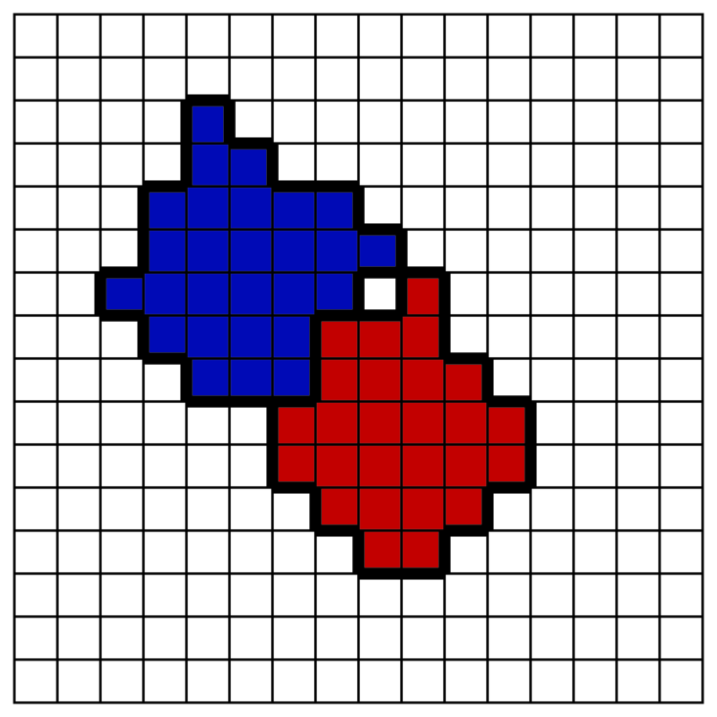
The GGH Model: A basic description
The GGH model is lattice-based, so you can think of it as occurring on a field of pixels (either 2D or 3D). Square and hexagonal lattices are available.
Each generalized cell in a GGH simulation is made up of a collection of pixels:
A generalized cell can represent:
A cluster of cells
A cell
A subcellular compartment
Non-cell material
…something that behaves, for the purposes of the model, as a unit

Slide 7
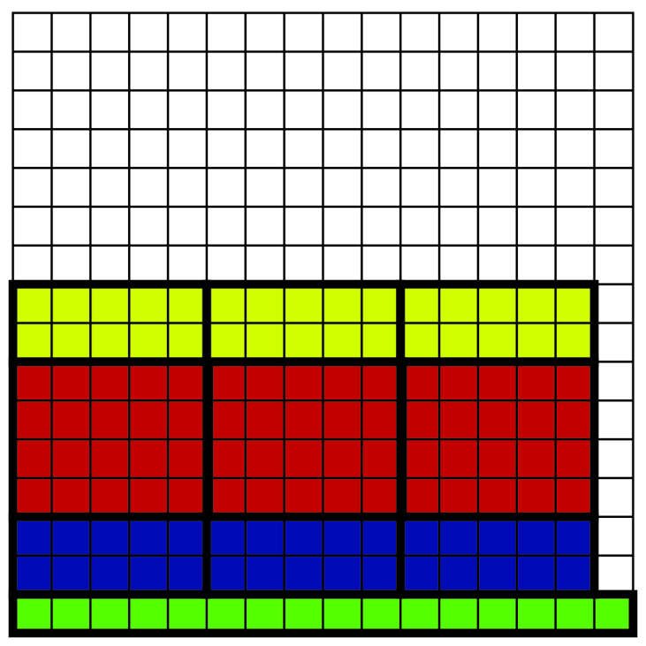
The GGH Model: A basic description
The GGH model is lattice-based, so you can think of it as occurring on a field of pixels (either 2D or 3D).
Each generalized cell in a GGH simulation is made up of a collection of pixels:
A generalized cell can represent:
A cluster of cells
A cell
A subcellular compartment
Non-cell material
…something that behaves, for the purposes of the model, as a unit

Slide 8
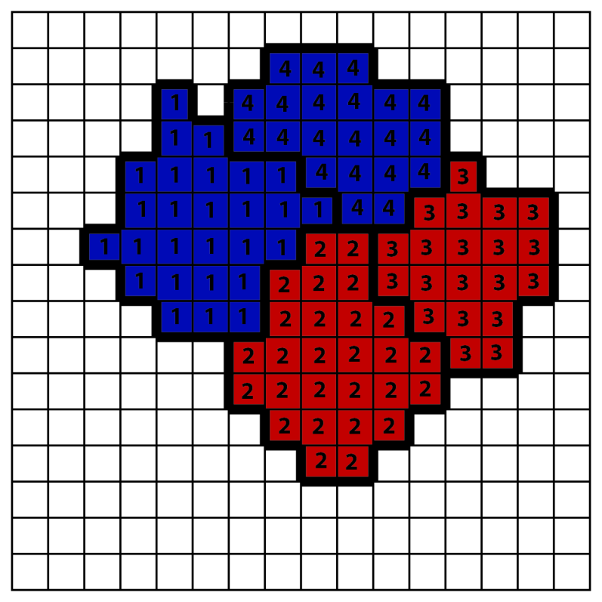
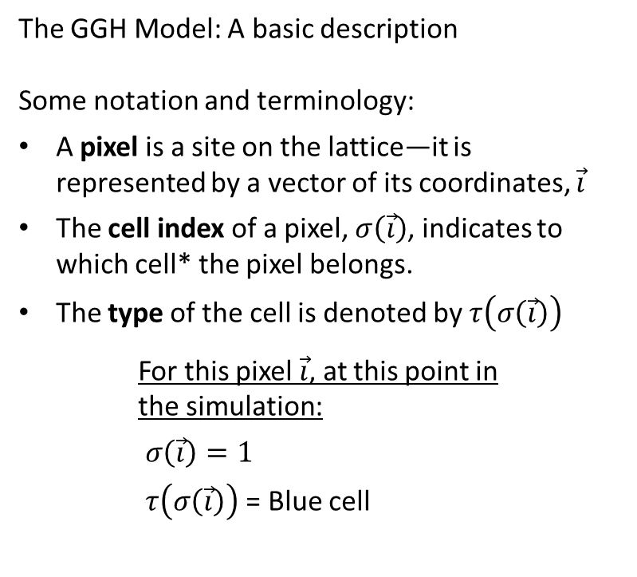
The GGH Model: A basic description
Some notation and terminology:
A pixel is a site on the lattice—it is represented by a vector of its coordinates, $\vec{i}$
The cell index of a pixel, $σ\left(\vec{i}\right)$, indicates to which cell* the pixel belongs.
The type of the cell is denoted by $τ\left(σ\left(\vec{i}\right)\right)$
For this pixel $\vec{i}$, at this point in the simulation:
$σ\left(\vec{i}\right)=1$
$τ\left(σ\left(\vec{i}\right)\right)$ = Blue cell
*Note: Above, cell = generalized cell

Slide 9
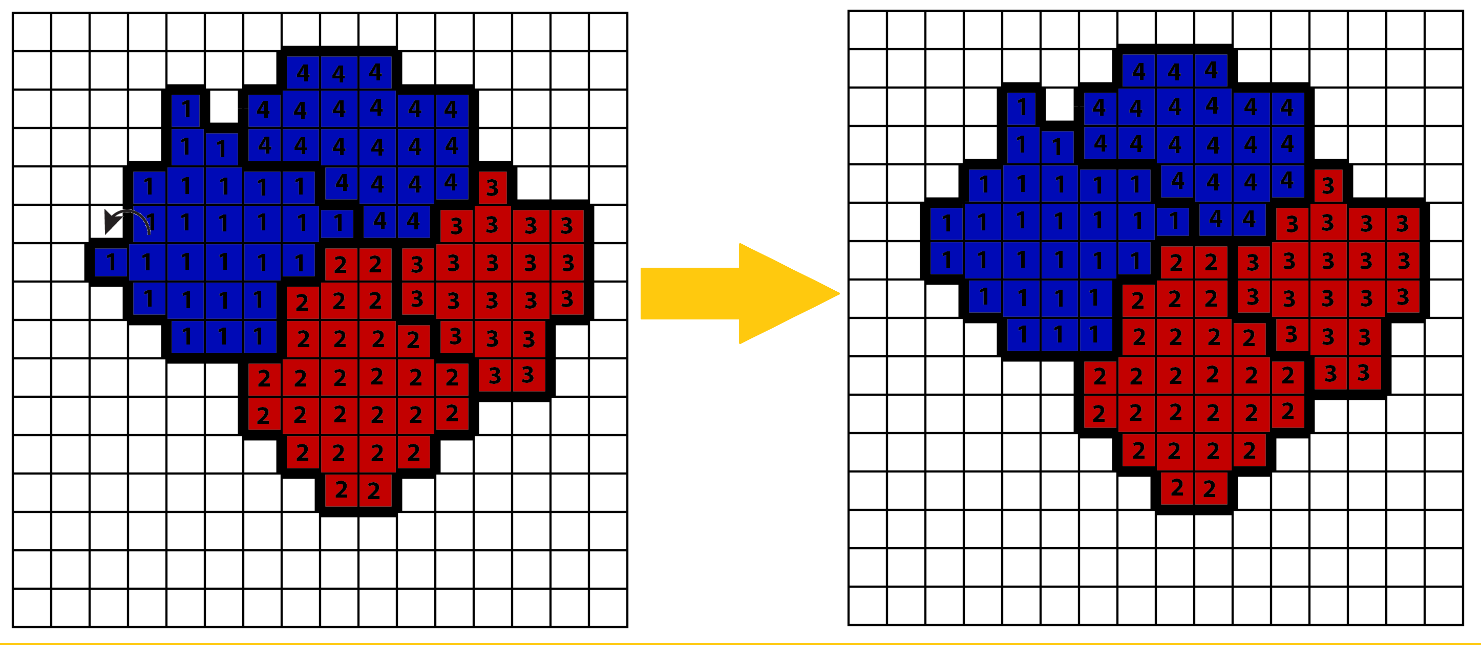
The GGH Model: A basic description
Cell boundaries change when one pixel “takes over” an adjacent pixel (this is called an index copy)
*Note: Above, cell = generalized cell

Slide 10
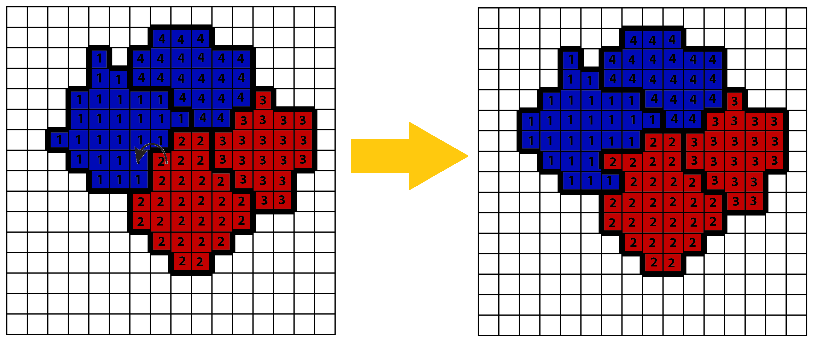
The GGH Model: A basic description
Cell boundaries change when one pixel “takes over” an adjacent pixel (this is called an index copy)
*Note: Above, cell = generalized cell

Slide 11

The GGH Model: A basic description
Cell boundaries change when one pixel “takes over” an adjacent pixel (this is called an index copy)
Each simulation step (Monte Carlo Step) includes N random index-copy attempts, where N is the number of pixels in the simulation lattice.
These are attempts –they don’t always result in an index copy.
The rules that influence which index-copy attempts are successful govern the dynamics of a simulation.
This is where the effective energy comes into play.
?
*Note: Above, cell = generalized cell

Slide 12
Effective energy and GGH simulation dynamics
The effective energy is where the rubber meets the road: where the biology that we are modeling comes into play and impacts the behavior of our simulation.
Before talking about the kinds of constraints that will go into determining the effective energy, I’m going to cut to the chase and discuss how the effective energy influences the dynamics of a simulation.
For now, suffice it to say that the effective energy depends on the configuration of the simulation—some configurations will have higher effective energy than others.
Changing the configuration of the simulation with an index copy will therefore change the effective energy.
Note: The effective energy does NOT represent the amount of actual energy in the simulated system. It is a tool for governing simulation dynamics.

Slide 13
Effective energy and GGH simulation dynamics
As mentioned before, for each Monte Carlo step (MCS), there are a number of index-copy attempts:
The probability that any given attempt is successful depends on how that index copy would change the effective energy.
?

Slide 14

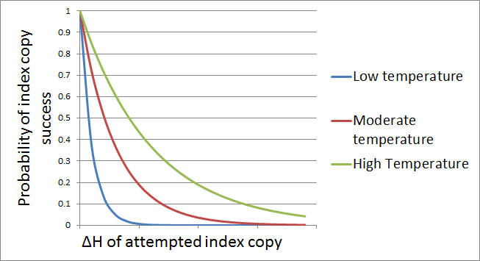
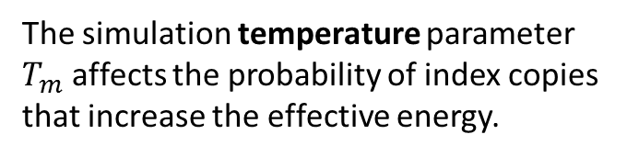
Effective energy and GGH simulation dynamics
The probability that any given attempt is successful depends on how that index copy would change the effective energy (ΔH):
?
The simulation temperature parameter $T_{m}$ affects the probability of index copies that increase the effective energy.

Slide 15
Translating biology into effective energy terms
Biological constraints are modeled as terms in the effective-energy calculation.*
Examples:
Contact energies between cell types (adhesion/repulsion)
Surface area (perimeter in 2D) and volume (area in 2D) constraints
Chemotactic “pressure”
Cell shape, e.g., elongation
Neighbor fidelity
Standard
Specialized
*Note: The effective energy for the simulation is not calculated, as there is no need to do so—for each index-copy attempt, the change in the effective energy that would be caused by the attempted index copy is calculated.

Slide 16
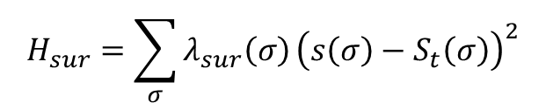
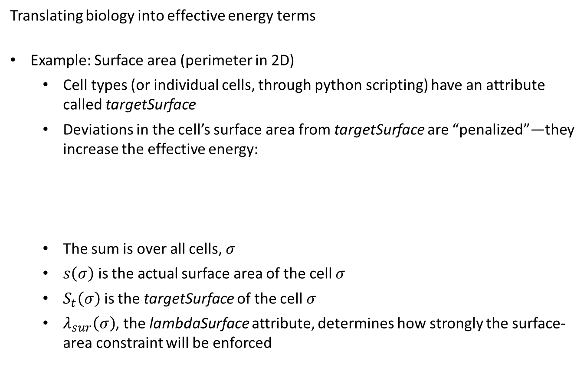
Translating biology into effective energy terms
Example: Surface area (perimeter in 2D)
Cell types (or individual cells, through python scripting) have an attribute called targetSurface
Deviations in the cell’s surface area from targetSurface are “penalized”—they increase the effective energy:
The sum is over all cells, $σ$
$s\left(σ\right)$ is the actual surface area of the cell $σ$
$S_{t}\left(σ\right)$ is the targetSurface of the cell $σ$
$λ_{sur}\left(σ\right)$, the lambdaSurface attribute, determines how strongly the surface-area constraint will be enforced
$$H_{sur}=\sum_{σ}{λ_{sur}\left(σ\right)}{\left(s\left(σ\right)−S_{t}\left(σ\right)\right)}^{2}$$

Slide 17

Translating biology into effective energy terms
Example: Surface area (perimeter in 2D)
Above, the proposed change would increase the surface (perimeter) of cell 1 from 28 to 30 and increase the surface of cell 2 from 26 to 28
?
$$ΔH_{sur}=λ_{sur}\left(σ=1\right)\left[{\left(30−S_{t}\left(σ=1\right)\right)}^{2}−{\left(28−S_{t}\left(σ=1\right)\right)}^{2}\right]+λ_{sur}\left(σ=2\right)\left[{\left(28−S_{t}\left(σ=2\right)\right)}^{2}−{\left(26−S_{t}\left(σ=2\right)\right)}^{2}\right]$$

Slide 18
Translating biology into effective energy terms
Example: Surface area (perimeter in 2D)
Above, the proposed change would not change the surface area of any of the simulation cells.
?
$$ΔH_{sur}=0$$

Slide 19
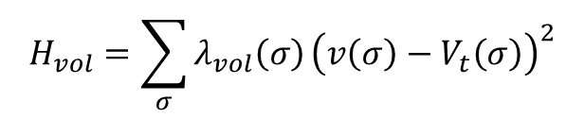
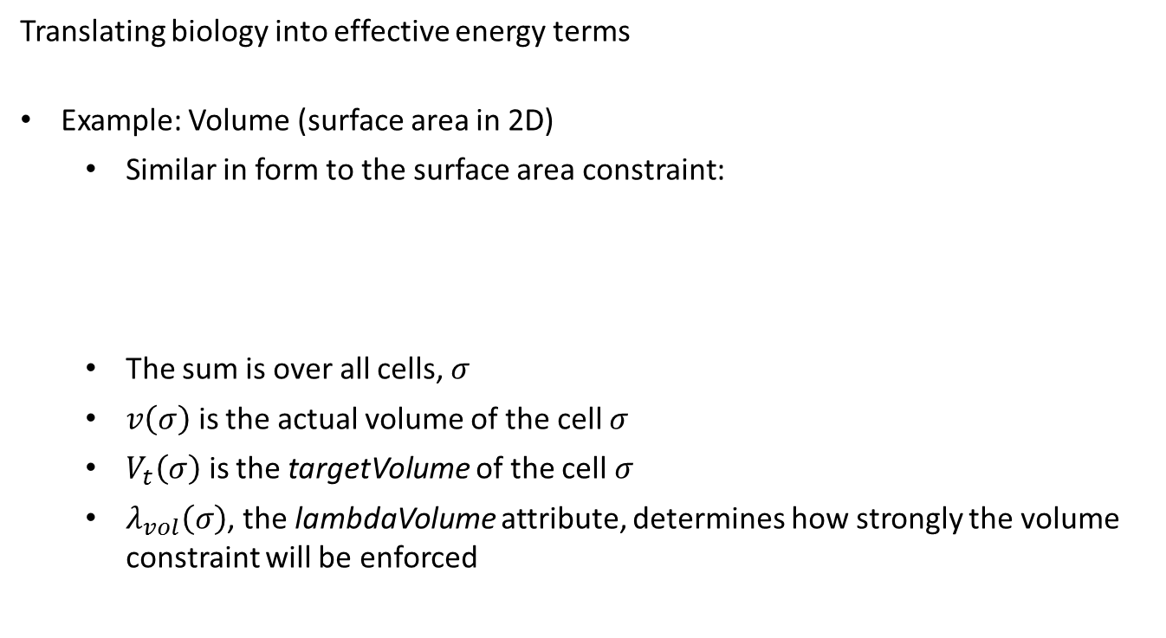
Translating biology into effective energy terms
Example: Volume (surface area in 2D)
Similar in form to the surface area constraint:
The sum is over all cells, $σ$
$v\left(σ\right)$ is the actual volume of the cell $σ$
$V_{t}\left(σ\right)$ is the targetVolume of the cell $σ$
$λ_{vol}\left(σ\right)$, the lambdaVolume attribute, determines how strongly the volume constraint will be enforced
$$H_{vol}=\sum_{σ}{λ_{vol}\left(σ\right)}{\left(v\left(σ\right)−V_{t}\left(σ\right)\right)}^{2}$$

Slide 20
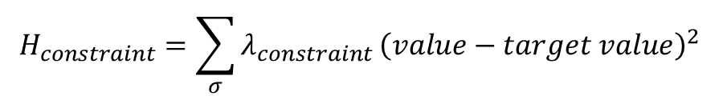
Translating biology into effective energy terms
Many constraints can be expressed as effective energies in this elastic form:
Many different types of constraints are available in CompuCell3D. The user manual defines the form of each available energy constraint, sometimes allowing the user to decide between different forms.
$$H_{constraint}=\sum_{σ}{λ_{constraint}}{\left(value−target value\right)}^{2}$$

Slide 21
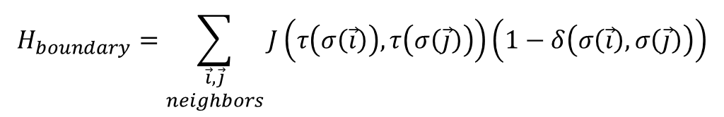
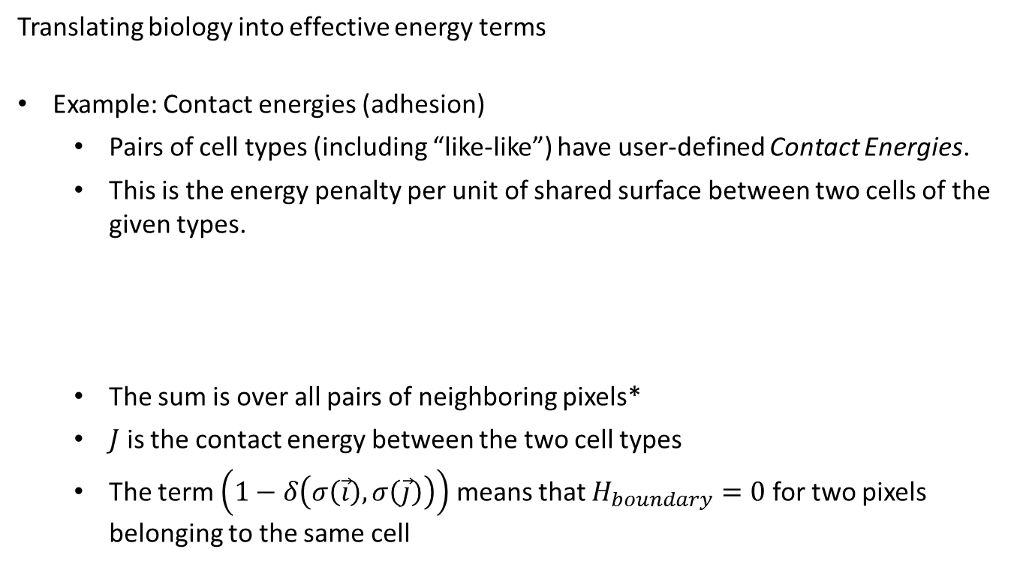
Translating biology into effective energy terms
Example: Contact energies (adhesion)
Pairs of cell types (including “like-like”) have user-defined Contact Energies.
This is the energy penalty per unit of shared surface between two cells of the given types.
The sum is over all pairs of neighboring pixels*
$J$ is the contact energy between the two cell types
The term $\left(1−δ\left(σ\left(\vec{i}\right),σ\left(\vec{j}\right)\right)\right)$ means that $H_{boundary}=0$ for two pixels belonging to the same cell
$$H_{boundary}=\sum_{\begin{aligned}\vec{i},\vec{j} \\ neighbors\end{aligned}}{J}\left(τ\left(σ\left(\vec{i}\right)\right),τ\left(σ\left(\vec{j}\right)\right)\right)\left(1−δ\left(σ\left(\vec{i}\right),σ\left(\vec{j}\right)\right)\right)$$
*Recall that the effective energy for the entire simulation lattice is not calculated.

Slide 22

Translating biology into effective energy terms
Example: Contact energies (adhesion)
The attempted index copy above would increase the contact area between cell 1 and cell 2 by two; it would thus increase the effective energy by two times the contact-energy parameter $J\left(Red Cell Type, Blue Cell Type\right)$
?

Slide 23
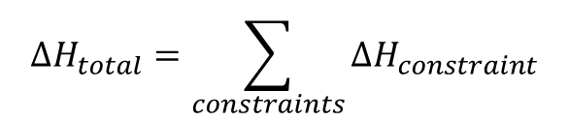
Translating biology into effective energy terms
Keep in mind…
Typically, several constraints come to bear on how an attempted index copy would change the effective energy of the simulation
Whether and under what circumstances a particular constraint dominates another depends on how you set the parameters of your simulation.
It can often be worthwhile to “play” with parameters in a very simple simulation—just a few cells—to gain an intuition for how changing different parameters will affect simulated cell behaviors
A consciousness about the underlying “guts” of CC3D can help you design simulation constraints that are in keeping with the biology you are modeling
$${ΔH}_{total}=\sum_{constraints}{{ΔH}_{constraint}}$$

Slide 24
Some ideas for next time:
The power of Python: user-built CC3D modules
CC3D files in Python
Navigating CC3D structure in Python
The power of the Cell List
Attaching additional attributes to cells: some examples
Module-building in CC3D: some guidelines

