Slide 1
Server Monitor
Bao Vue

Slide 2
Problem Statement
Manage Servers
Over 100 servers
No centralized location to manage
Very reactive protocol

Slide 3
Objectives
Create GUI
Table with server information
IP address
Service list
Memory usage
Server status
Send email to notify user of server being down

Slide 4
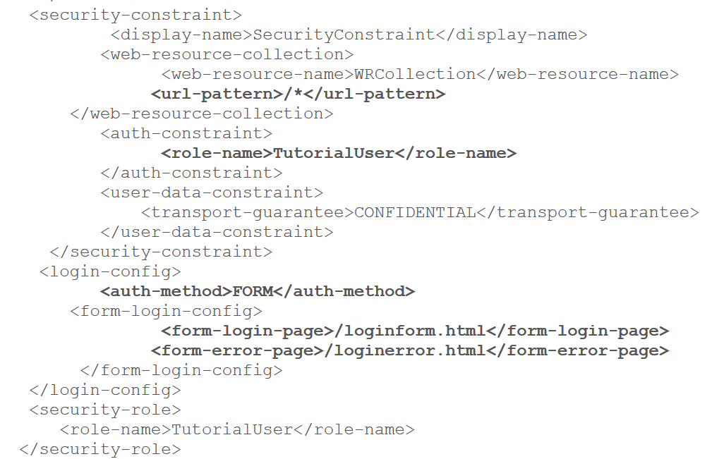
Security
Authentication and Authorization
Form based authentication
J security check
All security declared in the deployment descriptor for the application aka web.xml
A security constraint is defined which tells the server:
Use the login form to collect user data
Verify that the user is authorized to access the application
If user is authorized, display the page to the user
If user not authorized, display error page
Registered users are given “employee” access

Slide 5
Technologies Used
Bootstrap
Front End
More info: http://www.tutorialspoint.com/bootstrap/
JavaMail API v1.5.2
Back End
More info: http://www.oracle.com/technetwork/java/javamail/faq/index.html
Java Secure Channel (JSCH)
Java Implementation of SSH2
Secure Shell provides an encrypted channel for logging into another computer over a network
More info: http://www.jcraft.com/jsch/

Slide 6
Technologies Used
Bootstrap
html, css, and javascript framework
a lot of documentation online
easily create responsive web sites which automatically adjust themselves to look good on all devices
design templates for typography, forms, buttons, tables, navigation, modals, image carousels and many others
2 ways to get bootstrap:
Download Bootstrap from getbootstrap.com
Include Bootstrap from a CDN

Slide 7
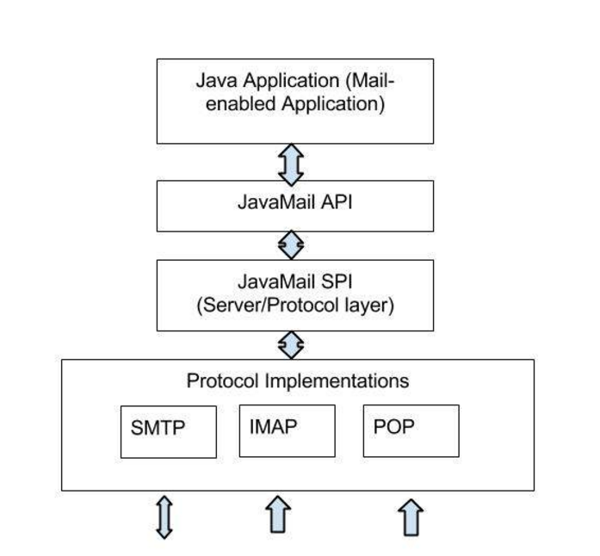
JavaMail API v1.5.2
JavaMail API is divided into two main parts:
An application-independent part
API is used by the application components to send or receive mail messages
A service-dependent part
Service Provider Interface (SPI) speaks the protocol-specific languages. In my case, Simple Mail Transfer Protocol (SMTP)

Slide 8
JavaMail API v1.5.2
To send an email:
Get a Session by using Session class. The Session object acts as the connection factory for the JavaMail API, which handles both configuration setting and authentication
Create a default MimeMessage object and pass your session into it
This will create your message body in the email
Use the Address object to address the email to the target
Send the message using the Transport object. Transport class is used as a message transport mechanism. This class normally uses the SMTP protocol to send a message.

Slide 9
Java Secure Channel (JSCH)
Steps to creating a connection to the remote server:
Create a JSCH object and open a session with your credentials
Create execution channel (aka where you will be executing your commands to the remote server)
Get your input from the remote server via InputStream
Read your stream from above via BufferedReader
Disconnect your channel and disconnect session

Slide 10
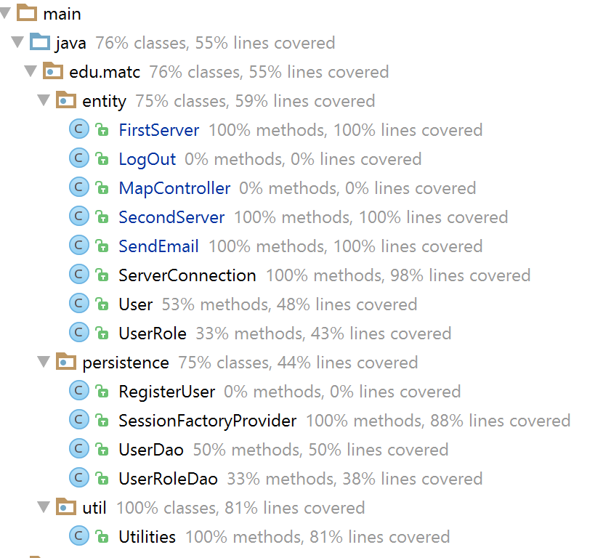
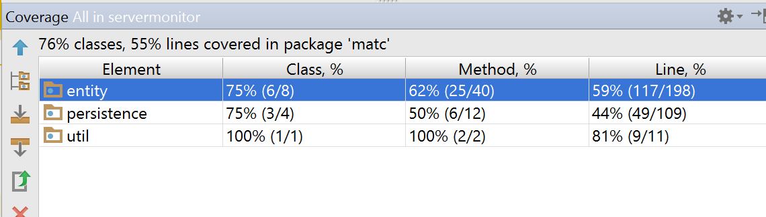
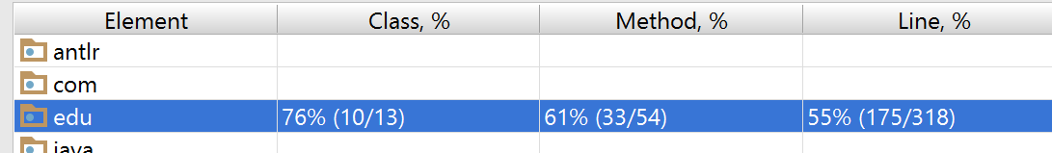
Unit Testing

Slide 11
Key Learning Points & Takeaways
Digital Ocean is not as easy as I thought it’d be
The most time consuming issues ended up being minor errors / problems
How to design an application
Code that’s testable

Slide 12


