Slide 1
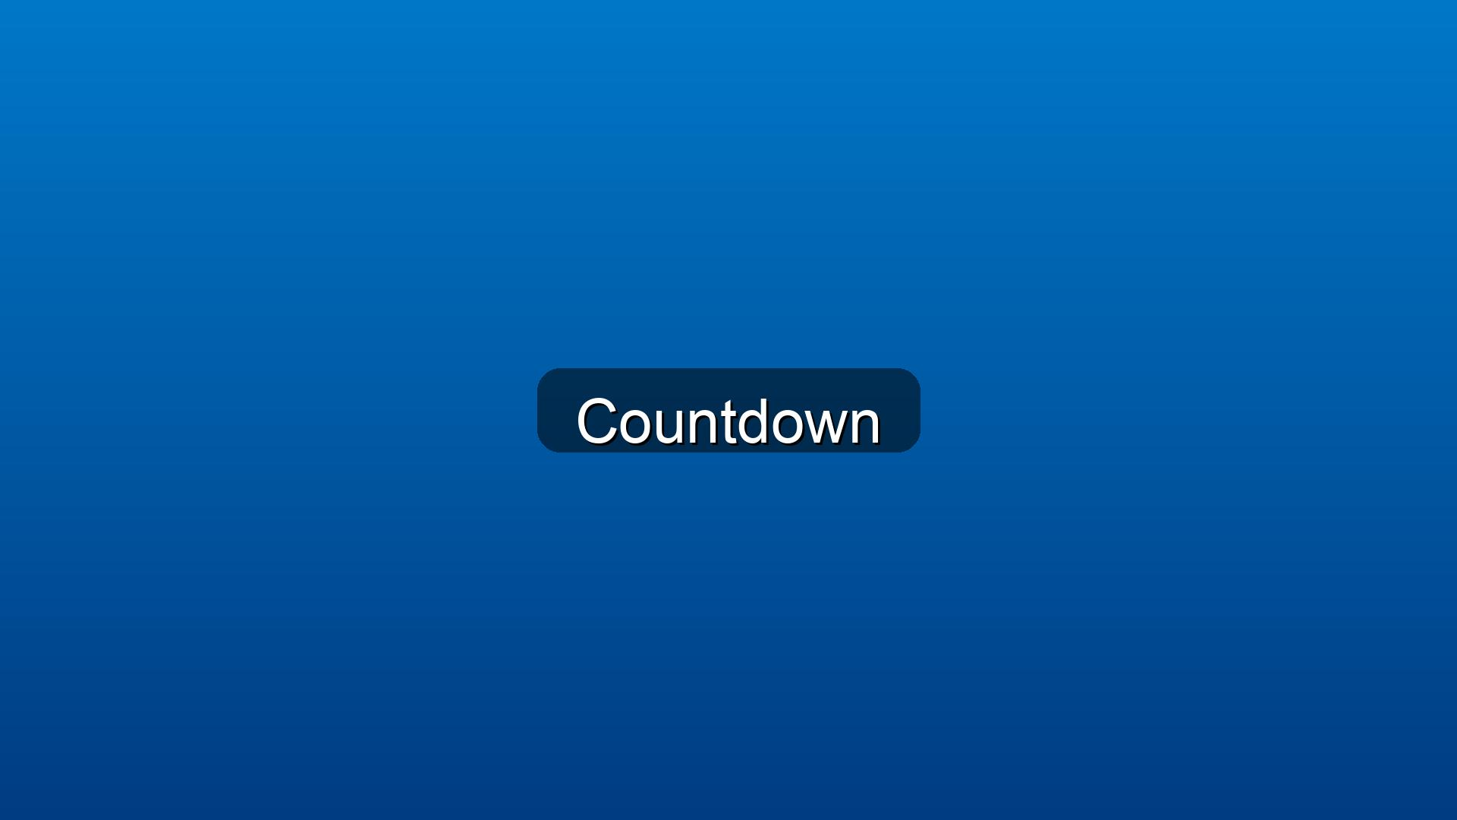
5 Minute Countdown

Slide 2
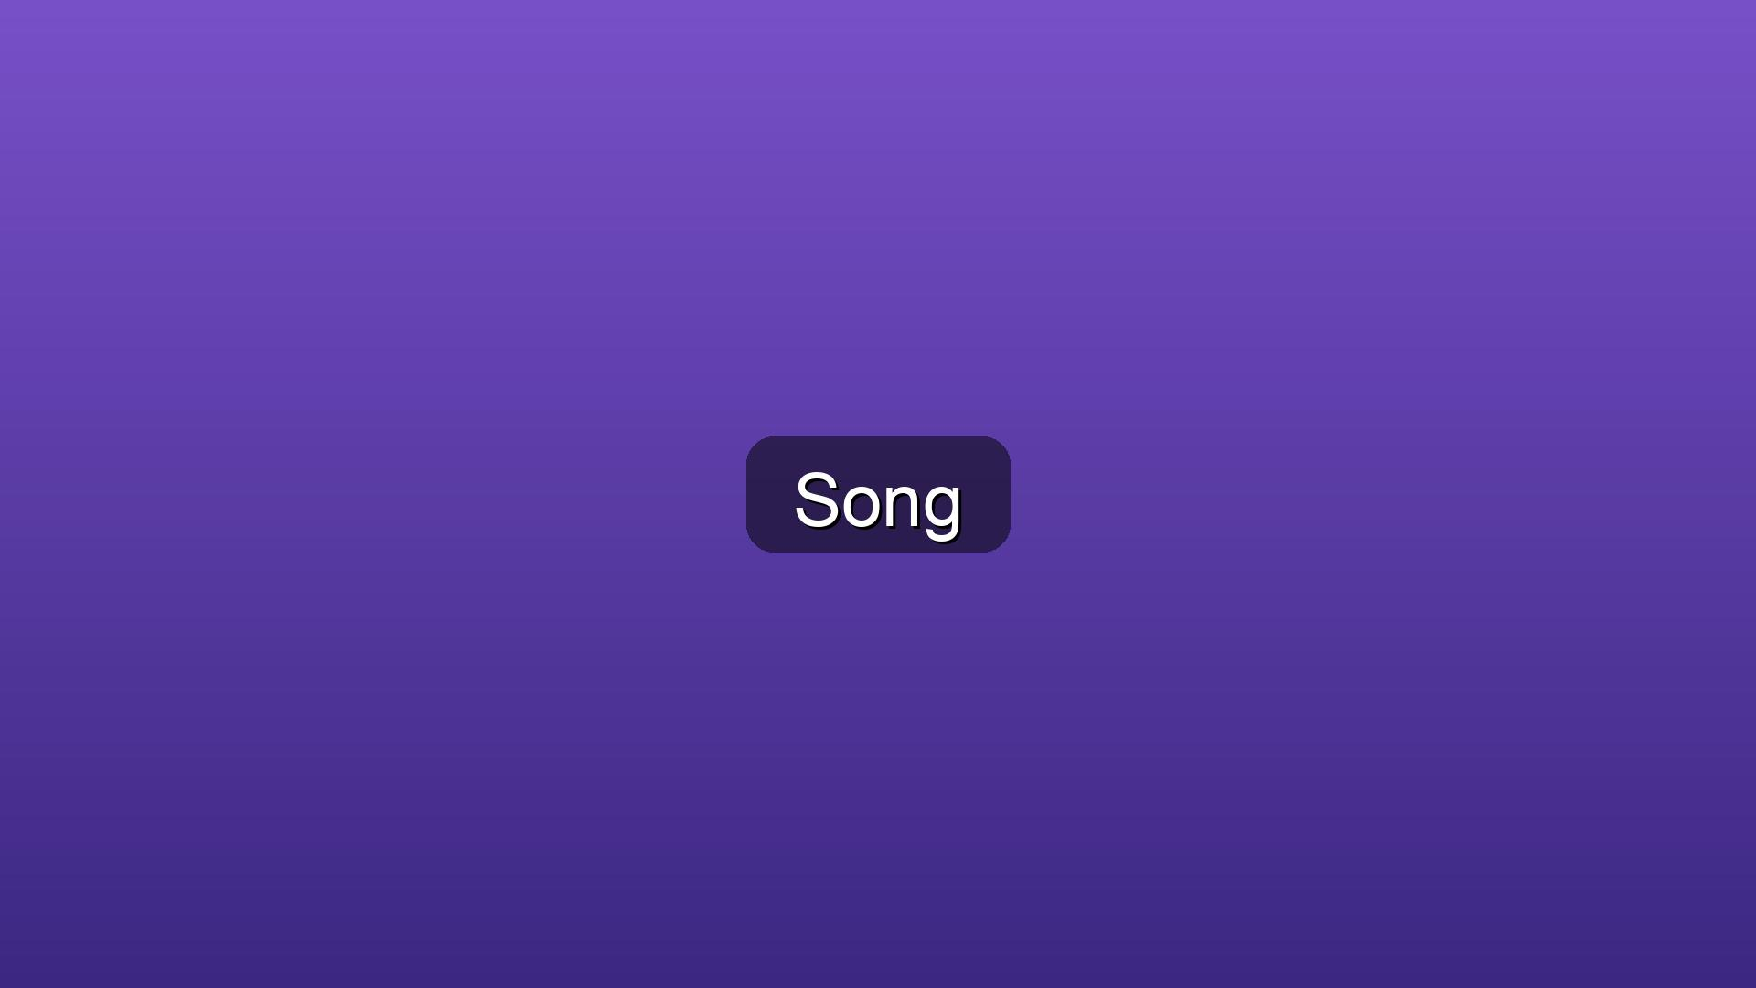
Opening Praise

Slide 3

Announcements

Slide 4
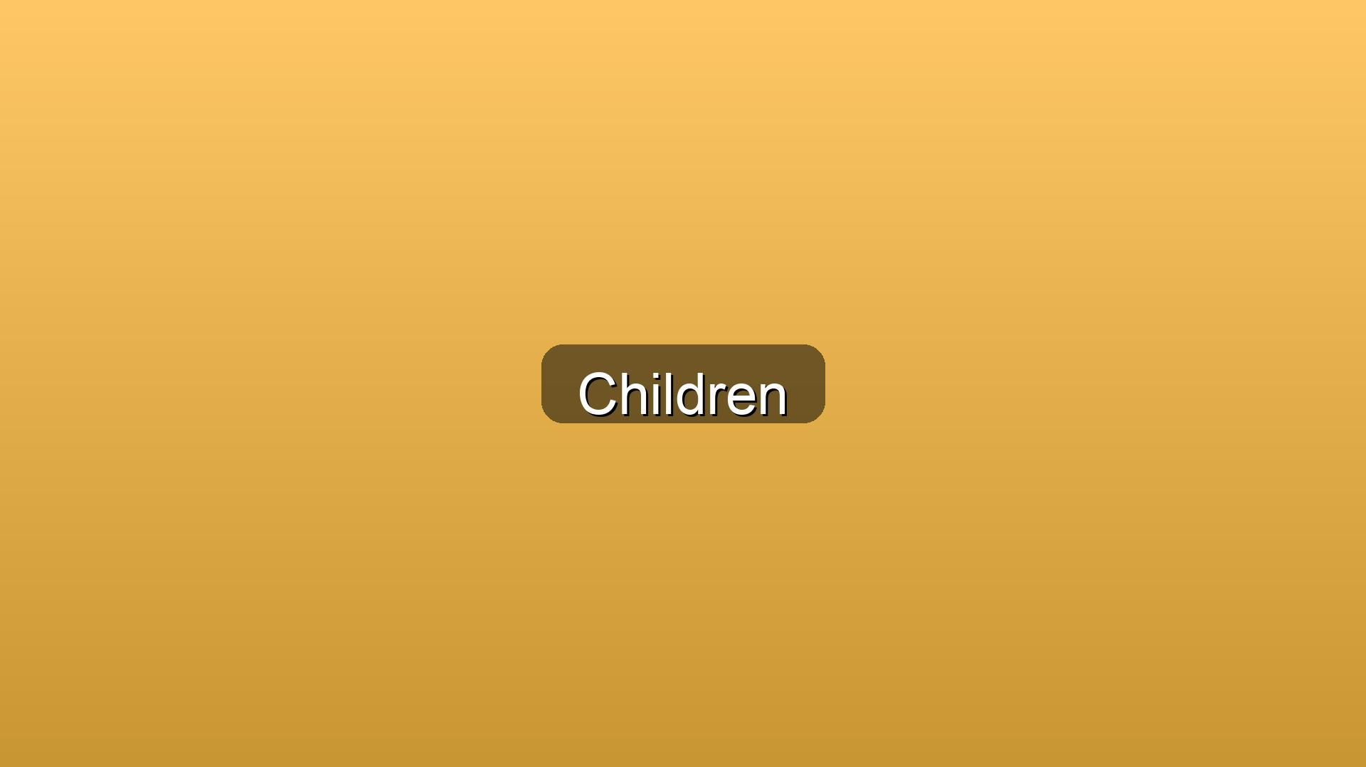
Children’s Message
Presenter: Bruce Wilkins

Slide 5

Call to Worship
Leader: Come, all who are burdened by the weight of hurt, anger, or regret.
People: We come seeking the peace that only God can give.
Leader: Come, all who long to experience the freedom of forgiveness.
People: We come to be reminded of God’s boundless grace and love.
Leader: As Christ has forgiven us, so we are called to forgive one another.
People: With open hearts and willing spirits, we gather to worship the God of mercy and restoration.
Leader: Let us lay down our burdens and lift our voices in praise.
All: For in Christ, we are forgiven, set free, and made whole. Amen.

Slide 6
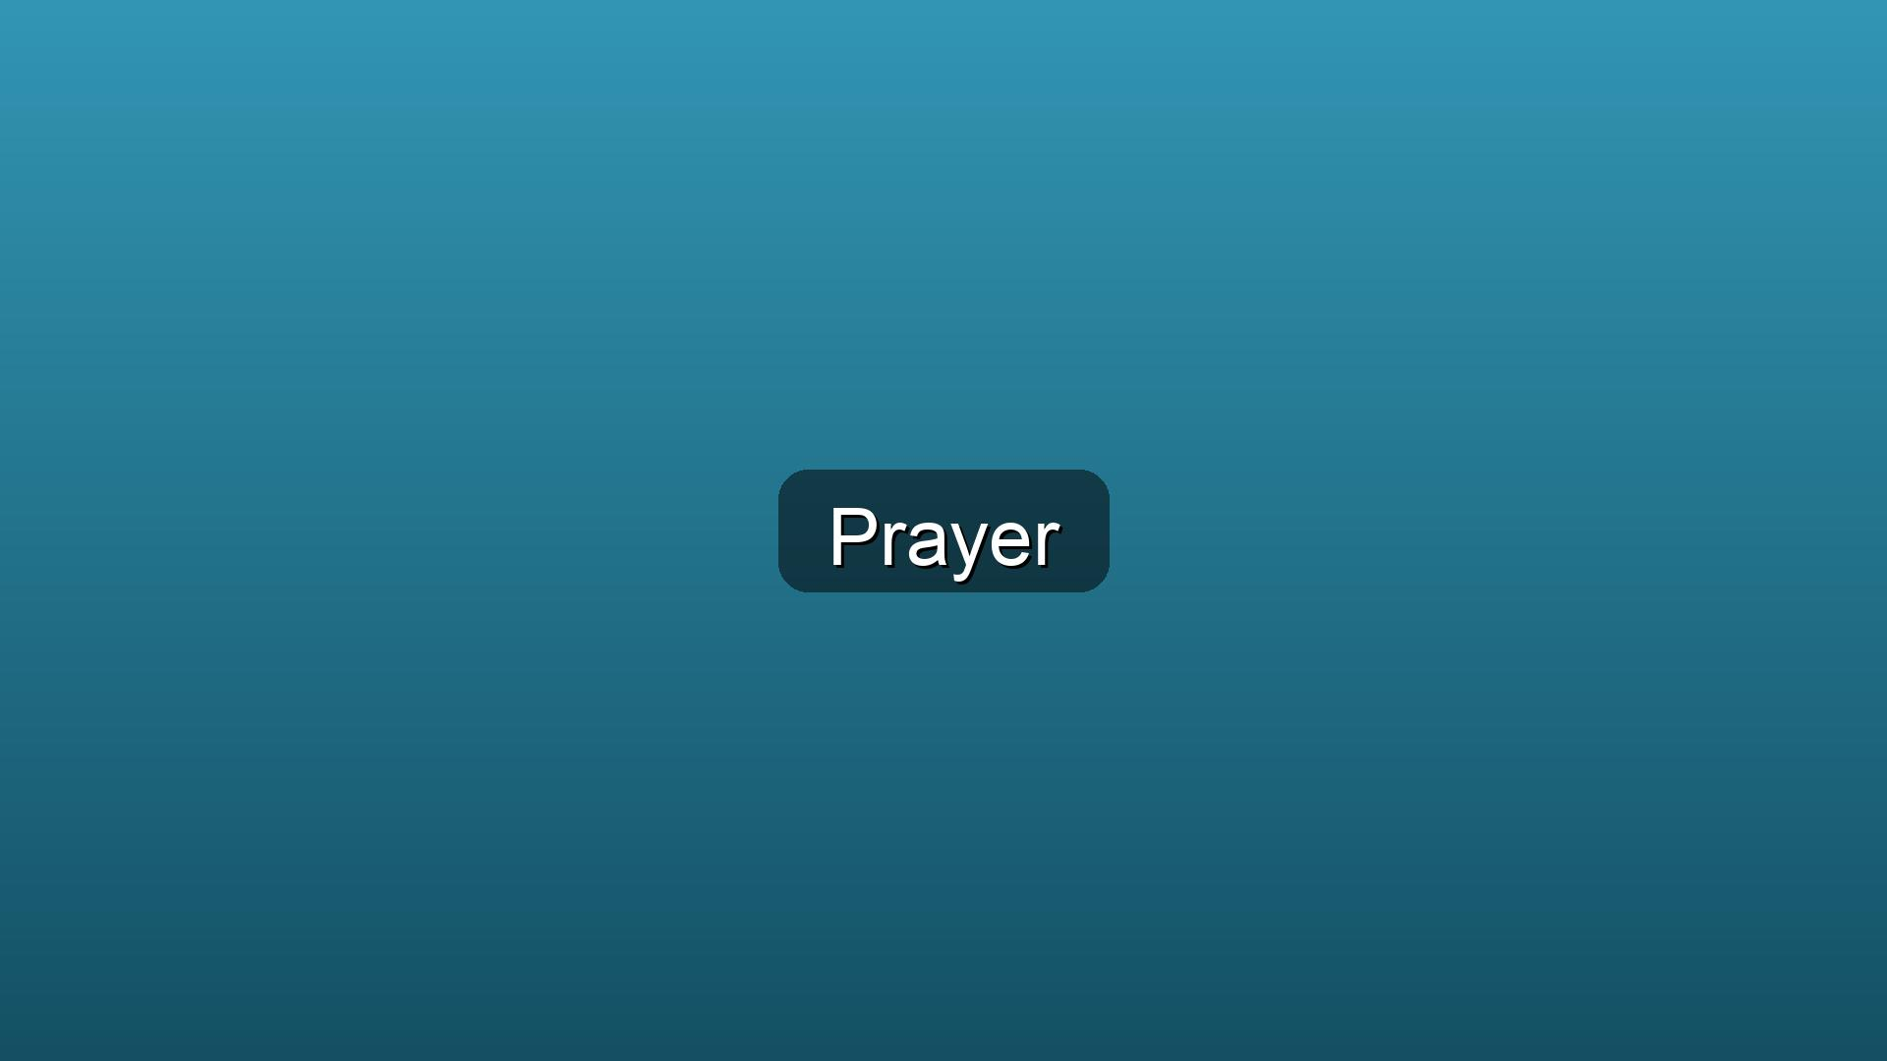
Opening Prayer
Gracious and merciful God, we come before you with hearts open to your forgiveness.
Teach us to forgive as you have forgiven us, and help us to extend grace to those who have wronged us.
May your Spirit guide us in our worship today, leading us to deeper understanding and compassion.
In Jesus' name, we pray. Amen.

Slide 7
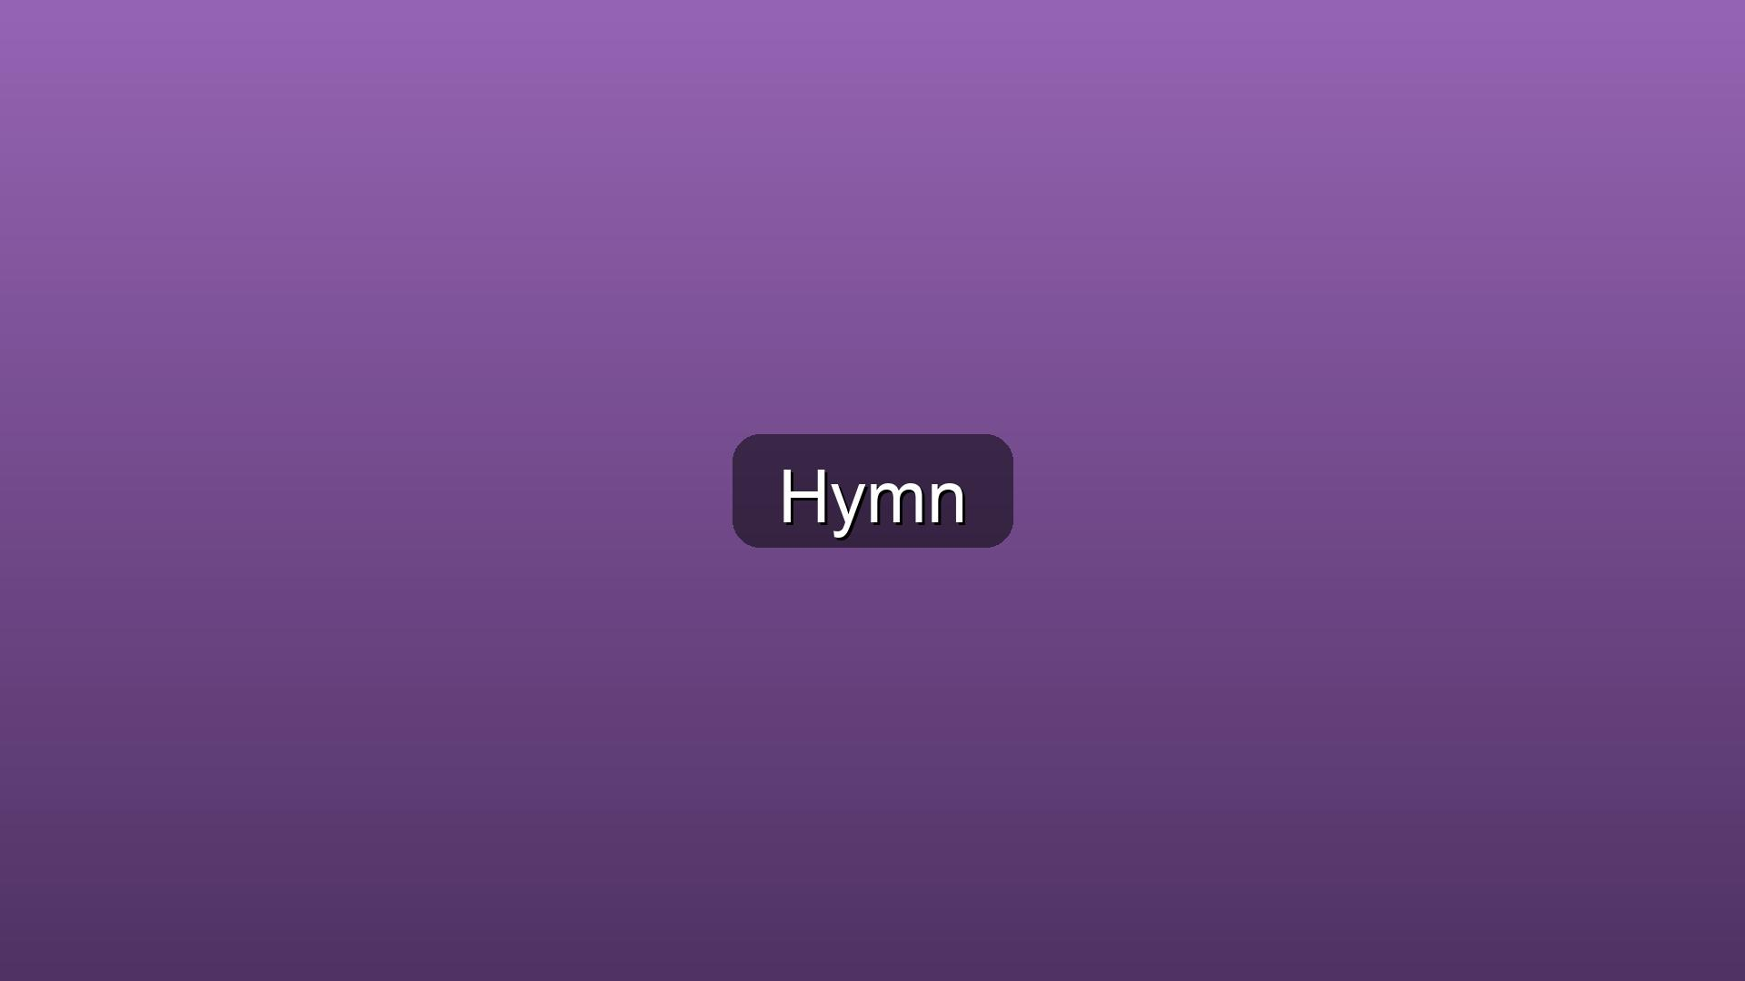
Hymn of Praise
Amazing Grace (#378)

Slide 8
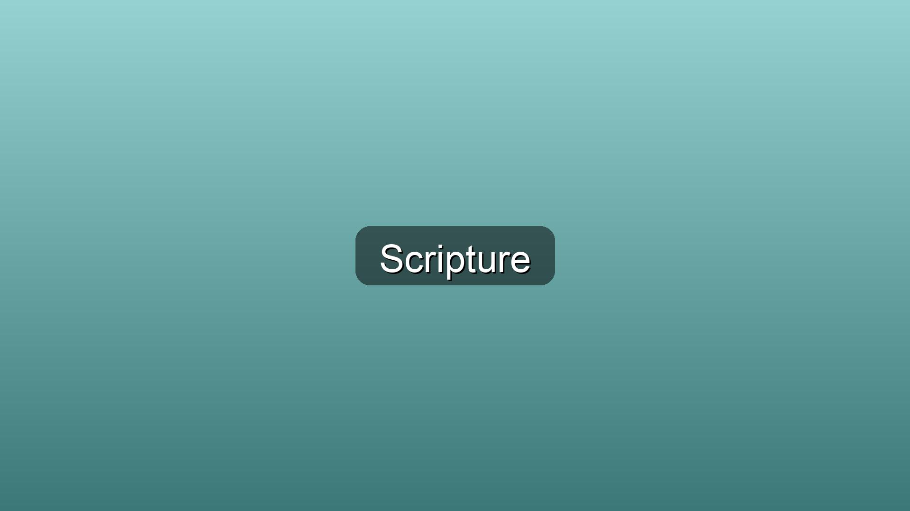
15 Then the Lord said to Moses, “Why are you crying out to me? ...

Slide 9
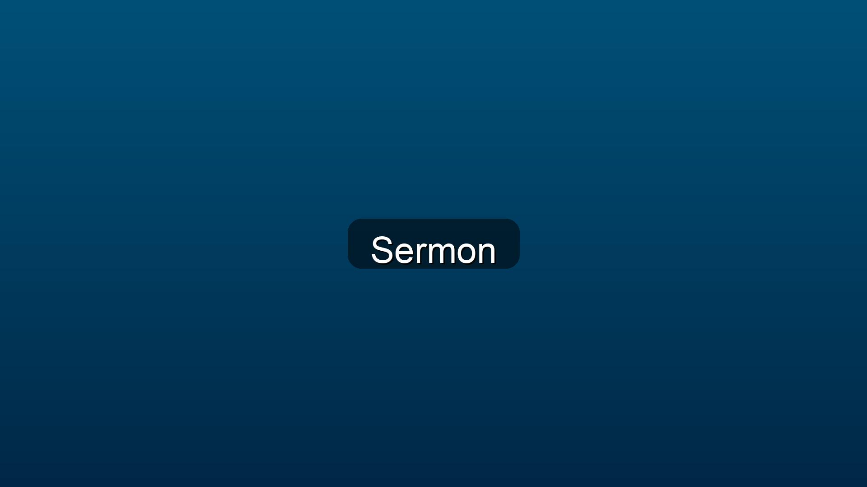
Moses and the Red Sea
Speaker: Bruce Wilkins

Slide 10
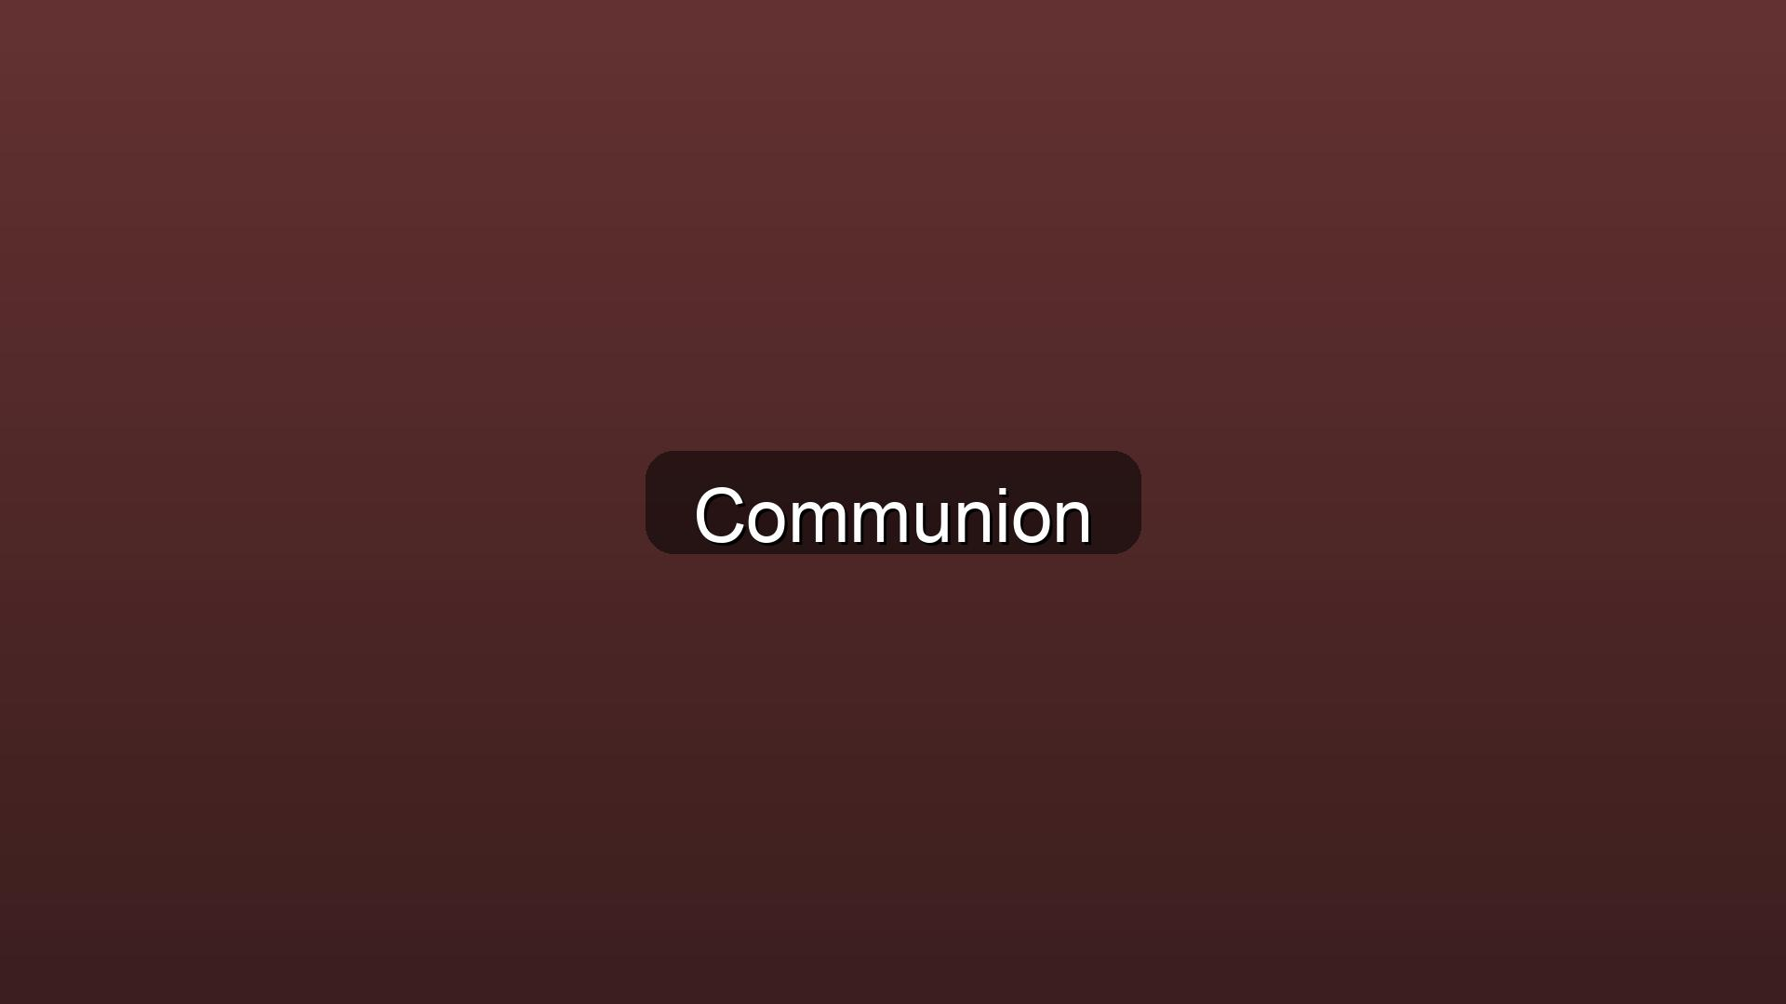
Holy Communion

Slide 11
Lord’s Prayer

Slide 12
Prayers for the Community

Slide 13

Offering with Doxology

Slide 14
Closing Praise

Slide 15
Dismissal

