Slide 1
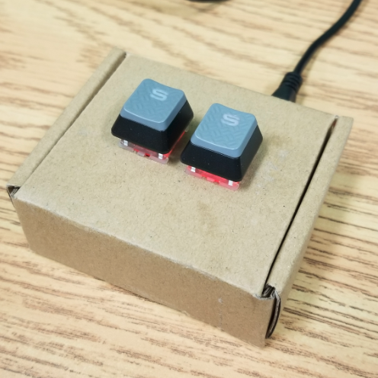
osu!Keypad
Brandon Wang
May 31, 2019

Slide 2
Description
The osu!Keypad is a two-key box that is used to play the rhythm game osu!
Osu! Is a game where you are required to click (with your keyboard) the circles according to the beat of a song. This keypad acts as a replacement “clicker”.
The two keys are binded to the corresponding “x” and “z” keys on a keyboard, used to click in osu!.
What is the osu!Keypad?

Slide 3
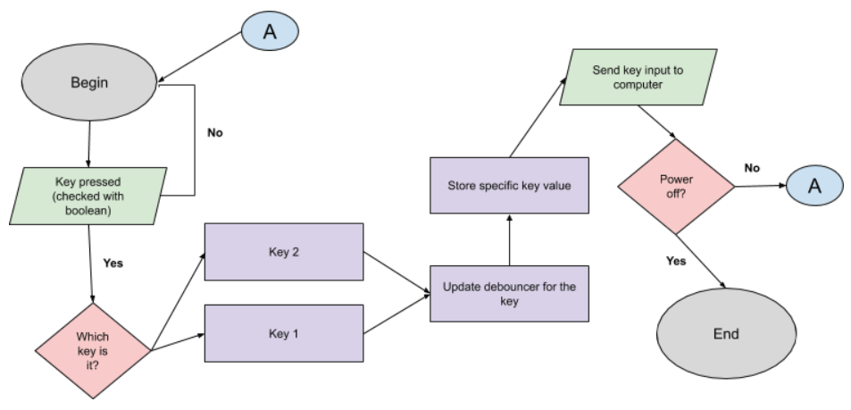
Flowchart
Process
Begin
Is the key pressed?
No: back to beginning
Proceed to 3.
Which key is it?
Key 1
Key 2
Debounce the keys
Send key input to computer
Outputted key values to computer to print
Power on or off?
Power on: Go to 1.
Power off: Proceed to 7.
End

Slide 4
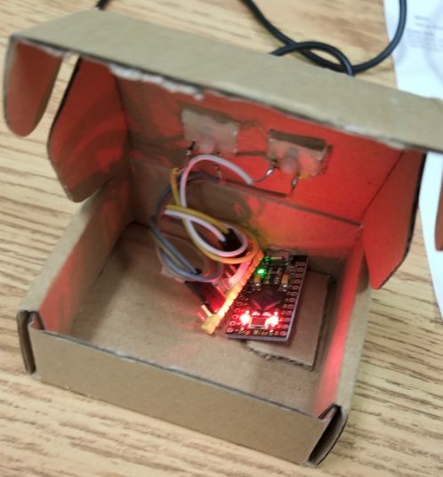
Components
Switches - Cherry MX Pink Switches (silent reds)
Keycaps - CORSAIR Contoured and Textured Performance Keycaps
Casing - Small Cardboard Box
PCB - Arduino Pro Micro with a Atmega32U4 Microcontroller

Slide 5
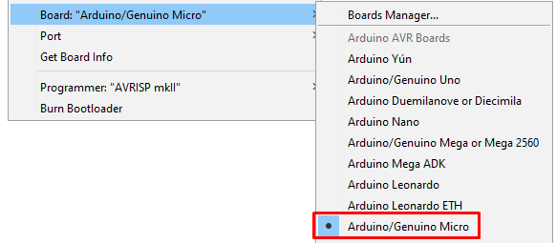

Requirements
The osu!Keypad program was compiled and uploaded through the updated Arduino IDE version 1.8.9.
In version 1.8.9, you are able to select “Arduino/Genuino Micro” in the boards tab, which does not exist in version 1.7.10 (school version). This was a requirement to upload the code to the Arduino Pro Micro board.
Prerequisites for Program Upload
Other requirements include the download, import and access of the external Arduino libraries:
Keyboard Library and Debouncer (Bounce2) Library.
Keyboard Library: https://github.com/arduino-libraries/Keyboard
Bounce2:
https://github.com/thomasfredericks/Bounce2

Slide 6
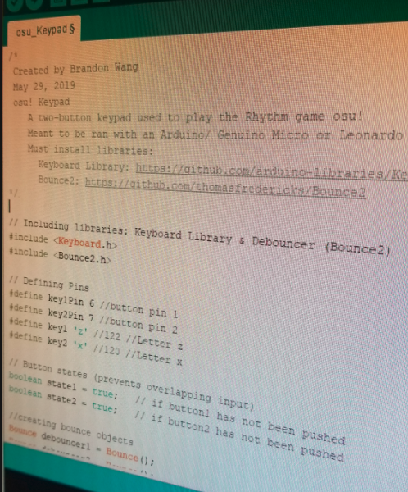
The Code

Slide 7



The Code - Libraries
The Keyboard Library allows the Arduino microcontroller to copy the functions of a regular keyboard. Using the method
Keyboard.begin();
The Arduino is able to simulate keyboard key presses and key releases.
The code for the osu!Keypad includes two Arduino libraries: the Keyboard Library and Bounce2.
The Bounce2 Library is a debouncing library for Arduino. Debouncers are attached to key pins via
.attach();
By debouncing each key press, the Arduino is able to check for multiple key presses and prevent spastic outputs.
By simultaneously using the Keyboard and Bounce2 libraries, the osu!Keypad is able to accurately simulate a functional keyboard.

Slide 8
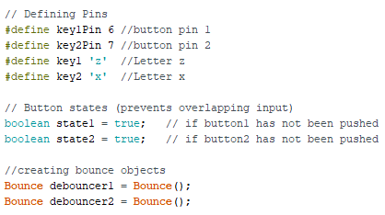
The Code - Declaring Variables
This piece of code consists of the variable declaration.
First, is the definition of the key pins and values that will be outputted to them. The first key pin will connect to pin 6 and output the letter “z”, the second will connect to pin 7 and output the letter “x”.
Two boolean states are declared, which will be used to check for key presses and key releases in the main function of the program.
Two bounce objects are created, used to debounce their two respective keys.

Slide 9
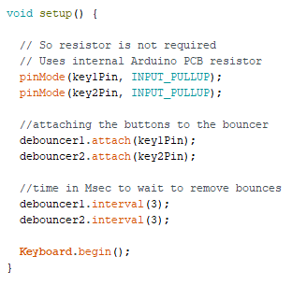
The Code - Setup
This piece of code consists of the setup(); of the program.
The pinMode for the two keys is declared with INPUT_PULLUP. This allows the use of the internal Arduino PCB resistor, rather than requiring an external one.
The .attach() function attaches the debouncers to the two key pins, and then an interval of 3ms is set in between debouncing.
Finally, the Keyboard.begin(); function begins the Arduino keyboard simulation.

Slide 10
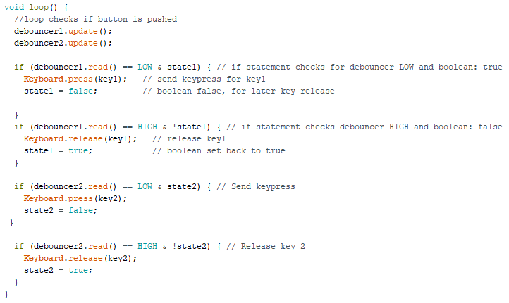
The Code - Loop/ Main Function
This piece of code consists of the main function of the program, the loop that checks for key presses. There are two sets of if statements corresponding to the two key switches.
This loop runs indefinitely until the PCB is no longer receiving power. At the beginning of each loop, the debouncers are checked and updated.
The first if statement checks if the key is pressed. If the debouncer signal is read as LOW and the boolean is read true, a key press will be sent, and the boolean will be updated as false. The key press will be read as long as the key is held.
The second if statement checks for the key release. If the debouncer signal is read as HIGH and the boolean is read false (updated in first if statement), the Arduino will signal that the key has been released, and update the boolean back to true.

Slide 11
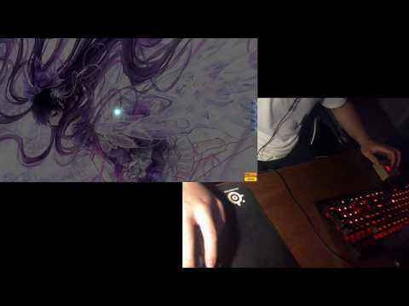
Liveplay
https://www.youtube.com/watch?v=m3WDlYKW468&feature=youtu.be

