Slide 1

MBAI 5600G · CAPSTONE · MILESTONE 7
/ project · cross-school dropout EWS · final
PORTABLE DYNAMIC MODEL | HELD-OUT PERFORMANCE
UCI enrolment | pooled XGBoost
OULAD day 35 | pooled XGBoost
0.771
0.677
Cross-Institution Student Dropout Early Warning System
ROC-AUC
ROC-AUC
AP 0.635 | local-only AUC 0.774
AP 0.311 | local-only AUC 0.686
Best OULAD snapshot
Later OULAD portability cost
0.694
0.009-0.013
ROC-AUC | day 60
ROC-AUC below local-only
One Fixed Model for Enrolment and In-Course Snapshots
One pooled 16-feature model
Significant AUC gaps at days 35, 60, and 75
RECOMMENDATION
Use one frozen model behind a documented local adapter, then rank and validate locally.
Group 21 · Oral Presentation
Different raw columns are acceptable | 4 required fields | 12 optional fields | human review remains required
Xinyu Wang · Wu Hanming
August 11, 2026 / Faculty of Business and IT
01 / 20 · Cover
Notes:
SPEAKER: Xinyu
Good afternoon. Our project asks whether one fixed dropout model can be reused when schools store different raw columns and when new information arrives during a course. We designed a 16-feature semantic contract. Four fields are required and twelve are optional. UCI contributes an enrolment snapshot, while OULAD contributes enrolment and day-35, day-60, and day-75 snapshots. The same pooled XGBoost object scores every context. It reached an AUC of 0.771 on UCI enrolment and 0.677 to 0.694 on later OULAD snapshots. The later OULAD AUC is slightly below a local-only model, so our claim is practical reuse with a measured cost, not perfect transfer.
[Sources]
- Project output: dynamic_unified_metrics.csv
- Project output: dynamic_unified_significance.csv

Slide 2
§ 00 · Agenda
02 / 20
What we'll cover
Nine sections · 20 minutes talk · 5 minutes Q&A
01
Introduction
1.5 min
06
Business Impact
2 min
Why a transferable model is needed
Transfer steps and advisor workload
02
Problem Definition
1.5 min
07
Limitations & Ethics
1 min
Different columns -> one fixed 16-feature contract
Transfer limits · fairness · scope
03
Data & EDA
3 min
08
Deployment & Future Work
1.5 min
Profiles · UCI findings · OULAD findings
Adapter | shadow test | local ranking
04
Methodology & Shared Schema
4 min
09
Key Takeaways
0.5–1 min
Adapters | dynamic snapshots | validation
Primary message
05
Results & Interpretation
4 min
10
Questions & Discussion
5 min
Pooled model | portability cost | SHAP | validity
Open floor · appendix + references
18 spoken slides
2 appendix slides (not spoken)
3 min allocated to EDA
20 min talk · 5 min Q&A
Notes:
SPEAKER: Xinyu
I will first explain the problem and the two datasets. We then spend about three minutes on EDA because it determines which raw fields can be mapped and when they become available. After that, we explain the 16-feature contract, the dynamic snapshot workflow, and the local-only versus pooled comparison. The results section includes the portability cost, SHAP interpretation, and a supporting OULAD timing check. We finish with advisor use, limitations, and a third-school validation plan. Slides 19 and 20 are appendix material and are not part of the spoken presentation.
[Sources]
- Activity 7 presentation requirements
- Project methodology and results

Slide 3
§ 01 · Introduction
03 / 20
THE CONTEXT
Schools collect useful student data, but their column names, scales, and systems rarely match.
THE PROJECT AT A GLANCE
UCI · Portuguese higher education institution
4,424
student records
3 outcomes · Dropout / Enrolled / Graduate
A model built for only one institution is difficult to reuse. UCI and OULAD provide a practical test because one dataset is mainly administrative while the other includes online learning behaviour.
OULAD · Open University UK
32,593
student-module rows
4 outcomes · Pass / Distinction / Fail / Withdrawn
Shared model input
16 semantic features
RESEARCH OBJECTIVE
Four required fields plus 12 optional fields on documented 0-1 scales
Build one fixed model, then test whether local adapters can convert different raw inputs and snapshot feeds into the same semantic feature contract.
Deliverable
Target: Dropout / future Withdrawn vs persistence | One 16-feature schema | Enrolment and day-35/60/75 tests
Adapters, one frozen model, a feature contract, scoring scripts, and a cautious pilot plan.
Notes:
SPEAKER: Xinyu
The practical issue is that schools do not share one student table. UCI mainly contains administrative and enrolment records. OULAD also contains dated assessments and online activity. A model tied to exact raw columns cannot be moved safely. Our objective is to keep the model input fixed while allowing each school to build its own documented adapter. Every adapter must produce the same 16 numeric concepts on zero-to-one scales. Four core concepts are required. Optional background, assessment, and activity fields can remain blank when the source system does not have them. This lets us test one model at enrolment and again as course evidence becomes available.
[Sources]
- UCI dataset 697
- Open University Learning Analytics Dataset
- unified_dynamic_feature_contract.json

Slide 4
§ 02 · Problem, scope & success
04 / 20
Different school tables should not require a completely new model.
The shared meaning of a feature matters more than its local column name.
Business problem
Transfer architecture
Identify at-risk students with one reusable modelling pipeline.
Local raw columns -> semantic adapter -> 16 fixed features -> one model
· Local systems use different names, coding rules, and available columns.
· A raw-column model breaks when another school's schema changes.
UCI local inputs
OULAD local inputs
· A semantic adapter can preserve one model while keeping local data ownership.
Examples
Examples
age, tuition status, prior education, and registered first-semester load
age band, deprivation band, credits, dated assessments, and active days
Stakeholders
Students · academic advisors · student-success offices · IT / data-governance teams
Adapter output
Adapter output
→
age_scaled | financial_stability | prior_education_level | study_load
the same 16-column contract; unavailable optional groups remain blank
Constraints
Two public institutions only · no live SIS/LMS access · approximate concept mappings · limited local compute
Scope
IN fixed-schema pooled model | enrolment and in-course snapshots | ranking-based scoring
OUT automatic field discovery | causal claims | autonomous action
Full assumption list → appendix (slide 19)
Evidence required before a new-school pilot
Statistical | ROC-AUC, AP, F1 + student-cluster tests
|
Transfer | local-only versus pooled across five held-out contexts
|
Calibration | rank locally; raw score is not a probability
|
Robustness | missing-group masking + temporal holdout
Notes:
SPEAKER: Xinyu
The business goal is consistent risk ranking without rebuilding the complete model for each school. The left side shows the scope and constraints. The right side shows the architecture. UCI maps age, tuition status, prior education, and registered load. OULAD maps age band, deprivation band, credits, dated assessments, and active days. Both produce the same 16-column order. This is not automatic field discovery. A new school must still decide which local columns represent the required concepts, document the scales, and check the mapped values. The model output is also a ranking score, not a calibrated personal probability.
[Sources]
- unified_dynamic_feature_contract.json
- map_new_school_snapshots.py

Slide 5
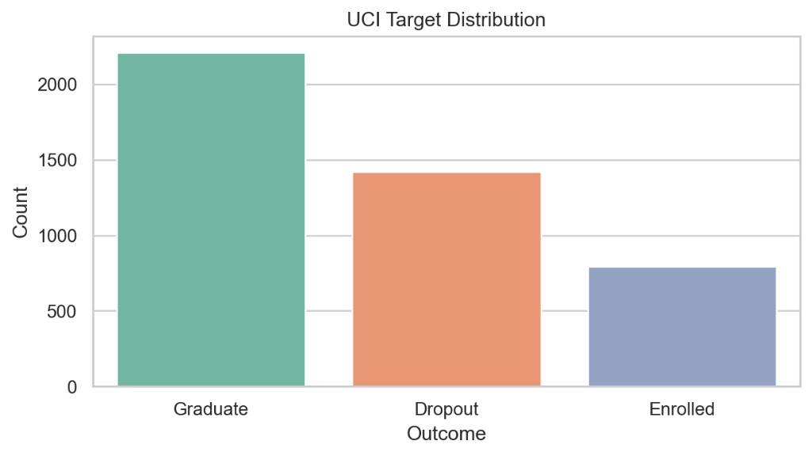
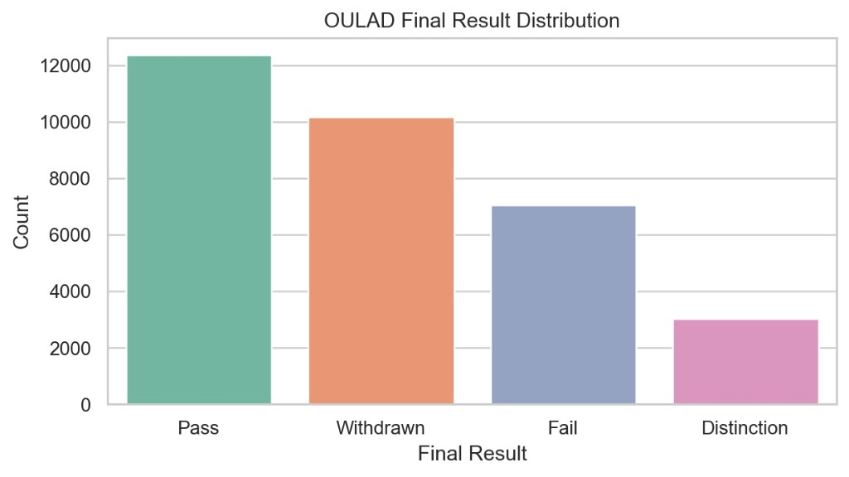
§ 03 · EDA · Data profile & quality · 1 of 3
05 / 20
Two institutions describe the same risk through different evidence.
EDA guides the adapter; held-out transfer tests use stricter modelling cohorts.
FIG · UCI target distribution
FIG · OULAD final-result distribution
n = 4,424 records · Dropout ≈ 32%
Full table: n = 32,593 · Withdrawn ≈ 31% · day-35 future risk = 17.4%
UCI · Data quality
OULAD final table · Data quality
How we handled it
0 missing values · 0 duplicate rows.
Enrolled is a valid outcome and stays in the non-dropout class of the binary task.
0 duplicate rows.
imd_band: 3.41% missing.
date_registration & registration_lead_days: 0.14% each.
Imputation and clipping occur inside the training pipeline.
Student identifiers, targets, and dates after each prediction point are excluded.
Notes:
SPEAKER: Wu Hanming
The EDA begins with the target distributions. UCI has 4,424 student records, with about 32 percent labelled Dropout. OULAD has 32,593 student-module records, with about 31 percent finally Withdrawn. At later landmarks, the future-withdrawal rate is lower because students who already withdrew are removed. UCI has no missing values in the downloaded table. OULAD has limited missingness in deprivation band and registration information. These differences matter. Average precision changes with class prevalence, and the later snapshots must be built only from events available by that day. Student identifiers, outcomes, and future events are never model inputs.
[Sources]
- UCI Predict Students' Dropout and Academic Success dataset
- Open University Learning Analytics Dataset
- Project EDA outputs

Slide 6
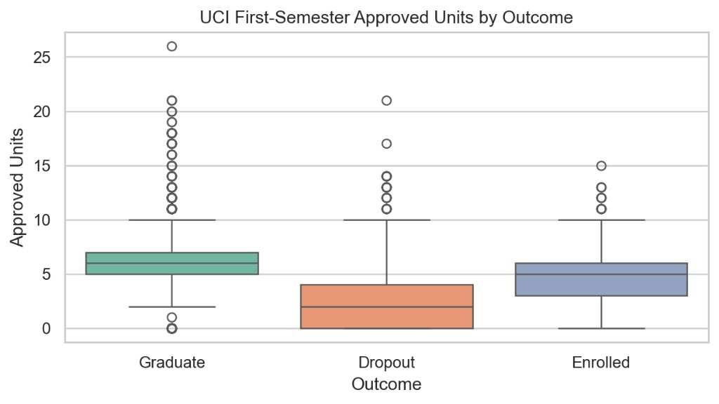
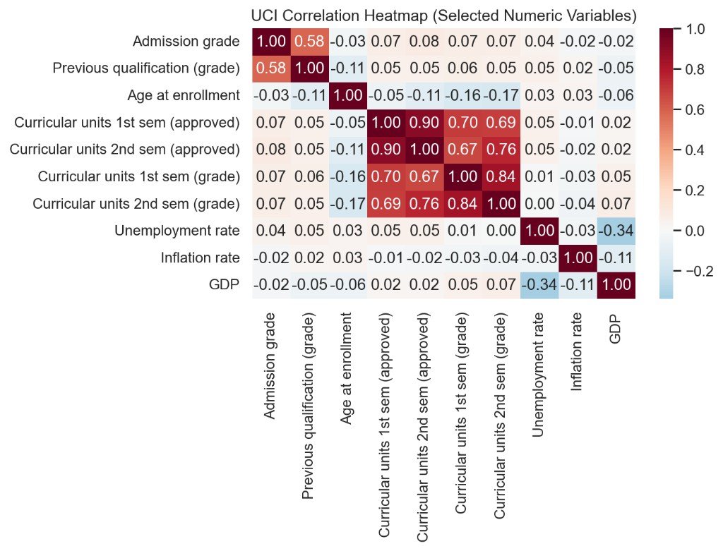
§ 03 · EDA · UCI findings · 2 of 3
06 / 20
UCI shows why useful semester outcomes cannot be used at enrolment.
Exploratory analysis — associations only, not causal claims.
FIG · 1st-semester approved units by outcome
FIG · Correlation heatmap · exploratory analysis
Dropout students approve fewer 1st-semester units than Graduate or Enrolled.
1st- and 2nd-sem academic variables strongly correlated; macro variables weakly.
What we see · why it matters
Modelling implication
Dropout ≈ 2 approved units (median); Graduate ≈ 6. Admission grade & previous qualification correlate moderately (0.58). Macro variables show weak associations with academic variables.
Semester completion and grade explain dropout, but they occur after enrolment. The portable UCI snapshot therefore keeps only entry-time fields; the six-feature model is a supporting baseline.
Notes:
SPEAKER: Wu Hanming
This UCI EDA shows that semester completion and grade separate the outcomes strongly. Dropout students approve fewer first-semester units, and academic variables are correlated. However, those values do not exist at enrolment. The redesigned portable model therefore does not use semester results for the UCI enrolment snapshot. Instead, UCI contributes entry-time background and study-load fields. We keep the old six-feature enrolment analysis only as a supporting baseline. This is a timing lesson from EDA: a feature may be predictive, but it is invalid if it appears after the prediction point. The chart is descriptive, not causal evidence.
[Sources]
- UCI dataset
- Project UCI EDA figures

Slide 7
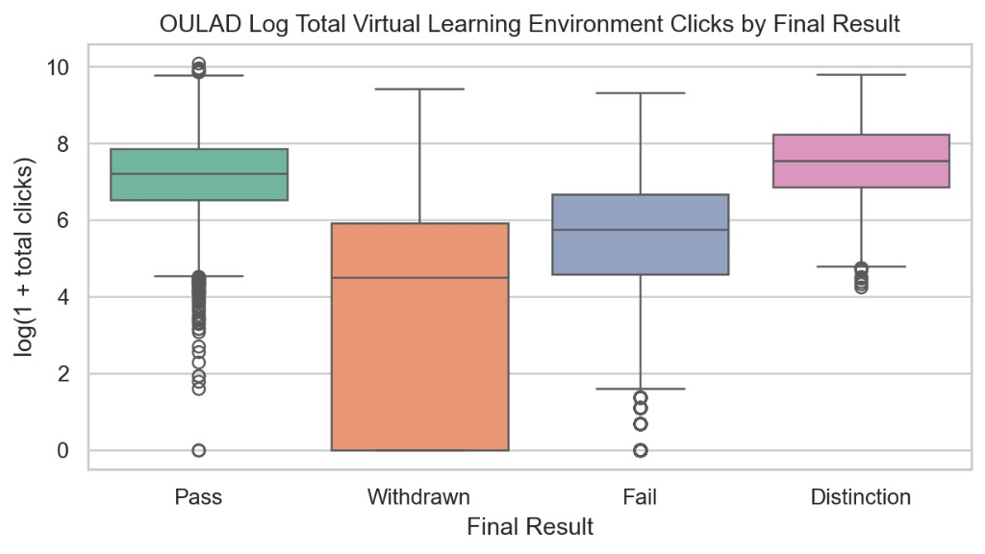
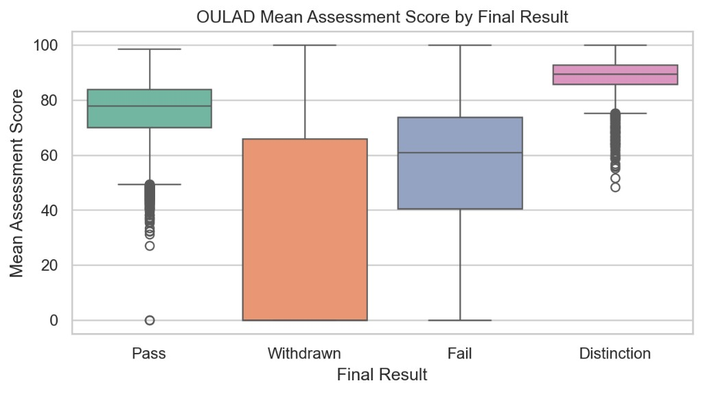
§ 03 · EDA · OULAD findings · 3 of 3
07 / 20
OULAD shows why participation, completion, and score must be represented.
FIG · Log VLE clicks by final result
FIG · Mean assessment score by final result
Withdrawn students show lower VLE activity than successful students.
Distinction students clearly separate; Withdrawn distribution is wide and low.
Full-course EDA motivates rates. Dynamic modelling rebuilds them only through each snapshot and removes earlier withdrawals.
What we see
Modelling implication
Withdrawn students have lower VLE activity and lower or missing assessment scores. Distinction students separate cleanly at high scores. Distributions overlap — no single measure is sufficient for prediction.
Map dated events to assessment completion, normalized score, active-day rate, and activity recency.
Notes:
SPEAKER: Wu Hanming
OULAD gives us dated events that can be rebuilt at each snapshot. The full-course charts show that withdrawn students generally have lower activity and lower or missing assessment performance, although the groups overlap. For modelling, we do not use the final totals shown in EDA. At each day, we reconstruct assessment completion, normalized average score, active-day rate, inactivity recency, and recent activity using only events observed up to that day. Students who withdrew before the snapshot are removed because the task is future withdrawal. This avoids look-ahead leakage and gives the dynamic part of the model a realistic prediction time.
[Sources]
- Open University Learning Analytics Dataset
- cross_school_dynamic_model.py

Slide 8
§ 04 · Methodology framework
08 / 20
A school-specific adapter feeds one fixed shared model.
One model object; no institution ID; equal institution-and-class training weight.
STEP 01
STEP 02
STEP 03
STEP 04
STEP 05
STEP 06
Local audit
Semantic adapter
Group split
Unified training
Held-out tests
Evidence check
Review raw fields | confirm snapshot | define future outcome
Map local columns | keep 16 columns | validate 0-1 ranges
· Split by student ID · 60 / 20 / 20 · No student overlap
Pooled snapshots | equal school/class cells | mask optional groups
Local-only vs pooled | entry/day 35/60/75 | same test records
1,000 cluster bootstraps | paired permutations | SHAP by snapshot
Why two algorithms
Evaluation stack
A simple linear benchmark and a nonlinear main model.
Metrics chosen for the decision, not just accuracy.
Main · XGBoost
Captures interactions among background, assessment, activity, and course progress.
ROC-AUC / AP · ranking
Brier · probability quality
Check · LogReg
Shows whether transfer findings depend only on a complex tree model.
Clustered 95% CIs
Permutation tests · comparison
Earlier work
Base-paper reproduction still includes Decision Tree, Random Forest, and Gradient Boosting.
Raw score = ranking only | local calibration remains required
Notes:
SPEAKER: Wu Hanming
This is the redesigned workflow. First, we audit local fields, choose a snapshot day, and define the future outcome. Second, the adapter maps the data into the fixed 16-column contract and validates every scale. We split by student so one person's records cannot appear in both training and testing. Pooled training gives equal total weight to each institution and outcome class. It also masks optional feature groups during training so that a missing assessment or activity feed is not completely unfamiliar. We compare the pooled model with local-only models on the same held-out records. Finally, we use one thousand student-cluster bootstraps, paired permutation tests, and SHAP.
[Sources]
- cross_school_dynamic_model.py
- dynamic_unified_significance.csv

Slide 9
§ 04 · Shared semantic feature schema
09 / 20
Four required concepts anchor a 16-feature contract.
01
02
Required core
Optional background
Needed for every snapshot
Five student-context fields
prior_academic_score | previous_attempts | male | support_need | financial_stability
age_scaled | prior_education_level | study_load | course_progress_ratio
03
04
Optional assessment
Optional activity
Four progress fields
Three platform-neutral fields
completion | average_score | score_available | late_rate
active_day_rate | inactivity_recency | recent_activity_rate
Notes:
SPEAKER: Xinyu
The fixed contract has four required concepts. They are scaled age, prior education level, study load, and course progress ratio. Five optional background fields describe prior score, previous attempts, gender, support need, and financial stability. Four optional assessment fields summarize completion, average score, score availability, and late submissions. Three optional activity fields summarize active days, inactivity recency, and recent activity. The raw column names can differ, but the semantic definition and scale cannot. Optional fields may be blank. The pipeline imputes them using training information, while required fields are rejected if they are missing.
[Sources]
- unified_dynamic_feature_contract.json
- map_new_school_snapshots.py

Slide 10
§ 05 | Results | one model across contexts
10 / 20
One pooled model stays close to local-only models.
Later OULAD gaps are small but statistically significant.
FIG | Held-out ROC-AUC across five contexts
UCI enrolment | pooled XGBoost
Same test records | local-only XGBoost vs one pooled XGBoost
0.771
ROC-AUC
AP
Local AUC
AUC diff.
0.635
0.774
-0.003
OULAD day 35 | pooled XGBoost
0.677
ROC-AUC
AP
Local AUC
AUC diff.
0.311
0.686
-0.009
Notes:
SPEAKER: Xinyu
This chart compares a local-only XGBoost with the same one pooled model across five held-out contexts. On UCI enrolment, pooled AUC is 0.771 versus 0.774 for local-only. At OULAD enrolment, they are 0.595 and 0.597. At days 35, 60, and 75, the pooled model reaches 0.677, 0.694, and 0.689. The local-only values are slightly higher. The important point is that one frozen estimator can rank students across all five contexts, but the convenience is not free. The next slide tests whether those small differences could be random.
[Sources]
- dynamic_unified_metrics.csv
- dynamic_unified_significance.csv

Slide 11
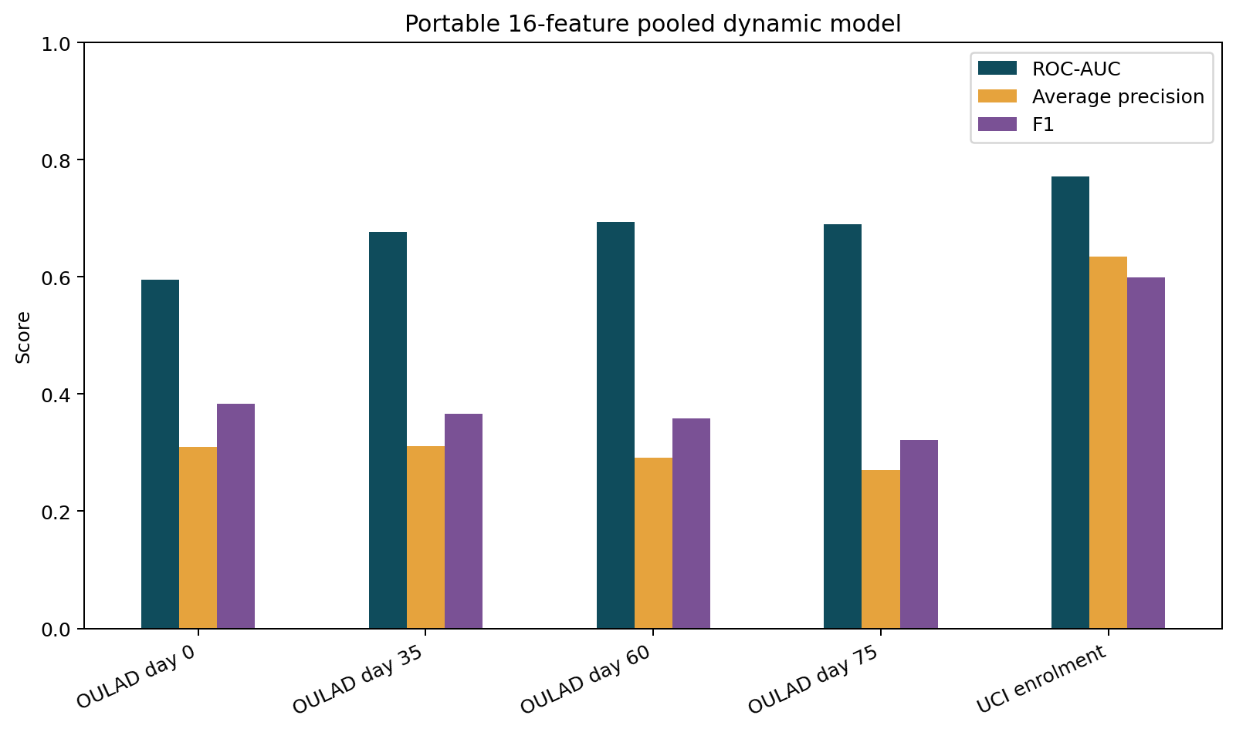
§ 05 | Results | portability cost
11 / 20
The portability cost is small, but statistically real after day 35.
Paired student-cluster tests compare the same held-out records.
FIG | One pooled dynamic model across entry and later snapshots
ENTRY CONTEXTS
Best OULAD AUC: 0.694 at day 60
Pooled stays close to local-only
UCI: 0.771 vs 0.774 | p = 0.561
OULAD: 0.595 vs 0.597 | p = 0.740
No significant AUC loss
AP differences also not significant
LATER OULAD
Local-only remains slightly stronger
Day 35: -0.009 | p = 0.005
Day 60: -0.013 | p = 0.001
Day 75: -0.009 | p = 0.005
All three AUC gaps are significant
AP gaps were not significant at 0.05; raw scores remain ranking values.
portable reuse = one model + measured performance cost + local validation
Notes:
SPEAKER: Xinyu
The significance tests compare pooled and local-only predictions on exactly the same held-out students. At UCI enrolment and OULAD enrolment, the AUC differences are not significant. At OULAD days 35, 60, and 75, pooled AUC is lower by about 0.009, 0.013, and 0.009. The paired permutation p-values are 0.005, 0.001, and 0.005. This means the later AUC cost is small but statistically real in this sample. Average-precision differences were not significant at the five-percent level. We therefore describe the result as model reuse with a measured portability cost and local validation, not as equal performance everywhere.
[Sources]
- dynamic_unified_significance.csv
- dynamic_unified_performance.png

Slide 12
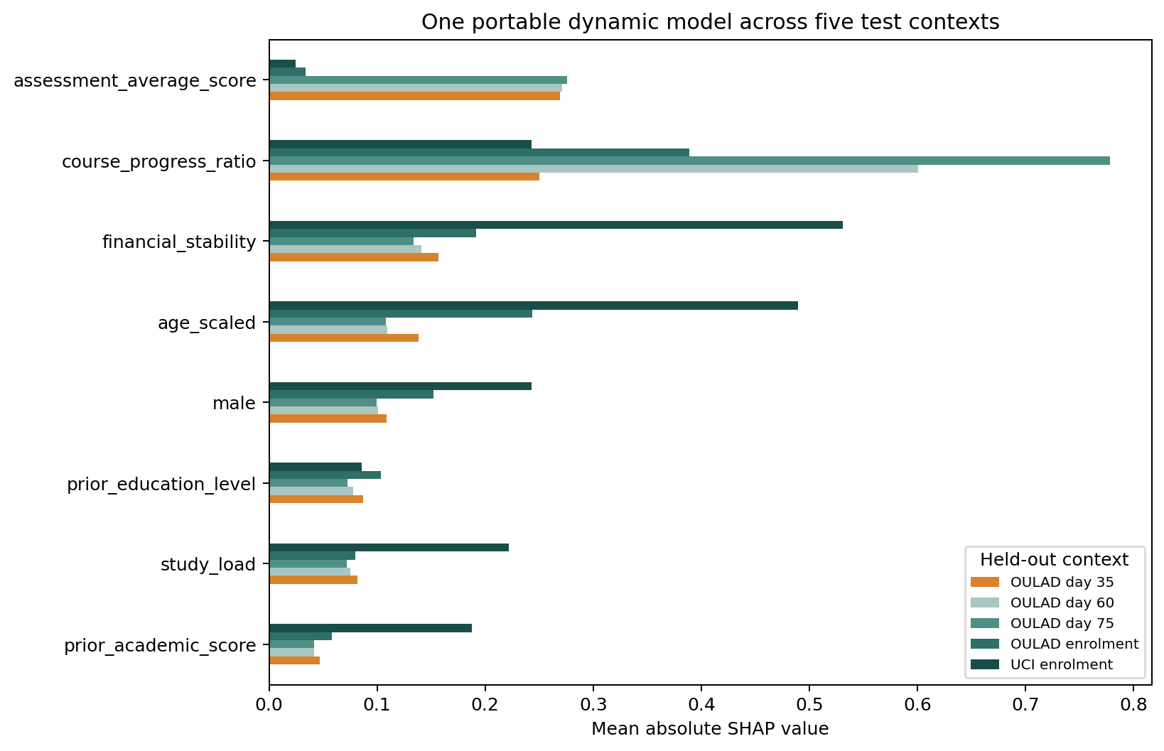
§ 05 | Results | dynamic SHAP
12 / 20
The same model changes as assessment and activity data arrive.
Mean absolute SHAP by held-out context; model behaviour, not causality.
FIG | Dynamic SHAP across UCI enrolment and OULAD snapshots
ENTRY CONTEXTS
One pooled model | five contexts | same 16-column order
Background fields lead before events arrive
UCI: financial stability and age
OULAD: age and financial stability
Optional event groups remain blank
No causal interpretation
DAY 35+
Assessment average becomes visible
Assessment score contributes
Progress marks the course stage
The same model changes by context
Local explanations remain necessary
Course progress shifts the shared time baseline; within one day it cannot rank students by itself.
entry: background review | later: academic and engagement outreach
Notes:
SPEAKER: Xinyu
This SHAP figure summarizes the same pooled model in five contexts. At enrolment, background fields such as financial stability and age contribute more because assessment and activity groups are blank. After day 35, assessment average becomes available and contributes to the ranking. Course progress ratio also has a large SHAP value because it tells one pooled model which stage the row represents. Within a single snapshot day, that ratio is constant, so it does not rank students by itself. SHAP describes model behaviour, not causes. Advisors still need local explanations and should connect a review flag to supportive outreach rather than an automatic decision.
[Sources]
- dynamic_unified_shap.csv
- dynamic_unified_shap.png
- Lundberg and Lee, 2017

Slide 13
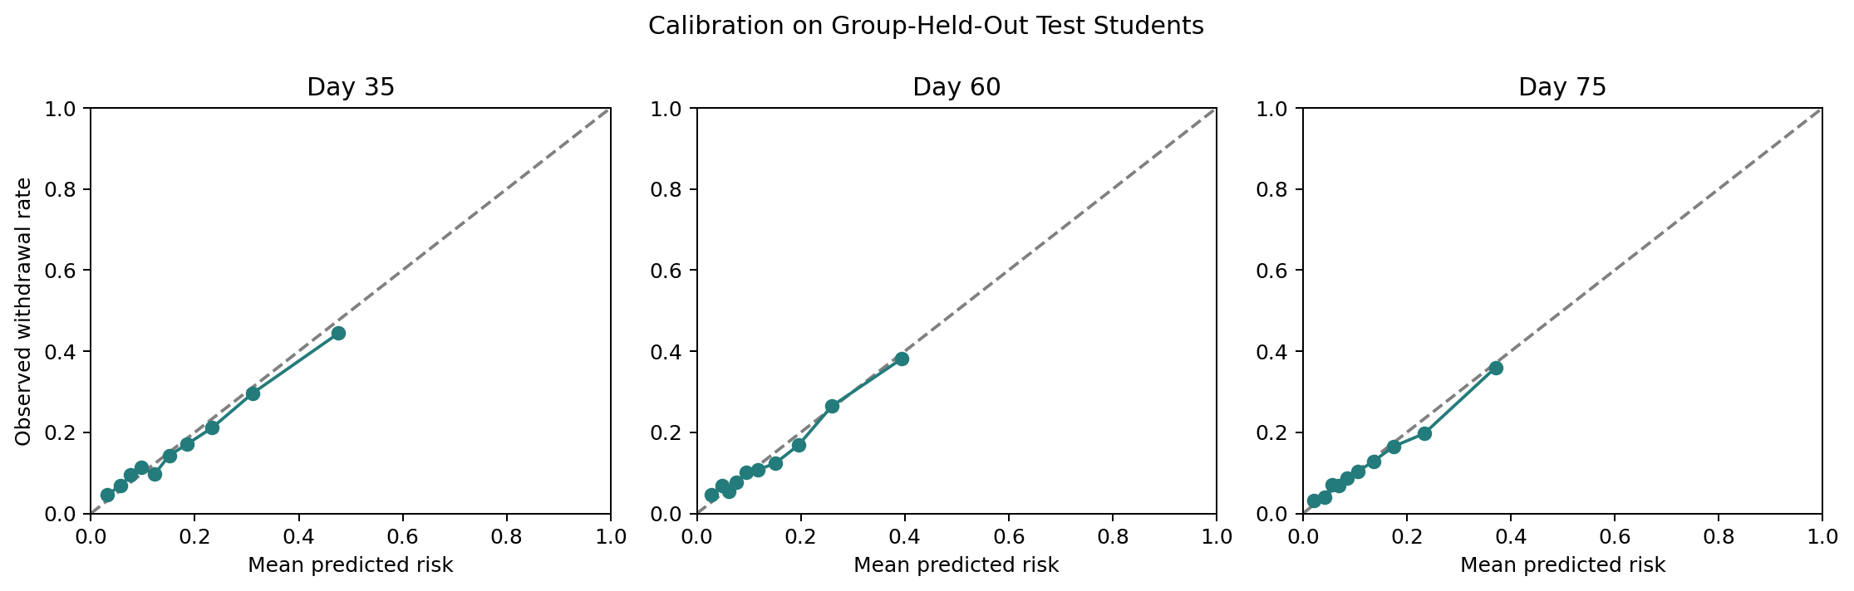
Supporting check · calibration & time
13 / 20
Transfer evidence is stronger when prediction timing and calibration are also checked.
The OULAD landmark analysis remains a supporting operational validity test.
FIG · Calibration on group-held-out OULAD test students
LATER-COHORT TEST · 2014J
Train: 2013B/J · validate: 2014B · test: 2014J
DAY 35
DAY 60
DAY 75
Temporal generalization
Brier score 0.126
Brier score 0.110
Brier score 0.101
Ranking remains above chance, but the drop is material.
Skill vs. null: +9.7%
Calibration slope: 0.88
Skill vs. null: +8.7%
Calibration slope: 0.91
Skill vs. null: +7.6%
Calibration slope: 0.88
ROC-AUC 0.678
95% CI 0.661–0.695
F1 0.301 · AP 0.229
Brier 0.107
Notes:
SPEAKER: Wu Hanming
This is a supporting OULAD-specific check rather than the main cross-school result. The larger 51-feature OULAD model uses platform and course-specific details that the portable model intentionally removes. Its Brier scores improve from day 35 to day 75, and a later 2014J cohort reaches an AUC of 0.678. The portable model is simpler and easier to map, while the OULAD-specific benchmark reaches about 0.717 AUC at the later snapshots. That gap shows the accuracy-versus-portability tradeoff. It also reminds us that ranking, calibration, and time stability must all be checked before an operational pilot.
[Sources]
- OULAD landmark model outputs
- student_dropout_analysis.py

Slide 14
§ 06 · Business impact & transfer plan
14 / 20
One shared model reduces rebuild effort; local work remains.
PLANNING SCENARIO
The adapter handles schema differences; local thresholds handle advisor capacity.
FIG | OULAD-specific capacity planning scenario
New-school use | minimum steps
ADAPTER
REVIEW
16
Top 15%
fixed semantic columns
within-course ranking
VALIDATE
CALIBRATE
PILOT
ROC-AUC · AP
Brier · subgroup checks
Local probability scale
and alert threshold
Shadow term before
advisor use
One frozen model version | one local adapter and review policy per institution
Why it matters
Lower build cost
Local control
Reuse
Keep
local definitions
future cases
Decision rule
Use the model only after an untouched historical test; set the review budget with advisors.
Illustrative advisor workload from the supporting OULAD model; not a guaranteed outcome for a new school.
This project evaluates prediction and workload, not whether an intervention causes retention.
Notes:
SPEAKER: Wu Hanming
The proposed business use is advisor prioritization. A new school first maps its fields and runs the frozen model on an untouched historical cohort. Scores should be converted into within-course percentiles. The example scoring script flags roughly the top 15 percent for review, but the actual share must match advisor capacity and an equity review. The chart on the left is an illustrative OULAD workload scenario from the supporting model, not a guaranteed result at another school. One model version can be shared, while each institution owns its adapter, review policy, and local validation evidence. Human review remains required.
[Sources]
- score_new_school_dynamic.py
- OULAD capacity analysis

Slide 15
§ 07 · Challenges & limitations
15 / 20
Four limits define what the transfer claim means.
01
02
Only two institutions
Dynamic fields have one source
No third-school external test yet.
Cross-school dynamic validity is not finished.
UCI supplies enrolment only. OULAD supplies all day-35/60/75 assessment and activity values. A third school with dated events is still required.
UCI and OULAD show that the approach is possible, but they do not represent every institutional system or student population.
03
04
Mappings are approximate
Portability has a cost
Local measurements are not identical.
Later OULAD AUC is slightly lower.
Age, education, load, and financial stability use documented but non-identical local measurements.
Pooled minus local-only is -0.009 to -0.013 and statistically significant at days 35, 60, and 75.
Notes:
SPEAKER: Wu Hanming
Four limitations define the claim. First, only two public datasets are used. Second, UCI supplies only enrolment snapshots, while OULAD supplies all dynamic assessment and activity values. This means cross-school dynamic validity is not yet complete. Third, the mappings for age, education, load, and financial stability are documented but not identical measurements. Fourth, the later pooled OULAD AUC is slightly below local-only performance, and the difference is statistically significant. The project demonstrates a working portable prototype and a transparent test. It does not prove safe deployment at every school.
[Sources]
- Project limitations
- dynamic_unified_significance.csv

Slide 16
§ 08 · Deployment & future work
16 / 20
Deploy the shared model as advisor support, not autonomous action.
A proposed third-school validation plan, not an existing institutional deployment.
Proposed pilot timeline — not currently deployed
Step 1 · Map
Step 2 | Score
Step 3 · Validate
Step 4 · Pilot
Build local adapter
Score frozen model
Validate ranking and workload
Limited advisor use
Document raw fields | construct 4 required + available optional features
Run untouched historical cohort | report optional-feature coverage
Check ranking, calibration, subgroup results, and advisor workload
Human review · support-only action · rollback rule
Monitoring stack
Model governance
Required next study
What we watch by institution.
Shared core, local configuration.
Validate dynamic portability at a third institution.
· Missing-feature and range failures · ROC-AUC, AP, Brier, and calibration · Subgroup metrics with uncertainty · Alert volume and workload · Adapter and score drift
· Version the shared model and each adapter · Recalibrate each term · Retest after schema changes · Roll back on regression · Record mapping decisions
Pre-register untouched dynamic validation | test missing optional feeds | compare local-only and frozen pooled scores | study advisor outcomes prospectively
Notes:
SPEAKER: Wu Hanming
For a third school, we propose four stages. First, document raw fields and construct the four required features plus any optional groups. Second, score an untouched historical cohort with the frozen model and report feature coverage. Third, check ranking, calibration, subgroup results, and advisor workload. A silent shadow period should come before any limited support use. The model and local adapter should be versioned separately so a schema change can be reviewed without silently changing the estimator. The most important next study is a pre-registered third-school test with dated events, including missing optional feeds and a direct local-only comparison.
[Sources]
- map_new_school_snapshots.py
- score_new_school_dynamic.py
- Project validation plan

Slide 17
§ 09 · Key takeaways
17 / 20
Primary message
A shared model crosses schools only through a validated adapter.
One fixed 16-feature model scores enrolment and later snapshots. It stays close to local-only models, but the later OULAD cost is small and statistically real.
Project contribution
A semantic contract, two source adapters, one frozen model artifact, missing-group handling, paired tests, SHAP, and a working new-school scoring example.
01
02
03
Shared meaning comes before shared modelling.
One pooled dynamic model is feasible.
Local evidence decides readiness.
Different raw columns are acceptable only when each school can map them to the same documented concepts and prediction time.
A third school must map fields, test the frozen model, review calibration and subgroups, and complete a shadow pilot.
Pooled AUC is 0.771 on UCI enrolment and 0.677-0.694 on later OULAD snapshots; local-only is slightly stronger.
Notes:
SPEAKER: Wu Hanming
The main takeaway is that one fixed model can work with different raw columns only when a documented semantic adapter comes first. Our redesigned contribution is a 16-feature contract, two source adapters, one frozen XGBoost artifact, optional-group masking, paired significance tests, SHAP summaries, and a complete mapping and scoring example. Pooled AUC is 0.771 on UCI enrolment and between 0.677 and 0.694 on later OULAD snapshots. Local-only models remain slightly stronger later. Therefore, a third institution must validate the frozen model on local history, review calibration and subgroups, and complete a shadow pilot before advisor use.
[Sources]
- Milestone 8 final report
- Project code and result package

Slide 18

§ 10 · Discussion
18 / 20
Q&A
Group 21
Xinyu Wang
Wu Hanming
MBAI 5600G Capstone
Faculty of Business and IT
Ontario Tech University
August 11, 2026
Five minutes for discussion
Questions and Discussion
All figures produced from the project pipeline. Full references on slide 20.
Questions?
Suggested topics | 16-feature contract | adapter mapping | pooled model | portability cost | SHAP | statistical tests | deployment limits
Notes:
SPEAKER: Xinyu
Thank you. We are ready for questions about the 16-feature contract, the local adapter, pooled weighting, the measured portability cost, SHAP, statistical testing, or the limits of a third-school deployment.
[Sources]
- Full project report and reproducibility package

Slide 19
Unified-model assumptions & evaluation criteria.
19 / 20
Detailed assumptions & evaluation criteria.
Reference material for the written submission and Q&A — not part of the spoken talk.
Working assumptions
Evidence considered
What has to hold for the results to be meaningful.
Evidence considered before recommending a pilot.
A1 Each school can map local fields to documented shared concepts.
Statistical
Held-out ROC-AUC, AP, F1, clustered bootstrap CIs, and paired permutation tests.
A2 Optional feature groups may be blank, but the four required fields remain available.
Operational
A3 Labels represent non-persistence after the chosen prediction point.
Frozen-model historical test, local ranking, and optional-feature coverage.
A4 Student-level train and test sets have zero ID overlap.
Fairness
Subgroup ranking and calibration with uncertainty; no formal parity claim.
A5 Thresholds, calibration, and review share use local training-side data only.
Robustness
No school ID, equal institution/class weights, missing-group masking, range checks, and temporal validation.
Notes:
APPENDIX
Appendix only. Use this slide if the audience asks about working assumptions or the evidence required before a pilot.
[Sources]
- Project methodology and evaluation criteria

Slide 20
Appendix · References (not spoken)
20 / 20
References
IEEE style · core sources used in the report and presentation
Primary literature & datasets
Methods & recent validation literature
[1]
M. M. Islam et al., "The integration of explainable AI in Educational Data Mining for student academic performance prediction and support system," Telematics and Informatics Reports, vol. 18, Art. no. 100203, 2025.
[5]
T. Chen and C. Guestrin, "XGBoost: A scalable tree boosting system," Proc. ACM SIGKDD, 2016.
[6]
S. M. Lundberg and S.-I. Lee, "A unified approach to interpreting model predictions," NeurIPS, 2017.
[2]
V. Realinho et al., "Predicting Student Dropout and Academic Success," Data, vol. 7, no. 11, Art. no. 146, 2022.
[7]
D. Zhou et al., "Comparative Performance of Machine Learning Models for Predicting At-Risk Students Using the OULAD Dataset," 2026.
[3]
V. Realinho et al., Predict Students' Dropout and Academic Success, UCI Machine Learning Repository, 2021.
[8]
KuznetsovKarazin, "OULAD Early Warning," GitHub repository, accessed 2026.
[4]
J. Kuzilek, M. Hlosta, and Z. Zdrahal, "Open University Learning Analytics dataset," Scientific Data, vol. 4, Art. no. 170171, 2017.
[9] J. Demšar, "Statistical Comparisons of Classifiers over Multiple Data Sets," Journal of Machine Learning Research, 2006.
Notes:
APPENDIX
Appendix only. This slide lists the main datasets, base paper, XGBoost and SHAP references, and recent OULAD comparison sources.
[Sources]
- References shown on slide

