Slide 1
5 Scenarios that were tested
Dec 12, 2021

Slide 2
Alpha= 19
Noun noise = 0.9
Size noise = 0.8
Color noise = 0.95
Gender noise = {0.7, 0.8, 0.9, 1.0}
Costs = {0.0, 0.1}
Gender has no cost!

Slide 3

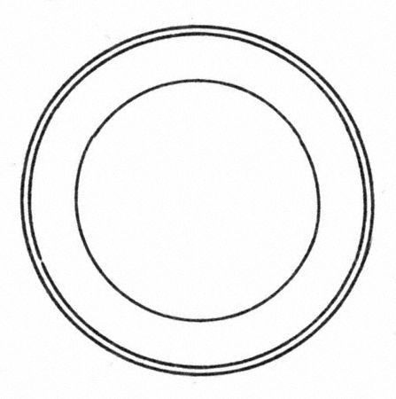
Scenario 1
masc
masc
fem

Slide 4
Scenario 2
masc
masc
masc

Slide 5
Scenario 3
masc
masc
masc

Slide 6
Scenario 4
masc
masc
fem
fem

Slide 7
Scenario 5
masc
masc
fem
fem

