Slide 1
Wafer Anomaly Detection
Bryan Walsh
Sep 2023

Slide 2
Overview
In wafer testing some range of variation can occur and may be difficult to determine when the process is out of norm.
For this project I sought to investigate how machine learning may categorize anomalies and be used to predict process issues.

Slide 3
Data
The data was used was found at:
https://www.kaggle.com/datasets/arbazkhan971/anomaly-detection
There are 1700+ entries of 1500+ features.
The data is mostly binary and very sparse among the feature set for each row.
This data was obfuscated by the owner and was part of a competition, so no insight into the features was provided.
There were about 8% anomaly classifications within the data to work with.

Slide 4
Modeling
My goal was to create a model that minimized the error on false anomaly detection.
I started by exploring many different machine learning models including some ensemble techniques.
The accuracy of the models were skewed by the overwhelming non-anomaly classification, making it difficult to tune the parameters for finding the best model features.

Slide 5
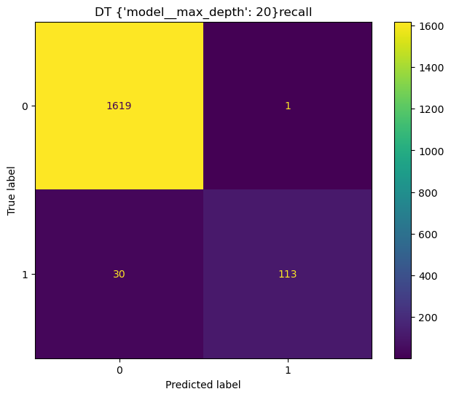
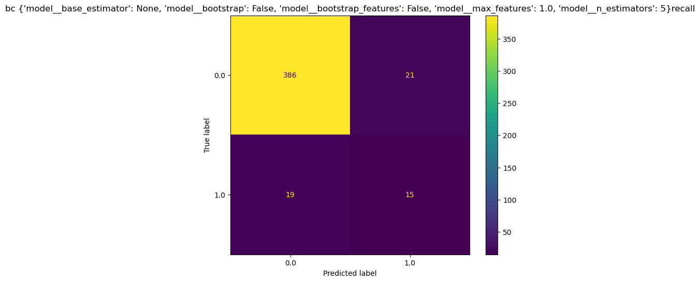
Results
Below left we have a confusion matrix where the DT – Decision Tree was used to create a very small error in anomaly detection on the full data set. And to the right an ensemble model with the Decision tree as its base was used but this time prediction a subset not used in training.

Slide 6
Conclusion
The results show strong evidence that perhaps with more work a model could be made to predict accurately anomalies based on this data.
Time constraints are an issue when hyperparameter tuning but with more effort I believe we could achieve good results as seen when training on the entire dataset.

