Slide 1
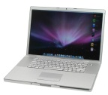
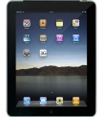
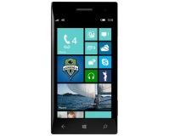

Presentation tier
Application / data access tier
Data tier
Database

Slide 2
Controlling Software
View / Control tier
Applications
Database
Database tier
Device tier
Controllable Hardware Devices
Non – Controllable Hardware Devices

Slide 3




Other Controlling Software (python, …)
View / Control tier
CouchApps
2
Database tier
1
Device tier
Controllable Hardware Devices

Slide 4
Database tier
Send Data
Receive Data
Device tier
Controllable Hardware Devices

Slide 5
Controllable Hardware Devices
Controllable Hardware Devices
int registerAtCouchDB()
char* server
char* name
char* title
int* types
int typesCount
int insertStringData()
char* server
char* source
char* data
accCouchDB

