Slide 2
Outline
Intro

Slide 3
Data Storage
Data is stored in structured or unstructured databases
Structured data is stored in tables

Slide 4
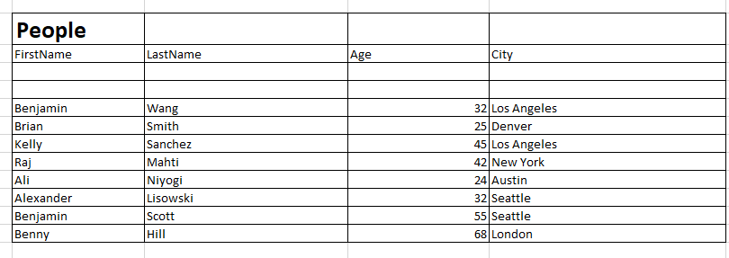
Example Table

Slide 5
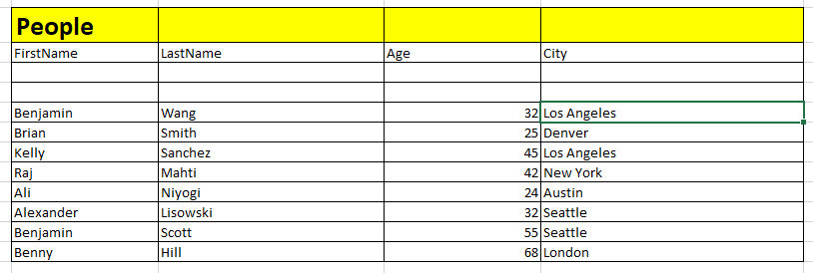
People is the table name

Slide 6
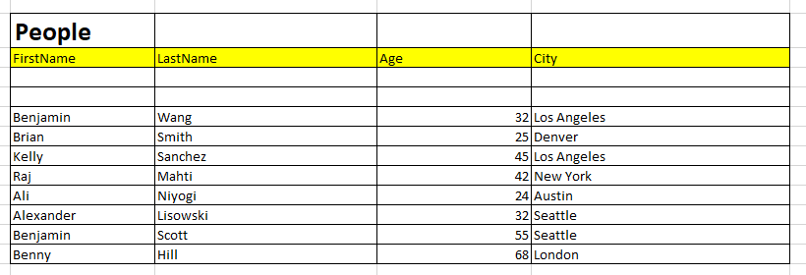
Tables have Rows and Columns and each Column has a unique Column Name to identify itself in the table.

Slide 7
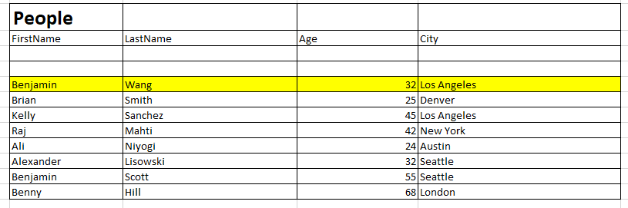
First Row of the table

Slide 8
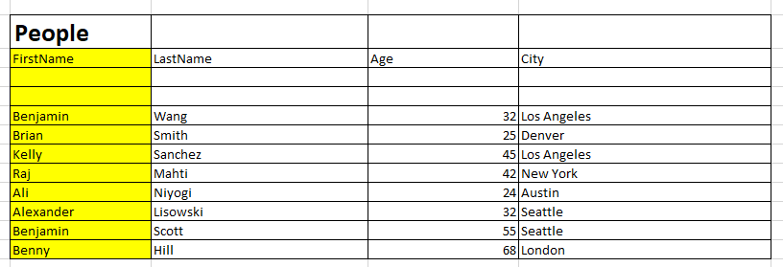
First Column of the table

Slide 9
SQL
Computer language used to write queries
Queries are ‘searches’ you write to find data within a table or tables

Slide 10
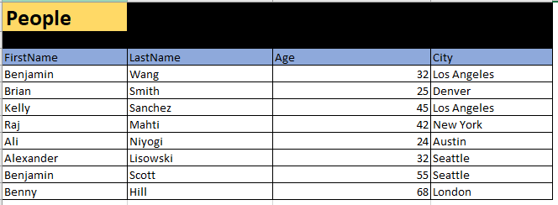
SQL Query Structure

Slide 11
Example in Excel

