Slide 1
AngularJs

Slide 2
Introduce
Developed in 2009 by Miško Hevery and Adam Abrons — both Google employees at that time.
Entirely JavaScript and entirely client-side, so anywhere JavaScript can run, AngularJs can run.
Single-page apps.
First Example http://localhost:3000/apis/1

Slide 3
Why AngularJs
Quick to develop.
Write your own HTML vocabulary.
Support MVC pattern.
Reduce JavaScript code.
Unit Test – Get rid of bind-callback functions, encourage TDD.
Single page app.

Slide 4
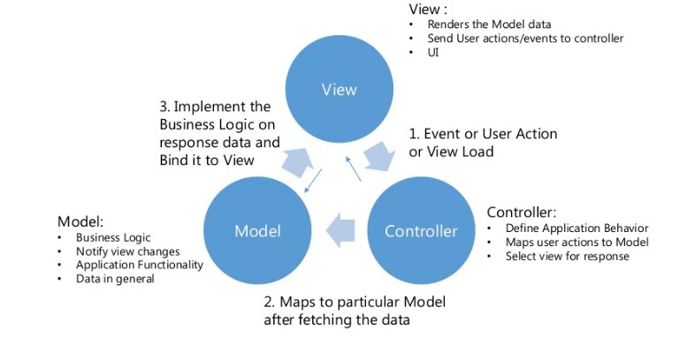
MVC -1

Slide 5
MVC -2
Controller – A controller is a JavaScript function(type/class) that is used to augment instances of angular Scope, excluding the root scope.
Model - A model is any data that is reachable as a property of an angular Scope object. The name of the property is the model identifier and the value is any JavaScript object (including arrays and primitives).
View - The view is the DOM loaded and rendered in the browser, after Angular has transformed the DOM based on information in the template, controller and model.
http://localhost:3000/apis/2

Slide 6
Scope
Scope is an object that refers to the application model. It is an execution context for expressions. Scopes are arranged in hierarchical structure which mimic the DOM structure of the application.
$watch - similar with the change event.
$apply – apply the DOM render
http://localhost:3000/apis/3

Slide 7
Data Binding
Data-binding in Angular web apps is the automatic synchronization of data between the model and view components. The way that Angular implements data-binding lets you treat the model as the single-source-of-truth in your application. The view is a projection of the model at all times. When the model changes, the view reflects the change, and vice versa.
Mark up {{}} – unidirectional
ngModel – bidirectional
ngBind – unidirectional
http://localhost:3000/apis/4

Slide 8
Events
AngularJs nested events includes mouse, keyboard, etc.
ngClick, ngKeyPress, ngChecked, etc.
When the AngularJs events actived, the events callback can update the DOM by the callback function automatically.
If not using the AngularJs events, the DOM may not be updated, but you can use $scope.$apply() to update the change manaually.
http://localhost:3000/apis/5

Slide 9
Filters
Angular filters format data for display to the user.
Pattern: {{data | filter1 | filter2}}
http://localhost:3000/apis/6

Slide 10
ngRepeat
The ngRepeat directive instantiates a template once per item from a collection. Each template instance gets its own scope, where the given loop variable is set to the current collection item, and $index is set to the item index or key.
Special properties are exposed on the local scope of each template instance, including:
This directive creates new scope.
http://localhost:3000/apis/7
Variable | Type | Details
$index | number | iterator offset of the repeated element (0..length-1)
$first | boolean | true if the repeated element is first in the iterator.
$middle | boolean | true if the repeated element is between the first and last in the iterator.
$last | boolean | true if the repeated element is last in the iterator.
$even | boolean | true if the iterator position $index is even (otherwise false).
$odd | boolean | true if the iterator position $index is odd (otherwise false).

Slide 11
Directives
The directive of AngularJs let you to teach the browser new tricks.
Refer to: http://docs.angularjs.org/guide/directive
Scope (@, =, &)
Example: http://localhost:3000/apis/8

Slide 12
Http Request
$http
$resource
A factory which creates a resource object that lets you interact with RESTful server-side data sources.
The returned resource object has action methods which provide high-level behaviors without the need to interact with the low level $http service.
http://localhost:3000/apis/9

Slide 13
A Web App Simple Structure
Use ngView
Use $routerProvider
Separate modules – service, filters, directives, your app modules.
http://localhost:3000/apps/main

Slide 14
Testing
Unit Test – Karma, node.js, jasmine
Only test logic code, recommend controller
E2E Test – jasmine, angular scenario
Simulate user’s behavior

Slide 15
Thanks
Author: Bo
Example URL: https://github.com/bwang073/AngularJsKT.git

