Slide 1

Project 1 Time Table Exchange
Brett Warrender
CSCI-3601 Operating Systems
Hawaii Pacific University
Dr. Yi Zhu

Slide 2
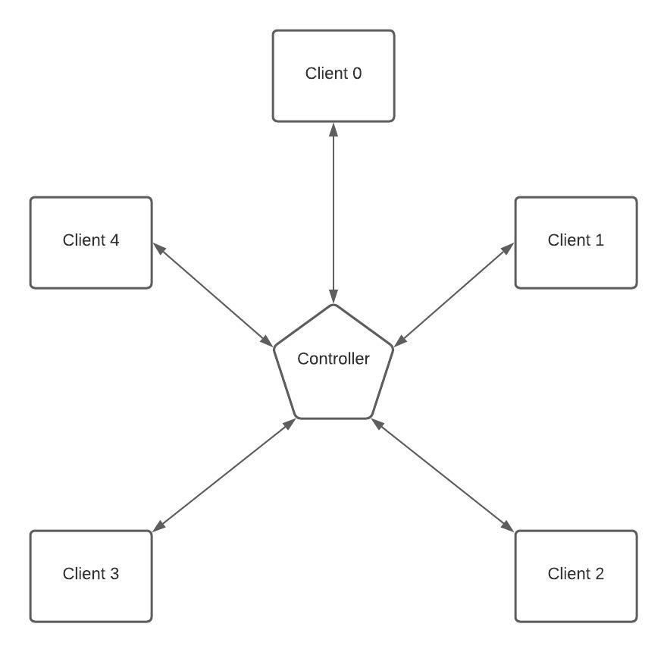
Problem:
1 Controller
5 Clients
Clients initialize vector [0, 0, 0, 0, 0]
Clients generates 100 events
Each event increments clients own vector element
Client randomly chooses destination (0-4)
Client sends vector to controller
Controller routes vector to destination
Destination client compares received vector with its own vector, keeps highest value for each element
After 100 events, client no longer generates events and only receives new vectors
When all done, close the sockets
Notes:
The Problem starts with 1 controller or server and 5 clients
Each client initializes a vector of 5 elements, all at 0
Each client will connect to the server, once all clients have connected, then they begin to generate events
The clients will generate 100 events total and simultaneously accepts vectors from other clients
Each event generated by the client will increase the clients own vector element
(e.g.) If client 1 generates an event, then element 1 in Client 1’s local vector will be incremented
The client will send its vector to either itself, or one of the other clients at random
The vector gets sent to the controller which routes it to the destination
The receiving client will compare the values in the vector to its own vector, keeping the highest value for each element
Once 100 events have been generated, a client will cease to generate events, but will continue to accept incoming vectors
When all events have been generated and sent/received, the server will tell the clients it’s okay to disconnect

Slide 3
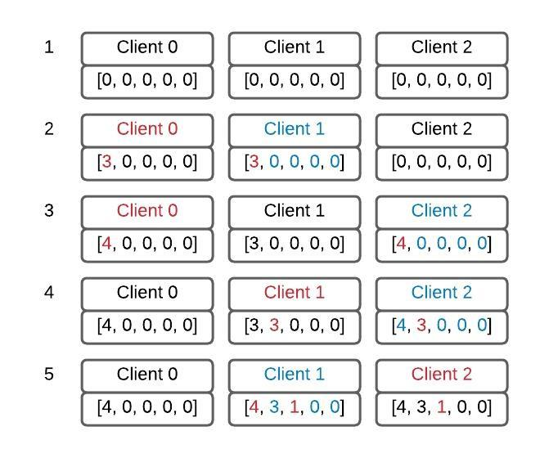
Clarification of the process:
All clients begin with a 0 initialized vector of 5 elements [0, 0, 0, 0, 0]
Client 0 generates 2 local events and 1 additional event to send to client 1
Client 0 generates an event to send to client 2
Client 1 generates 2 local events and 1 additional event to send to client 2
Client 2 generates an event to send to client 1
Notes:
Here is some clarification of the process
1: All of the clients initialize their 5 element vectors with 0s
2: Client 0 generates 2 local events and then 1 additional event, so the 0th element In client 0s vector increments by 3. It then sends its vector to client 1. Client 1 compares the values and only changes the 3 in the 0th element of its own vector
3: Client 0 generates 1 event. The 0th element is incremented and then Client 2 receives the vector, changing only the 0th element of its own vector
4: Client 1 generates 2 local events and 1 additional event, so the 1th element in the vector is incremented by 3. It then sends its vector to Client 2. Client 2 compares the values and only changes the 1th element in its own vector because it has a 4 in the 0th element.
5: Client 2 generates an event to send to client 1. The 2th element in client 2 vector is incremented. Client 1 receives the vector and updates its 0th and 2th

Slide 4
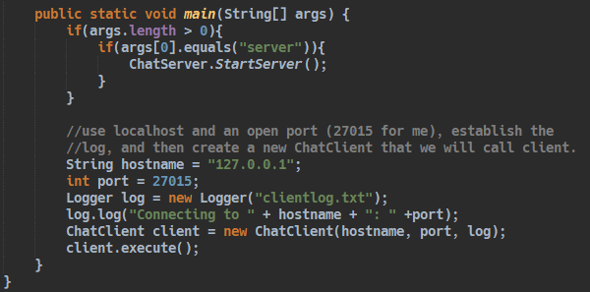
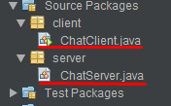
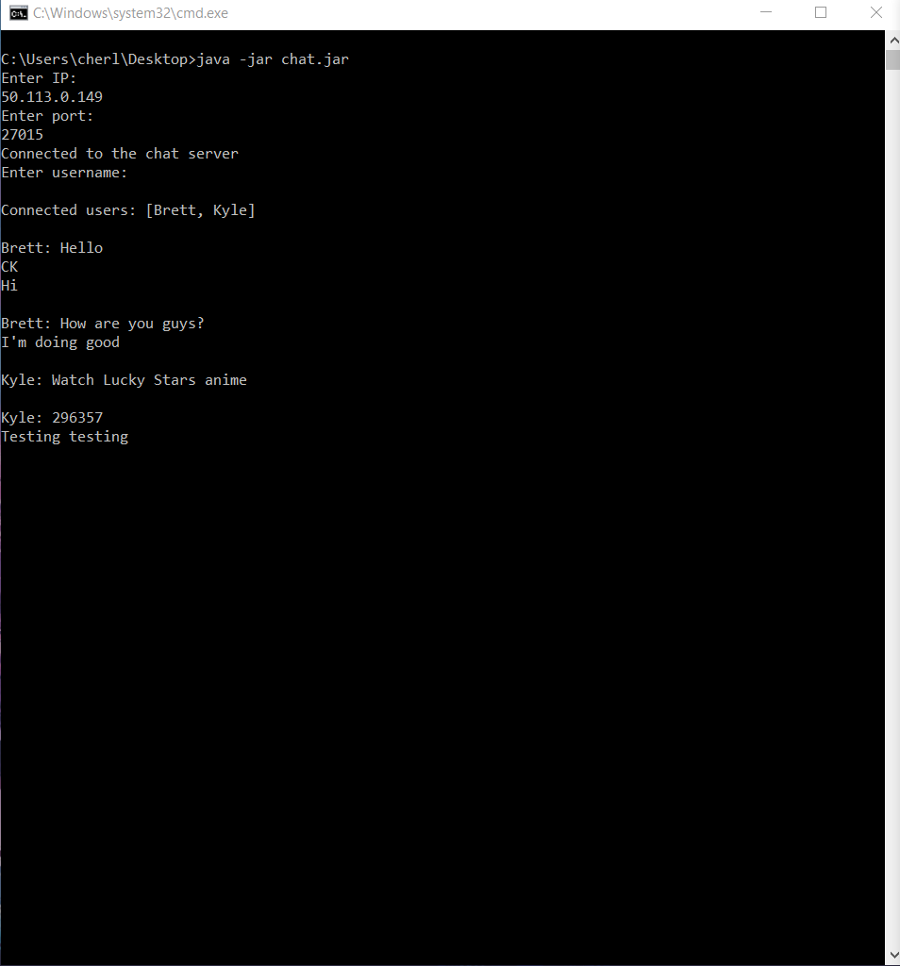
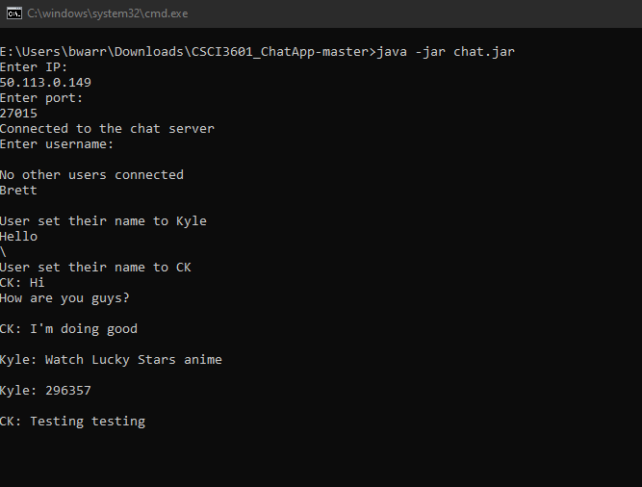
Client/Server TCP Socket Connection
Two separate Java files, runs client or server depending on command line argument passed
As a foundation for the TCP client/server I cannibalized the TCP chat program we made earlier in the semester

Slide 5
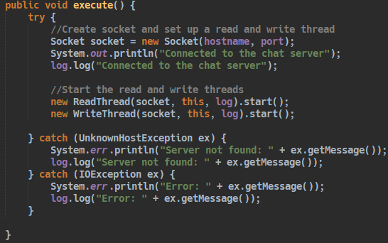
Client
Client connects via IP and port
Creates instance of Logger class
Creates a thread for reading and another thread for writing, pass in instance of Logger
Notes:
The client will connect to the server based on a given ip address and port number
We then create an instance of the logger class to make it easier to log events as we go
The client then creates a thread for reading and a thread for writing

Slide 6
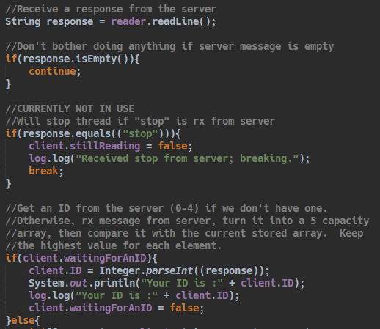
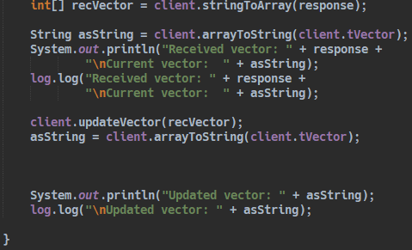
Client Read Thread
Will loop while trying to receive messages from server
Expects first message to be ID
This is the “GO” message
After we have an ID, receive String messages from other clients.
Log everything
Notes:
This is the Read thread
It will loop while trying to receive a message
The first message that it expects to receive is an ID
The server is responsible for divvying out IDs, which helps to keep things synchronized
Receiving the ID is like receiving a “GO” message from the server
When we do receive the ID, we set a Boolean flag to true, this lets the write thread to start generating events
Then we the next messages we receive will be String messages from the server

Slide 7
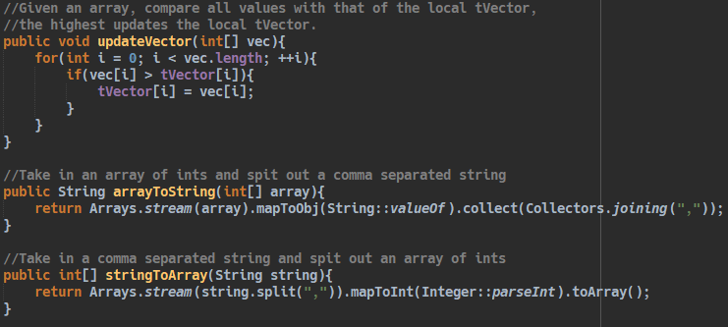
Client Read Thread (cont…)
Convert String messages to array
Compare values of the received array with local array
Update local array based on highest value between the two arrays per element
Log everything
Notes:
After we have our ID, we start receiving String messages from the other clients
The Strings are just comma separated values converted from arrays that are converted into Strings to make it easier to send/receive.
We then convert the string back into an array and compare it to the local array
We keep the highest value for each element in our local array

Slide 8
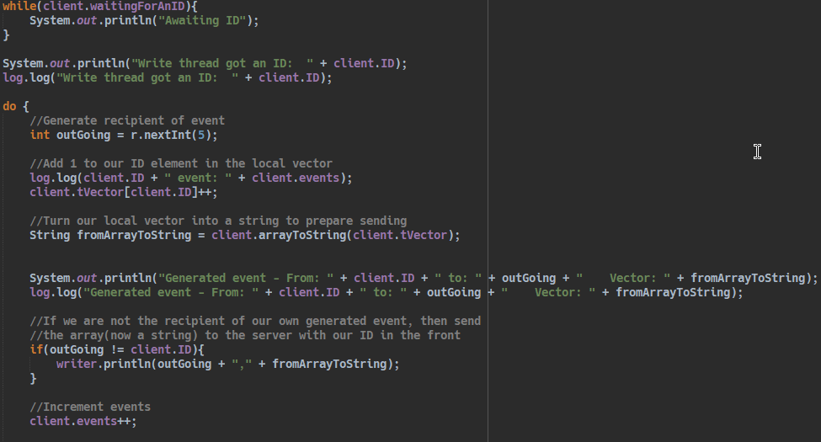
Client Write Thread
Waits until Read Thread says that we have an ID
Generates random number (0-4)
Increments the ID th element of the local array
If random number does not equal our ID
Package the array into comma separated value String
Append outgoing # to the front
Send to server
Notes:
This is the client write thread
At first, we are waiting for the read thread to flip a Boolean flag to true
Then, we will generate a number between 0 and 4
That number will determine the recipient of the event
We then increment the IDTH element of the local array
Then, if the generated value is equal to our ID, we just continue, we don’t need to send anything to the server
But if it’s not, then we package our local array up into a comma separated value String
Then we append the outgoing client’s ID to the front of the string and send it off to the server

Slide 9

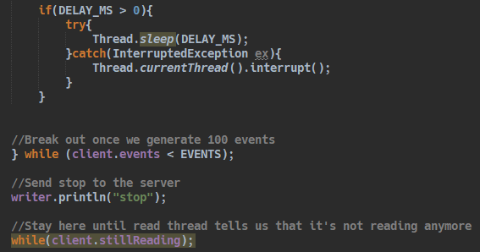
Client Write Thread (cont…)
Constants for number of events and delay between generating events
Send “stop” to server when we are done generating events
Wait here while the read thread is still potentially reading
Notes:
We can set these constants to determine the number of events to generate and the delay between generating events
I set the delay because it looks very odd where is not delay
The clients can generate sometimes 50 events before they start receiving them
Gives time for the server route the arrays
When we are done generating events, we send a message to the server saying “stop”
Then we wait while the read thread is still possibly receiving messages

Slide 10
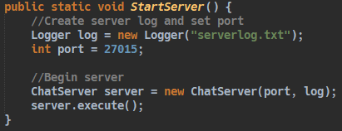
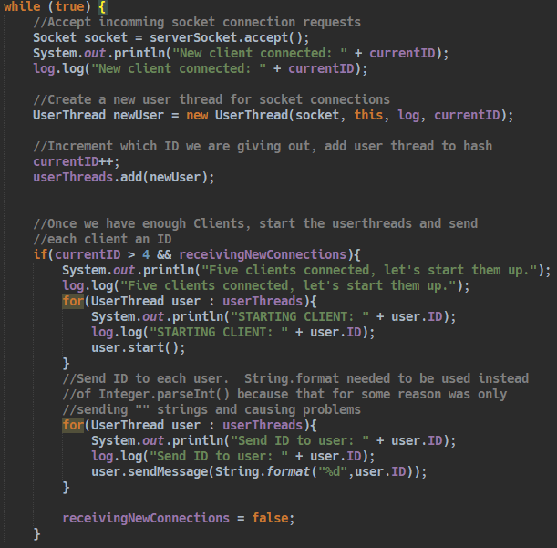
Server
Server is started by creating an instance of ChatServer and providing it with a port
Server loops while accepting new clients
Creates a UserThread for each client
Once we have enough clients, start the UserThreads and send IDs to each user
“GO” message
Notes:
We start the server by creating an instance of ChatServer and passing in a valid port number
The server will loop while accepting incoming socket connections
As it receives new connections, it creates a UserThread for each client, and assigns an ID to it
Once we have enough connections, we start all of the threads, and then send the clients their IDs
As started before, sending the IDs is like a “GO” message

Slide 11
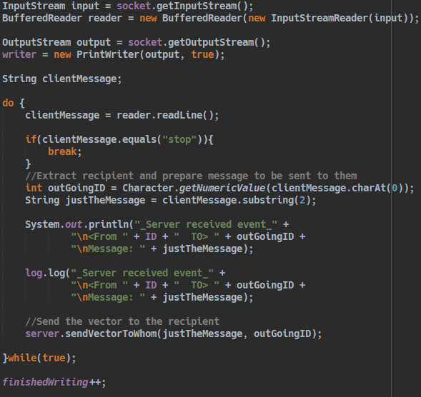
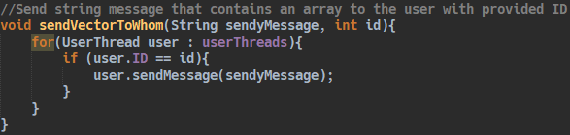

Server – User Thread
Receives a String
Determines where it’s supposed to go
Send the message to its destination
Notes:
The Userthread is overall very simple
In a loop, we try to receive messages
Once we receive a message, we pull the first value from the String
If you can recall, this is the value that was appended on to the front of the String by the Client Write Thread
Then we save just the message part
We send just the message part to the intended recipient
The server does not have to do any String array conversions

Slide 12
Demonstration
Questions
Notes:
The Userthread is overall very simple
In a loop, we try to receive messages
Once we receive a message, we pull the first value from the String
If you can recall, this is the value that was appended on to the front of the String by the Client Write Thread
Then we save just the message part
We send just the message part to the intended recipient
The server does not have to do any String array conversions

