Slide 1
Classification of the genre of the film based on the description of the plot
Aleksandra Musiał
Benedykt Waszkiewicz
GKiO3, sekcja 7

Slide 2

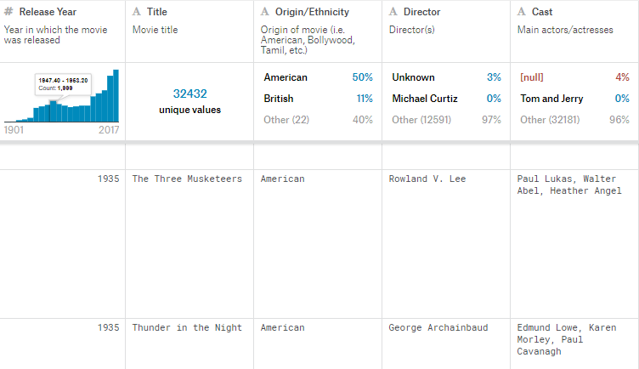
DATA SET - Wikipedia Movie Plots
Source: www.Kaggle.com
About 35 000 movies
Columns:
Release year
Title
Origin/ethnicy
Director
Actors and actresses
Genre
Wiki page
Plot

Slide 3
DATA CLEANSING
GENRES | PLOTS
2265 different genres at the beggining Multiple genres for one movie (e.g. drama historical short) Different names for the same genre (e.g. biographical, biography, biopiC) About 1000 after cleansing | Extracting single words Removing punctuation marks Changing short forms into long forms (e.g. can’t -> can not) Eliminating nonsignificant words (e.g. about, with, but)

Slide 4
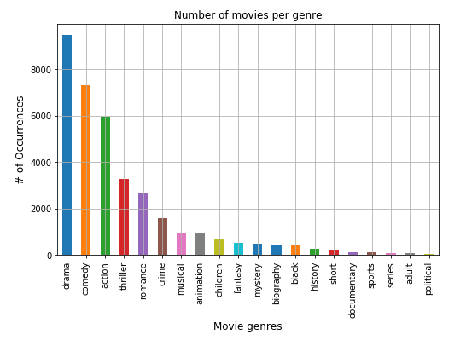
NUMBER OF MOVIES PER GENRE

Slide 5
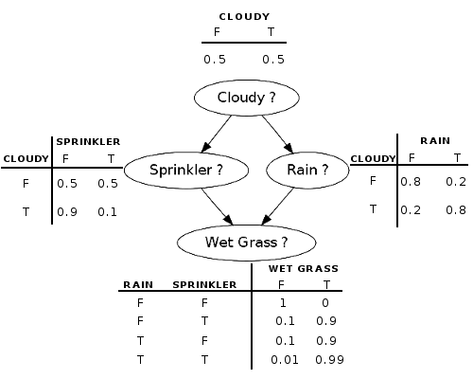
BAYESIAN NETWORK
Bayesian networks are a type of Probabilistic Graphical Model.
A Bayesian network is composed of:
- random variables (nodes),
- their conditional dependencies (arcs)
which, together, form a directed acyclic graph. A conditional probability table is associated with each node.

Slide 6
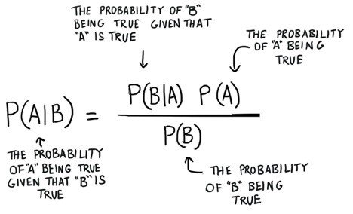
NAIVE BAYES CASSIFICATION
The Naive Bayes classification algorithm is based off of Bayes’ Theorem.
Bayes’ Theorem uses conditional probabilities to “predict” the outcome of later probabilities.

Slide 7
NAIVE BAYES CASSIFICATION
Machine learning method used to predict the likelihood an event will occur given evidence that’s present in your data.
Why naive? It assumes that the presence (or absence) of a particular feature of a class is unrelated to the presence (or absence) of any other feature, given the class variable.

Slide 8
TYPES OF NAIVE BAYES MODELS
Multinomial – works well for data with categorical features which can easily be turned into counts, such as word counts in text
Bernoulli – for making predictions from binary features
Gaussian – for making predictions from normally distributed features

Slide 9
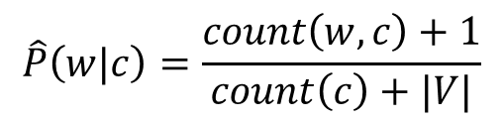
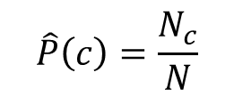
ALGORITHM
Probability of each class = $\frac{\text{num}\text{b}\text{er} \text{of} \text{documents} \text{with} \text{that} \text{class}}{\text{total} \text{number} \text{of} \text{the} \text{documents}}$
$$\hat{P}\left(c\right)=\frac{N_{c}}{N}$$
Probability of each word per class = $\frac{\text{count} \text{of} \text{the} \text{word} \text{in} \text{the} \text{class}}{\text{total} \text{numer} \text{of} \text{words} \text{in} \text{the} \text{class}}$
$$\hat{P}\left(w|c\right)=\frac{count\left(w,c\right)+1}{count\left(c\right)+|V|}$$

Slide 10

SCIKIT-LEARN (SKLEARN) LIBRARY
Free software machine learning library for the Python programming language. It features various classification, regression and clustering algorithms including support vector machines, random forests, gradient boosting, and is designed to interoperate with the Python numerical and scientific libraries NumPy and SciPy.

Slide 11
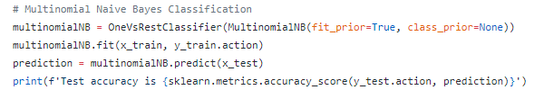
IMPLEMENTATION
sklearn.multiclass.OneVsRestClassifier (estimator, n_jobs=None) this strategy consists in fitting one classifier per class. For each classifier, the class is fitted against all the other classes
sklearn.naive_bayes.MultinomialNB (alpha=1.0, fit_prior=True, class_prior=None) implements the naive Bayes algorithm for multinomially distributed data

Slide 12
Thank you!
Aleksandra Musiał
Benedykt Waszkiewicz
GKiO3, sekcja 7

