Slide 1

Food Monitoring
Pritish Yuvraj
Brennan Waters
4th January, 2018

Slide 2
Overview
POS Tags
Automated precision system
Notes:
<number>

Slide 3
Papers:
“Speech2Health: A Mobile Framework for Monitoring Dietary Composition from Spoken Data”
Author: Niloofar Hezarjaribi, Sepideh Mazrouee, Hassan Ghasemzadeh
“S2NI: A Mobile Platform for Nutrition Monitoring from Spoken Data”
Author: Niloofar Hezarjaribi, Cody A. Reynold, Drew T. Miller, Naomi Chaytor, Hassan Ghasemzadeh
<number>

Slide 4
Health Issues requiring Diet Management:
Chronic Diseases
Diabetes
Cardiovascular Disease
Obesity
<number>

Slide 5
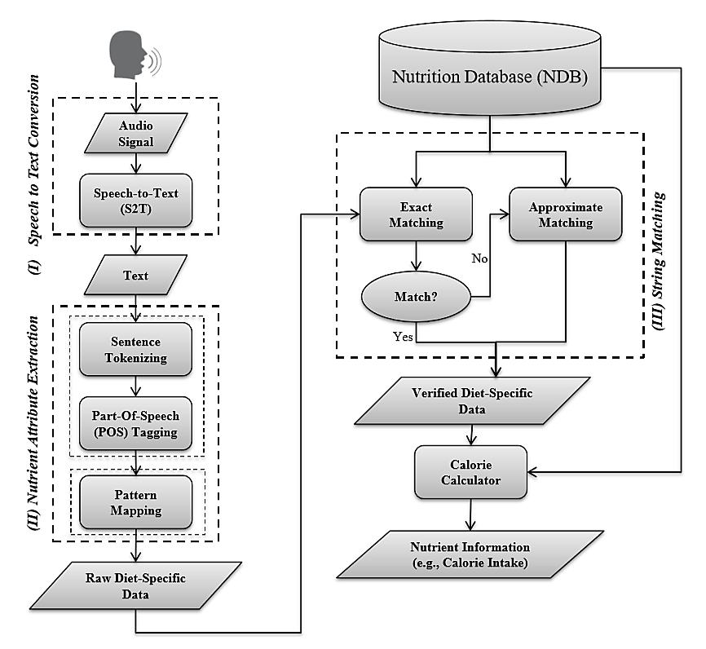
Architecture
<number>

Slide 6
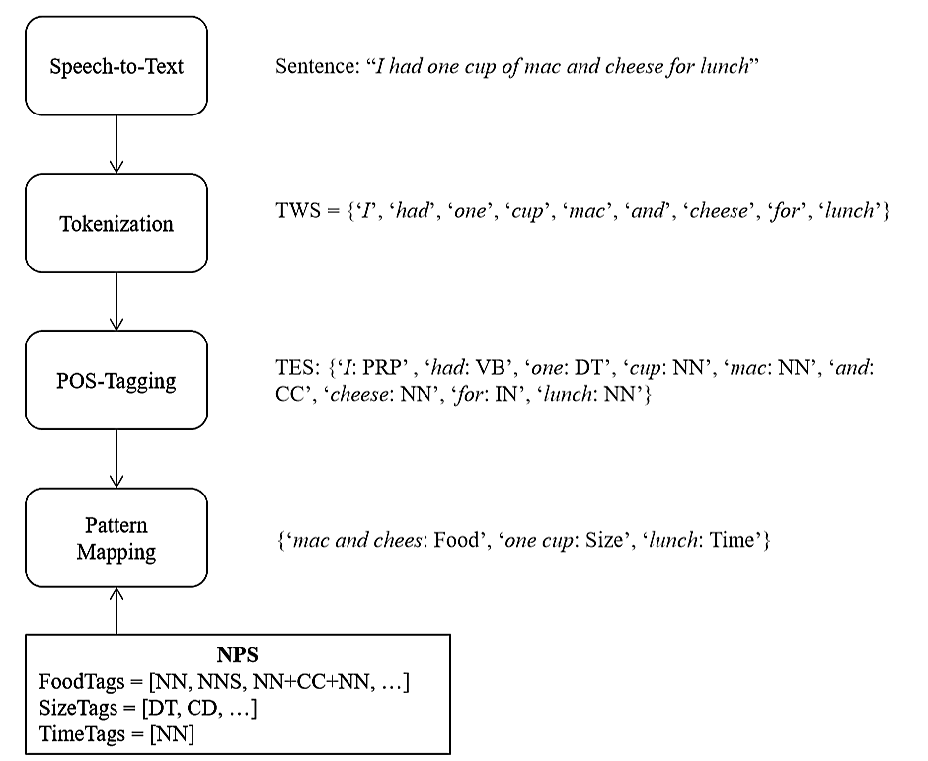
Pattern Mapping
<number>

Slide 7
String Matching
Step -> 1) Exact Matching (Eg. Apple, apple)
Step -> 2) Approximate Matching (Eg. Apple, Apples)
Threshold = Len(String1) / Len(String2)
If Threshold in range(0.75,1):
Then, (Levenshtein Algorithm) or Edit Distance
Approximate Matching improves the accuracy by 7% (on an average of four different classes).
<number>

Slide 8
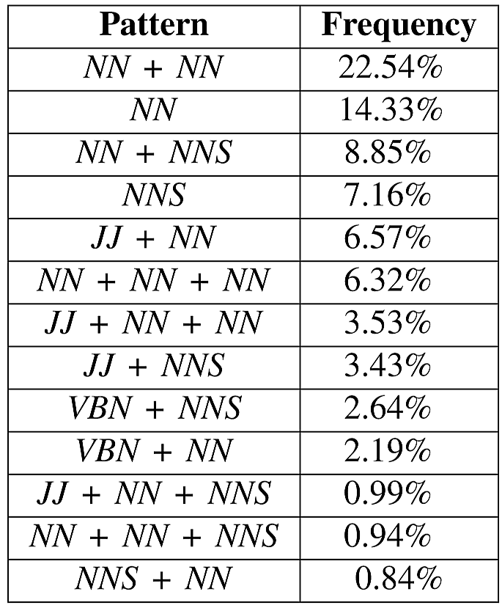
Food Frequent Patterns:
<number>

Slide 9
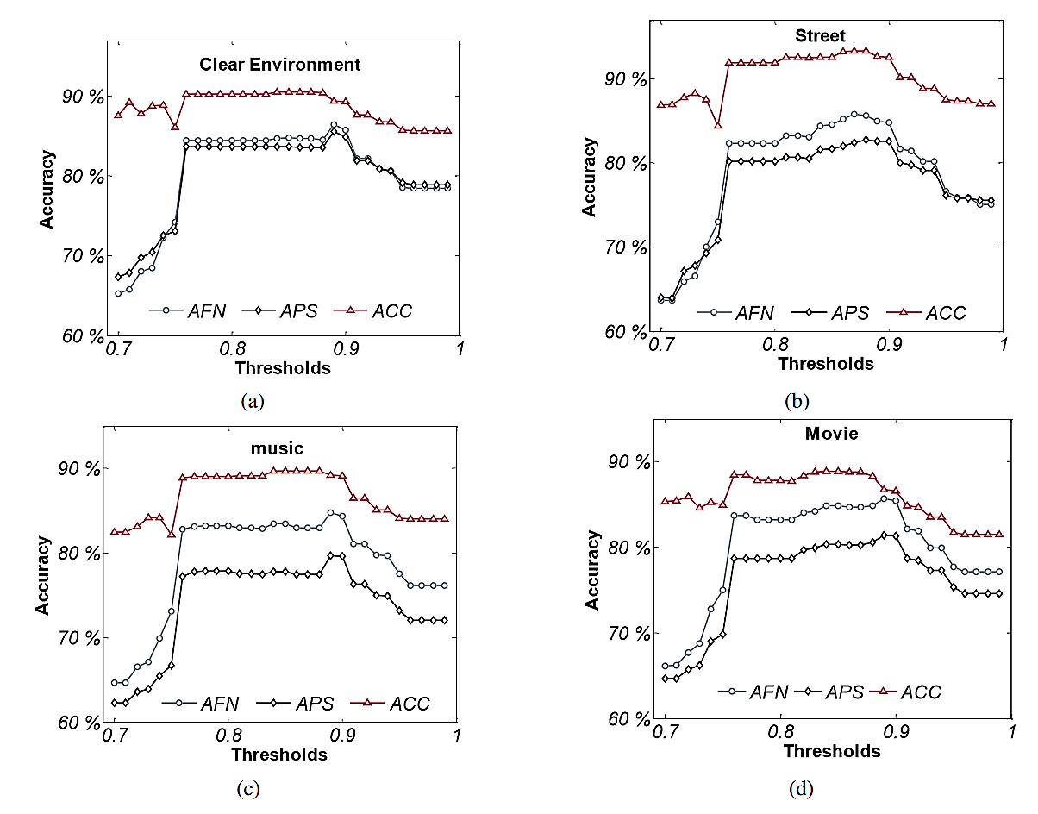
Results
AFN: Accuracy Food Name
APS: Accuracy Portion Size
ACC: Accuracy
<number>

Slide 10
Possible Monitoring Solutions:
Category | Speech Based (Out of 5) | Text Based (Out of 5) | Image Based (Out of 5)
Attention (How frequently they recorded their food conversations) | 3.89 | 3.13 | 2.75
Interaction (Ease – of – use) | 4.25 | 3.13 | 2.25
Privacy | 3.56 | 3.75 | 2.38
Impact (Overall Acceptance) | 2.44 | 2.00 | 1.56
Rating | 3.25 | N/A | N/A
Notes:
<number>

Slide 11
Differences in Research
Speech2Health is also attempting to create a food monitoring system using speech processing and NLP techniques
However, the system is specifically envisioned to be used actively
users press record and talk about what food they ate as well as when they ate it (e.g. breakfast, lunch, or dinner).
Our research so far has been into passive systems, that automatically listen to mealtime conversations (without intervention on the part of the listener).

Slide 12
References:
“Speech2Health: A Mobile Framework for Monitoring Dietary Composition from Spoken Data”. Niloofar Hezarjaribi, Sepideh Mazrouee, Hassan Ghasemzadeh. IEEE JOURNAL OF BIOMEDICAL AND HEALTH INFORMATICS, 2017.
“S2NI: A Mobile Platform for Nutrition Monitoring from Spoken Data”. Niloofar Hezarjaribi, Cody A. Reynold, Drew T. Miller, Naomi Chaytor, Hassan Ghasemzadeh. IEEE Engineering in Medicine and Biology Society. 2016
<number>

