Slide 1

Food Monitoring
Pritish Yuvraj
Brennan Waters
4th January, 2018

Slide 2
Overview
POS Tags
Automated precision/recall system
Notes:
<number>

Slide 3
Precision/Recall
Previously, calculating the precision and recall of our algorithm required going through multiple documents by hand
Time consuming
We updated our program so that it compares its tagging answers to a saved solution and automatically calculates the precision and recall
Currently only the file ‘admmt1.cha’ has a saved solution, as creating the solutions is labor-intensive
Notes:
<number>

Slide 4
Precision/Recall Example
Using the file ‘admmt1.cha’:
precision: 0.65625
recall: 0.724137931034
Notes:
<number>

Slide 5
Precision/Recall Example
true positives:[(79, (22, 29)), (79, (34, 38)), (99, (31, 40)), (104, (14, 21)), (115, (21, 28)), (121, (48, 55)), (134, (37, 44)), (155, (15, 21)), (276, (27, 31)), (276, (36, 42)), (284, (30, 36)), (284, (41, 46)), (308, (20, 25)), (308, (30, 36)), (314, (15, 22)), (314, (60, 66)), (329, (19, 24)), (329, (29, 35)), (651, (18, 24)), (810, (55, 60)), (869, (16, 23))]
lines:
((79, (22, 29)), '*MOT:\tKim got lots_of carrots and peas in the xxx .\n')
((79, (34, 38)), '*MOT:\tKim got lots_of carrots and peas in the xxx .\n')
((99, (31, 40)), "*FAT:\tAdam's not gonna eat her beef stew .\n")
((104, (14, 21)), '*MOT:\tsee the carrots in there ?\n')
((115, (21, 28)), '*CHI:\t<I have my xxx carrots> [<] .\n')
((121, (48, 55)), '*MOT:\tsee if we can <find some more of> [>] the carrots in here .\n')
((134, (37, 44)), "*MOT:\there you go here's some of the carrots right on top !\n")
((155, (15, 21)), '*CHI:\tI have a carrot haha [x 2] &=singing .\n')
((276, (27, 31)), '*MOT:\t<let me> [<] see the salt and pepper .\n')
((276, (36, 42)), '*MOT:\t<let me> [<] see the salt and pepper .\n')
((284, (30, 36)), "*MOT:\tsure you don't want any butter and bread Adam ?\n")
((284, (41, 46)), "*MOT:\tsure you don't want any butter and bread Adam ?\n")
((308, (20, 25)), '*MOT:\tyou want some bread and butter ?\n')
((308, (30, 36)), '*MOT:\tyou want some bread and butter ?\n')
((314, (15, 22)), "*MOT:\teat some carrots on there I'll give you the bread and butter .\n")
((314, (60, 66)), "*MOT:\teat some carrots on there I'll give you the bread and butter .\n")
((329, (19, 24)), "*MOT:\tthere's your bread and butter right there .\n")
((329, (29, 35)), "*MOT:\tthere's your bread and butter right there .\n")
((651, (18, 24)), '*CHI:\tMommy ate a cookie and I ate a cookie .\n')
((810, (55, 60)), "*FAT:\tyep alright well you don't have_to skitch@f your bread in it just put it on the table if you don't want it Kim .\n")
((869, (16, 23)), '*SIS:\tI have my chicken .\n')
Notes:
<number>

Slide 6
Precision/Recall Example
false positives: [(99, (31, 35)), (99, (36, 40)), (196, (25, 31)), (196, (32, 37)), (253, (38, 43)), (305, (15, 21)), (305, (22, 27)), (314, (50, 55)), (644, (6, 18)), (806, (18, 23)), (869, (16, 24))]
lines:
((99, (31, 35)), "*FAT:\tAdam's not gonna eat her beef stew .\n")
((99, (36, 40)), "*FAT:\tAdam's not gonna eat her beef stew .\n")
((196, (25, 31)), '*MOT:\tAdam you want some butter bread ?\n')
((196, (32, 37)), '*MOT:\tAdam you want some butter bread ?\n')
((253, (38, 43)), "*MOT:\t<there's no kids out> [<] there honey .\n")
((305, (15, 21)), '*MOT:\tyou want butter bread ?\n')
((305, (22, 27)), '*MOT:\tyou want butter bread ?\n')
((314, (50, 55)), "*MOT:\teat some carrots on there I'll give you the bread and butter .\n")
((644, (6, 18)), '*CHI:\tpotato chips (.) and coke .\n')
((806, (18, 23)), "*FAT:\tI'll eat it honey .\n")
((869, (16, 24)), '*SIS:\tI have my chicken .\n')
Notes:
<number>

Slide 7
Precision/Recall Example
false negatives: [(196, (25, 37)), (305, (15, 27)), (314, (50, 59)), (631, (8, 15)), (634, (8, 15)), (644, (6, 17)), (644, (27, 31)), (651, (37, 43))]
lines:
((196, (25, 37)), '*MOT:\tAdam you want some butter bread ?\n')
((305, (15, 27)), '*MOT:\tyou want butter bread ?\n')
((314, (50, 59)), "*MOT:\teat some carrots on there I'll give you the bread and butter .\n")
((631, (8, 15)), '*CHI:\ta brownie .\n')
((634, (8, 15)), '*CHI:\ta brownie .\n')
((644, (6, 17)), '*CHI:\tpotato chips (.) and coke .\n')
((644, (27, 31)), '*CHI:\tpotato chips (.) and coke .\n')
((651, (37, 43)), '*CHI:\tMommy ate a cookie and I ate a cookie .\n')
Notes:
<number>

Slide 8
Description of USDA database
~01001~^~0100~^~Butter, salted~^~BUTTER,WITH SALT~^~~^~~^~Y~^~~^0^~~^6.38^4.27^8.79^3.87 → (14 fields)
1 → Food Item No:
2 → Food Group
3 → Long Description
4 → Short Description
5 → Common Name
Important Points:
Words in Capital represents Company Names.
Consists of Few Acronyms:
eg. REST-PREP → Restaurant Prepared, CHICK → Chicken
Notes:
<number>

Slide 9
Food Groups
Total 25 food groups, some of them are:
Dairy and Egg Products
Baby Foods
Pork Products
Sweets
Fast Foods
Notes:
<number>

Slide 10
LanguaL – Language of Food
Expanded standardized food description
For some food groups. eg. (pork products, spices and herbs, etc)
classifying food products for information retrieval
Based on concept that:
Any food is comprised of combination of characteristics
Characteristics can be categorized into viewpoints (& coded for computer processing)
Resulting viewpoints/characteristic codes can be used to retrieve data about food
Notes:
<number>

Slide 11
LanguaL - catsup
Condiment or relish
Vegetables and vegetable products
Tomato
Fruit
Fully heat-treated
Acidified
Low sodium food
Flavoring
Semi liquid with smooth consistency
Cooking method not applied
Container or wrapping not know
Notes:
<number>

Slide 12
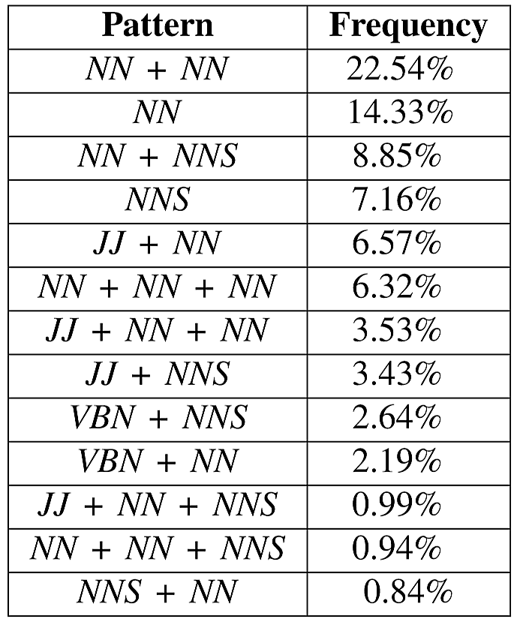
Using POS Tags:
Helpful:
Honey → VBD
Shake → VB
Sunshine → JJ
Tea (from Tea party) → JJ, VBN
Not Helpful:
Honey → NN
Duck → NN
Confusion:
Why is no NN in POS Tags?
eg. macroni/cheese/cheddar
Notes:
<number>

