Slide 1
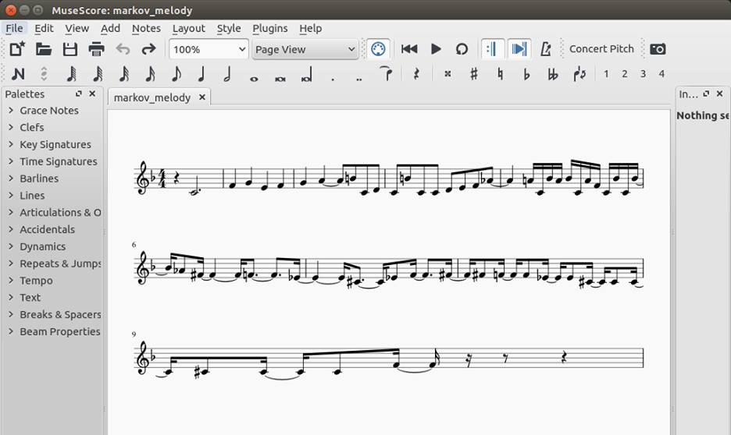
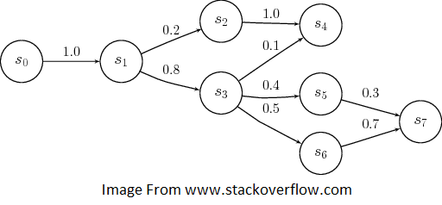

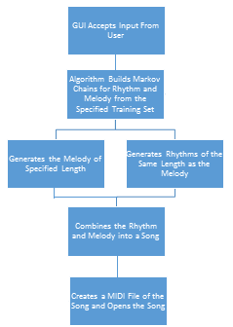
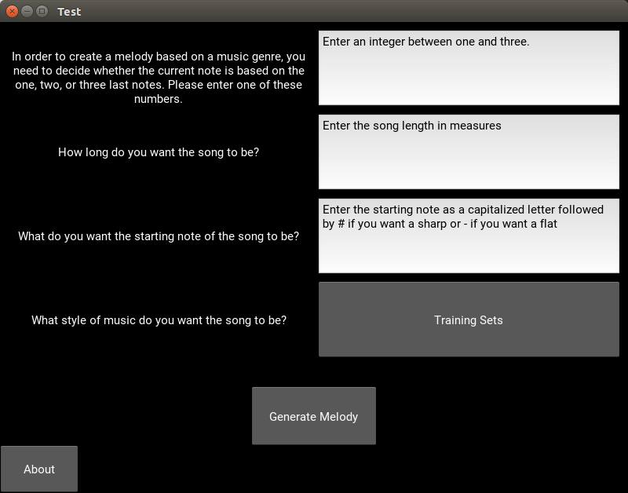
Interactive Algorithmic Music Composition
Joseph Lee & Bryan Werth
Why Algorithmic Music Composition?
Program Architecture
Examples of Music Generated by Our Program
Music has been around for a very long time, and, like many things, it has continuously evolved. This opens up many different genres, styles, and structures. Historically, these musical works were created by compositional masters – people with a talent for musical understanding and creativity. Recently, there has been a growing interest in the use of computers to compose musical works. This field of algorithmic music composition is huge with applications ranging from attempting to compose masterpiece works in the style of a particular composer to allowing music to be composed/generated real-time for DJ settings.
Markov chains are a way of determining the future state of a system based on a framing of the probabilities of specific transitions based on the current state of the system (1st order markov chain) or based on the current state as well as previous states (nth order markov chain).
To build a markov chain, a training set is broken down into a sort of histogram containing information about the number of times each possible transition takes place within the training set. From this information, it is possible to derive the probabilities of each transition given an initial state or ‘seed’.
In the context of algorithmic music composition, we use markov chains to develop the rhythms and notes of the melody of a song. Our training set is in the form of musicXML files of various musical works which our algorithm parses and stores as a dictionary where the keys are the ‘seeds’ and the values are a list of all transitions (including repeated transitions).
Interesting Applications for
Algorithmic Music Composition
Music Composed by our Program using a Training Set of Beethoven Sonatas
Algorithmic music composition opens up a range of interesting applications. The speed at which an algorithm can compose a work allows for a degree of interactivity where music can be generated while the user varies algorithmic parameters or in some cases even real-time as the algorithm executes. Another interesting advantage of algorithmic composition is that it makes some really diverse approaches possible – things like composing music mathematically, based on other existing music, and based on constrained random generation to name a few.
An Example Markov Probability Map
(note that in the case of markov chains for music composition, each possible state would be a musical note and there would be additional transitions between all of the different states as dictated by the training set used)
What we have done is created an algorithm specifically for interactive algorithmic music composition – a program where the user defines a set of parameters such as the number of notes in their song, a set of songs that the user wishes the program to compose in the style of, and the seed for the song. Once the user is happy with what they have input, the algorithm generates a song based on the user’s input.
Image Showing the User Interface of Our Program
What our Program Does
To actually generate a song from this information, our algorithm accepts the first note as input from the user. If the user wishes to use markov chains higher than first order, the algorithm randomly selects the other notes in the seed. It then uses this seed as a key and searches the markov dictionary for this key. If the key does not appear in the dictionary, a random output note is selected to allow the program to continue. If the key appears in the dictionary, the algorithm randomly selects an output state from the list of possible output states. Because repeated transitions are included in that list, the probabilities of each transition are preserved.
The same process is followed for selecting the rhythm of the piece except that currently due to constraints within the Graphical User Interface, the program does not accept a seed for the rhythm markov chain. Instead, the program automatically uses half notes as the seed for the rhythm.
Music Composed by our Program using a Training Set of Haydn String Quartets
Plans for Future Work
Implement a ‘smarter’ algorithm that can recognize the melody and harmonies in a song to create smarter markov probability maps.
Implement music theory rules that help keep the generated music within certain stylistic bounds.
Work on developing an algorithm to create harmonies for a given melody
Develop a way to produce musical developments and be able to generate songs based on musical motives
Create a set of options around song structures
Allow the program to work with separate training sets for different aspects of the song to allow for more unique and diverse output
Work on reducing computational inefficiencies to improve run time
Have an option for interconnected markov chains such that the rhythm is influenced by the melody and vice versa
Enable the user to remove parts of the generated songs that they do not like
Polish the user interface
Allow the user to select different output formats such as musicXML, Midi, .abc, etc.
Block Diagram Showing our Basic Program Structure

