Slide 1
{{UNIT}}
{{EVENT}} FAAR
{{BRIEF_DATE}}

Slide 2
Agenda
Purpose/Rules of an AAR
Mission, METs, & CDR Training Objectives
MAAR Deliverables
AAR Discussion
References
Closing Remarks

Slide 3

https://www.youtube.com/watch?v=IdTMDpizis8

Slide 4
What is an AAR?
Definition:
a guided analysis of an organization’s performance, conducted in a timely manner, at the conclusion of a training event with the
objective of improving future performance.
AARs are a
professional dialogue that turns friction into
organizational agility.

Slide 5
Rules of the AAR
This is your AAR, Participation is Key
  Be respectful
  Everyone has a voice and perspective, the team needs to hear it
  Remain Open-minded
  Look for the lesson
  Open, candid, professional discussion
  Only one speaker at a time
  “The more you sweat [during training] the less you bleed in war.”
  – General Norman Schwarzkopf

Slide 6
Mission, METs, & CTOs
Mission:
{{MISSION}}
Mission Essential Tasks:
{{SEQ:met:item}}{{.code}}: {{.title}}
Commander’s Training Objectives:
{{SEQ:cto:item}}{{.text}}

Slide 7
MAAR Deliverables
{{SEQ:maar:item}}{{.label}}{{.text}}

Slide 8
{{PAGE_TITLE}}
{{SEQ:disc:teo}}{{.text}}
{{SEQ:disc:head}}{{.text}}
{{SEQ:disc:para}}{{.text}}
{{SEQ:disc:rec}}Recommendation: {{.text}}

Slide 9
FAAR Deliverables
MAAR Deliverables:
{{SEQ:maar:item}}{{.label}}{{.text}}
FAAR Deliverables:
{{SEQ:faar:item}}{{.text}}

Slide 10
Heroes of the Battle

Slide 11
References
  {{SEQ:ref:item}}{{.text}}

Slide 12
Closing Remarks

Slide 13
How do we conduct MA in 77th CSSB?
MDMP
Definition:
The Military Decision Making Process is an iterative planning methodology that integrates the activities of the commander, staff, subordinate headquarters, and other partners to understand the situation and mission, develop and compare courses of action, decide on a course of action that best accomplishes the mission, and produce an operation plan or order for execution.
The purpose of MDMP: a proven analytical process for solving problems and making decisions.
• Step 1 - Receipt of mission.
• Step 2 - Mission analysis.
• Step 3 - COA development.
• Step 4 - COA analysis.
• Step 5 - COA comparison.
• Step 6 - COA approval.
• Step 7 - Orders production, dissemination, and transition.

Slide 14
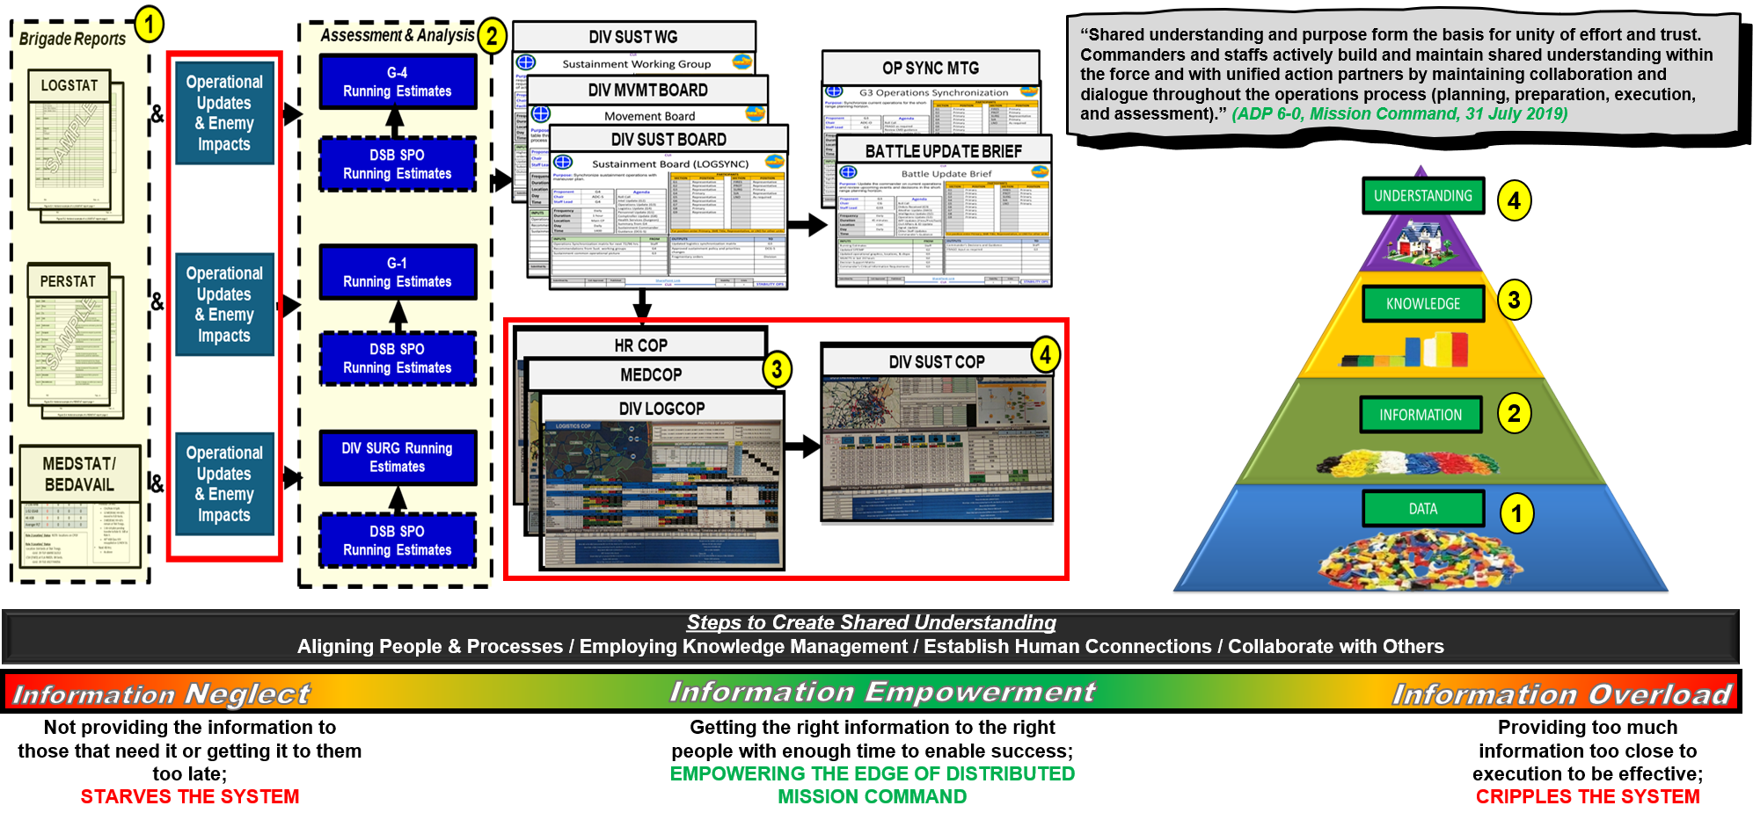
Sustainment Shared Understanding

Slide 15
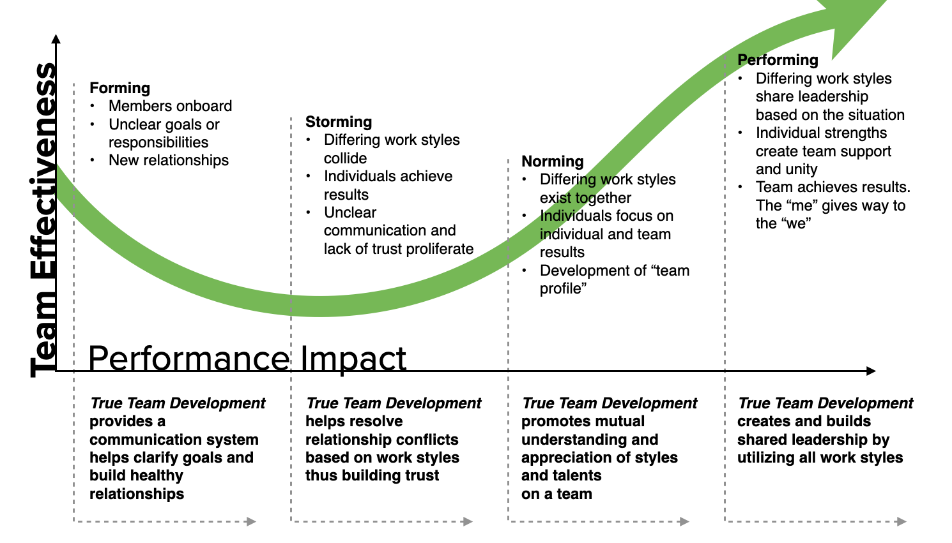
How did we do?
How far did the team progress through the model?

