Slide 1
CA WSDM UI Design Review
Manish Vashist (vasma03)
10 January 2005

Slide 2
Agenda
Set expectations
Deliverables
Role based dashboards
  Administrator
  Business User
  Security Officer
Storyboards
  View Policy
  View Alerts
  Services
  Catalog
  Reports
  Configuration
Assumptions

Slide 3
Expectations
UI design - current status
Assumptions
Review comments

Slide 4
Deliverable Status
12 November 04
Done
Review existing
product and collateral
26 November 04
Draft
UI Requirements Document
Functional Summary
Define Use Cases
Define User Roles
15 December 04
Omar
Usability test
26 December 04
Draft
Architectural
Diagram &
Process flow
7 January 05
Done with assumptions
Storyboards
9 February 05
TBD
Prototype
1 March 05
TBD
Usability Evaluation/
Heuristic evaluation
14 March 05
TBD
Refine UI and
Iterate Designs

Slide 5
Role Based Dashboard

Slide 6
Administrator
Primary Tasks
Manage WSDM users and user groups
Assign accesses to WSDM functions to user groups
Configure WSDM and set various product options
Run and review WSDM Administration Reports
Maintain WSDM Web services catalog
Instrument Web services for management
Create, maintain and remove content based monitors
Create, maintain and remove management policies
Select monitors and set alert thresholds
Manage alerts
Manage WSDM database and logs
Apply WSDM product updates

Slide 7
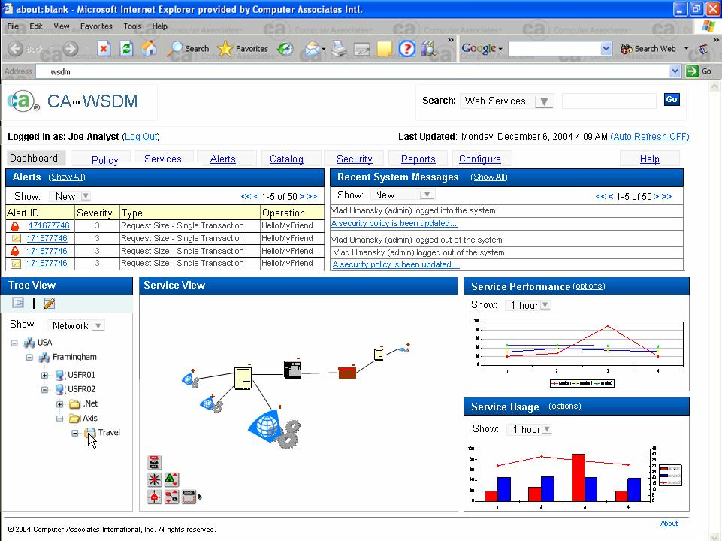
branding
Login info
Top level tabs
Search operation
Last update
alerts
Auto refresh
Displayed system messages here
Tree view
Service performance graph
Service usage graph
Service view
Edit and view policy option
Toggle between different views

Slide 8
Security Officer
Primary Tasks
  Creation of monitoring and security policies
  Modification of monitoring and security policies
  Define and document security policies in an SOA environment
  Administer identities and access policies

Slide 9
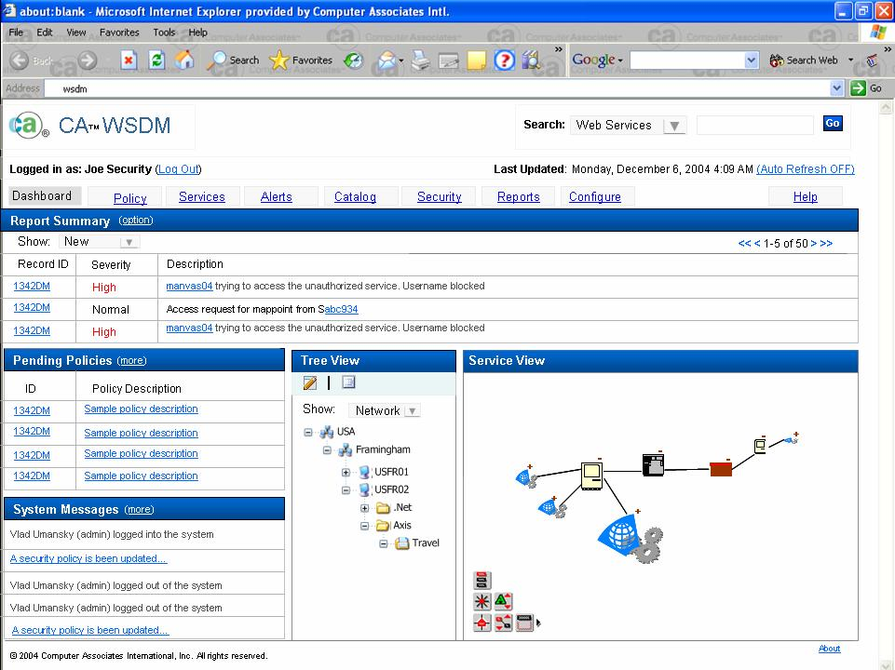
branding
Login info
Top level tabs
Search operation
Last update
Report Summary
Auto refresh
Pending policies
Service view
System Messages
Footer
Tree view

Slide 10
Business User
Primary Tasks
  Receive WSDM alerts
  Review and acknowledge alerts
  Define WSDM reports for analysis of Web service activities
  Access and review WSDM reports
  Review WSDM management policies

Slide 11
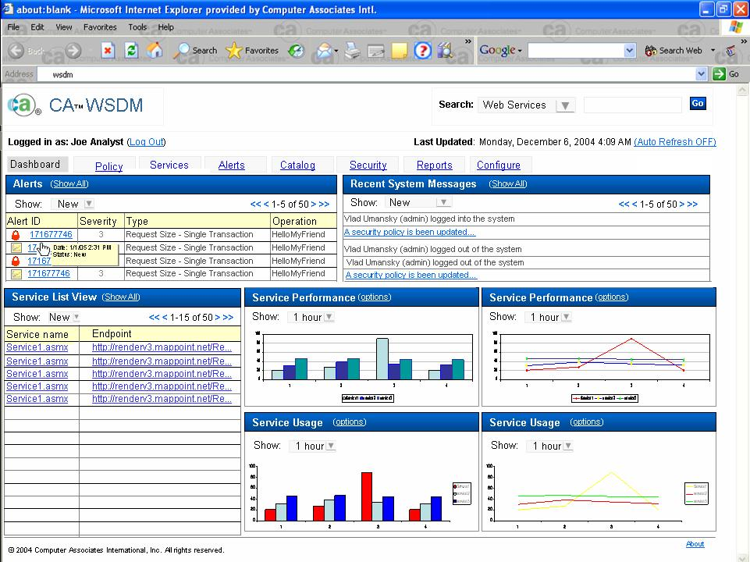
branding
Login info
Top level tabs
Search operation
Last update
alerts
Auto refresh
Displayed system messages here
Catalog list view
Performance graph
Performance graph
Usage graph
Usage graph
Footer

Slide 12
Storyboards

Slide 13
Scenario 1 - Policy View
WSDM administrator needs to view the existing policy

Slide 14
Policy View
From the dashboard
User can either select a node from the tree view
Or selects a node from the service view

Slide 15
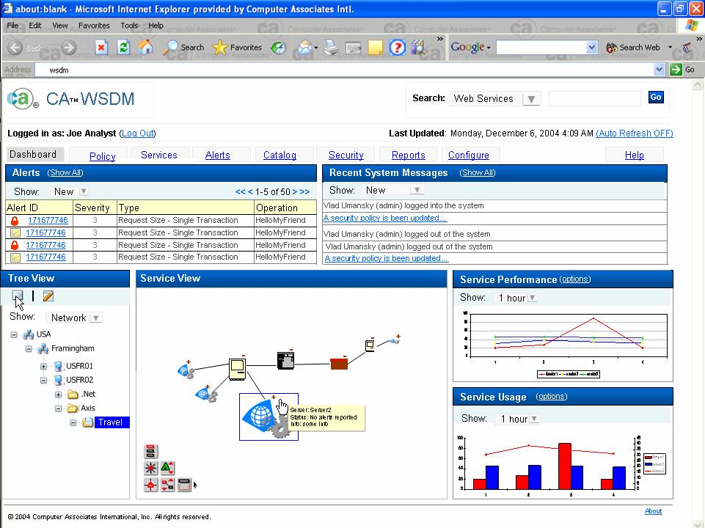
Policy View
After selection the node, user clicks on “View Policy” Icon
corresponding node at the service view will be selected and vice versa
Say, in this case user selects travel.

Slide 16
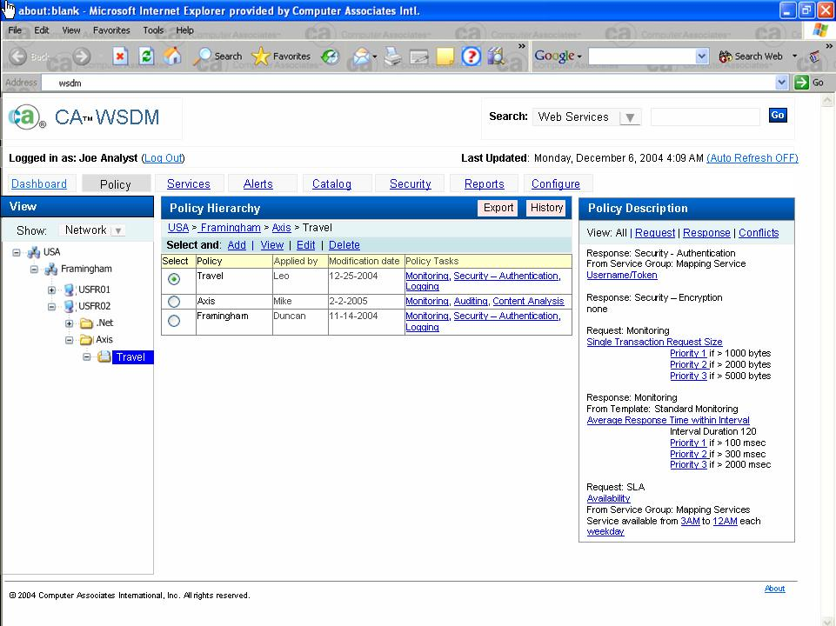
Policy View
Policy page for that particular node will be displayed
User can perform actions on this policy set
Or user can apply actions to individual policies
Policy description is been displayed here

Slide 17
Scenario 2 - View Alerts
Business user needs to view the recent system alerts

Slide 18

View Alerts
From the dashboard
User clicks on the alert ID in the alert view table

Slide 19
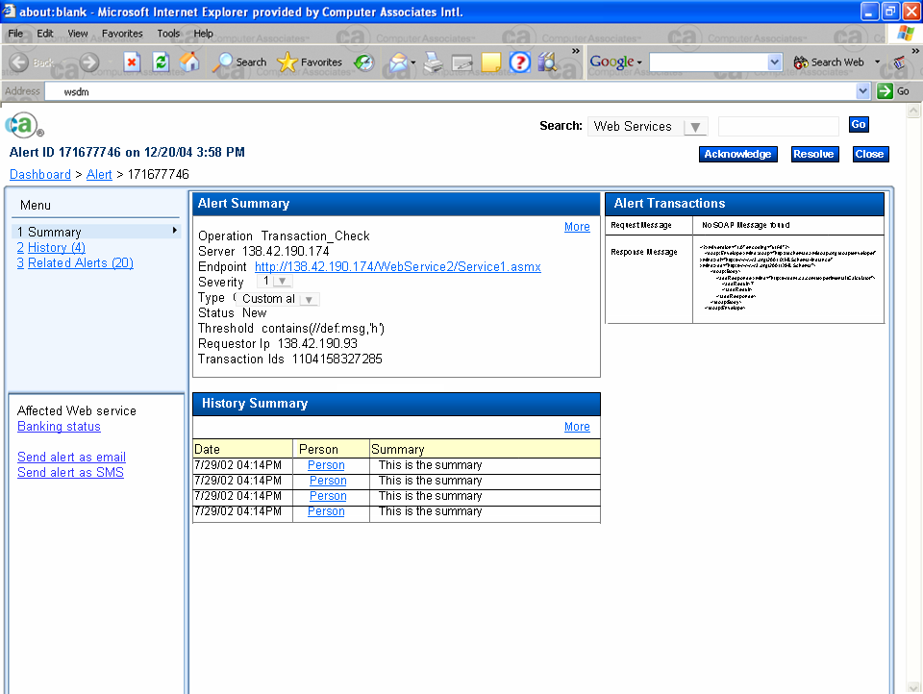
Policy View
Alert detail page opens up
User can view Alert summary
Alert Transactions
Alert History summary
And other related information

Slide 20
Scenario 3 - Services View
Business User wants to create new services group

Slide 21
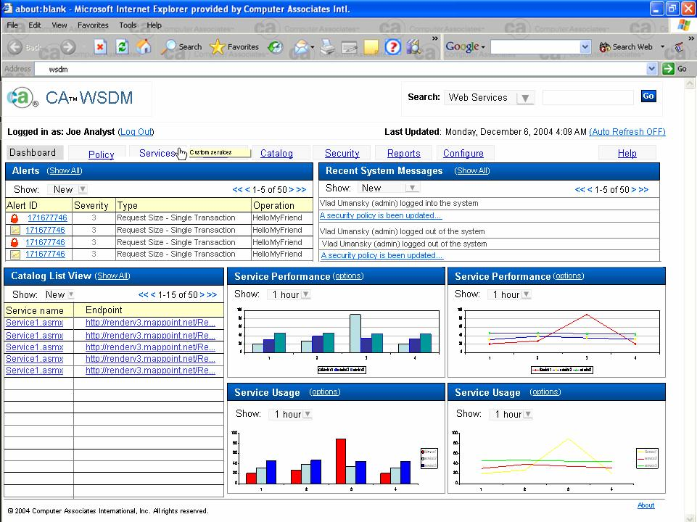
View Services
User clicks on the Services tab
From the dashboard

Slide 22
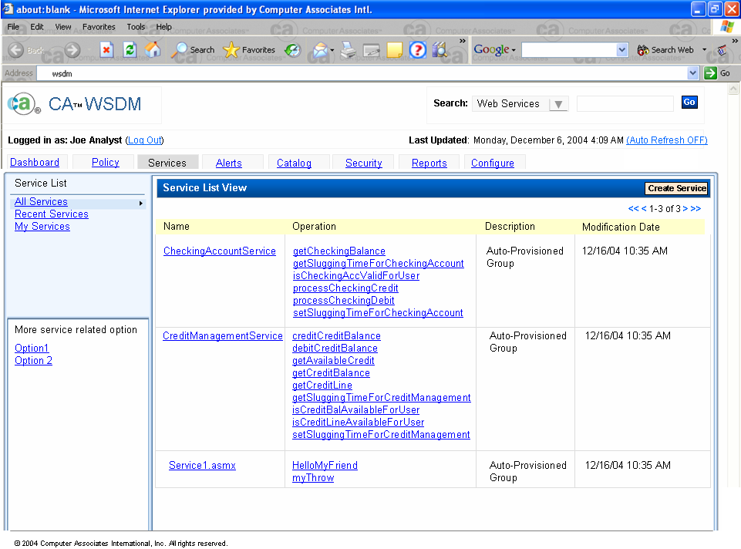
User can view services category wise
User is taken to the service List page
User can create new service group by clicking on this link

Slide 23
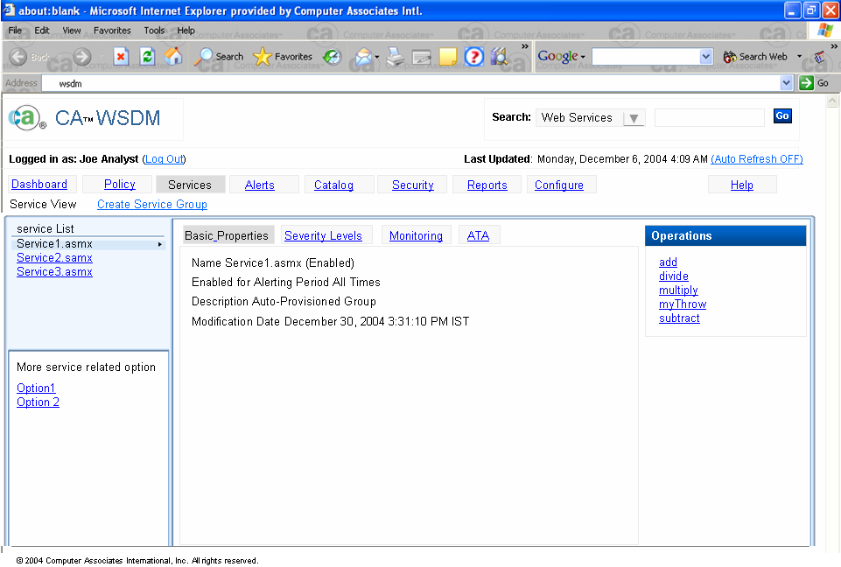
View Services
User can view the list of available service groups
User is taken to the service page
User can create new service group by clicking on this link
Related operations can also be viewed
This will change
User can view properties related to the selected service

Slide 24
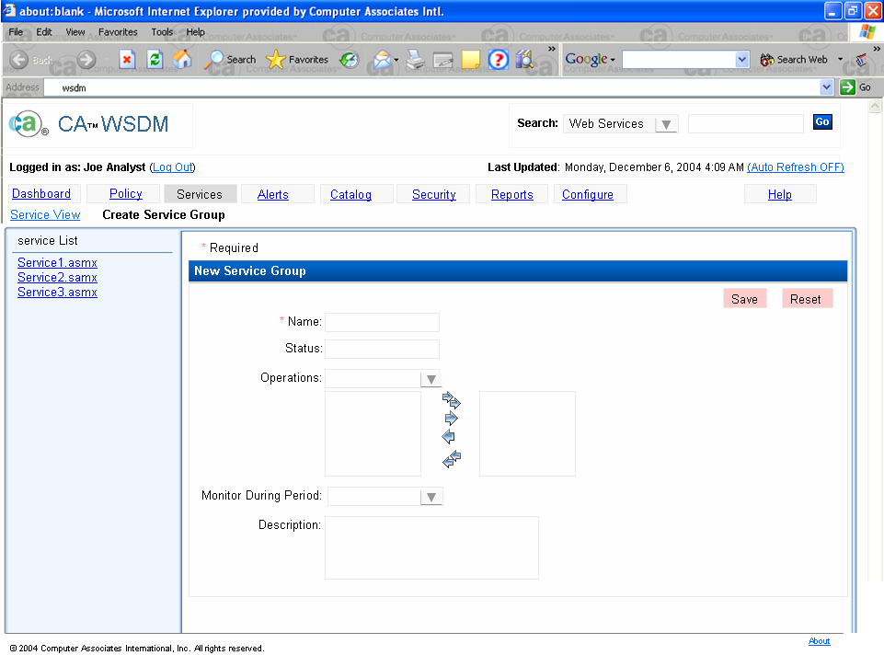
View Services
Create New service group page comes up
User can fill the required info in order to create new service group
This will change

Slide 25
Scenario 4 - Catalog
Business User wants to view the service details in the catalog

Slide 26

Catalog
From the dashboard
User clicks on the service name in the catalog list view

Slide 27
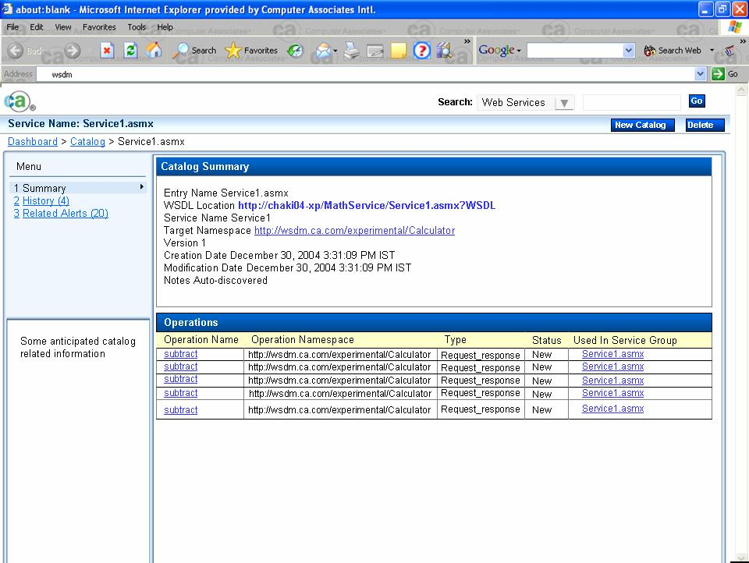
Catalog
Service detail page opens
User can view service name
Perform functions related to catalog
Catalog summary
List of related operations

Slide 28
Scenario 5 - View Reports
Business User wants to view report option

Slide 29
View Reports
From the dashboard
User clicks on the Reports tab

Slide 30
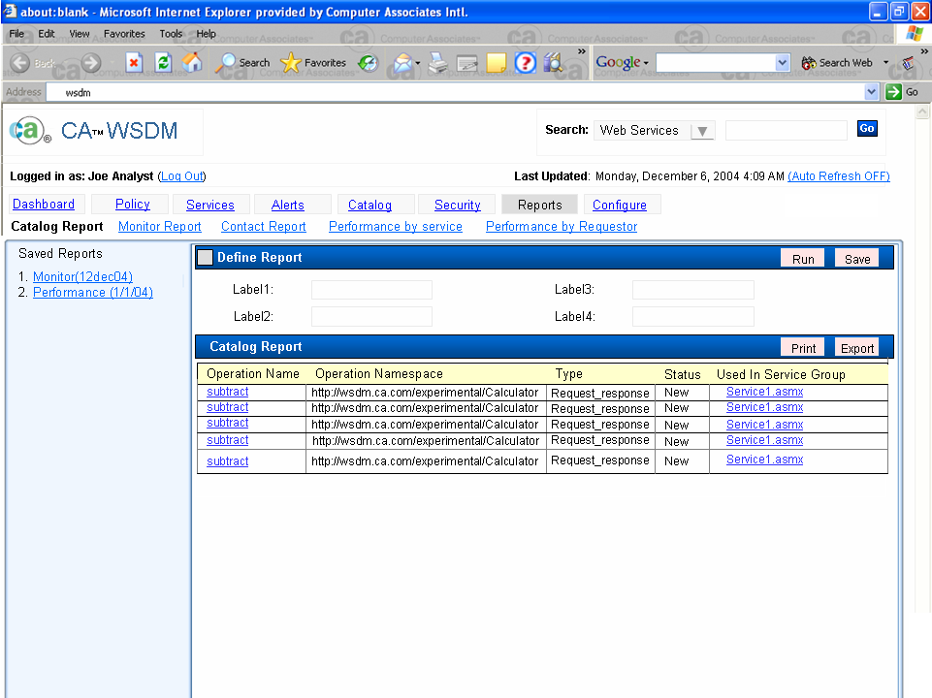
View Reports
User can select the report type
User reaches at Reports page
User can also perform some actions on results
Or rerun the saved reports
Report is visible here

Slide 31
Scenario 6 - Setup WSDM Configuration
Administrator needs to edit configuration settings for CA WSDM

Slide 32
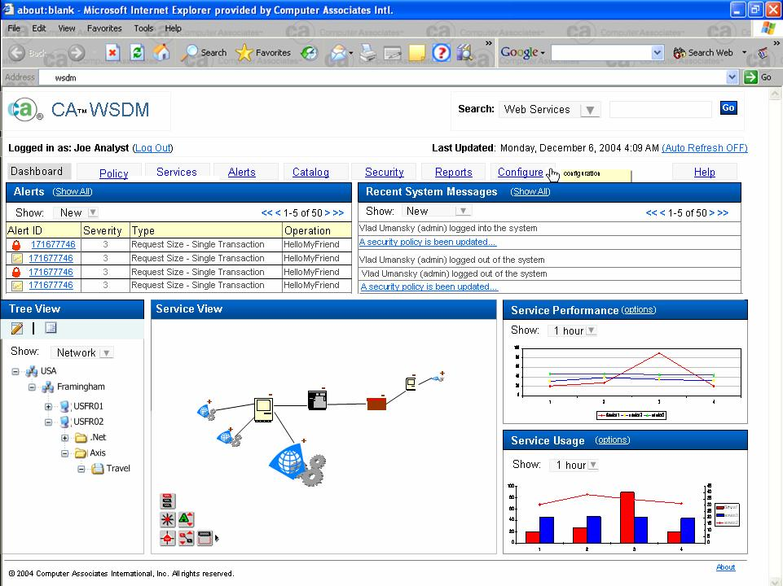
Setup WSDM Configuration
From the dashboard
User clicks on the configuration tab

Slide 33
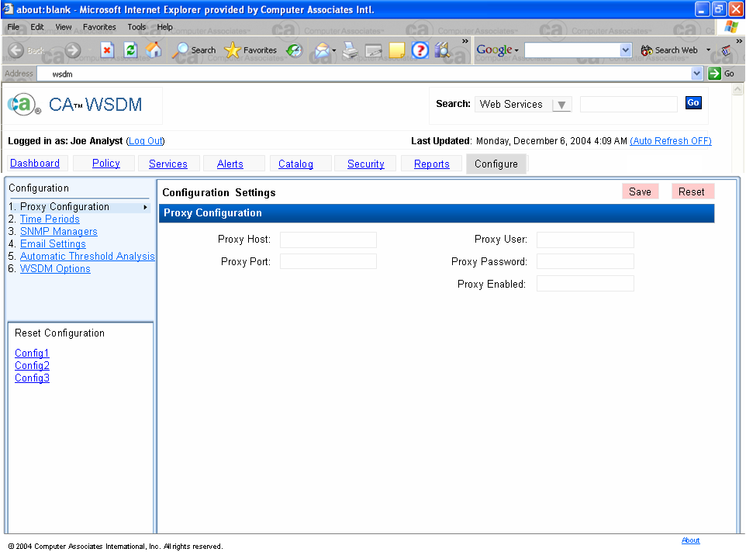
Setup WSDM Configuration
User reaches at the configuration page
Configuration can be saved or rested
Proxy configuration is been selected, user can view other options by clicking on respective links

Slide 34
Assumptions
No user data to validate the design direction provided in the storyboards
Storyboards are based on the tasks identified for V3.11 and the new requirements provided by the product team

