Slide 1
Microservices Architecture
Chapter 18, Fundamentals of Software Architecture (2nd Edition)
Presentation: Blaine Harris

Slide 2
Background
Monolithic applications can become difficult to manage and add features for development teams
Microservices are small, independently deployable services each focused on (ideally) one aspect of the business logic
Each service has its own code, data structure, and configuration
Trading off higher network complexity for greater team independence and flexibility

Slide 3
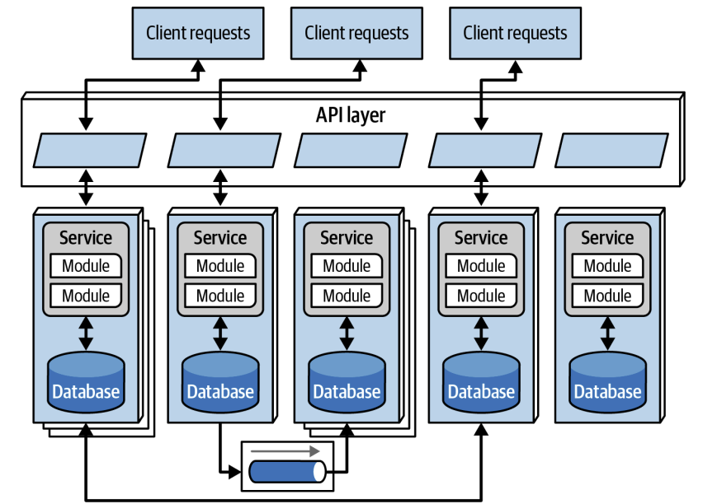
Core Principles
Domain boundaries define service boundaries (inspired by Domain-Driven Design)
Services are tightly integrated internally but loosely connected externally
Teams can choose different technologies and databases for each service
Services communicate through well-defined APIs and events, not shared databases

Slide 4
Bounded Context
Each service should represent one of the following:
Business Domain
Subdomain
Workflow
Each service owns its own internal model; other services use translation layers
Prevent business logic from crossing across services
If services are constantly being changed together, boundaries may need to be reconsidered

Slide 5
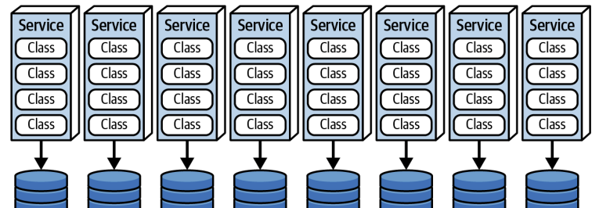
Data Topology
Each service owns its database
Enables independent scaling and reduces dependencies
Allows more flexibility for schema changes and reduces bottlenecks
Services are integrated through APIs and events, and ideally never through shared database access

Slide 6
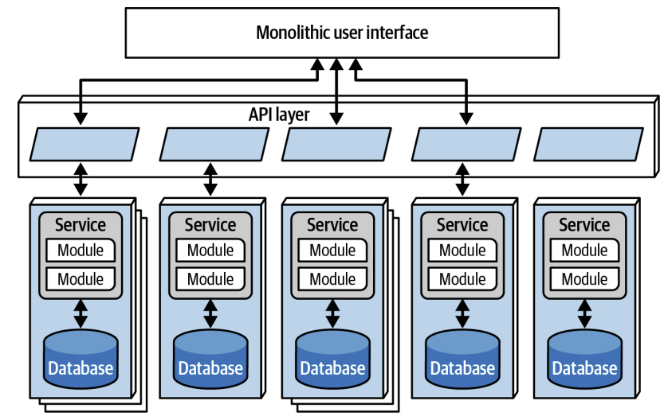
API Gateways
Single entry point that routes requests to the appropriate microservice
Handles cross-cutting concerns (authentication, monitoring, rate limiting, etc.)
Contains no business logic
Allows internal services to evolve without affecting external clients

Slide 7
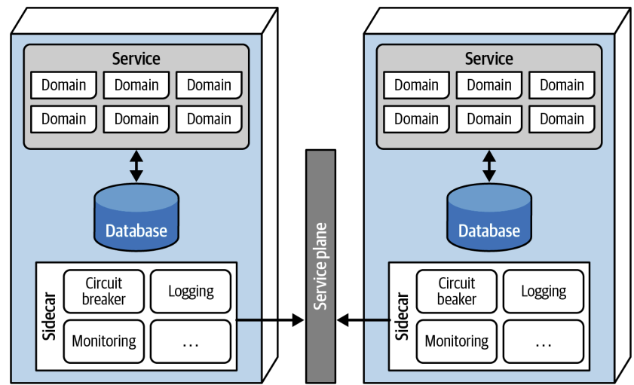
Sidecars & Service Mesh
Sidecar: Helper container that handles infrastructure concerns (logging, security, monitoring, etc.)
Service Mesh: Network of sidecars with centralized control
Provides consistent behavior and a degree of reuse without mixing infrastructure code and business logic

Slide 8
Communication Styles
Synchronous calls (REST, gRPC): Direct request-response for immediate results
Asynchronous messaging: Events and queues for loose coupling and resilience
Useful when response timing is not critical
Microservices typically utilize protocol-aware heterogenous interoperability
Not centralized
Supports polyglot environment
Services distributed across network

Slide 9
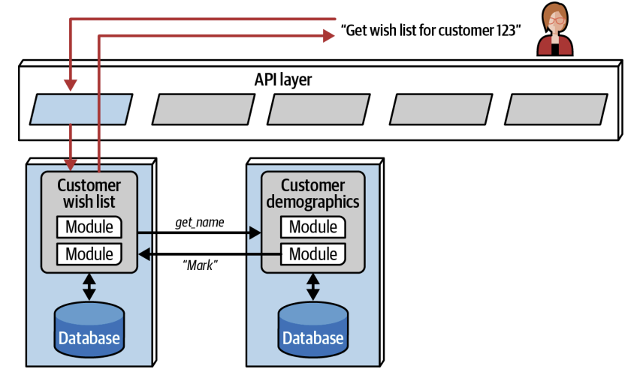
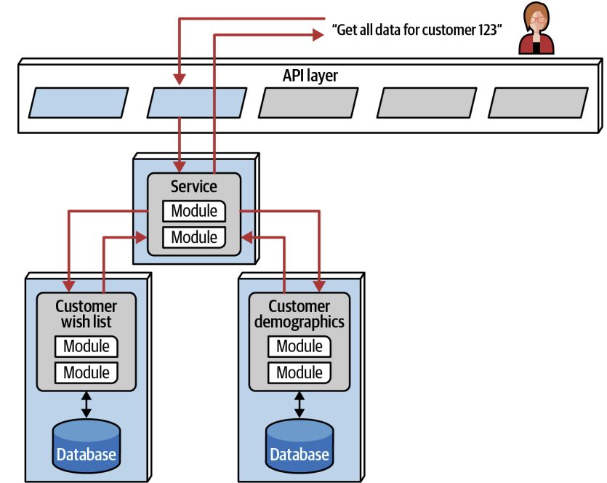
Choreography vs Orchestration
Choreography: Services respond to events independently (no central controller)
Orchestration: Central coordinator manages the workflow sequence and decisions
Ex. Kubernetes

Slide 10
Transactions & Sagas
Avoid traditional database transactions across multiple services
Is often slow and fragile
Saga pattern: Break transaction into steps with compensating actions for rollback
If you need many sagas, reconsider your service boundaries

Slide 11
Governance
Static coupling: Shared code libraries, build dependencies, deployment scripts
Dynamic coupling: Runtime service-to-service calls and communication patterns
Fitness functions: Automated tests that check architectural rules (e.g., max dependencies, linters, etc.)
Provide guidelines and tools rather than rigid approval processes

Slide 12
Team Topologies
Stream-aligned teams: Own complete business domains from UI to database
Platform teams: Build shared infrastructure (service mesh, CI/CD, monitoring tools)
Enabling teams: Coach other teams on practices like observability and resilience
Complex subsystem teams: Handle specialized technical domains requiring deep expertise

Slide 13
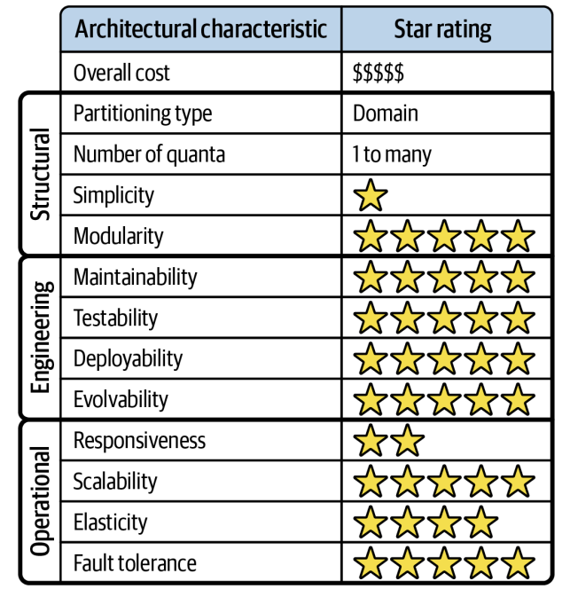
Advantages & Disadvantages
Strengths:
Independent development and deployment
Scalability (for application and teams)
High flexibility for technologies used
Easier testing and fault isolation
Weaknesses:
Network complexity
Operational overhead
Consistency challenges
Expensive boundary mistakes
Risks
Too many service calls
Network latency
Data consistency
Dependencies on shared libraries
Missing visibility

